Slide 1
Network+ Guide to Networks 7th Edition
Chapter 9
Unified Communications and Network Performance Management
© 2016 Cengage Learning®. May not be scanned, copied or duplicated, or posted to a publicly accessible website, in whole or in part.
Notes:
Network+ Guide to Networks 7th Edition
Chapter 9
Unified Communications and Network Performance Management

Slide 2
Objectives
Describe the basic concepts of network management
Utilize system and event logs to evaluate, monitor, and manage network performance
Explain how unified communications, including voice and video transmissions, affect network performance
Explain three common quality of service techniques
Troubleshoot network availability issues and evaluate network redundancy measures
Notes:
Objectives
Describe the basic concepts of network management
Utilize system and event logs to evaluate, monitor, and manage network performance
Explain how unified communications, including voice and video transmissions, affect network performance
Explain three common quality of service techniques
Troubleshoot network availability issues and evaluate network redundancy measures

Slide 3
Fundamentals of Network Management
Network management
Assess, monitor, and maintain all network aspects
Scope differs according to network’s size and importance
Several network management disciplines
All share same goals
Enhance efficiency and performance
Prevent costly downtime and loss
Predict problems before they occur
Notes:
Fundamentals of Network Management
Network management
Assess, monitor, and maintain all network aspects
Scope differs according to network’s size and importance
Several network management disciplines
All share same goals
Enhance efficiency and performance
Prevent costly downtime and loss
Predict problems before they occur

Slide 4
Baseline Measurements
Baseline
Report of network’s current operation state
Example baseline measurements
Network backbone utilization rate
Number of users logged on per day or per hour
Number of protocols running on network
Error statistics
Runts, jabbers, or giants
Frequency of application use
Bandwidth usage
Notes:
Baseline Measurements
Baseline
Report of network’s current operation state
Example baseline measurements
Network backbone utilization rate
Number of users logged on per day or per hour
Number of protocols running on network
Error statistics
Runts, jabbers, or giants
Frequency of application use
Bandwidth usage

Slide 5
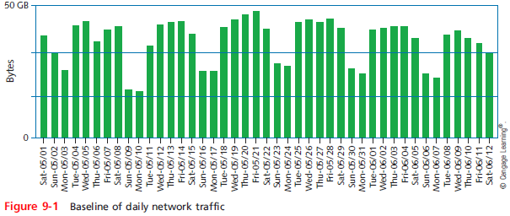
Baseline Measurements
Notes:
Baseline Measurements

Slide 6
Baseline Measurements
Compare future and past performance
Most critical network, user functions
More data provides more accuracy
Forecasting network traffic patterns
Difficult to predict users’ habits, new technology effects, changes in resource demand
Gathering baseline data
Software applications
Freeware
Expensive, customizable hardware and software
Notes:
Baseline Measurements
Compare future and past performance
Most critical network, user functions
More data provides more accuracy
Forecasting network traffic patterns
Difficult to predict users’ habits, new technology effects, changes in resource demand
Gathering baseline data
Software applications
Freeware
Expensive, customizable hardware and software

Slide 7
Policies, Procedures, and Regulations
Rules limit chaos, confusion, and downtime
State and federal regulations
CALEA (Communications Assistance for Law Enforcement Act)
Telecommunications carriers, equipment manufacturers must provide for surveillance capabilities
HIPAA (Health Insurance Portability and Accountability Act)
Protect medical records security and privacy
Notes:
Policies, Procedures, and Regulations
Rules limit chaos, confusion, and downtime
State and federal regulations
CALEA (Communications Assistance for Law Enforcement Act)
Telecommunications carriers, equipment manufacturers must provide for surveillance capabilities
HIPAA (Health Insurance Portability and Accountability Act)
Protect medical records security and privacy

Slide 8
Policies, Procedures, and Regulations
PCI DSS (Payment Card Industry Data Security Standard)
Created by the PCI Security Standards Council
To protect credit card data and transactions
Requires network segmentation as part of security controls
Many policies and procedures
Are not laws, but are best practices to prevent network problems
Notes:
Policies, Procedures, and Regulations
PCI DSS (Payment Card Industry Data Security Standard)
Created by the PCI Security Standards Council
To protect credit card data and transactions
Requires network segmentation as part of security controls
Many policies and procedures
Are not laws, but are best practices to prevent network problems

Slide 9
Monitoring and Managing Network Traffic
Assess network’s status on an ongoing basis
Performance management
Monitor links and devices’ ability to keep up with demand
Fault management
Detection and signaling of device, link, component faults
Notes:
Monitoring and Managing Network Traffic
Assess network’s status on an ongoing basis
Performance management
Monitor links and devices’ ability to keep up with demand
Fault management
Detection and signaling of device, link, component faults

Slide 10
SNMP Logs
Enterprise-wide network management systems
Accomplish fault and performance management
All use similar architecture
Central collection point is called the network management system (NMS)
Network management agent
Software routine that collects information about device’s operation
Provides information to the NMS
Managed device
Any network node monitored by the NMS
Notes:
SNMP Logs
Enterprise-wide network management systems
Accomplish fault and performance management
All use similar architecture
Central collection point is called the network management system (NMS)
Network management agent
Software routine that collects information about device’s operation
Provides information to the NMS
Managed device
Any network node monitored by the NMS

Slide 11
SNMP Logs
Various aspects of a device can be managed
Processor, memory, hard disk, NIC, and intangibles
MIB (Management Information Base)
Contains managed devices definition, data
SNMP (Simple Network Management Protocol)
Used to communicate managed device information
Part of TCP/IP suite
SNMPv3: most secure version of the protocol
SNMPv2: still widely used
SNMPv1: original version; rarely used today
Notes:
SNMP Logs
Various aspects of a device can be managed
Processor, memory, hard disk, NIC, and intangibles
MIB (Management Information Base)
Contains managed devices definition, data
SNMP (Simple Network Management Protocol)
Used to communicate managed device information
Part of TCP/IP suite
SNMPv3: most secure version of the protocol
SNMPv2: still widely used
SNMPv1: original version; rarely used today

Slide 12
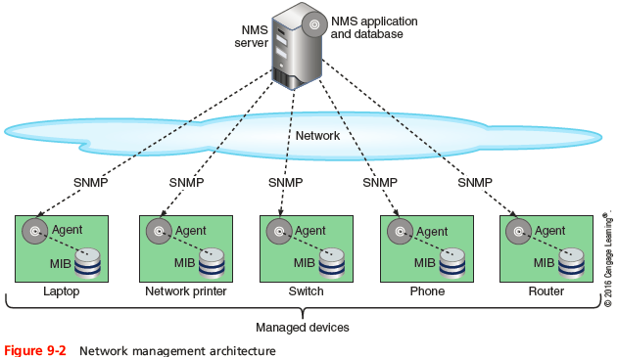
SNMP Logs
Notes:
SNMP Logs

Slide 13
SNMP Logs
Several ways to view and analyze data
Network management applications
Flexible
Challenging to configure and fine-tune
Choose correct type and amount of information to collect
Notes:
SNMP Logs
Several ways to view and analyze data
Network management applications
Flexible
Challenging to configure and fine-tune
Choose correct type and amount of information to collect

Slide 14
System and Event Logs
Log
Contains recorded conditions recognized by operating system
Event log
Windows-based computer log containing monitored device information
Event Viewer application
Application to view log information in Windows
Notes:
System and Event Logs
Log
Contains recorded conditions recognized by operating system
Event log
Windows-based computer log containing monitored device information
Event Viewer application
Application to view log information in Windows

Slide 15
System and Event Logs
Syslog function
Standard for generating, storing, and processing messages about events on Linux or UNIX
Data written to system log
Syslog defines roles for each computer that participates in logging
Generator - computer that is monitored by a syslog-compatible application and issues event information
Collector - computer that gathers event messages from generators
Notes:
System and Event Logs
Syslog function
Standard for generating, storing, and processing messages about events on Linux or UNIX
Data written to system log
Syslog defines roles for each computer that participates in logging
Generator - computer that is monitored by a syslog-compatible application and issues event information
Collector - computer that gathers event messages from generators

Slide 16
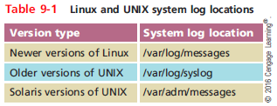
System and Event Logs
Using logs for fault management
Logs keep history
Information collected does not point to problem
Logs must be monitored for errors
Most UNIX and Linux OSs provide a GUI application used for viewing and filtering information
Notes:
System and Event Logs
Using logs for fault management
Logs keep history
Information collected does not point to problem
Logs must be monitored for errors
Most UNIX and Linux OSs provide a GUI application used for viewing and filtering information

Slide 17
Traffic Analysis
Network monitor
Tool that continually monitors network traffic
Interface monitor
Tool that can monitor traffic at a specific interface between a server or client and the network
Difference
Network monitor can monitor traffic that a single device encounters
Interface monitor can monitor traffic patterns throughout a particular network
Notes:
Traffic Analysis
Network monitor
Tool that continually monitors network traffic
Interface monitor
Tool that can monitor traffic at a specific interface between a server or client and the network
Difference
Network monitor can monitor traffic that a single device encounters
Interface monitor can monitor traffic patterns throughout a particular network

Slide 18
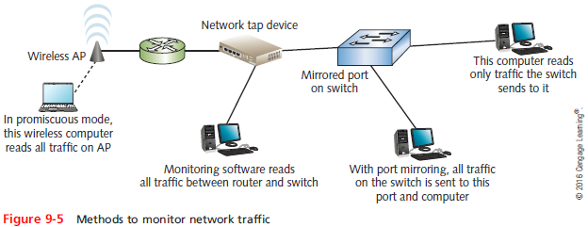
Traffic Analysis
Notes:
Traffic Analysis

Slide 19
Traffic Analysis
All network monitoring tools can perform the following functions:
Set the NIC to run in promiscuous mode to pass all traffic to the monitoring software
Continuously monitor network traffic on a segment
Capture network data transmitted on a segment
Capture frames sent to or from a specific node
Reproduce network conditions by transmitting a selected amount and type of data
Generate statistics about network activity
Notes:
Traffic Analysis
All network monitoring tools can perform the following functions:
Set the NIC to run in promiscuous mode to pass all traffic to the monitoring software
Continuously monitor network traffic on a segment
Capture network data transmitted on a segment
Capture frames sent to or from a specific node
Reproduce network conditions by transmitting a selected amount and type of data
Generate statistics about network activity

Slide 20
Traffic Analysis
Some network monitoring tools can also perform the following functions:
Discover all network nodes on a segment
Establish a baseline, including performance, utilization rate, and so on
Track utilization of network resources and device resources and report it in graphs or charts
Store traffic data and generate reports
Trigger alarms for certain preconfigured conditions
Identify usage anomalies, such as top talkers or top listeners
Notes:
Traffic Analysis
Some network monitoring tools can also perform the following functions:
Discover all network nodes on a segment
Establish a baseline, including performance, utilization rate, and so on
Track utilization of network resources and device resources and report it in graphs or charts
Store traffic data and generate reports
Trigger alarms for certain preconfigured conditions
Identify usage anomalies, such as top talkers or top listeners

Slide 21
Traffic Analysis
Monitoring tools can help identify the following:
Runts
Giants
Jabber
Ghosts
Packet loss
Discarded packets
Interface resets
Alerts might be transmitted by email or text
Called SMS (Short Message Service)
Notes:
Traffic Analysis
Monitoring tools can help identify the following:
Runts
Giants
Jabber
Ghosts
Packet loss
Discarded packets
Interface resets
Alerts might be transmitted by email or text
Called SMS (Short Message Service)

Slide 22
Traffic Management
Traffic shaping (packet shaping)
Manipulating packet, data stream, and connection characteristics
Manage type and amount of traffic traversing network
Goals
Assure timely delivery of most important traffic
Offer best possible performance for all users
Notes:
Traffic Management
Traffic shaping (packet shaping)
Manipulating packet, data stream, and connection characteristics
Manage type and amount of traffic traversing network
Goals
Assure timely delivery of most important traffic
Offer best possible performance for all users

Slide 23
Traffic Management
Techniques
Delay less important traffic
Increase priority of more important traffic
Traffic policing
Limit traffic volume flowing in and out of interface during specified time period
Limit momentary throughput rate for an interface
Not without controversy
Comcast discriminated against certain traffic types
Notes:
Traffic Management
Techniques
Delay less important traffic
Increase priority of more important traffic
Traffic policing
Limit traffic volume flowing in and out of interface during specified time period
Limit momentary throughput rate for an interface
Not without controversy
Comcast discriminated against certain traffic types

Slide 24
Traffic Management
Traffic prioritization
Treating more important traffic preferentially
Prioritization based on characteristics
Protocol
IP address
User group
DiffServ (Differentiated Services) flag in an IP packet
VLAN tag in Data Link layer frame
Service or application
Notes:
Traffic Management
Traffic prioritization
Treating more important traffic preferentially
Prioritization based on characteristics
Protocol
IP address
User group
DiffServ (Differentiated Services) flag in an IP packet
VLAN tag in Data Link layer frame
Service or application

Slide 25
Caching
Caching
Local storage of frequently needed files
Allows quick access
Web caching
Most common caching type, highly customizable
Web pages stored locally
On host or network, and then delivered to requesters
ISP cache engine
Network device devoted to storage, frequently requested file delivery
Saves money; lowers WAN traffic
Notes:
Caching
Caching
Local storage of frequently needed files
Allows quick access
Web caching
Most common caching type, highly customizable
Web pages stored locally
On host or network, and then delivered to requesters
ISP cache engine
Network device devoted to storage, frequently requested file delivery
Saves money; lowers WAN traffic

Slide 26
Unified Communications Technologies
PSTN (Public Switched Telephone Network)
Circuit-switched model, carries telephone calls/faxes
Switching
Determines how connections are created between nodes
Circuit-switched networks
Connection is established between two network nodes before transmitting data
Packet-switched networks
Break data into packets before they are transported
Notes:
Unified Communications Technologies
PSTN (Public Switched Telephone Network)
Circuit-switched model, carries telephone calls/faxes
Switching
Determines how connections are created between nodes
Circuit-switched networks
Connection is established between two network nodes before transmitting data
Packet-switched networks
Break data into packets before they are transported

Slide 27
Unified Communications Technologies
Greatest advantage to packet switching
Does not waste bandwidth by holding a connection open until a message reaches its destination
Ethernet networks and the Internet
Most common examples of packet-switched networks
In unified communications, a user can:
Access the Web
Send/receive faxes, email, voice mail, instant messages, or telephone calls
Participate in videoconference calls
Notes:
Unified Communications Technologies
Greatest advantage to packet switching
Does not waste bandwidth by holding a connection open until a message reaches its destination
Ethernet networks and the Internet
Most common examples of packet-switched networks
In unified communications, a user can:
Access the Web
Send/receive faxes, email, voice mail, instant messages, or telephone calls
Participate in videoconference calls

Slide 28
VoIP Applications and Interfaces
IP telephony (VoIP)
Any network carrying voice signals using TCP/IP
Public or private
Runs over any packet-switched network
Data connection types carrying VoIP signals
T-carriers, ISDN, DSL, broadband cable, satellite connections, WiFi, WiMAX, HSPA+, LTE, cellular telephone networks
Notes:
VoIP Applications and Interfaces
IP telephony (VoIP)
Any network carrying voice signals using TCP/IP
Public or private
Runs over any packet-switched network
Data connection types carrying VoIP signals
T-carriers, ISDN, DSL, broadband cable, satellite connections, WiFi, WiMAX, HSPA+, LTE, cellular telephone networks

Slide 29
VoIP Applications and Interfaces
Reasons for implementing VoIP
Lower voice call cost
New, enhanced features and applications
Centralize voice and data network management
Voice and data configurations
Analog telephone (sends, receives analog signals) and must be connected to one of the following:
ATA analog telephone adapter
Switch, router, or gateway capable of accepting analog signals and convert them into packets
Digital PBX (IP-PBX) or analog PBX
Notes:
VoIP Applications and Interfaces
Reasons for implementing VoIP
Lower voice call cost
New, enhanced features and applications
Centralize voice and data network management
Voice and data configurations
Analog telephone (sends, receives analog signals) and must be connected to one of the following:
ATA analog telephone adapter
Switch, router, or gateway capable of accepting analog signals and convert them into packets
Digital PBX (IP-PBX) or analog PBX

Slide 30
VoIP Applications and Interfaces
Voice and data configurations (cont’d)
IP telephones
Transmit and receive only digital signals
Softphones
A computer programed to act like an IP phone
Notes:
VoIP Applications and Interfaces
Voice and data configurations (cont’d)
IP telephones
Transmit and receive only digital signals
Softphones
A computer programed to act like an IP phone

Slide 31
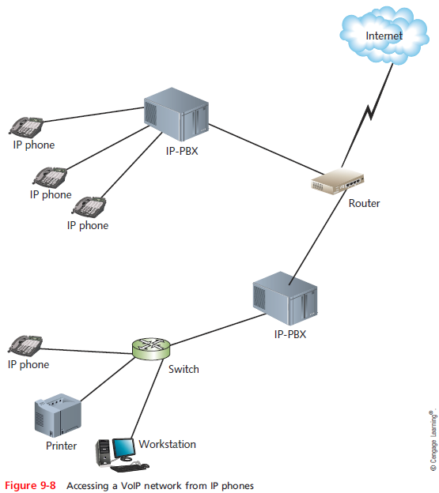
VoIP Applications and Interfaces
Notes:
VoIP Applications and Interfaces

Slide 32
Video over IP Applications and Interfaces
Videoconferencing (video teleconferencing or VTC)
Allows multiple participants to communicate and collaborate in a real-time meeting
Cisco Systems estimate
By 2018, over 79% of Internet traffic will be video traffic
Factors fueling growth
Large quantity of video content available
Increasing number of devices accessing Internet
Decreasing cost of bandwidth and equipment
Notes:
Video over IP Applications and Interfaces
Videoconferencing (video teleconferencing or VTC)
Allows multiple participants to communicate and collaborate in a real-time meeting
Cisco Systems estimate
By 2018, over 79% of Internet traffic will be video traffic
Factors fueling growth
Large quantity of video content available
Increasing number of devices accessing Internet
Decreasing cost of bandwidth and equipment

Slide 33
Streaming Video
Simplest among video-over-IP applications
Basic computer hardware, software requirements
Video-on-demand (VoD)
Files stored on video streaming server
Popular
Viewer chooses video when convenient
Views using Web browser
Live streaming video
From source directly to user
Notes:
Streaming Video
Simplest among video-over-IP applications
Basic computer hardware, software requirements
Video-on-demand (VoD)
Files stored on video streaming server
Popular
Viewer chooses video when convenient
Views using Web browser
Live streaming video
From source directly to user

Slide 34
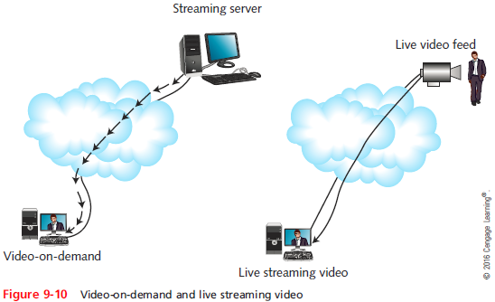
Streaming Video
Notes:
Streaming Video

Slide 35
Streaming Video
Consider number of clients receiving each service
Point-to-point video over IP
Point-to-multipoint video over IP
Not the same as multicast transmission
Unicast transmissions
Single node issues data stream to one other node
Example: CSPAN source issues signals to each viewer
Network classification: public or private
Most streaming video occurs over public networks
Notes:
Streaming Video
Consider number of clients receiving each service
Point-to-point video over IP
Point-to-multipoint video over IP
Not the same as multicast transmission
Unicast transmissions
Single node issues data stream to one other node
Example: CSPAN source issues signals to each viewer
Network classification: public or private
Most streaming video occurs over public networks

Slide 36
Videoconferencing
Unidirectional video-over-IP services
Video delivered to user who only watches content
Videoconferencing
Full-duplex connections
Participants send and receive audiovisual signals
Real time
Benefits
Cost savings, convenience
Replace face-to-face business meetings
Allow collaboration
Notes:
Videoconferencing
Unidirectional video-over-IP services
Video delivered to user who only watches content
Videoconferencing
Full-duplex connections
Participants send and receive audiovisual signals
Real time
Benefits
Cost savings, convenience
Replace face-to-face business meetings
Allow collaboration

Slide 37
Videoconferencing
Videoconferencing uses
Telemedicine
Tele-education
Judicial proceedings
Surveillance
Hardware, software requirements
A means to generate, send and receive audiovisual signals
Computer workstation with cameras, microphones, software
Video terminal or video phone
Notes:
Videoconferencing
Videoconferencing uses
Telemedicine
Tele-education
Judicial proceedings
Surveillance
Hardware, software requirements
A means to generate, send and receive audiovisual signals
Computer workstation with cameras, microphones, software
Video terminal or video phone

Slide 38
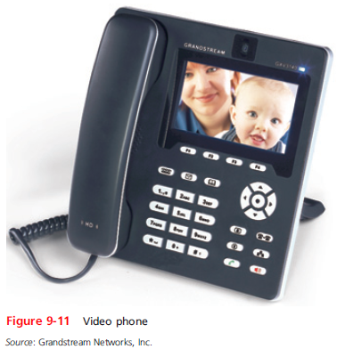
Videoconferencing
Notes:
Videoconferencing

Slide 39
Videoconferencing
Video bridge
Manages multiple audiovisual sessions
Participants can see, hear each other
Conference server
Hardware or software
Leased Internet-accessible video bridging services
For occasional videoconference use
Video bridges depend on signaling protocols
Notes:
Videoconferencing
Video bridge
Manages multiple audiovisual sessions
Participants can see, hear each other
Conference server
Hardware or software
Leased Internet-accessible video bridging services
For occasional videoconference use
Video bridges depend on signaling protocols

Slide 40
Signaling Protocols
Signaling
Information exchange between network components or system
Establish, monitor, and release connections
Control system operations
Signaling protocols
Set up, manage client sessions
Perform several other functions
Early VoIP: vendors developed proprietary signaling protocols
Today: standardized signaling protocols are used
Notes:
Signaling Protocols
Signaling
Information exchange between network components or system
Establish, monitor, and release connections
Control system operations
Signaling protocols
Set up, manage client sessions
Perform several other functions
Early VoIP: vendors developed proprietary signaling protocols
Today: standardized signaling protocols are used

Slide 41
H.323
ITU standard describing architecture, protocols
Establishing, managing packet-switched network multimedia sessions
Supports voice, video-over-IP services
Terms
H.323 terminal
H.323 gateway
H.323 gatekeeper
MCU (multipoint control unit)
H.323 zone
Notes:
H.323
ITU standard describing architecture, protocols
Establishing, managing packet-switched network multimedia sessions
Supports voice, video-over-IP services
Terms
H.323 terminal
H.323 gateway
H.323 gatekeeper
MCU (multipoint control unit)
H.323 zone

Slide 42
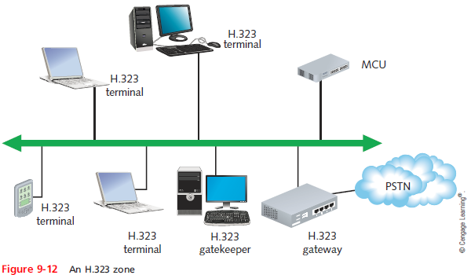
H.323
Notes:
H.323

Slide 43
H.323
H.225 and H.245 signaling protocols
Specified in H.323 standard
Operate at Session layer
H.225 handles call or videoconference signaling
H.245 ensures correct information type formatting
Uses logical channels
H.323 standard
Specifies protocol interoperability
Presentation layer: coding, decoding signals
Transport layer
Notes:
H.323
H.225 and H.245 signaling protocols
Specified in H.323 standard
Operate at Session layer
H.225 handles call or videoconference signaling
H.245 ensures correct information type formatting
Uses logical channels
H.323 standard
Specifies protocol interoperability
Presentation layer: coding, decoding signals
Transport layer

Slide 44
SIP (Session Initiation Protocol)
Application layer signaling, multiservice control protocol, packet-based networks
Performs similar functions as H.323
Modeled on HTTP
Reuse existing TCP/IP protocols
Session management, enhanced services
Modular and specific
Limited capabilities compared to H.323
Example: no caller ID
Notes:
SIP (Session Initiation Protocol)
Application layer signaling, multiservice control protocol, packet-based networks
Performs similar functions as H.323
Modeled on HTTP
Reuse existing TCP/IP protocols
Session management, enhanced services
Modular and specific
Limited capabilities compared to H.323
Example: no caller ID

Slide 45
SIP (Session Initiation Protocol)
SIP network components
User agent
User agent client
User agent server
Registrar server
Proxy server
Redirect server
Notes:
SIP (Session Initiation Protocol)
SIP network components
User agent
User agent client
User agent server
Registrar server
Proxy server
Redirect server

Slide 46
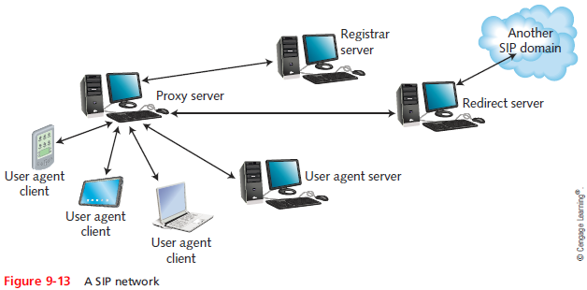
SIP (Session Initiation Protocol)
Notes:
SIP (Session Initiation Protocol)

Slide 47
SIP (Session Initiation Protocol)
Advantages of SIP over H.323
Simplicity
Fewer instructions to control call
Consumes fewer processing resources
More flexible
SIP and H.323
Regulate call signaling, control for VoIP or video-over-IP clients and servers
Do not account for communication between media gateways
Notes:
SIP (Session Initiation Protocol)
Advantages of SIP over H.323
Simplicity
Fewer instructions to control call
Consumes fewer processing resources
More flexible
SIP and H.323
Regulate call signaling, control for VoIP or video-over-IP clients and servers
Do not account for communication between media gateways

Slide 48
MGCP (Media Gateway Control Protocol) and Megaco (H.248)
Media gateway (UC Gateway)
Accepts PSTN lines
Converts analog signals into VoIP format
Translates between different signaling protocols
Information transmissions use different channels than control signals
Also different logical and physical paths
Expedites information handling
Gateways still need to exchange and translate signaling and control information
Notes:
MGCP (Media Gateway Control Protocol) and Megaco (H.248)
Media gateway (UC Gateway)
Accepts PSTN lines
Converts analog signals into VoIP format
Translates between different signaling protocols
Information transmissions use different channels than control signals
Also different logical and physical paths
Expedites information handling
Gateways still need to exchange and translate signaling and control information

Slide 49
MGCP (Media Gateway Control Protocol) and Megaco (H.248)
MGC (media gateway controller)
Computer managing multiple media gateways
Facilitates exchange of call signaling information
Also called a softswitch
Advantageous on large VoIP networks
MGCP (Media Gateway Control Protocol)
Used on multiservice networks supporting many media gateways
Operate with H.323 or SIP
Older protocol
Notes:
MGCP (Media Gateway Control Protocol) and Megaco (H.248)
MGC (media gateway controller)
Computer managing multiple media gateways
Facilitates exchange of call signaling information
Also called a softswitch
Advantageous on large VoIP networks
MGCP (Media Gateway Control Protocol)
Used on multiservice networks supporting many media gateways
Operate with H.323 or SIP
Older protocol

Slide 50
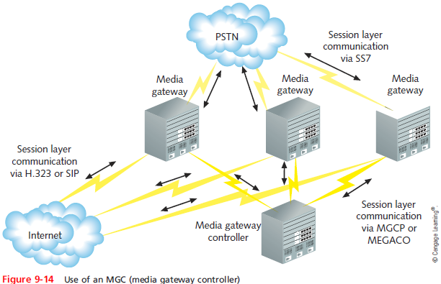
MGCP (Media Gateway Control Protocol) and Megaco (H.248)
Notes:
MGCP (Media Gateway Control Protocol) and Megaco (H.248)

Slide 51
MGCP (Media Gateway Control Protocol) and Megaco (H.248)
MEGACO
Newer protocol
Performs same functions as MGC
Different commands and processes
Operates with H.323 or SIP
Superior to MGCP
Supports ATM
Developed by ITU and IETF
Notes:
MGCP (Media Gateway Control Protocol) and Megaco (H.248)
MEGACO
Newer protocol
Performs same functions as MGC
Different commands and processes
Operates with H.323 or SIP
Superior to MGCP
Supports ATM
Developed by ITU and IETF

Slide 52
Transport Protocols
A different protocol set delivers voice or video payload
Transport layer
Transport layer protocols
TCP: connection oriented protocol
Delivery guarantees
UDP: connectionless protocol
No accountability; preferred for real-time applications
Packet loss tolerable if additional protocols overcome UDP shortcomings
Notes:
Transport Protocols
A different protocol set delivers voice or video payload
Transport layer
Transport layer protocols
TCP: connection oriented protocol
Delivery guarantees
UDP: connectionless protocol
No accountability; preferred for real-time applications
Packet loss tolerable if additional protocols overcome UDP shortcomings

Slide 53
RTP (Real-time Transport Protocol)
Operates at Application layer
Relies on UDP at the Transport layer
Applies sequence numbers to indicate:
Destination packet assembly order
Packet loss during transmission
Assigns packet timestamp
Receiving node
Compensates for network delay
Synchronizes signals
No mechanism to detect success
Notes:
RTP (Real-time Transport Protocol)
Operates at Application layer
Relies on UDP at the Transport layer
Applies sequence numbers to indicate:
Destination packet assembly order
Packet loss during transmission
Assigns packet timestamp
Receiving node
Compensates for network delay
Synchronizes signals
No mechanism to detect success

Slide 54
RTCP (Real-time Transport Control Protocol)
Provides quality feedback to participants
Packets transmitted periodically
RTCP allows for several message types
RTCP value
Depends on clients’, applications’ information use
Not mandatory on RTP networks
RTP and RTCP
Provide information about packet order, loss, delay
Cannot correct transmission flaws
Notes:
RTCP (Real-time Transport Control Protocol)
Provides quality feedback to participants
Packets transmitted periodically
RTCP allows for several message types
RTCP value
Depends on clients’, applications’ information use
Not mandatory on RTP networks
RTP and RTCP
Provide information about packet order, loss, delay
Cannot correct transmission flaws

Slide 55
QoS (Quality of Service) Assurance
VoIP, video over IP transmission difficulty
Caused by connection’s inconsistent QoS
Preventing delays, disorder, distortion
Requires more dedicated bandwidth
Requires techniques ensuring high QoS
QoS measures network service performance
High QoS: uninterrupted, accurate, faithful reproduction
Improvements to QoS made in recent years
Service quality now comparable to PSTN, cable TV
Notes:
QoS (Quality of Service) Assurance
VoIP, video over IP transmission difficulty
Caused by connection’s inconsistent QoS
Preventing delays, disorder, distortion
Requires more dedicated bandwidth
Requires techniques ensuring high QoS
QoS measures network service performance
High QoS: uninterrupted, accurate, faithful reproduction
Improvements to QoS made in recent years
Service quality now comparable to PSTN, cable TV

Slide 56
DiffServ (Differentiated Service)
Addresses QoS issues through traffic prioritization
DiffServ
Modifies actual IP datagram
Accounts for all network traffic
Can assign different streams different priorities
To prioritize traffic
IPv4 datagram: DiffServ field
IPv6 datagram: Traffic Class field
Notes:
DiffServ (Differentiated Service)
Addresses QoS issues through traffic prioritization
DiffServ
Modifies actual IP datagram
Accounts for all network traffic
Can assign different streams different priorities
To prioritize traffic
IPv4 datagram: DiffServ field
IPv6 datagram: Traffic Class field

Slide 57
DiffServ (Differentiated Service)
Two forwarding types
EF (Expedited Forwarding)
Data stream assigned minimum departure rate
Circumvents delays
AF (Assured Forwarding)
Data streams assigned different router resource levels
Prioritizes data handling
No guarantee of on time, in sequence packet arrival
Notes:
DiffServ (Differentiated Service)
Two forwarding types
EF (Expedited Forwarding)
Data stream assigned minimum departure rate
Circumvents delays
AF (Assured Forwarding)
Data streams assigned different router resource levels
Prioritizes data handling
No guarantee of on time, in sequence packet arrival

Slide 58
MPLS (Multiprotocol Label Switching)
Modifies data streams at Network layer
Replaces IP datagram header with label:
At first router data stream encounters
Next router revises label
Label contains packet forwarding information
Considers network congestion
Very fast forwarding
Destination IP address compared to routing tables
Forward data to closest matching node
Notes:
MPLS (Multiprotocol Label Switching)
Modifies data streams at Network layer
Replaces IP datagram header with label:
At first router data stream encounters
Next router revises label
Label contains packet forwarding information
Considers network congestion
Very fast forwarding
Destination IP address compared to routing tables
Forward data to closest matching node

Slide 59
CoS (Class of Service)
CoS
Refers to techniques performed at Layer 2 on Ethernet frames
Most often used to route Ethernet traffic between VLANs
Priority Code Point (PCP)
A 3-bit field in the frame header of a frame that has been tagged (addressed to a specific VLAN)
CoS sets these bits to one of eight levels ranging from 0 to 7
Notes:
CoS (Class of Service)
CoS
Refers to techniques performed at Layer 2 on Ethernet frames
Most often used to route Ethernet traffic between VLANs
Priority Code Point (PCP)
A 3-bit field in the frame header of a frame that has been tagged (addressed to a specific VLAN)
CoS sets these bits to one of eight levels ranging from 0 to 7

Slide 60
Troubleshooting Network Integrity and Availability
Integrity
assurance that a network’s programs, data, services, devices, and connections have not been altered
Availability
How consistently and reliably a file or system can be accessed
Uptime
Measure of time functioning normally between failures
Linux or UNIX command
Microsoft utility
Notes:
Troubleshooting Network Integrity and Availability
Integrity
assurance that a network’s programs, data, services, devices, and connections have not been altered
Availability
How consistently and reliably a file or system can be accessed
Uptime
Measure of time functioning normally between failures
Linux or UNIX command
Microsoft utility

Slide 61
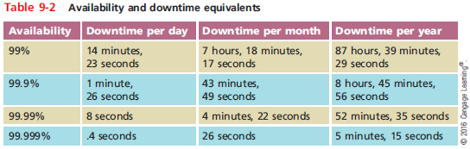
Troubleshooting Network Integrity and Availability
Notes:
Troubleshooting Network Integrity and Availability

Slide 62
General Guidelines
Allow only network administrators to create or modify NOS and application system files
Monitor the network for unauthorized access or changes
Record authorized system changes in a change management system
Install redundant components
Perform regular health checks on the network
Check system performance, error logs, and the system log book regularly
Notes:
General Guidelines
Allow only network administrators to create or modify NOS and application system files
Monitor the network for unauthorized access or changes
Record authorized system changes in a change management system
Install redundant components
Perform regular health checks on the network
Check system performance, error logs, and the system log book regularly

Slide 63
General Guidelines
Keep backups, system images, and emergency repair disks current and available
Implement and enforce security and disaster recovery policies
Notes:
General Guidelines
Keep backups, system images, and emergency repair disks current and available
Implement and enforce security and disaster recovery policies

Slide 64
Fault Tolerance
Capacity for system to continue performing
Despite unexpected hardware, software malfunction
Failure
Deviation from specified system performance level
Given time period
Fault
Malfunction of one system component
Can result in failure
Fault-tolerant system goal
Prevent faults from progressing to failures
Notes:
Fault Tolerance
Capacity for system to continue performing
Despite unexpected hardware, software malfunction
Failure
Deviation from specified system performance level
Given time period
Fault
Malfunction of one system component
Can result in failure
Fault-tolerant system goal
Prevent faults from progressing to failures

Slide 65
Devices and Interfaces
Redundancy
Reduces the risk of lost functionality and potentially lost profits
Disadvantage: cost
Redundancy scenario:
A network design with many single points of failure (see Figure 9-16)
Solution: create a network design that ensures full redundancy for all components (see Figure 9-17)
Notes:
Devices and Interfaces
Redundancy
Reduces the risk of lost functionality and potentially lost profits
Disadvantage: cost
Redundancy scenario:
A network design with many single points of failure (see Figure 9-16)
Solution: create a network design that ensures full redundancy for all components (see Figure 9-17)

Slide 66
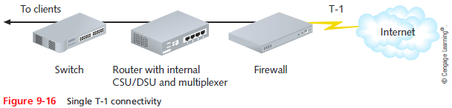
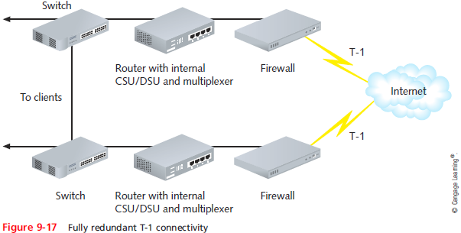
Devices and Interfaces
Notes:
Devices and Interfaces

Slide 67
Devices and Interfaces
Failover capable or hot swappable components
Desired for switches or routers supporting critical links
Adds to device cost
Hot spare is a component already installed in a device that can assume control at failure
Cold spare is a component, not installed, but can be in the event of failure
Link aggregation (port bonding)
Combination of multiple network interfaces to act as one logical interface
Example: NIC teaming
Notes:
Devices and Interfaces
Failover capable or hot swappable components
Desired for switches or routers supporting critical links
Adds to device cost
Hot spare is a component already installed in a device that can assume control at failure
Cold spare is a component, not installed, but can be in the event of failure
Link aggregation (port bonding)
Combination of multiple network interfaces to act as one logical interface
Example: NIC teaming

Slide 68
Devices and Interfaces
Load balancing (content switching)
Automatic traffic distribution over multiple components or links
To optimize performance and fault tolerance
Switch Dependent Mode
NIC teaming accomplished with a single switch
Requires an intelligent switch
Variety of this mode implements Link Aggregation Control Protocol (LACP)
Notes:
Devices and Interfaces
Load balancing (content switching)
Automatic traffic distribution over multiple components or links
To optimize performance and fault tolerance
Switch Dependent Mode
NIC teaming accomplished with a single switch
Requires an intelligent switch
Variety of this mode implements Link Aggregation Control Protocol (LACP)

Slide 69
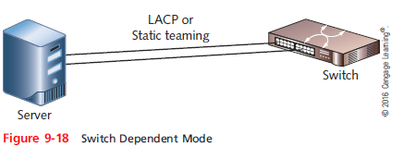
Devices and Interfaces
Notes:
Devices and Interfaces

Slide 70
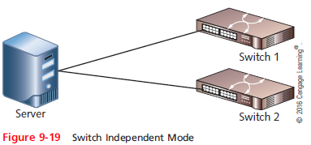
Devices and Interfaces
NICS could be teamed to multiple switches using Switch Independent Mode
Can be used with nonintelligent switches
Notes:
Devices and Interfaces
NICS could be teamed to multiple switches using Switch Independent Mode
Can be used with nonintelligent switches

Slide 71
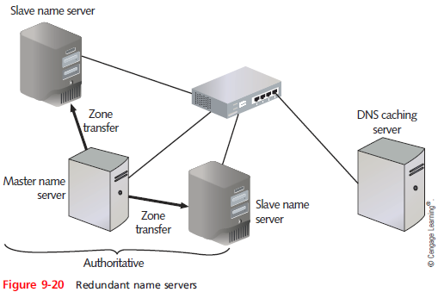
Naming and Addressing Services
Naming and addressing services
Failure causes nearly all traffic to come to a halt
Solution: maintain redundant name servers
Notes:
Naming and Addressing Services
Naming and addressing services
Failure causes nearly all traffic to come to a halt
Solution: maintain redundant name servers

Slide 72
Naming and Addressing Services
DNS can point to redundant locations for each host name
Round-robin DNS
Enables load balancing between servers and increases fault tolerance
Load balancer
Distributes traffic intelligently among multiple computers
Notes:
Naming and Addressing Services
DNS can point to redundant locations for each host name
Round-robin DNS
Enables load balancing between servers and increases fault tolerance
Load balancer
Distributes traffic intelligently among multiple computers

Slide 73
Naming and Addressing Services
CARP(Common Address Redundancy Protocol)
Allows a pool of computers or interfaces to share one or more IP addresses
Pool is known as a group of redundancy
In CARP
One computer, acting as the master of the group, receives requests for an IP address
Then parcels out the requests to one of several computers in a group
Notes:
Naming and Addressing Services
CARP(Common Address Redundancy Protocol)
Allows a pool of computers or interfaces to share one or more IP addresses
Pool is known as a group of redundancy
In CARP
One computer, acting as the master of the group, receives requests for an IP address
Then parcels out the requests to one of several computers in a group

Slide 74
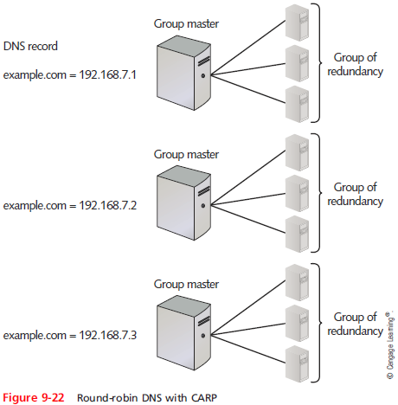
Naming and Addressing Services
Notes:
Naming and Addressing Services

Slide 75
Data Backup
Backup
Copies of data or program files
Created for archiving, safekeeping
When creating a backup system, keep in mind:
Use only proven and reliable backup software
Verify backup hardware and software are compatible with network
Make sure backup software uses data error-checking
Verify that your backup storage media provides sufficient capacity
Notes:
Data Backup
Backup
Copies of data or program files
Created for archiving, safekeeping
When creating a backup system, keep in mind:
Use only proven and reliable backup software
Verify backup hardware and software are compatible with network
Make sure backup software uses data error-checking
Verify that your backup storage media provides sufficient capacity

Slide 76
Data Backup
When creating a backup system, keep in mind (cont’d):
Be aware of how your backup process affects the system
Be aware of the degree of manual intervention required to manage backups
Make wise choices for storage media
When storing data to hard drives, recognize that drives can be installed on computers on the LAN
Keep backups secure
Notes:
Data Backup
When creating a backup system, keep in mind (cont’d):
Be aware of how your backup process affects the system
Be aware of the degree of manual intervention required to manage backups
Make wise choices for storage media
When storing data to hard drives, recognize that drives can be installed on computers on the LAN
Keep backups secure

Slide 77
Data Backup
When creating a backup system, keep in mind (cont’d):
Consider cloud backups
Decide what to back up
Plan what type of backup will be done
Full, incremental, or differential backups
Plan when backups will be done
Develop a backup schedule
Establish a regular schedule of verification
Notes:
Data Backup
When creating a backup system, keep in mind (cont’d):
Consider cloud backups
Decide what to back up
Plan what type of backup will be done
Full, incremental, or differential backups
Plan when backups will be done
Develop a backup schedule
Establish a regular schedule of verification

Slide 78
Summary
Baseline measurements allow you to compare future performance increases or decreases caused by network changes or events with past network performance
In addition to internal policies, a network manager must consider state and federal regulations
The syslog protocol is a standard for generating, storing, and processing messages about system events
Effective utilization of interface system and event logs can help identify and prevent complications
Notes:
Summary
Baseline measurements allow you to compare future performance increases or decreases caused by network changes or events with past network performance
In addition to internal policies, a network manager must consider state and federal regulations
The syslog protocol is a standard for generating, storing, and processing messages about system events
Effective utilization of interface system and event logs can help identify and prevent complications

Slide 79
Summary
Traffic shaping involves manipulating characteristics of packets, data streams, or connections to manage the type and amount of traffic traversing a network
Caching is the local storage of frequently needed files that would otherwise be obtained externally
Ethernet networks and the Internet are the most common examples of packet-switched networks
In a unicast transmission, a single node issues a stream of data to one other node
Signaling protocols set up and manage sessions between clients
Notes:
Summary
Traffic shaping involves manipulating characteristics of packets, data streams, or connections to manage the type and amount of traffic traversing a network
Caching is the local storage of frequently needed files that would otherwise be obtained externally
Ethernet networks and the Internet are the most common examples of packet-switched networks
In a unicast transmission, a single node issues a stream of data to one other node
Signaling protocols set up and manage sessions between clients

Slide 80
Summary
On a VoIP, logical channels are identified as port numbers at each IP address
SIP is an Application layer signaling and control protocol for multiservice, packet-based networks
MGCP and Megaco are commonly used on multiservice networks that support a number of media gateways
UDP is preferred over TCP for real-time services, such as telephone conversations and videoconferences
Notes:
Summary
On a VoIP, logical channels are identified as port numbers at each IP address
SIP is an Application layer signaling and control protocol for multiservice, packet-based networks
MGCP and Megaco are commonly used on multiservice networks that support a number of media gateways
UDP is preferred over TCP for real-time services, such as telephone conversations and videoconferences

Slide 81
Summary
QoS is a measure of how well a network service matches its expected performance
MPLS can operate over Ethernet frames, but it is more often used with other Layer 2 protocols
One way to consider availability is by measuring a system or network’s uptime
Redundancy is intended to eliminate single points of failure
Link aggregation is the seamless combination of multiple network interfaces or ports to act as one logical interface
Notes:
Summary
QoS is a measure of how well a network service matches its expected performance
MPLS can operate over Ethernet frames, but it is more often used with other Layer 2 protocols
One way to consider availability is by measuring a system or network’s uptime
Redundancy is intended to eliminate single points of failure
Link aggregation is the seamless combination of multiple network interfaces or ports to act as one logical interface

