Slide 1
Network+ Guide to Networks 7th Edition
Chapter 10
Network Segmentation and Virtualization
© 2016 Cengage Learning®. May not be scanned, copied or duplicated, or posted to a publicly accessible website, in whole or in part.
Notes:
Network+ Guide to Networks 7th Edition
Chapter 10
Network Segmentation and Virtualization

Slide 2
Objectives
Describe methods of network design unique to TCP/IP networks, including subnetting, CIDR, and supernetting
Explain virtualization and identify characteristics of virtual network components
Describe techniques for incorporating virtual components in VLANs
Notes:
Objectives
Describe methods of network design unique to TCP/IP networks, including subnetting, CIDR, and supernetting
Explain virtualization and identify characteristics of virtual network components
Describe techniques for incorporating virtual components in VLANs

Slide 3
Objectives
Explain the advanced features of a switch and understand popular switching techniques, including VLAN management
Identify methods of combining VM and VLAN technologies
Notes:
Objectives
Explain the advanced features of a switch and understand popular switching techniques, including VLAN management
Identify methods of combining VM and VLAN technologies

Slide 4
Segmentation and Subnetting
Segmentation
Dividing a network into multiple smaller networks
Traffic on one network is separated from another network’s traffic
Each network is its own broadcast domain
Accomplish the following:
Enhance security
Improve performance
Simplify troubleshooting
Notes:
Segmentation and Subnetting
Segmentation
Dividing a network into multiple smaller networks
Traffic on one network is separated from another network’s traffic
Each network is its own broadcast domain
Accomplish the following:
Enhance security
Improve performance
Simplify troubleshooting

Slide 5
How a Computer Uses a Subnet Mask
IPv4 address is divided into two parts:
Network ID and host ID
Subnet mask is used so devices can determine which part of an IP address is network ID and which part is the host ID
Number of 1s in the subnet mask determines the number of bits in the IP address belong to the network ID
Notes:
How a Computer Uses a Subnet Mask
IPv4 address is divided into two parts:
Network ID and host ID
Subnet mask is used so devices can determine which part of an IP address is network ID and which part is the host ID
Number of 1s in the subnet mask determines the number of bits in the IP address belong to the network ID

Slide 6
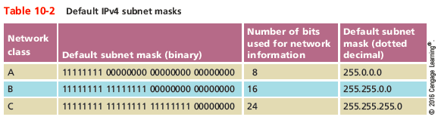
How a Computer Uses a Subnet Mask
Notes:
How a Computer Uses a Subnet Mask

Slide 7
CIDR (Classless Interdomain Routing)
CIDR
Provides additional ways of arranging network and host information in an IP address
Takes the network ID or a host’s IP address and follows it with a forward slash (/), followed by the number of bits used for the network ID
192.168.89.127/24
24 represents the number of 1s in the subnet mask and the number of bits in the network ID
Known as a CIDR block
Notes:
CIDR (Classless Interdomain Routing)
CIDR
Provides additional ways of arranging network and host information in an IP address
Takes the network ID or a host’s IP address and follows it with a forward slash (/), followed by the number of bits used for the network ID
192.168.89.127/24
24 represents the number of 1s in the subnet mask and the number of bits in the network ID
Known as a CIDR block

Slide 8
Why Subnets?
Example: A business has grown from 20-30 computers to having a few hundred computers on three floors
There is only a single LAN or broadcast domain
One router serves as the default gateway for the entire network
To better manage network traffic, segment the network so that each floor contains one LAN, or broadcast domain
Notes:
Why Subnets?
Example: A business has grown from 20-30 computers to having a few hundred computers on three floors
There is only a single LAN or broadcast domain
One router serves as the default gateway for the entire network
To better manage network traffic, segment the network so that each floor contains one LAN, or broadcast domain

Slide 9
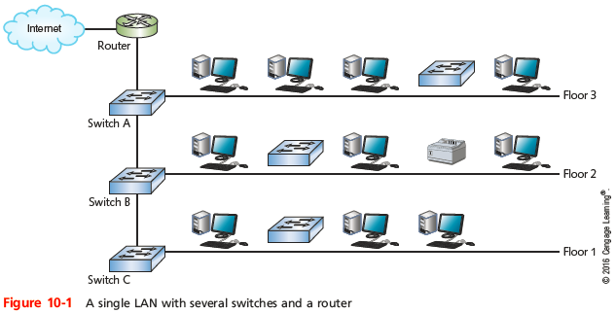
Why Subnets?
Notes:
Why Subnets?

Slide 10
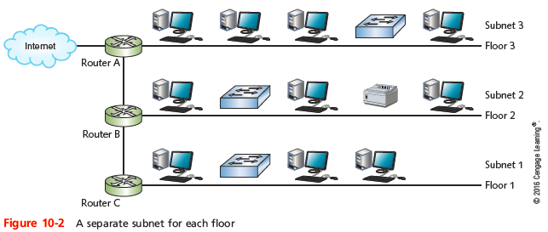
Why Subnets?
Notes:
Why Subnets?

Slide 11
Subnet Mask Tables
Class A, Class B, and Class C networks
Can be subnetted
Each class has different number of host information bits usable for subnet information
Varies depending on network class and the way subnetting is used
LAN subnetting
LAN’s devices interpret device subnetting information
External routers
Need network portion of device IP address
Notes:
Subnet Mask Tables
Class A, Class B, and Class C networks
Can be subnetted
Each class has different number of host information bits usable for subnet information
Varies depending on network class and the way subnetting is used
LAN subnetting
LAN’s devices interpret device subnetting information
External routers
Need network portion of device IP address

Slide 12
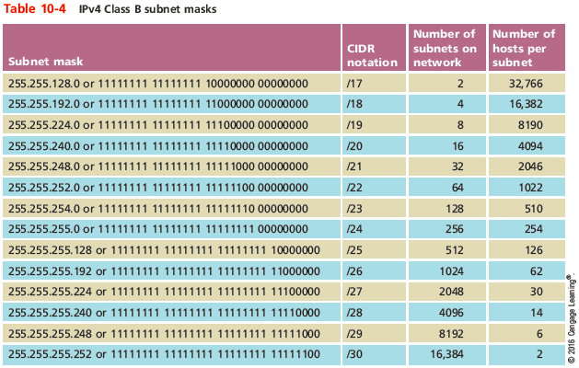
Subnet Mask Tables
Notes:
Subnet Mask Tables

Slide 13
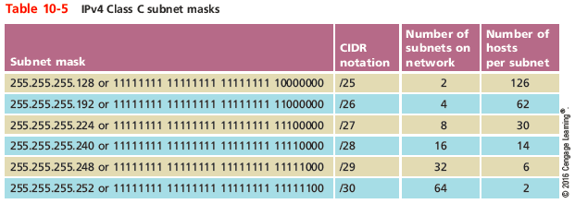
Subnet Mask Tables
Notes:
Subnet Mask Tables

Slide 14
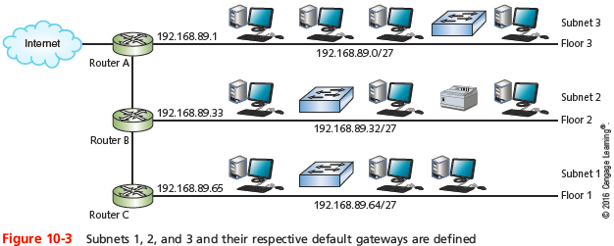
Subnet Mask Tables
Notes:
Subnet Mask Tables

Slide 15
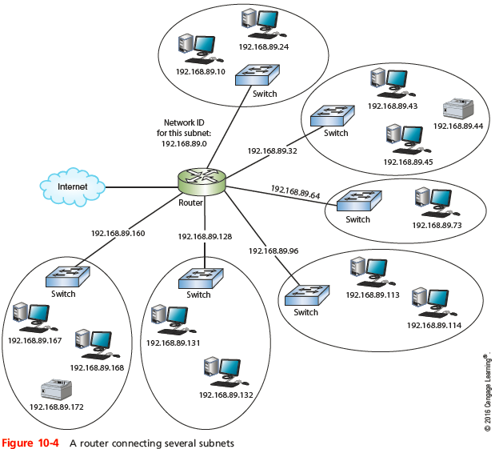
Subnet Mask Tables
Notes:
Subnet Mask Tables

Slide 16
Supernetting
Supernetting
Combine contiguous networks that all use the same CIDR block into one supernet
Also called classless routing or IP address segmentation
Supernetting is helpful for two reasons:
Reduce the number of routing table entries by combining several entries
Allow a company to create a single network made up of more than one Class C license
Notes:
Supernetting
Supernetting
Combine contiguous networks that all use the same CIDR block into one supernet
Also called classless routing or IP address segmentation
Supernetting is helpful for two reasons:
Reduce the number of routing table entries by combining several entries
Allow a company to create a single network made up of more than one Class C license

Slide 17
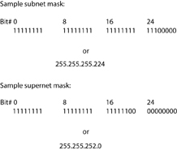
Supernetting
Supernet is defined by a supernet mask
Moves the network prefix to the left
Figure 10-6 Subnet mask and supernet mask for a Class C network
Notes:
Supernetting
Supernet is defined by a supernet mask
Moves the network prefix to the left

Slide 18
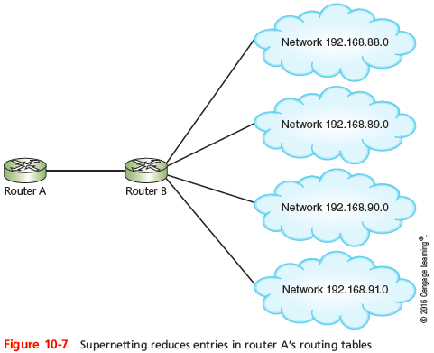
Supernetting
Notes:
Supernetting

Slide 19
Subnetting in IPv6
Each ISP can offer customers an entire IPv6 subnet
Subnetting in IPv6
Simpler than IPv4
Classes not used
Subnet masks not used
First four blocks (64 bits) normally identify the network
Serve as the network prefix or routing prefix
Interfaces that share a network prefix belong to the same subnet
Notes:
Subnetting in IPv6
Each ISP can offer customers an entire IPv6 subnet
Subnetting in IPv6
Simpler than IPv4
Classes not used
Subnet masks not used
First four blocks (64 bits) normally identify the network
Serve as the network prefix or routing prefix
Interfaces that share a network prefix belong to the same subnet

Slide 20
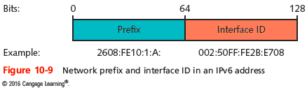
Subnetting in IPv6
Sometimes the slash notation is called the prefix mask
Route prefixes vary in length
The slash notation is necessary when defining them
Example: 2608:FE10::/32
Includes all subnets whose prefixes begin with 2608:FE10
Notes:
Subnetting in IPv6
Sometimes the slash notation is called the prefix mask
Route prefixes vary in length
The slash notation is necessary when defining them
Example: 2608:FE10::/32
Includes all subnets whose prefixes begin with 2608:FE10

Slide 21
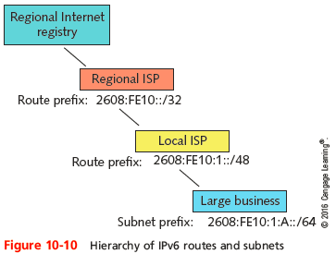
Subnetting in IPv6
Notes:
Subnetting in IPv6

Slide 22
Virtualization
Emulation of a computer, operating system environment, or application:
On a physical system
Virtual machines (VMs)
Virtual workstations
Virtual servers
Can be configured to use different types of:
CPU
Storage drive
NIC
Notes:
Virtualization
Emulation of a computer, operating system environment, or application:
On a physical system
Virtual machines (VMs)
Virtual workstations
Virtual servers
Can be configured to use different types of:
CPU
Storage drive
NIC

Slide 23
Virtualization
To users, a VM appears no different from a physical computer:
Running the same software
Host
Physical computer
Guest
Each virtual machine
Hypervisor
Software that allows you to define and manage virtual machines (also known as a virtual machine manager)
Notes:
Virtualization
To users, a VM appears no different from a physical computer:
Running the same software
Host
Physical computer
Guest
Each virtual machine
Hypervisor
Software that allows you to define and manage virtual machines (also known as a virtual machine manager)

Slide 24
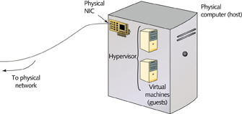
Virtualization
Figure 10-11 Elements of virtualization
Notes:
Virtualization

Slide 25
Virtualization
Advantages of virtualization
Efficient use of resources
Cost and energy savings
Fault and threat isolation
Simple backups, recovery, and replication
Disadvantages
Compromised performance
Increased complexity
Increased licensing costs
Single point of failure
Notes:
Virtualization
Advantages of virtualization
Efficient use of resources
Cost and energy savings
Fault and threat isolation
Simple backups, recovery, and replication
Disadvantages
Compromised performance
Increased complexity
Increased licensing costs
Single point of failure

Slide 26
Virtualization
VMware
Makes the most widely implemented virtualization software
Provides several which are designed for managing virtual workstations on a single host
Other examples that provide similar functionality but differ in features, interfaces, and ease of use:
Microsoft’s Hyper-V
KVM (Kernel-based Virtual Machine)
Oracle’s VirtualBox
Citrix’s XenAPP
Notes:
Virtualization
VMware
Makes the most widely implemented virtualization software
Provides several which are designed for managing virtual workstations on a single host
Other examples that provide similar functionality but differ in features, interfaces, and ease of use:
Microsoft’s Hyper-V
KVM (Kernel-based Virtual Machine)
Oracle’s VirtualBox
Citrix’s XenAPP

Slide 27
Virtual Network Components
Virtual network
Can be created to consist solely of virtual machines on a physical server
Most networks combine physical and virtual elements
Notes:
Virtual Network Components
Virtual network
Can be created to consist solely of virtual machines on a physical server
Most networks combine physical and virtual elements

Slide 28
Virtual Machines and Network Adapters
Virtualization program
Assigns VM’s software and hardware characteristics
Often an easy to use, step-by-step wizard
Network connection
Requires virtual adapter (vNIC)
Each VM can have several vNICs
Upon creation, each vNIC is automatically assigned a MAC address
Also, by default, every VMs vNIC is connected to a port on a virtual switch
Notes:
Virtual Machines and Network Adapters
Virtualization program
Assigns VM’s software and hardware characteristics
Often an easy to use, step-by-step wizard
Network connection
Requires virtual adapter (vNIC)
Each VM can have several vNICs
Upon creation, each vNIC is automatically assigned a MAC address
Also, by default, every VMs vNIC is connected to a port on a virtual switch

Slide 29
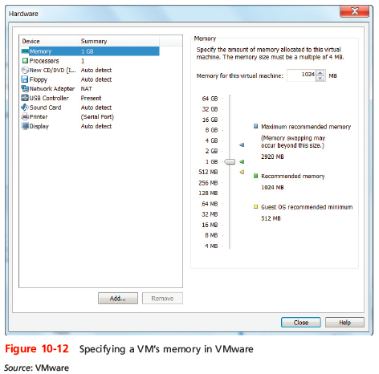
Virtual Machines and Network Adapters
Notes:
Virtual Machines and Network Adapters

Slide 30
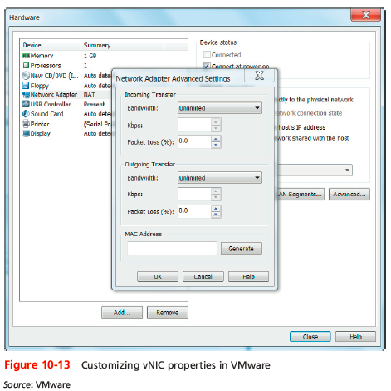
Virtual Machines and Network Adapters
Notes:
Virtual Machines and Network Adapters

Slide 31
Virtual Switches and Bridges
When first VM’s vNIC is selected
Hypervisor creates a connection between that VM and the host
This connection might be called a bridge or switch
Virtual switch
Logically defined device
Operates at Data Link layer
Passes frames between nodes
The hypervisor controls the virtual switches
VMs can go through a virtual switch to reach network
Notes:
Virtual Switches and Bridges
When first VM’s vNIC is selected
Hypervisor creates a connection between that VM and the host
This connection might be called a bridge or switch
Virtual switch
Logically defined device
Operates at Data Link layer
Passes frames between nodes
The hypervisor controls the virtual switches
VMs can go through a virtual switch to reach network

Slide 32
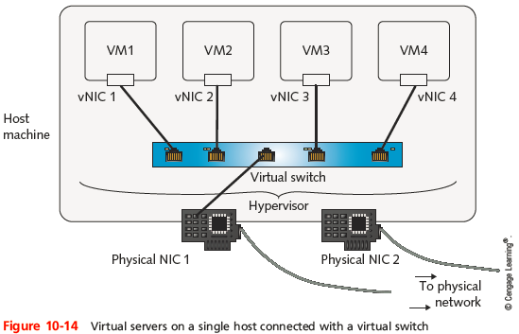
Virtual Switches and Bridges
Notes:
Virtual Switches and Bridges

Slide 33
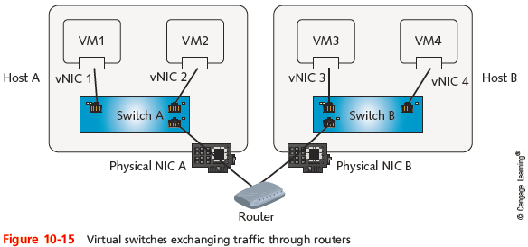
Virtual Switches and Bridges
Notes:
Virtual Switches and Bridges

Slide 34
Network Connection Types
Must identify networking mode the vNIC will use
Frequently-used network connection types
Bridged
NAT
Host-only
Bridged Mode
vNIC accesses physical network using host machine’s NIC
Obtains own IP address, default gateway, and netmask from DHCP server on physical LAN
Notes:
Network Connection Types
Must identify networking mode the vNIC will use
Frequently-used network connection types
Bridged
NAT
Host-only
Bridged Mode
vNIC accesses physical network using host machine’s NIC
Obtains own IP address, default gateway, and netmask from DHCP server on physical LAN

Slide 35
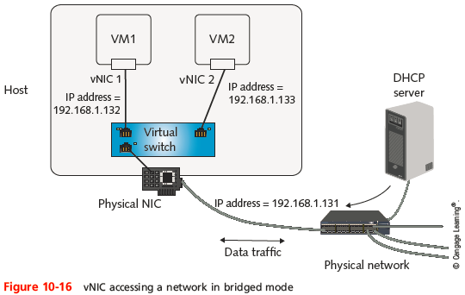
Network Connection Types
Notes:
Network Connection Types

Slide 36
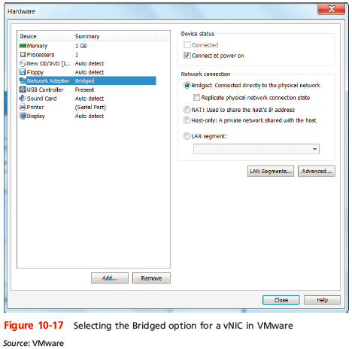
Network Connection Types
Notes:
Network Connection Types

Slide 37
Network Connection Types
NAT Mode
vNIC relies on host to act as NAT device
Obtains IP addressing information from host
Virtualization software acts as a DHCP server
Appropriate for VMs that do not need to be accessed at a known address by other network nodes
Host-only Mode
VMs on one host can exchange data with each other and the host
Cannot communicate with nodes beyond the host
Never receive or transmit data with host’s physical NIC
Notes:
Network Connection Types
NAT Mode
vNIC relies on host to act as NAT device
Obtains IP addressing information from host
Virtualization software acts as a DHCP server
Appropriate for VMs that do not need to be accessed at a known address by other network nodes
Host-only Mode
VMs on one host can exchange data with each other and the host
Cannot communicate with nodes beyond the host
Never receive or transmit data with host’s physical NIC

Slide 38
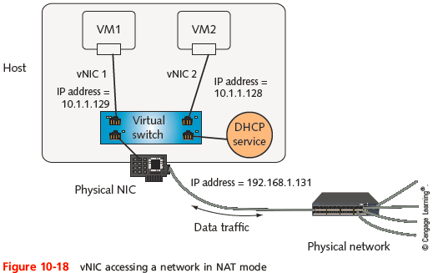
Network Connection Types
Notes:
Network Connection Types

Slide 39
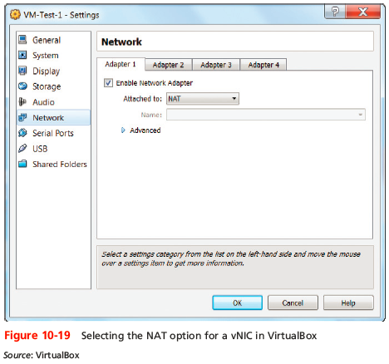
Network Connection Types
Notes:
Network Connection Types

Slide 40
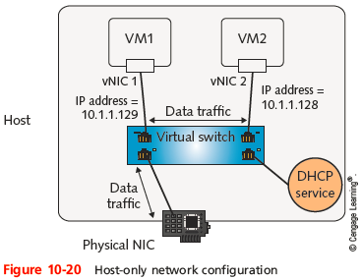
Network Connection Types
Notes:
Network Connection Types

Slide 41
Virtual Appliances and Virtual Network Services
Alternative to test servers for new software
Virtual appliance includes:
Image of operating system, software, hardware specifications, and application configuration
Most commonly virtual servers
Popular functions
Firewall
Network management
E-mail solutions
Remote access
Notes:
Virtual Appliances and Virtual Network Services
Alternative to test servers for new software
Virtual appliance includes:
Image of operating system, software, hardware specifications, and application configuration
Most commonly virtual servers
Popular functions
Firewall
Network management
E-mail solutions
Remote access

Slide 42
VRRP (Virtual Router Redundancy Protocol) and HSRP (Hot Standby Routing Protocol)
VRRP
Cisco’s proprietary version is HSRP
Used to assign a virtual IP address to a group of routers
Virtual IP address
Can be shared by the entire group
Messages routed to the virtual IP address are handled by the master router
Routers involved are all physical routers acting together as a single virtual router or a group of virtual routers
Notes:
VRRP (Virtual Router Redundancy Protocol) and HSRP (Hot Standby Routing Protocol)
VRRP
Cisco’s proprietary version is HSRP
Used to assign a virtual IP address to a group of routers
Virtual IP address
Can be shared by the entire group
Messages routed to the virtual IP address are handled by the master router
Routers involved are all physical routers acting together as a single virtual router or a group of virtual routers

Slide 43
SDN (Software Defined Networking)
SDN
The virtualization of network services
A network controller manages these services instead of services being directly managed by hardware devices
Network controller integrates all of the network’s virtual and physical devices into one cohesive system
Protocols handle the process of making decisions (called the control plane)
Physical devices make actual contact with data transmissions as they traverse the network (called the data plane)
Notes:
SDN (Software Defined Networking)
SDN
The virtualization of network services
A network controller manages these services instead of services being directly managed by hardware devices
Network controller integrates all of the network’s virtual and physical devices into one cohesive system
Protocols handle the process of making decisions (called the control plane)
Physical devices make actual contact with data transmissions as they traverse the network (called the data plane)

Slide 44
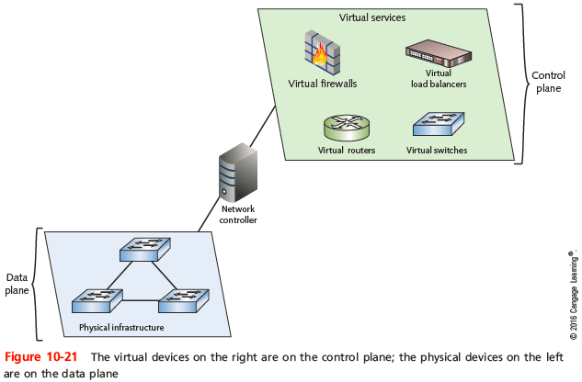
SDN (Software Defined Networking)
Notes:
SDN (Software Defined Networking)

Slide 45
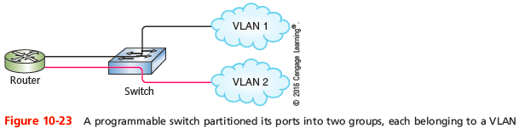
VLANs and Trunking
VLAN (virtual local area network)
Groups ports on a switch so that some of the local traffic on the switch is forced to go through a router
To create a VLAN
You need a programmable physical switch whose ports can be partitioned into groups
Notes:
VLANs and Trunking
VLAN (virtual local area network)
Groups ports on a switch so that some of the local traffic on the switch is forced to go through a router
To create a VLAN
You need a programmable physical switch whose ports can be partitioned into groups

Slide 46
VLANs and Trunking
802.1Q
The IEEE standard that specifies how VLAN information appears in frames and how switches interpret that information
Each VLAN is assigned its own subnet of IP addresses
Each VLAN and subnet normally is a broadcast domain
A VLAN can include ports from more than one switch
Notes:
VLANs and Trunking
802.1Q
The IEEE standard that specifies how VLAN information appears in frames and how switches interpret that information
Each VLAN is assigned its own subnet of IP addresses
Each VLAN and subnet normally is a broadcast domain
A VLAN can include ports from more than one switch

Slide 47
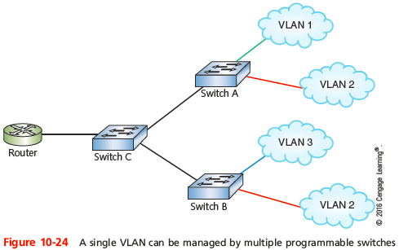
VLANs and Trunking
Notes:
VLANs and Trunking

Slide 48
VLANs and Trunking
Reasons for using VLANs:
Separating groups of users who need special security or network functions
Isolating connections with heavy or unpredictable traffic patterns
Identifying groups of devices whose data should be given priority handling
Containing groups of devices that rely on legacy protocols incompatible with the majority of the network’s traffic
Separating a large network into smaller subnets
Notes:
VLANs and Trunking
Reasons for using VLANs:
Separating groups of users who need special security or network functions
Isolating connections with heavy or unpredictable traffic patterns
Identifying groups of devices whose data should be given priority handling
Containing groups of devices that rely on legacy protocols incompatible with the majority of the network’s traffic
Separating a large network into smaller subnets

Slide 49
VLANs and Trunking
Trunk
A single physical connection between switches through which many logical VLANs can transmit and receive data
A port on a switch is configured as either an access port or a trunk port
Access port - used for connecting a single node
Trunk port - capable of managing traffic among multiple VLANs
Notes:
VLANs and Trunking
Trunk
A single physical connection between switches through which many logical VLANs can transmit and receive data
A port on a switch is configured as either an access port or a trunk port
Access port - used for connecting a single node
Trunk port - capable of managing traffic among multiple VLANs

Slide 50
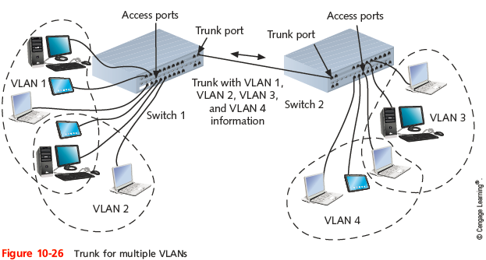
VLANs and Trunking
Notes:
VLANs and Trunking

Slide 51
VLANs and Trunking
To keep data belonging to each VLAN separate
Each frame is identified with a VLAN identifier or tag
Trunking protocols assign and interpret these tags
Cisco’s VTP (VLAN trunking protocol)
The most popular protocol for exchanging VLAN information over trunks
VTP allows changes to VLAN database on one switch, called the stack master, to be communicated to all other switches in the network
Notes:
VLANs and Trunking
To keep data belonging to each VLAN separate
Each frame is identified with a VLAN identifier or tag
Trunking protocols assign and interpret these tags
Cisco’s VTP (VLAN trunking protocol)
The most popular protocol for exchanging VLAN information over trunks
VTP allows changes to VLAN database on one switch, called the stack master, to be communicated to all other switches in the network

Slide 52
VLANs and Trunking
Potential problem in creating VLANs
By grouping certain nodes, you are excluding another group
To allow different VLANs to exchange data
You need to connect VLANs with a router or Layer 3 switch
VLAN hopping attack
Occurs when an attacker generates transmissions that appear to belong to a protected VLAN
Prevented by disabling auto trunking and moving native VLAN to an unused VLAN
Notes:
VLANs and Trunking
Potential problem in creating VLANs
By grouping certain nodes, you are excluding another group
To allow different VLANs to exchange data
You need to connect VLANs with a router or Layer 3 switch
VLAN hopping attack
Occurs when an attacker generates transmissions that appear to belong to a protected VLAN
Prevented by disabling auto trunking and moving native VLAN to an unused VLAN

Slide 53
STP (Spanning Tree Protocol) and SPB (Shortest Path Bridging)
IEEE standard 802.1D
Operates in Data Link layer
Prevents traffic loops
Calculating paths avoiding potential loops
Artificially blocking links completing loop
STP information is transmitted between switches
Via BPDUs (Bridge Protocol Data Units)
BPDU guard
Help to enforce STP path rules
BPDU filter can be used to disable STP on ports
Notes:
STP (Spanning Tree Protocol) and SPB (Shortest Path Bridging)
IEEE standard 802.1D
Operates in Data Link layer
Prevents traffic loops
Calculating paths avoiding potential loops
Artificially blocking links completing loop
STP information is transmitted between switches
Via BPDUs (Bridge Protocol Data Units)
BPDU guard
Help to enforce STP path rules
BPDU filter can be used to disable STP on ports

Slide 54
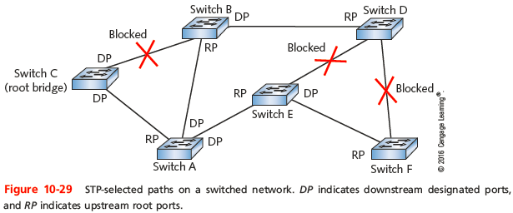
STP (Spanning Tree Protocol) and SPB (Shortest Path Bridging)
Three steps
Select root bridge based on Bridge ID (BID)
Examine possible paths between network bridge and root bridge
Disables links not part of shortest path
Notes:
STP (Spanning Tree Protocol) and SPB (Shortest Path Bridging)
Three steps
Select root bridge based on Bridge ID (BID)
Examine possible paths between network bridge and root bridge
Disables links not part of shortest path

Slide 55
STP (Spanning Tree Protocol) and SPB (Shortest Path Bridging)
Newer versions of STP can detect and correct for link failures in seconds
RSTP (Rapid Spanning Tree Protocol)
MSTP (Multiple Spanning Tree Protocol)
TRILL (Transparent Interconnection of Lots of Links)
Designed to replace STP
A multipath, link-state protocol
SPB (Shortest Path Bridging)
A descendent of STP that operates at Layer 3
Keeps all potential paths active while managing flow of data
Notes:
STP (Spanning Tree Protocol) and SPB (Shortest Path Bridging)
Newer versions of STP can detect and correct for link failures in seconds
RSTP (Rapid Spanning Tree Protocol)
MSTP (Multiple Spanning Tree Protocol)
TRILL (Transparent Interconnection of Lots of Links)
Designed to replace STP
A multipath, link-state protocol
SPB (Shortest Path Bridging)
A descendent of STP that operates at Layer 3
Keeps all potential paths active while managing flow of data

Slide 56
Switch Configurations
Unmanaged switch
Provides plug-and-play simplicity with minimal configuration
Has no IP address assigned to it
Managed switch
Can be configured via a command-line interface and are usually assigned an IP address
VLANS can only be implemented through managed switches
Notes:
Switch Configurations
Unmanaged switch
Provides plug-and-play simplicity with minimal configuration
Has no IP address assigned to it
Managed switch
Can be configured via a command-line interface and are usually assigned an IP address
VLANS can only be implemented through managed switches

Slide 57
Switch Configurations
Configuration options on a managed switch:
Password security
Console
Management console
Remote configuration is managed through a virtual terminal or virtual console
AAA method
Switch port security
Speed and duplex
Notes:
Switch Configurations
Configuration options on a managed switch:
Password security
Console
Management console
Remote configuration is managed through a virtual terminal or virtual console
AAA method
Switch port security
Speed and duplex

Slide 58
Wireless VLANs
Wireless controller (Wi-Fi controller or WLAN controller)
Provides a central management console for all of the APs in the network
APs can also provide several options
Thick AP is self-contained without relying on a higher-level management device
Thin APs are simple devices that must be configured from the wireless controller’s console
Notes:
Wireless VLANs
Wireless controller (Wi-Fi controller or WLAN controller)
Provides a central management console for all of the APs in the network
APs can also provide several options
Thick AP is self-contained without relying on a higher-level management device
Thin APs are simple devices that must be configured from the wireless controller’s console

Slide 59
Wireless VLANs
LWAPP (Lightweight Access Point Protocol)
Direct all wireless frames to the controller by adding extra headers to the frames
CAPWAP (Control and Provisioning of Wireless Access Points) is another example
Wireless controller can provide centralized authentication for wireless clients, load balancing, and channel management
VLAN pooling is accomplished by grouping multiple VLANs into a single VLAN group
Notes:
Wireless VLANs
LWAPP (Lightweight Access Point Protocol)
Direct all wireless frames to the controller by adding extra headers to the frames
CAPWAP (Control and Provisioning of Wireless Access Points) is another example
Wireless controller can provide centralized authentication for wireless clients, load balancing, and channel management
VLAN pooling is accomplished by grouping multiple VLANs into a single VLAN group

Slide 60
Troubleshooting VMs and VLANs
Virtual networks resemble physical networks in many ways
Backups, troubleshooting, and software updates concerns are similar
To add VMs to a VLAN defined on a physical network
Use the hypervisor to modify a virtual switch’s configuration
VMs are not added to a preexisting VLAN on the physical switch that manages that VLAN
Notes:
Troubleshooting VMs and VLANs
Virtual networks resemble physical networks in many ways
Backups, troubleshooting, and software updates concerns are similar
To add VMs to a VLAN defined on a physical network
Use the hypervisor to modify a virtual switch’s configuration
VMs are not added to a preexisting VLAN on the physical switch that manages that VLAN

Slide 61
Summary
Separating traffic by subnets or VLANs helps enhance security, improve network performance, and simplify troubleshooting
CIDR notation takes the network ID or a host’s IP address and follows it with a forward slash (/) followed by the number of bits used for network ID
To create a subnet, borrow bits that would represent host information in classful addressing
Supernetting allows you to combine contiguous networks that all use the same CIDR block into one supernet
Notes:
Summary
Separating traffic by subnets or VLANs helps enhance security, improve network performance, and simplify troubleshooting
CIDR notation takes the network ID or a host’s IP address and follows it with a forward slash (/) followed by the number of bits used for network ID
To create a subnet, borrow bits that would represent host information in classful addressing
Supernetting allows you to combine contiguous networks that all use the same CIDR block into one supernet

Slide 62
Summary
Subnetting in IPv6 is simpler than subnetting in IPv4
For a single computer, virtualization can emulate the hardware, OS, and/or applications
When you create a VM, use the virtualization program to assign the VM’s software and hardware characteristics
VMs can communicate with a virtual switch on the host computer to reach the physical network
A vNIC using bridged mode accesses a physical network using the host machine’s NIC
Notes:
Summary
Subnetting in IPv6 is simpler than subnetting in IPv4
For a single computer, virtualization can emulate the hardware, OS, and/or applications
When you create a VM, use the virtualization program to assign the VM’s software and hardware characteristics
VMs can communicate with a virtual switch on the host computer to reach the physical network
A vNIC using bridged mode accesses a physical network using the host machine’s NIC

Slide 63
Summary
A vNIC using NAT mode relies on the host machine to act as a NAT device
In host-only mode, VMs on one host can exchange data with each other and with their host, but cannot communicate with any nodes beyond the host
In software defined networking (SDN), services are delivered by applications that are managed by a network controller
Programmable switches create VLANs by partitioning their ports into groups
Notes:
Summary
A vNIC using NAT mode relies on the host machine to act as a NAT device
In host-only mode, VMs on one host can exchange data with each other and with their host, but cannot communicate with any nodes beyond the host
In software defined networking (SDN), services are delivered by applications that are managed by a network controller
Programmable switches create VLANs by partitioning their ports into groups

Slide 64
Summary
Switches and bridges use STP to help eliminate the possibility of broadcast storms and other loops
An unmanaged switch has minimal configuration and no IP address assigned to it
A large wireless network is often managed by a central wireless controller
Notes:
Summary
Switches and bridges use STP to help eliminate the possibility of broadcast storms and other loops
An unmanaged switch has minimal configuration and no IP address assigned to it
A large wireless network is often managed by a central wireless controller

