Slide 1
Network+ Guide to Networks 7th Edition
Chapter 11
Wide Area Networks
© 2016 Cengage Learning®. May not be scanned, copied or duplicated, or posted to a publicly accessible website, in whole or in part.
Notes:
Network+ Guide to Networks 7th Edition
Chapter 11
Wide Area Networks

Slide 2
Objectives
Identify a variety of uses for WANs
Explain different WAN topologies, including their advantages and disadvantages
Compare the characteristics of WAN technologies, including their switching type, throughput, media, security, and reliability
Describe several WAN transmission and connection methods, including dial-up, ISDN, T-carriers, frame relay, DSL, broadband cable, broadband over power line, ATM, SONET, MPLS, and Metro Ethernet
Notes:
Objectives
Identify a variety of uses for WANs
Explain different WAN topologies, including their advantages and disadvantages
Compare the characteristics of WAN technologies, including their switching type, throughput, media, security, and reliability
Describe several WAN transmission and connection methods, including dial-up, ISDN, T-carriers, frame relay, DSL, broadband cable, broadband over power line, ATM, SONET, MPLS, and Metro Ethernet

Slide 3
Objectives
Describe wireless WAN technologies, including 802.16 (WiMAX), HSPA+, LTE, and satellite communications
Explore common problems with WAN connections and ways to prevent Internet connection problems
Notes:
Objectives
Describe wireless WAN technologies, including 802.16 (WiMAX), HSPA+, LTE, and satellite communications
Explore common problems with WAN connections and ways to prevent Internet connection problems

Slide 4
WAN Essentials
WAN
Network traversing some distance, connecting LANs
Transmission methods depend on business needs
WAN and LAN differences
LANs connect nodes; WANs connect networks
Layers 1 and 2 access methods, topologies, media
LAN wiring: privately owned
WAN wiring: public through NSPs (network service providers)
Examples: AT&T, Verizon, Charter, and Comcast
Notes:
WAN Essentials
WAN
Network traversing some distance, connecting LANs
Transmission methods depend on business needs
WAN and LAN differences
LANs connect nodes; WANs connect networks
Layers 1 and 2 access methods, topologies, media
LAN wiring: privately owned
WAN wiring: public through NSPs (network service providers)
Examples: AT&T, Verizon, Charter, and Comcast

Slide 5
WAN Essentials
WAN site
Individual geographic locations connected by WAN
WAN link
Connection between one WAN site and another site
Data Terminal Equipment (DTE)
Customer’s endpoint device on the WAN
Communicates on the LAN
Data Communications Equipment (DCE)
Carrier’s endpoint device for the WAN
Communicates on the WAN
Notes:
WAN Essentials
WAN site
Individual geographic locations connected by WAN
WAN link
Connection between one WAN site and another site
Data Terminal Equipment (DTE)
Customer’s endpoint device on the WAN
Communicates on the LAN
Data Communications Equipment (DCE)
Carrier’s endpoint device for the WAN
Communicates on the WAN

Slide 6
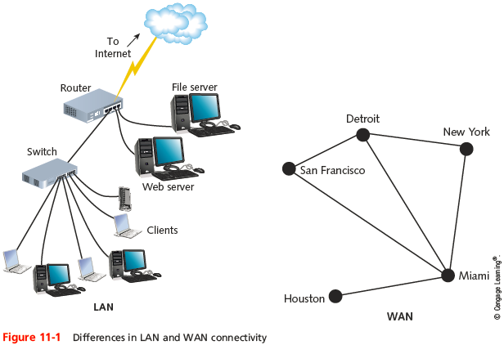
WAN Essentials
Notes:
WAN Essentials

Slide 7
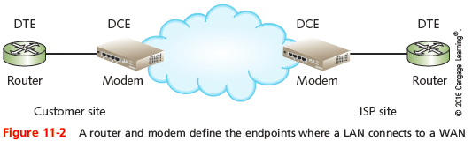
WAN Essentials
Notes:
WAN Essentials

Slide 8
WAN Topologies
WAN topologies differ from LAN topologies
Distance they must cover
Larger number of users they serve
Heavy traffic they often handle
Notes:
WAN Topologies
WAN topologies differ from LAN topologies
Distance they must cover
Larger number of users they serve
Heavy traffic they often handle

Slide 9
Bus Topology
Bus topology WAN
Each site connects serially to two sites maximum
Each site depends on every other site to transmit and receive traffic
Different locations connected to another through point-to-point links
Best use
Organizations requiring small WAN, dedicated circuits
Drawback
Not scalable
Notes:
Bus Topology
Bus topology WAN
Each site connects serially to two sites maximum
Each site depends on every other site to transmit and receive traffic
Different locations connected to another through point-to-point links
Best use
Organizations requiring small WAN, dedicated circuits
Drawback
Not scalable

Slide 10
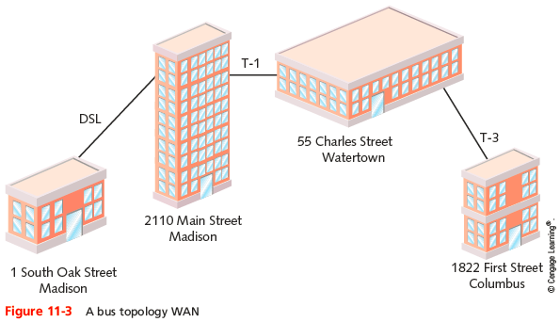
Bus Topology
Notes:
Bus Topology

Slide 11
Ring Topology
Ring topology WAN
Each site connected to two other sites to form a ring pattern
Connects locations rather than local nodes
Relies on redundant rings
Data rerouted upon site failure
Expansion
Difficult, expensive
Best use
Connecting maximum five locations
Notes:
Ring Topology
Ring topology WAN
Each site connected to two other sites to form a ring pattern
Connects locations rather than local nodes
Relies on redundant rings
Data rerouted upon site failure
Expansion
Difficult, expensive
Best use
Connecting maximum five locations

Slide 12
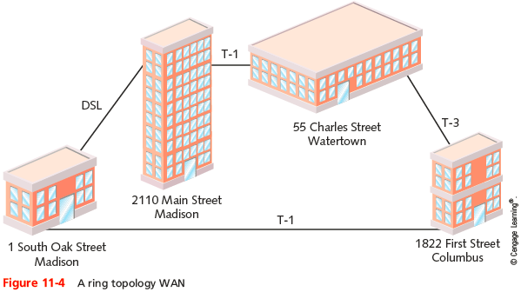
Ring Topology
Notes:
Ring Topology

Slide 13
Star Topology
Star topology WAN
Single site acts as a central connection point
Separate data routes between any two sites
Advantages
Single connection failure affects one location
Shorter data paths between any two sites
Expansion: simple, less costly
Drawback
Central site failure can bring down entire WAN
Notes:
Star Topology
Star topology WAN
Single site acts as a central connection point
Separate data routes between any two sites
Advantages
Single connection failure affects one location
Shorter data paths between any two sites
Expansion: simple, less costly
Drawback
Central site failure can bring down entire WAN

Slide 14
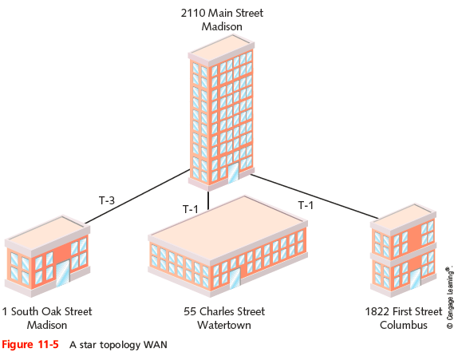
Star Topology
Notes:
Star Topology

Slide 15
Mesh Topology
Mesh topology WAN
Incorporates many directly interconnected sites
Data travels directly from origin to destination
Routers can redirect data easily, quickly
Most fault-tolerant WAN type
Full-mesh WAN
Every WAN site directly connected to every other site
Drawback: cost
Partial-mesh WAN
Less costly
Notes:
Mesh Topology
Mesh topology WAN
Incorporates many directly interconnected sites
Data travels directly from origin to destination
Routers can redirect data easily, quickly
Most fault-tolerant WAN type
Full-mesh WAN
Every WAN site directly connected to every other site
Drawback: cost
Partial-mesh WAN
Less costly

Slide 16
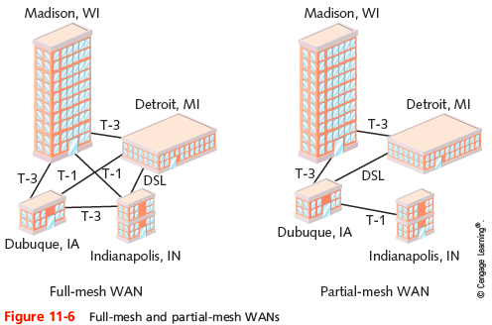
Mesh Topology
Notes:
Mesh Topology

Slide 17
Tiered Topology
Tiered topology WAN
Sites connected in star or ring formations
Interconnected at different levels
Interconnection points are organized into layers
Form hierarchical groupings
Flexibility
Allows many variations, practicality
Requires careful considerations
Geography, usage patterns, growth potential
Notes:
Tiered Topology
Tiered topology WAN
Sites connected in star or ring formations
Interconnected at different levels
Interconnection points are organized into layers
Form hierarchical groupings
Flexibility
Allows many variations, practicality
Requires careful considerations
Geography, usage patterns, growth potential

Slide 18
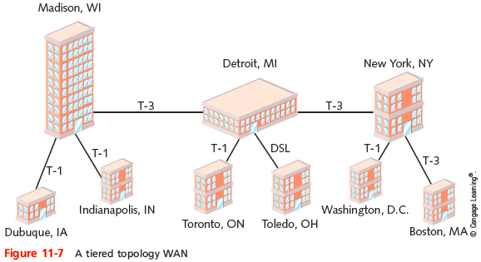
Tiered Topology
Notes:
Tiered Topology

Slide 19
PSTN (Public Switched Telephone Network)
PSTN (Public Switched Telephone Network)
Network of lines, carrier equipment providing telephone service
Also called POTS (plain old telephone service)
Encompasses entire telephone system
Originally: analog traffic
Today: digital data, computer controlled switching
CO (central office)
Where telephone company terminates lines
Switches calls between different locations
Notes:
PSTN (Public Switched Telephone Network)
PSTN (Public Switched Telephone Network)
Network of lines, carrier equipment providing telephone service
Also called POTS (plain old telephone service)
Encompasses entire telephone system
Originally: analog traffic
Today: digital data, computer controlled switching
CO (central office)
Where telephone company terminates lines
Switches calls between different locations

Slide 20
PSTN (Public Switched Telephone Network)
Local loop (last mile)
Portion connecting residence, business to nearest CO
NIU (network interface unit)
Termination point at customer’s demarcation point
FTTP (fiber to the premises)
Use of a fiber-optic cable to connect a home or business
Example of a digital local loop
Passive optical network (PON)
Carrier uses fiber-optic cabling to connect with multiple endpoints
Notes:
PSTN (Public Switched Telephone Network)
Local loop (last mile)
Portion connecting residence, business to nearest CO
NIU (network interface unit)
Termination point at customer’s demarcation point
FTTP (fiber to the premises)
Use of a fiber-optic cable to connect a home or business
Example of a digital local loop
Passive optical network (PON)
Carrier uses fiber-optic cabling to connect with multiple endpoints

Slide 21
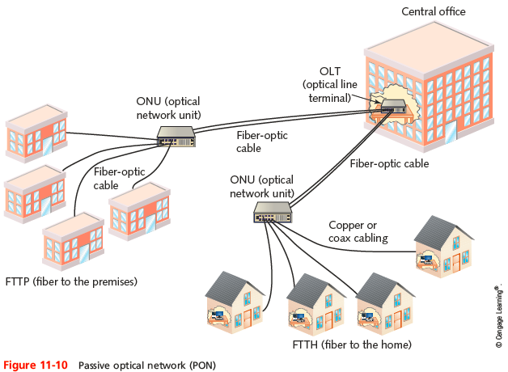
PSTN (Public Switched Telephone Network)
Notes:
PSTN (Public Switched Telephone Network)

Slide 22
PSTN (Public Switched Telephone Network)
OLT (optical line terminal)
Single endpoint at carrier’s central office in a PON
Device with multiple optical ports (PON interfaces)
ONU (optical network unit)
Distributes signals to multiple endpoints using fiber-optic cable
Or via copper or coax cable
Notes:
PSTN (Public Switched Telephone Network)
OLT (optical line terminal)
Single endpoint at carrier’s central office in a PON
Device with multiple optical ports (PON interfaces)
ONU (optical network unit)
Distributes signals to multiple endpoints using fiber-optic cable
Or via copper or coax cable

Slide 23
T-Carriers
T-carrier technology includes:
T1s, fractional T1s, and T3s
T-carrier standards (T-CXR standards)
Specify a method of signaling
A physical layer operation
Single channel divided into multiple channels
Uses TDM (time division multiplexing) over two wire pairs
Medium
Telephone wire, fiber-optic cable, wireless links
Notes:
T-Carriers
T-carrier technology includes:
T1s, fractional T1s, and T3s
T-carrier standards (T-CXR standards)
Specify a method of signaling
A physical layer operation
Single channel divided into multiple channels
Uses TDM (time division multiplexing) over two wire pairs
Medium
Telephone wire, fiber-optic cable, wireless links

Slide 24
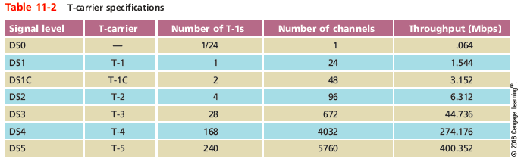
Types of T-Carriers
Many available
Notes:
Types of T-Carriers
Many available

Slide 25
Types of T-Carriers
T-carrier speed dependent on signal level
Physical layer electrical signaling characteristics
DS0 (digital signal, level 0)
One data, voice channel
T1 use
Connects branch offices, connects to carrier
Connects telephone company COs, ISPs
T3 use
Data-intensive businesses
Notes:
Types of T-Carriers
T-carrier speed dependent on signal level
Physical layer electrical signaling characteristics
DS0 (digital signal, level 0)
One data, voice channel
T1 use
Connects branch offices, connects to carrier
Connects telephone company COs, ISPs
T3 use
Data-intensive businesses

Slide 26
Types of T-Carriers
T3 provides 28 times more throughput (expensive)
Multiple T1’s may accommodate needs
TI costs vary by region
Fractional T1 lease
Use some T1 channels, charged accordingly
Best suited to businesses that expect traffic to grow but cannot currently justify leasing a full T-1
Notes:
Types of T-Carriers
T3 provides 28 times more throughput (expensive)
Multiple T1’s may accommodate needs
TI costs vary by region
Fractional T1 lease
Use some T1 channels, charged accordingly
Best suited to businesses that expect traffic to grow but cannot currently justify leasing a full T-1

Slide 27
T-Carrier Connectivity
T-carrier line requires connectivity hardware
At customer site and switching facility
Purchased or leased
Cannot be used with other WAN transmission methods
T-carrier line requires different media
Throughput dependent
Notes:
T-Carrier Connectivity
T-carrier line requires connectivity hardware
At customer site and switching facility
Purchased or leased
Cannot be used with other WAN transmission methods
T-carrier line requires different media
Throughput dependent

Slide 28
T-Carrier Connectivity
Wiring
Plain telephone wire
UTP or STP copper wiring
STP preferred for clean connection
Coaxial cable, microwave, fiber-optic cable
T1s using STP require repeater every 6000 feet
Multiple T1s or T3
Fiber-optic cabling is preferred
Notes:
T-Carrier Connectivity
Wiring
Plain telephone wire
UTP or STP copper wiring
STP preferred for clean connection
Coaxial cable, microwave, fiber-optic cable
T1s using STP require repeater every 6000 feet
Multiple T1s or T3
Fiber-optic cabling is preferred

Slide 29
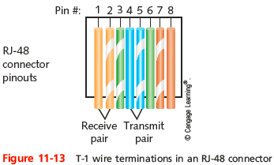
T-Carrier Connectivity
When copper cabling is used to carry T-1 traffic
It terminates in an RJ-48 connector
Notes:
T-Carrier Connectivity
When copper cabling is used to carry T-1 traffic
It terminates in an RJ-48 connector

Slide 30
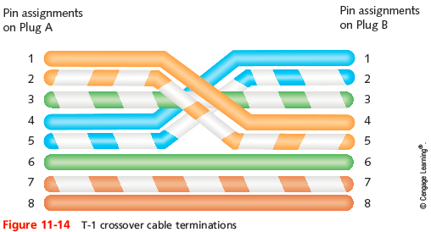
T-Carrier Connectivity
A T-1 crossover cable could be used to connect two connectivity devices
Such as CSUs/DSUs or WAN interface cards (WICs)
Notes:
T-Carrier Connectivity
A T-1 crossover cable could be used to connect two connectivity devices
Such as CSUs/DSUs or WAN interface cards (WICs)

Slide 31
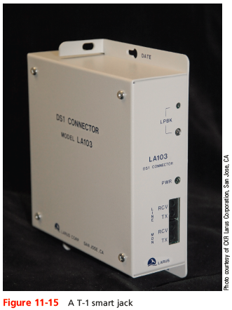
T-Carrier Connectivity
At the customer’s demarc (demarcation point)
RJ-48 connectors terminate in a smart jack
Notes:
T-Carrier Connectivity
At the customer’s demarc (demarcation point)
RJ-48 connectors terminate in a smart jack

Slide 32
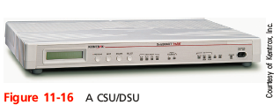
T-Carrier Connectivity
CSU/DSU (Channel Service Unit/Data Service Unit)
Two separate devices
Combined into single stand-alone device
Or an interface card
T1 line connection point
Notes:
T-Carrier Connectivity
CSU/DSU (Channel Service Unit/Data Service Unit)
Two separate devices
Combined into single stand-alone device
Or an interface card
T1 line connection point

Slide 33
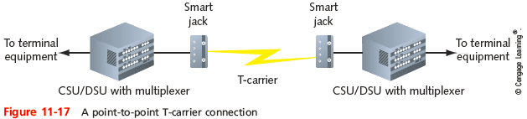
T-Carrier Connectivity
Incoming T-carrier line
Multiplexer separates combined channels
Outgoing T-carrier line
Multiplexer combines multiple LAN signals
Notes:
T-Carrier Connectivity
Incoming T-carrier line
Multiplexer separates combined channels
Outgoing T-carrier line
Multiplexer combines multiple LAN signals

Slide 34
T-Carrier Connectivity
Terminal equipment
The DTE is typically a router
Accepts incoming CSU/DSU signals
Translates Network layer protocols
Directs data to destination
Notes:
T-Carrier Connectivity
Terminal equipment
The DTE is typically a router
Accepts incoming CSU/DSU signals
Translates Network layer protocols
Directs data to destination

Slide 35
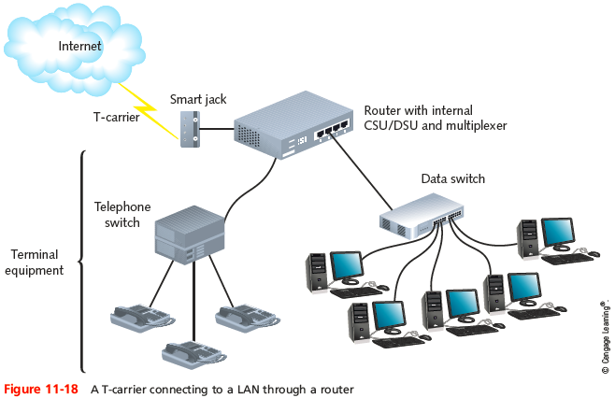
T-Carrier Connectivity
Notes:
T-Carrier Connectivity

Slide 36
Frame Relay
Frame relay
Group of Layer 2 protocols originally designed as a fast packet-switched network over ISDN
Today is used as the Data Link protocol for various circuit interfaces and media
Data-link connection identifier (DLCI)
Identifier routers read to determine which circuit to use for the frame
Frame relay is a connection-oriented protocol
Notes:
Frame Relay
Frame relay
Group of Layer 2 protocols originally designed as a fast packet-switched network over ISDN
Today is used as the Data Link protocol for various circuit interfaces and media
Data-link connection identifier (DLCI)
Identifier routers read to determine which circuit to use for the frame
Frame relay is a connection-oriented protocol

Slide 37
Frame Relay
Supports two types of virtual circuits:
SVC (switched virtual circuit)
Connections established when parties need to transmit, then terminated after transmission is complete
PVC (permanent virtual circuit)
Connections established before data needs to be transmitted and are maintained after transmission
Advantage
Pay for only the amount of bandwidth required
Less expensive than other WAN technologies
Notes:
Frame Relay
Supports two types of virtual circuits:
SVC (switched virtual circuit)
Connections established when parties need to transmit, then terminated after transmission is complete
PVC (permanent virtual circuit)
Connections established before data needs to be transmitted and are maintained after transmission
Advantage
Pay for only the amount of bandwidth required
Less expensive than other WAN technologies

Slide 38
DSL (Digital Subscriber Line)
Operates over PSTN
Directly competes with T-1 and broadband cable
Requires repeaters for longer distances
Best suited for WAN local loop
Supports multiple data, voice channels
Over a single line
Uses advanced data modulation techniques
Data signal alters carrier signal properties
Amplitude or phase modulation
Notes:
DSL (Digital Subscriber Line)
Operates over PSTN
Directly competes with T-1 and broadband cable
Requires repeaters for longer distances
Best suited for WAN local loop
Supports multiple data, voice channels
Over a single line
Uses advanced data modulation techniques
Data signal alters carrier signal properties
Amplitude or phase modulation

Slide 39
Types of DSL
xDSL refers to all DSL varieties
ADSL, G.Lite, HDSL, SDSL, VDSL, SHDSL
Symmetrical vs. Asymmetrical
Downstream
Data travels from carrier’s switching facility to customer
Upstream
Data travels from customer to carrier’s switching facility
Notes:
Types of DSL
xDSL refers to all DSL varieties
ADSL, G.Lite, HDSL, SDSL, VDSL, SHDSL
Symmetrical vs. Asymmetrical
Downstream
Data travels from carrier’s switching facility to customer
Upstream
Data travels from customer to carrier’s switching facility

Slide 40
Types of DSL
Symmetrical vs. Asymmetrical (cont’d)
Asymmetrical
More throughput in one direction
Downstream throughput higher than upstream throughput
Best use: video conferencing, web surfing
Symmetrical
Equal capacity for upstream, downstream data
Examples: HDSL, SDSL, SHDSL
Best use: uploading, downloading significant data amounts
Notes:
Types of DSL
Symmetrical vs. Asymmetrical (cont’d)
Asymmetrical
More throughput in one direction
Downstream throughput higher than upstream throughput
Best use: video conferencing, web surfing
Symmetrical
Equal capacity for upstream, downstream data
Examples: HDSL, SDSL, SHDSL
Best use: uploading, downloading significant data amounts

Slide 41
Types of DSL
Modulation
Some create multiple narrow channels in the higher frequency range
A splitter must be installed at the carrier and at the customer’s premises to separate data from voice
Some require the use of a filter to prevent high-frequency DSL signals from reaching the telephone
Other types of DSL cannot use the same wire pair used for voice signals
Use the extra pair of wires contained in the telephone cable
Notes:
Types of DSL
Modulation
Some create multiple narrow channels in the higher frequency range
A splitter must be installed at the carrier and at the customer’s premises to separate data from voice
Some require the use of a filter to prevent high-frequency DSL signals from reaching the telephone
Other types of DSL cannot use the same wire pair used for voice signals
Use the extra pair of wires contained in the telephone cable

Slide 42
Types of DSL
Capacity and Maximum Line Length
Varies in terms of capacity and maximum line length
VDSL carries as much as 52 Mbps can extend only a maximum of 1000 feet
Most popular form of DSL is ADSL
Latest version is ADSL2+M
Provides maximum throughput of 24 Mbps downstream and 3.3 Mbps upstream
Notes:
Types of DSL
Capacity and Maximum Line Length
Varies in terms of capacity and maximum line length
VDSL carries as much as 52 Mbps can extend only a maximum of 1000 feet
Most popular form of DSL is ADSL
Latest version is ADSL2+M
Provides maximum throughput of 24 Mbps downstream and 3.3 Mbps upstream

Slide 43
DSL Connectivity
ADSL: common example on home computer
Establish TCP connection
Transmit through DSL modem
Internal or external
Splitter separates incoming voice, data signals
May connect to switch or router
Notes:
DSL Connectivity
ADSL: common example on home computer
Establish TCP connection
Transmit through DSL modem
Internal or external
Splitter separates incoming voice, data signals
May connect to switch or router

Slide 44
DSL Connectivity
ADSL (cont’d.)
DSL modem forwards modulated signal to local loop
Signal continues over four-pair UTP wire
Distance less than 18,000 feet: signal combined with other modulated signals in telephone switch
Carrier’s remote switching facility
Splitter separates data signal from voice signals
Request sent to DSLAM (DSL access multiplexer)
Request issued from carrier’s network to Internet backbone
Notes:
DSL Connectivity
ADSL (cont’d.)
DSL modem forwards modulated signal to local loop
Signal continues over four-pair UTP wire
Distance less than 18,000 feet: signal combined with other modulated signals in telephone switch
Carrier’s remote switching facility
Splitter separates data signal from voice signals
Request sent to DSLAM (DSL access multiplexer)
Request issued from carrier’s network to Internet backbone

Slide 45
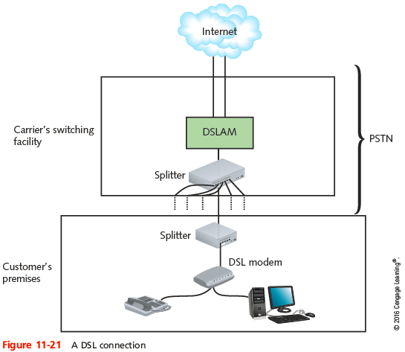
DSL Connectivity
Notes:
DSL Connectivity

Slide 46
Broadband Cable
Cable companies connectivity option
Based on coaxial cable wiring used for TV signals
Theoretical transmission speeds
100 Mbps downstream; 20 Mbps upstream
Real transmission
10 Mbps downstream; 3 Mbps upstream
Transmission limited ( throttled)
Shared physical connections
Best uses
Web surfing or network data download
Notes:
Broadband Cable
Cable companies connectivity option
Based on coaxial cable wiring used for TV signals
Theoretical transmission speeds
100 Mbps downstream; 20 Mbps upstream
Real transmission
10 Mbps downstream; 3 Mbps upstream
Transmission limited ( throttled)
Shared physical connections
Best uses
Web surfing or network data download

Slide 47
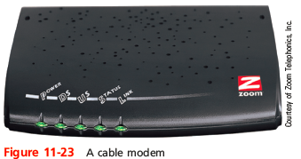
Broadband Cable
Cable modem
Modulates, demodulates transmission, reception signals via cable wiring
Operates at Physical and Data Link layer
May connect to connectivity device
Notes:
Broadband Cable
Cable modem
Modulates, demodulates transmission, reception signals via cable wiring
Operates at Physical and Data Link layer
May connect to connectivity device

Slide 48
Broadband Cable
Infrastructure required
HFC (hybrid fiber-coax)
Expensive fiber-optic link supporting high frequencies
Connects cable company’s offices to node
Cable drop
Connects node to customer’s business or residence
Fiber-optic or coaxial cable
Connects to head end
Provides dedicated connection
Many subscribers share same local line, throughput
Notes:
Broadband Cable
Infrastructure required
HFC (hybrid fiber-coax)
Expensive fiber-optic link supporting high frequencies
Connects cable company’s offices to node
Cable drop
Connects node to customer’s business or residence
Fiber-optic or coaxial cable
Connects to head end
Provides dedicated connection
Many subscribers share same local line, throughput

Slide 49
ATM (Asynchronous Transfer Mode)
Functions at the Data Link layer
Asynchronous communications method
Nodes do not conform to predetermined schemes
Specifying data transmissions timing
Each character transmitted
Start and stop bits
Specifies Data Link layer framing techniques
Fixed packet size
Packet (cell)
48 data bytes plus 5-byte header
Notes:
ATM (Asynchronous Transfer Mode)
Functions at the Data Link layer
Asynchronous communications method
Nodes do not conform to predetermined schemes
Specifying data transmissions timing
Each character transmitted
Start and stop bits
Specifies Data Link layer framing techniques
Fixed packet size
Packet (cell)
48 data bytes plus 5-byte header

Slide 50
ATM (Asynchronous Transfer Mode)
Smaller packet size requires more overhead
Decrease potential throughput
Cell efficiency compensates for loss
ATM relies on virtual circuits
ATM considered packet-switching technology
Virtual circuits provide circuit switching advantage
Reliable connection
Allows specific QoS (quality of service) guarantee
Important for time-sensitive applications
Notes:
ATM (Asynchronous Transfer Mode)
Smaller packet size requires more overhead
Decrease potential throughput
Cell efficiency compensates for loss
ATM relies on virtual circuits
ATM considered packet-switching technology
Virtual circuits provide circuit switching advantage
Reliable connection
Allows specific QoS (quality of service) guarantee
Important for time-sensitive applications

Slide 51
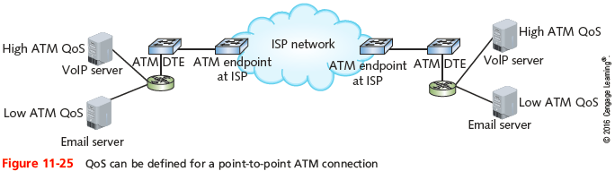
ATM (Asynchronous Transfer Mode)
Notes:
ATM (Asynchronous Transfer Mode)

Slide 52
ATM (Asynchronous Transfer Mode)
Compatibility
Other leading network technologies
Cells support multiple higher-layer protocol
LANE (LAN Emulation)
Allows integration with Ethernet, token ring network
Encapsulates incoming Ethernet or token ring frames
Converts to ATM cells for transmission
Throughput: 25 Mbps to 622 Mbps
Cost: relatively expensive
Notes:
ATM (Asynchronous Transfer Mode)
Compatibility
Other leading network technologies
Cells support multiple higher-layer protocol
LANE (LAN Emulation)
Allows integration with Ethernet, token ring network
Encapsulates incoming Ethernet or token ring frames
Converts to ATM cells for transmission
Throughput: 25 Mbps to 622 Mbps
Cost: relatively expensive

Slide 53
SONET (Synchronous Optical Network)
Key strengths
WAN technology interoperability
Fast data transfer rates
Simple link additions, removals
High degree of fault tolerance (self-healing)
Synchronous
Data transmitted and received by nodes must conform to timing scheme
Internationally, SONET is known as SDH (Synchronous Digital Hierarchy)
Notes:
SONET (Synchronous Optical Network)
Key strengths
WAN technology interoperability
Fast data transfer rates
Simple link additions, removals
High degree of fault tolerance (self-healing)
Synchronous
Data transmitted and received by nodes must conform to timing scheme
Internationally, SONET is known as SDH (Synchronous Digital Hierarchy)

Slide 54
SONET (Synchronous Optical Network)
SONET ring
Begins, ends at telecommunications carrier’s facility
Connects organization’s multiple WAN sites in ring fashion
Connect with multiple carrier facilities
Additional fault tolerance
Terminates at multiplexer
Easy SONET ring connection additions, removals
Data rate of a particular SONET ring is indicated by its OC (Optical Carrier) level
Notes:
SONET (Synchronous Optical Network)
SONET ring
Begins, ends at telecommunications carrier’s facility
Connects organization’s multiple WAN sites in ring fashion
Connect with multiple carrier facilities
Additional fault tolerance
Terminates at multiplexer
Easy SONET ring connection additions, removals
Data rate of a particular SONET ring is indicated by its OC (Optical Carrier) level

Slide 55
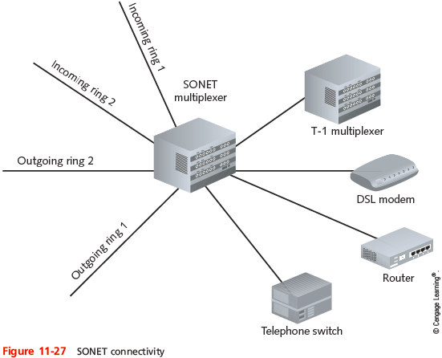
SONET (Synchronous Optical Network)
Notes:
SONET (Synchronous Optical Network)

Slide 56
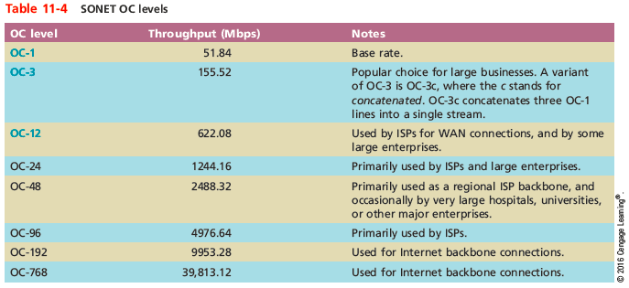
SONET (Synchronous Optical Network)
Notes:
SONET (Synchronous Optical Network)

Slide 57
MPLS (Multiprotocol Label Switching)
MPLS
Extremely fast
Can handle various types of payloads
Often used by ISPs on their own networks for moving traffic from one customer site to another
Becoming the solution of choice for many enterprises to connect their branch offices
Notes:
MPLS (Multiprotocol Label Switching)
MPLS
Extremely fast
Can handle various types of payloads
Often used by ISPs on their own networks for moving traffic from one customer site to another
Becoming the solution of choice for many enterprises to connect their branch offices

Slide 58
Metro Ethernet
Metro Ethernet Forum (MEF)
An alliance of over 220 industry organizations worldwide
Developing ways to send Ethernet traffic across MAN and WAN connections
Carrier-Ethernet Transport (CET)
An Ethernet-based transport solution designed to overcome weaknesses of implementing Ethernet outside the LAN environment
Notes:
Metro Ethernet
Metro Ethernet Forum (MEF)
An alliance of over 220 industry organizations worldwide
Developing ways to send Ethernet traffic across MAN and WAN connections
Carrier-Ethernet Transport (CET)
An Ethernet-based transport solution designed to overcome weaknesses of implementing Ethernet outside the LAN environment

Slide 59
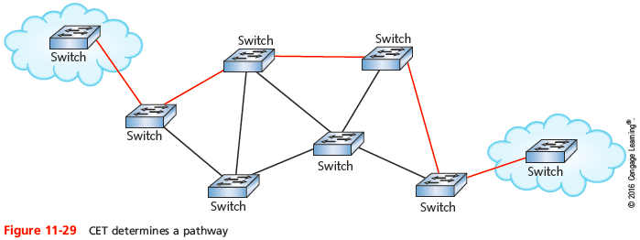
Metro Ethernet
Notes:
Metro Ethernet

Slide 60
Metro Ethernet
Metro Ethernet advantages:
Streamlined connections
Cost efficiency
Scalability
Familiarity
Hardware
Notes:
Metro Ethernet
Metro Ethernet advantages:
Streamlined connections
Cost efficiency
Scalability
Familiarity
Hardware

Slide 61
Wireless WANs
Wireless broadband
Specifically designed for:
High-throughput; long-distance digital data exchange
On wireless WANs
Downstream data transmission is typically faster than upstream transmission
Downstream may also be called downlink
Upstream (uplink) refers to the connection between a client’s transceiver and the carrier’s antenna
Notes:
Wireless WANs
Wireless broadband
Specifically designed for:
High-throughput; long-distance digital data exchange
On wireless WANs
Downstream data transmission is typically faster than upstream transmission
Downstream may also be called downlink
Upstream (uplink) refers to the connection between a client’s transceiver and the carrier’s antenna

Slide 62
802.16 (WiMAX)
WiMAX (Worldwide Interoperability for Microwave Access)
Line-of-sight transmission between two antennas for use with fixed clients
Use of frequencies in the 2-to-11 or 11-to-66 GHz range
Licensed or nonlicensed frequencies
Use of MIMO
Ability to transmit and receive signals up to 30 miles
With fixed antennas
QoS provisions
Notes:
802.16 (WiMAX)
WiMAX (Worldwide Interoperability for Microwave Access)
Line-of-sight transmission between two antennas for use with fixed clients
Use of frequencies in the 2-to-11 or 11-to-66 GHz range
Licensed or nonlicensed frequencies
Use of MIMO
Ability to transmit and receive signals up to 30 miles
With fixed antennas
QoS provisions

Slide 63
802.16 (WiMAX)
WiMAX
Offers installation savings and benefits over other broadband services
Well suited to rural customers
Provides network access for mobile devices
Can act as the backhaul link
An intermediate connection between subscriber networks and a telecommunications carrier’s network
Notes:
802.16 (WiMAX)
WiMAX
Offers installation savings and benefits over other broadband services
Well suited to rural customers
Provides network access for mobile devices
Can act as the backhaul link
An intermediate connection between subscriber networks and a telecommunications carrier’s network

Slide 64
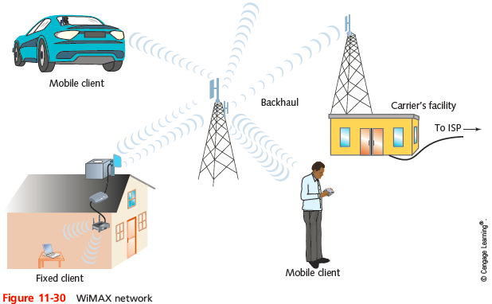
802.16 (WiMAX)
Notes:
802.16 (WiMAX)

Slide 65
802.16 (WiMAX)
Newer version of WiMAX, known as WiMAX Release 2 (WiMAX 2)
Based on the 802.16m standard
Positioned to compete favorably with cellular data services
Backward compatible with 802.16e equipment
Notes:
802.16 (WiMAX)
Newer version of WiMAX, known as WiMAX Release 2 (WiMAX 2)
Based on the 802.16m standard
Positioned to compete favorably with cellular data services
Backward compatible with 802.16e equipment

Slide 66
Cellular
Initially designed for analog phone service
Today it can deliver data and voice
Cellular technology generations
1G: analog
2G: digital transmission up to 240Kbps
3G: data rates up to 384Kbps
Data communications use packet switching
4G: all-IP, packet switched network for data and voice
Specifies throughputs of 100 Mbps for fast-moving clients; 1 Gbps for slow-moving clients
Notes:
Cellular
Initially designed for analog phone service
Today it can deliver data and voice
Cellular technology generations
1G: analog
2G: digital transmission up to 240Kbps
3G: data rates up to 384Kbps
Data communications use packet switching
4G: all-IP, packet switched network for data and voice
Specifies throughputs of 100 Mbps for fast-moving clients; 1 Gbps for slow-moving clients

Slide 67
Cellular
Use one of two competing voice technologies:
GSM (Global System for Mobile Communications)
CDMA (Code Division Multiple Access)
Network infrastructure
Cells served by antenna and base station
Controller assigns mobile clients frequencies
Cell size depends on:
Network’s access method
Region’s topology, population, and amount of cellular traffic
Notes:
Cellular
Use one of two competing voice technologies:
GSM (Global System for Mobile Communications)
CDMA (Code Division Multiple Access)
Network infrastructure
Cells served by antenna and base station
Controller assigns mobile clients frequencies
Cell size depends on:
Network’s access method
Region’s topology, population, and amount of cellular traffic

Slide 68
Cellular
MSC (Mobile switching center)
Also called an MTSO
Each base station is connected to an MSC by a wireless link or fiber-optic cabling (see Figure 11-33)
Basic infrastructure
HSPA+ (High Speed Packet Access Plus)
3G technology
LTE (Long Term Evolution)
4G technology
Notes:
Cellular
MSC (Mobile switching center)
Also called an MTSO
Each base station is connected to an MSC by a wireless link or fiber-optic cabling (see Figure 11-33)
Basic infrastructure
HSPA+ (High Speed Packet Access Plus)
3G technology
LTE (Long Term Evolution)
4G technology

Slide 69
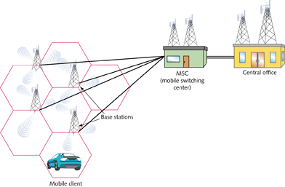
Cellular
Figure 11-33 Cellular network
Notes:
Cellular

Slide 70
Satellite
Used to deliver:
Digital television and radio signals
Voice and video signals
Cellular and paging signals
Data services to mobile clients in remote locations
Satellite Orbits
Geosynchronous Earth orbit (GEO)
Satellites orbit at same rate Earth turns
Most popular
Notes:
Satellite
Used to deliver:
Digital television and radio signals
Voice and video signals
Cellular and paging signals
Data services to mobile clients in remote locations
Satellite Orbits
Geosynchronous Earth orbit (GEO)
Satellites orbit at same rate Earth turns
Most popular

Slide 71
Satellite
Satellite Orbits (cont’d)
Downlink
Satellite transponder transmits signal to Earth-based receiver
Typical satellite
24 to 32 transponders
Unique downlink frequencies
Frequencies, as well as satellite’s orbit location are assigned and regulated by the FCC
Notes:
Satellite
Satellite Orbits (cont’d)
Downlink
Satellite transponder transmits signal to Earth-based receiver
Typical satellite
24 to 32 transponders
Unique downlink frequencies
Frequencies, as well as satellite’s orbit location are assigned and regulated by the FCC

Slide 72
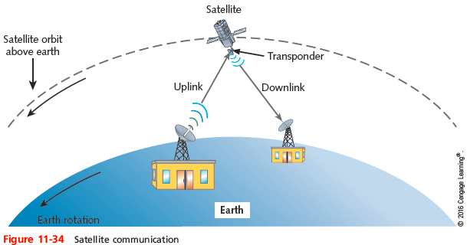
Satellite
Notes:
Satellite

Slide 73
Satellite
Satellite frequency bands
L-band—1.5–2.7 GHz
S-band—2.7–3.5 GHz
C-band—3.4–6.7 GHz
Ku-band (K-under band) —12–18 GHz
K-band—18–27 GHz
Ka-band (K-above band)—18–40 GHz
Within each band
Frequencies used for uplink and downlink transmissions differ
Notes:
Satellite
Satellite frequency bands
L-band—1.5–2.7 GHz
S-band—2.7–3.5 GHz
C-band—3.4–6.7 GHz
Ku-band (K-under band) —12–18 GHz
K-band—18–27 GHz
Ka-band (K-above band)—18–40 GHz
Within each band
Frequencies used for uplink and downlink transmissions differ

Slide 74
Satellite
Satellite Internet Services
Subscriber uses small satellite dish antenna, receiver
Exchanges signals with provider’s satellite network
Typically asymmetrical
Bandwidth shared among many subscribers
Throughput controlled by service provider
Slower, more latency than other wireless WAN options
Client equipment is more expensive than that required by WiMAX, HSPA+, or LTE
Notes:
Satellite
Satellite Internet Services
Subscriber uses small satellite dish antenna, receiver
Exchanges signals with provider’s satellite network
Typically asymmetrical
Bandwidth shared among many subscribers
Throughput controlled by service provider
Slower, more latency than other wireless WAN options
Client equipment is more expensive than that required by WiMAX, HSPA+, or LTE

Slide 75
Troubleshooting WAN Issues
There are steps to take when troubleshooting a problem with a WAN connection
Before calling your ISP
Preventative measures can be implemented to avoid having the problem in the first place
Notes:
Troubleshooting WAN Issues
There are steps to take when troubleshooting a problem with a WAN connection
Before calling your ISP
Preventative measures can be implemented to avoid having the problem in the first place

Slide 76
Company Policies
Consider incorporating the following into your company’s security policy:
Fair access and utilization limits
Throttling
Blocking
Notes:
Company Policies
Consider incorporating the following into your company’s security policy:
Fair access and utilization limits
Throttling
Blocking

Slide 77
Common ISP Problems
Need to know the difference between ISP’s equipment and equipment that belongs to the subscriber
Equipment located at the customer’s premises, regardless of who owns it and who is responsible, is called customer premise equipment (CPE)
Equipment belonging to the ISP should only be serviced by the ISP’s technicians
Even if located on the customer’s side of demarc
Notes:
Common ISP Problems
Need to know the difference between ISP’s equipment and equipment that belongs to the subscriber
Equipment located at the customer’s premises, regardless of who owns it and who is responsible, is called customer premise equipment (CPE)
Equipment belonging to the ISP should only be serviced by the ISP’s technicians
Even if located on the customer’s side of demarc

Slide 78
Common ISP Problems
Devices commonly found at or near the demarc:
NIU
Line drivers
CSU/DSU
Common issues to look for:
Interface error
Routing loops
Router misconfiguration
DNS issues
Interference
Notes:
Common ISP Problems
Devices commonly found at or near the demarc:
NIU
Line drivers
CSU/DSU
Common issues to look for:
Interface error
Routing loops
Router misconfiguration
DNS issues
Interference

Slide 79
Summary
Not all businesses need the same kind of WAN
A WAN in which each site is directly connected to no more than two other sites is known as a bus topology WAN
In a ring topology WAN, each site is connected to two other sites to form a ring patter
In a star topology WAN, a single site acts as the central connection point for several other points
A mesh topology WAN incorporates many directly interconnected sites
Notes:
Summary
Not all businesses need the same kind of WAN
A WAN in which each site is directly connected to no more than two other sites is known as a bus topology WAN
In a ring topology WAN, each site is connected to two other sites to form a ring patter
In a star topology WAN, a single site acts as the central connection point for several other points
A mesh topology WAN incorporates many directly interconnected sites

Slide 80
Summary
ISDN is a legacy technology that is now almost completely phased out
Multiplexing enables a single T-1 circuit to carry 24 channels, each capable of 64-Kbps throughput
The speed of a T-carrier depends on its signal level
For T-1s using STP, repeaters must regenerate the signal approximately every 6000 feet
Frame relay was originally designed as a fast packet-switched network over ISDN
DSL operates over the PSTN
Notes:
Summary
ISDN is a legacy technology that is now almost completely phased out
Multiplexing enables a single T-1 circuit to carry 24 channels, each capable of 64-Kbps throughput
The speed of a T-carrier depends on its signal level
For T-1s using STP, repeaters must regenerate the signal approximately every 6000 feet
Frame relay was originally designed as a fast packet-switched network over ISDN
DSL operates over the PSTN

Slide 81
Summary
Broadband cable is based on the coaxial cable used for TV signals
Signals transmitted via power lines are subject to much more noise than DSL or cable services
ATM specifies Data Link layer framing techniques
SONET is a high-bandwidth WAN signaling technique developed for fiber-optic cabling
MPLS is extremely fast and can carry various types of payloads
The 802.16 standards are known as WiMAX
Notes:
Summary
Broadband cable is based on the coaxial cable used for TV signals
Signals transmitted via power lines are subject to much more noise than DSL or cable services
ATM specifies Data Link layer framing techniques
SONET is a high-bandwidth WAN signaling technique developed for fiber-optic cabling
MPLS is extremely fast and can carry various types of payloads
The 802.16 standards are known as WiMAX

Slide 82
Summary
Geosynchronous earth orbit means that satellites orbit the Earth at the same rate as the Earth turns
Within each satellite band, frequencies used for uplink and downlink transmission differ to help ensure that signals traveling in one direction do not interfere with signals traveling in the other direction
Equipment located at the customer’s premises, regardless of who owns it, is called customer premise equipment (CPE)
Notes:
Summary
Geosynchronous earth orbit means that satellites orbit the Earth at the same rate as the Earth turns
Within each satellite band, frequencies used for uplink and downlink transmission differ to help ensure that signals traveling in one direction do not interfere with signals traveling in the other direction
Equipment located at the customer’s premises, regardless of who owns it, is called customer premise equipment (CPE)

