Slide 1
Parallel programs
Inf-2202 Concurrent and Data-intensive Programming
Fall 2018
Lars Ailo Bongo (larsab@cs.uit.no)

Slide 2
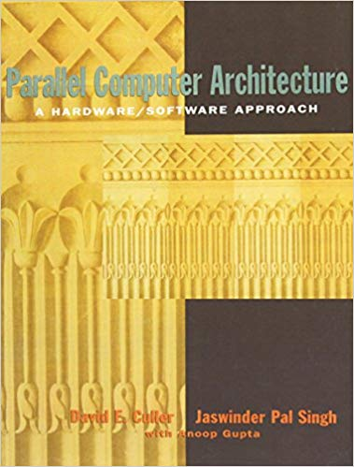

Slide 3
Parallel programs
Supercomputing
Scientific applications
Parallel programming was hard
Parallel architectures were expensive
Still important!
Data intensive computing
Will return to this topic
Server applications
Databases, Web servers, App servers, etc
Desktop applications
Games, image processing, etc
Mobile phone applications
Multimedia, sensor based, etc
GPU and hardware accelerator applications

Slide 4
Outline
Parallel architectures
Fundamental design issues
Case study
Parallelization process
Examples

Slide 5
Parallel architectures
A parallel computer is “a collection of processing elements that communicate and cooperate to solve large problems fast” (Almasi and Gottlieb, 1989)
Conventional computer architecture
+ communication among processes
+ coordination among processes
Notes:
Highly parallel computing (book), Almasi and Gottlieb, 1989.

Slide 6
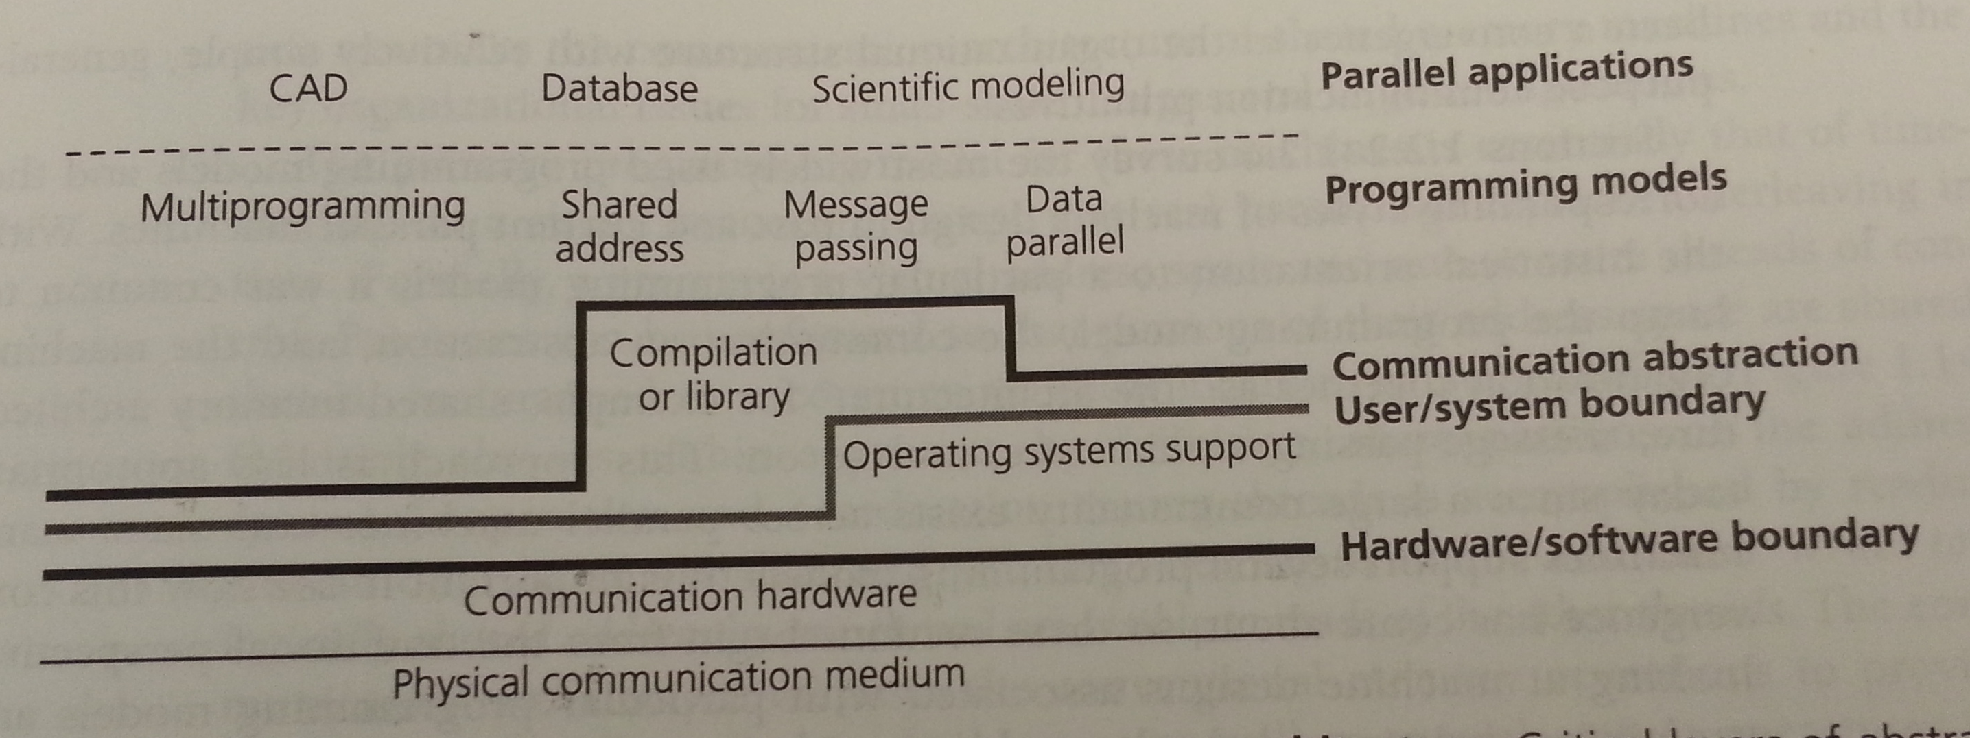
Communication architecture
Hardware/ software boundary?
User/ system boundary?
Defines:
Basic communication operations
Organizational structures to realize these operations

Slide 7
Parallel architectures
Shared address space
Message passing
Data parallel processing
Bulk synchronous processing (Valiant 1990)
Google’s Pregel (Malewicz, et al., 2010)
MapReduce (Dean & Ghemawat, 2010) and Spark (Zaharia et al, 2012)
Dataflow architectures (wikipedia1, wikipedia2)
VHDL, Verilog, Linda, Yahoo Pipes(?), Galaxy (?)
Notes:
BSP: http://dl.acm.org/citation.cfm?id=79181&CFID=355958399&CFTOKEN=92782375
Pregel: dl.acm.org/citation.cfm?id=1807184
BSV: http://dl.acm.org/citation.cfm?id=2442995
J. Dean and S. Ghemawat, “MapReduce: a flexible data processing tool,” Commun. ACM, vol. 53, no. 1, p. 72, Jan. 20
M. Zaharia, M. Chowdhury, T. Das, A. Dave, J. Ma, M. McCauley, M. J. Franklin, S. Shenker, and I. Stoica, “Resilient distributed datasets: a fault-tolerant abstraction for in-memory cluster computing,” in NSDI’12 Proceedings of the 9th USENIX conference on Networked Systems Design and Implementation, 2012.
Wikipedia1: http://en.wikipedia.org/wiki/Dataflow_architecture
Wikipedia2: http://en.wikipedia.org/wiki/Dataflow_programming

Slide 8
Outline
Parallel architectures
Fundamental design issues
Case study
Parallelization process
Examples

Slide 9
Fundamental design issues
Communication abstraction
Programming model requirements
Naming
Ordering
Communication and replication
Performance

Slide 10
Communication abstractions
Well defined operations
Suitable for optimization
Communication abstractions in Pthreads?

Slide 11
Programming model
One or more threads of control operating on data
What data can be named by which threads
What operations can be performed on the named data
What ordering exists among those operations
Programming model for a uniprocessor?
Pthreads programming model?
Why need for explicit synchronization primitives?

Slide 12
Naming
Critical at each level of the architecture

Slide 13
Operations
Operations that can be performed on the data
Pthreads?
More exotic?

Slide 14
Ordering
Important at all layers in the architecture
Performance tricks
If implicit ordering is not enough; need synchronization:
Mutual exclusion
Events / condition variables
Point-to-point
Global
Channels?

Slide 15
Communication and replication
Related to each other
Caching
IPC
Binding of data:
Write
Read
Data transfer
Data copy
IPC

Slide 16
Performance
Data types, addressing modes, and communication abstractions specifies naming, ordering and synchronization for shared objects
Performance characteristics specifies how they are actually used
Metrics
Latency: the time for an operation
Bandwidth: rate at which operations are performed
Cost: impact on execution time

Slide 17
Outline
Parallel architectures
Fundamental design issues
Case study
Parallelization process
Examples
Notes:
BLAST
KNNImpute
Deduplication engine

Slide 18
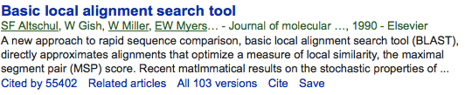

The Basic Local Alignment Search Tool (BLAST)
BLAST finds regions of local similarity between sequences. The program compares nucleotide or protein sequences to sequence databases and calculates the statistical significance of matches.
Popular to use
Popular to parallelize

Slide 19
Outline
Parallel architectures
Fundamental design issues
Case study
Parallelization process
Examples

Slide 20
Parallelization process
Goals:
Good performance
Efficient resource utilization
Low developer effort
May be done at any layer

Slide 21
Parallelization process (2)
Task: piece of work
Process/thread: entity that performs the work
Processor/core: physical processor cores

Slide 22
Parallelization process (3)
Decomposition of the computation into tasks
Assignment of tasks to processes
Orchestration of necessary data access, communication, and synchronization among processes
Mapping of processes to cores

Slide 23
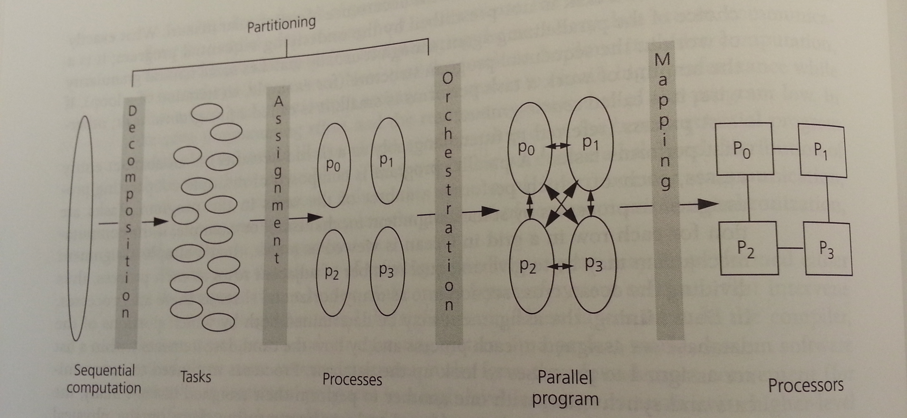
Steps in the parallelization process

Slide 24
Decomposition
Split computation into a collection of tasks
Algorithmic
Task granularity limits parallelism
➔ Amdahl’s law

Slide 25
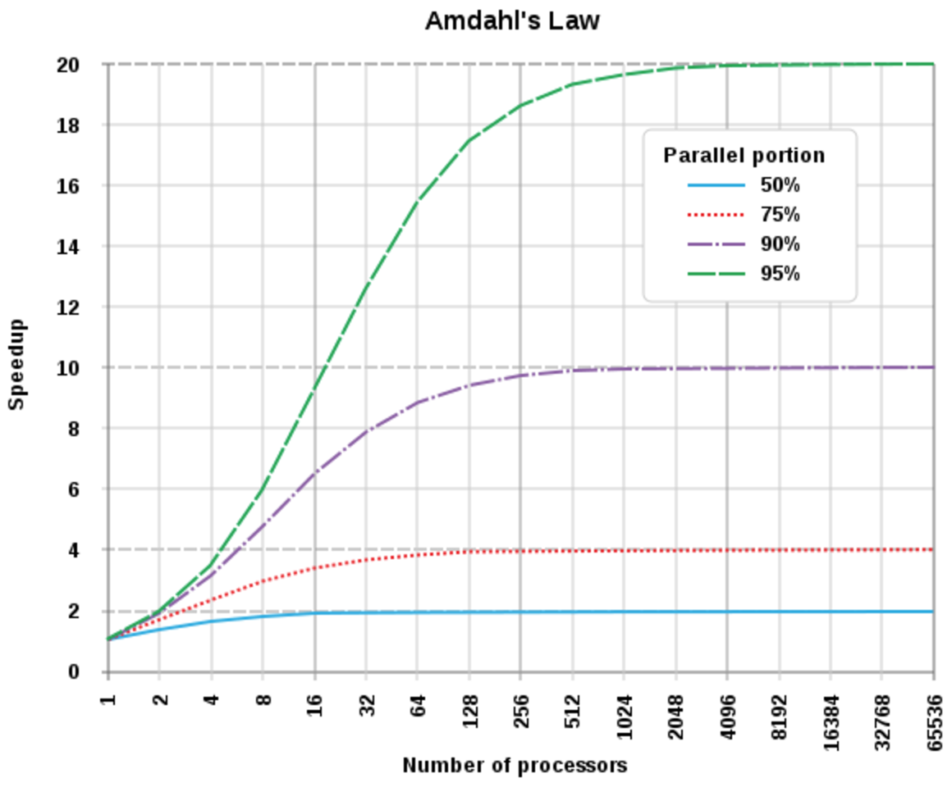
Speedup against number of processors
Image CC-BY-SA Daniels220 on wikipedia

Slide 26
Assignment
Algorithmic
Goal: load balancing
All processes should do equal amount of work
Important for performance
Goal: reduce communication volume
Send minimum amount of data
Two types:
Static
Dynamic

Slide 27
Orchestration
Specific to computer architecture, programming model, and programming language
Goals:
Reduce communication cost
Reduce synchronization cost
Locality of data
Efficient scheduling
Reduce overhead

Slide 28
Mapping
Specific to system or programming environment
Parallel system resource allocator
Queuing systems
OS scheduler

Slide 29
Goals of parallelization process
Step | Architecture dependent? | Major performance goals
Decomposition | Mostly no | Expose enough concurrency but not too much
Assignment | Mostly no | Balance workload Reduce communication volume
Orchestration | Yes | Reduce noninherent communication via data locality Reduce communication and synchronization cost as seen by the processor Reduce serialization to shared resources Schedule tasks to satisfy dependencies early
Mapping | Yes | Put related threads on the same core if necessary Exploit locality in chip and network topology

Slide 30
Summary
Fundamental design issues for parallel systems
How to write a parallel program
Examples

