Slide 1
Performance evaluation
Inf-2202 Concurrent and Data-intensive Programming
Fall 2018
Lars Ailo Bongo (larsab@cs.uit.no)

Slide 2
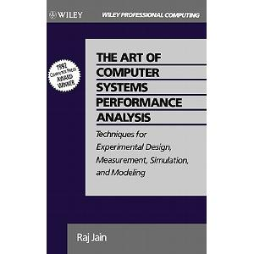
Source / recommended reading

Slide 3
Outline
Performance evaluation
Measurement
Simulation
Modeling
Best practices

Slide 4
Steps for a performance evaluation study
State the goals of the study and define the system boundaries
List system services and possible outcomes
Select performance metrics
List system and workload parameters
Select factors and their values
Select evaluation techniques
Select the workload
Design the experiments
Analyze and interpret the data
Presents the results. Start over, if necessary
Notes:
Box 2.2 in The art of computer systems performance analysis. Raj Jain. Wiley. 1991.

Slide 5
How to avoid common mistakes
Is the system correctly defined and the goals clearly stated?
Are the goals stated in an unbiased manner?
Have all steps of the analysis followed systematically?
Is the problem clearly understood before analyzing it?
Are the performance metrics relevant for this problem?
Is the workload correct for this problem?
Is the evaluation technique appropriate?
Is the list of parameters that affect performance that affect performance complete?
Notes:
Box 2.1 in The art of computer systems performance analysis. Raj Jain. Wiley. 1991.

Slide 6
How to avoid common mistakes
Have all parameters that affect performance been chosen as factors to be varied?
Is the experimental design efficient in terms of time and results?
Is the level of detail proper?
Is the measured data presented with analysis and interpretation?
Is the analysis statistically correct?
Has the sensitivity analysis been done?
Would errors in the input cause an insignificant change in the results?

Slide 7
How to avoid common mistakes
Have the outliers in the input or output been treated properly?
Have the future changes in the system and workload been taken into account?
Has the variance of input been taken into account?
Has the variance of the results been analyzed?
Is the analysis easy to explain?
Is the presentation style suitable for its audience?
Have the results been graphically presented as much as possible?
Are the assumptions and limitations of the analysis clearly documented?

Slide 8
Selection of techniques and metrics
Evaluation technique
Modeling
Simulation
Measurements
Metrics
Wall-clock time, system time, latency, throughput, scalability, correctness, availability, utilization, smoothness, usability…

Slide 9
Selection of technique
Criterion | Modeling | Simulation | Measurement
Stage | Any | Any | Post-prototype
2. Time required | Small | Medium | Varies
3. Tools | Analyst | Computer languages/ simulator | Instrumentation
4. Accuracy | Low | Moderate | Varies
5. Trade-off evaluation | Easy | Moderate | Difficult
6. Cost | Small | Medium | High
7. Scalability | Low | Medium | High
Notes:
Slightly modified table 3.1 from The art of computer systems performance analysis. Raj Jain. Wiley. 1991.

Slide 10
Selection of performance metrics
Type
Response time, turnaround time, reaction time
Throughput, bandwidth/ capacity
Efficiency, utilization, idle time
Reliability, availability, mean time to failure
Cost/performance ratio
Scalability
Energy efficiency
…
Mean, max, median, minimum?
Variability
Completeness

Slide 11
Performance requirements
Specific
Measurable
Acceptable
Realizable
Thorough

Slide 12
Outline
Performance evaluation
Measurement
Simulation
Modeling
Best practices

Slide 13
Performance measurements
Essence: monitor the system while it is being subjected to a particular workload
Need to understand system
Need to understand how system is used (workload)
What are the different types of workloads?
Which workloads are used in related work?
How are representative workload types selected?
How is the measured workload data summarized?
How is the system performance monitored?
How can the workload be placed on the system in a controlled manner?
How are the evaluation results presented?

Slide 14
Workload types
Real workload
Obviously realistic
Difficult to repeat
Synthetic workload
Similar characteristics to real workload
Easier to work with (port, scale, repeat, analyze)
Micro-benchmark: measure one type of operation
Kernel: small part of application
Synthetic program: simplified application
Benchmark: one (or more) applications

Slide 15
Workload selection
Services exercised
Level of detail
Representativeness
Repeatability

Slide 16
Workload characterization
Various statistical techniques
Will skip this part

Slide 17
Monitors
A tool to observe activities in a system
Observe performance
Collect performance statistics
Analyze the data
Display results
Central part of any performance measurement

Slide 18
Terminology
Event: change in system state
Trace: log of events (with timestamps and additional information)
Overhead: perturbation
Domain: set of observable activities
Input rate/ sample rate: maximum frequency of events that can be observed
Resolution: coarseness of the observed information
Input width: event size (rate * width = storage overhead)

Slide 19
Monitor classification
Software/ hardware
Online/ offline
Sampling / event-driven
Automated analysis?
Adaptive system?

Slide 20
Software monitor - design issues
Activation mechanism: trap, trace, timer
Buffer size and number of buffers
Buffer overflow
Data compression or online analysis
On/off switch
Programming language
Priority
Exception monitoring

Slide 21
Software monitor – common layers
Management: decide what parameters and states to change
Console: control system parameters and states
Interpretation: make use of results
Presentation: present analysis results
Analysis: analyze gathered data
Collection: collect gathered data
Observation: gather raw data

Slide 22
Software monitor – common layers
Management
Console
Interpretation
Presentation
Analysis
Collection
Observation
Decide what parameters and states to change
Implicit spying (for example monitor a bus)
Explicit instrumentation (add timer calls)
Probing (send requests)

Slide 23
Experimental design
Goal: obtain maximum information with minimum number of experiments

Slide 24
Terminology
Response (performance) variable
Factors
Levels
Primary factors
Secondary factors
Replication
Design
Experimental unit
Interactions

Slide 25
Common mistakes
Unclear goals
Ignoring variation due to experimental variation
Not controlling important parameters
Not isolating different factors
Using simple one-factor-at-a-time design
Conducting to many experiments

Slide 26
Experimental designs
Simple design
Start with a typical configuration
Vary one factor at a time
Analyze how that factor effects performance
Advantage: few experiments
Disadvantage: not statistically efficient, does not take into account factor interaction
Not recommended

Slide 27
Experimental designs
Simple design
Full factorial design
Utilize every possible combination of all levels of all factors
Advantage: full coverage
Disadvantage: cost of study
In practice:
Reduce number of levels per factor
Reduce the number of factors
Use fractional design

Slide 28
Experimental designs
Simple design
Full factorial design
Fractional factorial design
If full factorial design not practical
Change several factors at a time
Must know how to design such an experiment (not covered )

Slide 29
Experimental design steps (for your master thesis)
Find a good paper with related work
Study experiment goals and presentation
Study experimental methodology
Copy-and-modify methodology
Conduct experiments

Slide 30
Issues not covered
What to do with the monitored data
Performance tuning
Capacity tuning
How to present the results
How to cheat when presenting the results
Probability theory
Statistics
Experimental analysis

Slide 31
Outline
Performance evaluation
Measurement
Simulation
Modeling
Best practices

Slide 32
Simulation
Simulation is the imitation of the operation of a real-world process or system over time [wikipedia]
If system is not available
If experimental environment is not available
Easy to compare several alternatives (workloads, designs, environments)
Must be designed to provide realistic results
Many simulators available
Can simulate a part of a system

Slide 33
Checklist
Before developing:
Is the goal properly specified?
Is the level of detail appropriate for the goal?
Checks during development
Is the model reviewed regularly by end user?
Is the model documented?
Checks during simulation:
Is the simulation length appropriate?
Are the initial transients removed before computation?
Has the model been verified thoroughly?
Has the model been validated before using its results?
If there are any surprising results, have they been validated?

Slide 34
Common mistakes
Inappropriate level of detail
Improper language
Unverified models
Invalid models
Improperly handled initial conditions
Too short simulations
Notes:
Box 24.1 in The art of computer systems performance analysis. Raj Jain. Wiley. 1991.

Slide 35
Terminology
Emulation: duplicate functions of guest system on host
Focus: exact reproduction of behavior
State variables: defines state of system
Event: change in system state
Continuous-time model: system state is defined at all times
Discrete-time model: system state only defined at particular instants of time

Slide 36
Terminology
Continuous state model
Discrete state model
Deterministic model: output can be predicted with certainty
Probabilistic model: different result for same input parameters
Static model: time is not a variable
Dynamic model: time is a variable
Linear model
Non-linear model

Slide 37
Terminology
Open model: input is external to model
Closed model: no external input
Stable model: behavior settles eventually
Unstable model: behavior consciously changing

Slide 38
Types of simulation
Emulation
Monte Carlo
Trace-driven
Discrete-event

Slide 39
Simula
Simulation languages (Simula I, Simula 67)
Ole-Johan Dahl, Kristen Nygaard
Norsk Regnesentral, 1960s
First object oriented language
Turing award 2001
IEEE John von Neumann Medal 2002

Slide 40
Not covered
Analysis of simulation results

Slide 41
Outline
Performance evaluation
Measurement
Simulation
Modeling
Best practices

Slide 42
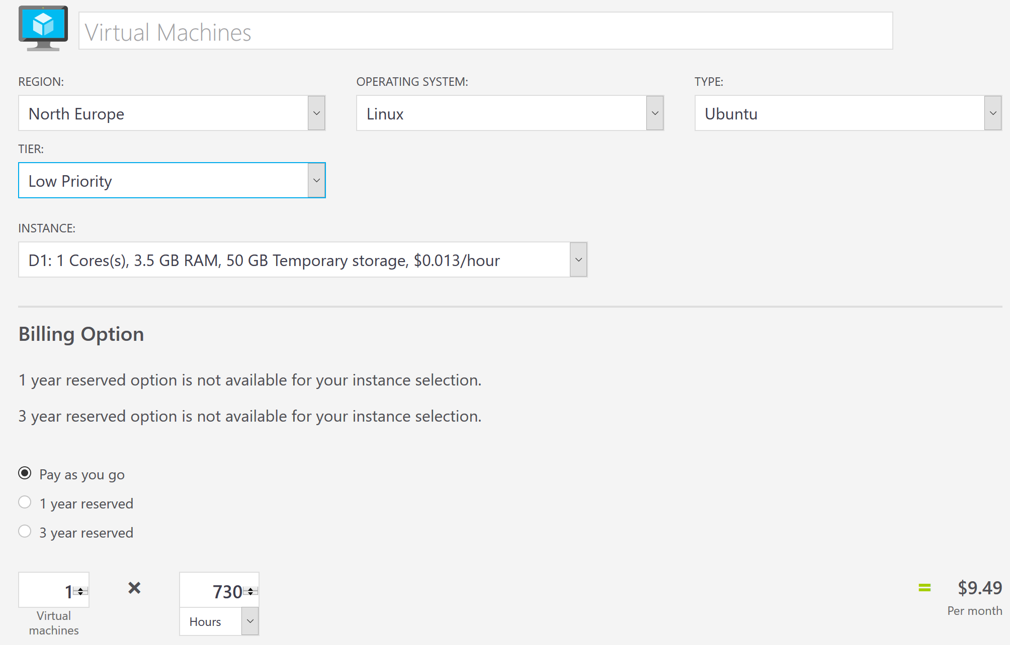
Analytical modeling
A mathematical model is a description of a system using mathematical concepts and language
Very cost effective
Limited detail

Slide 43
Modeling
Designs, Lessons and Advice from Building Large Distributed Systems. Jeff Dean. LADIS´09 keynote talk.
Slides 23—29

Slide 44
Summary
Performance evaluation
How to do it
How not to do it
Measurements:
Best results
Most expensive
Simulation:
Good results
Some effort
Modeling:
Initial results
Easy and cheap
In practice a combination should be used

