Slide 1
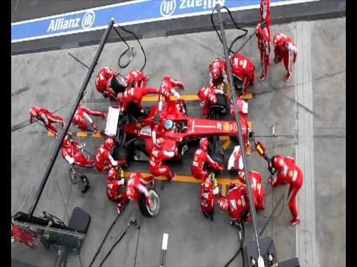
Programming for performance
Inf-2202 Concurrent and Data-intensive Programming
Fall 2018
Lars Ailo Bongo (larsab@cs.uit.no)

Slide 2
Parallelization process
Goals: performance, good resource utilization
Task: piece of work
Process/thread: entity that performs the work
Processor/core: physical processor cores
Decomposition of the computation into tasks
Assignment of tasks to processors
Orchestration of necessary data access, communication, and synchronization among processes
Mapping of threads to cores

Slide 3
Fundamental design issues
Communication abstraction
Programming model requirements
Naming
Ordering
Communication and replication
Performance

Slide 4
Outline
Partitioning for performance
Orchestration for performance

Slide 5
Partitioning
Algorithmic
Decomposition
Split computation into tasks
Task granularity limits performance
Assignment
Load balancing
Reduce communication volume
Send minimum amount of data
Static or dynamic

Slide 6
Primary algorithmic issues
Balance workload to reduce time spent waiting at communication and synchronization events
Reduce communication
Reduce extra work for determining and managing a good assignment
At odds with each other: must find best compromise

Slide 7
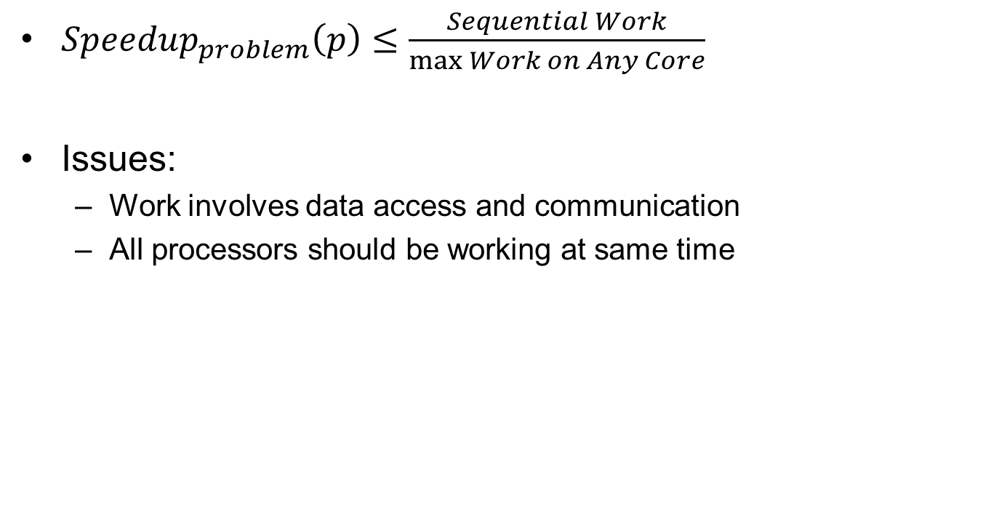
Load balancing and synchronization wait time
${Speedup}_{problem}\left(p\right)≤\frac{Sequential Work}{\max{Work on Any Core}}$
Issues:
Work involves data access and communication
All processors should be working at same time

Slide 8
Load balancing and synchronization wait time (2)
Identify enough concurrency and overcome Amdahl’s law
Decide how to mange concurrency (statically or dynamically)
Determine the granularity at which to exploit concurrency
Reduce serialization and synchronization cost

Slide 9
Identify enough concurrency
Data parallelism:
Same computation on different parts
Grows with data size
Mostly used
Functional parallelism
Different computations
Task parallelism
Pipelined computation
Typically used in combination with data parallelism
Often modest amount

Slide 10
Identify enough concurrency (2)
Static assignment
Algorithmic mapping
Depends on problem size, #cores, algorithm parameters,…
Low runtime overhead
Work per task must be predictable
Can be perturbed by other applications (or system workload)
Dynamic assignment
Pool (bag) of available tasks
Semistatic
Initially static assignment; then adjust dynamically

Slide 11
Linda
Seminal parallel programming approach
Library language
Uncoupled processes
Spatially and temporally
Tuple space (TS)
Tuple: arbitrary data
Tuples addressed by logical name (not address)
Tuples cannot be modified
Operations
out: insert tuple to TS
in: remove tuple from TS
read: read value from TS
(eval)
Read more: Ahuja, S.; Carriero, N.; Gelernter, D., Linda and Friends, Computer , vol.19, no.8, pp.26,34, Aug. 1986.

Slide 12
Linda bag of tasks
Tuples: (“Task”, <task descriptor>)
Loop { /* withdraw a task from the bag */ in(“Task”, formal NextTask); process “Next Task”; for (each new Task generated in the process) { /* drop task to bag */ out(“Task”, NewTask); } }

Slide 13
MongoDB
NoSQL database (key-value store)
Similar approach as in Linda
Widely in use
Learn more: http://www.mongodb.org/ and http://api.mongodb.org/python/current/tutorial.html

Slide 14
@home computing
Embarrassingly parallel computations
Popularized by SETI@home
Search for Extraterrestrial Intelligence
BOINC project
Oper-source software for @home projects

Slide 15
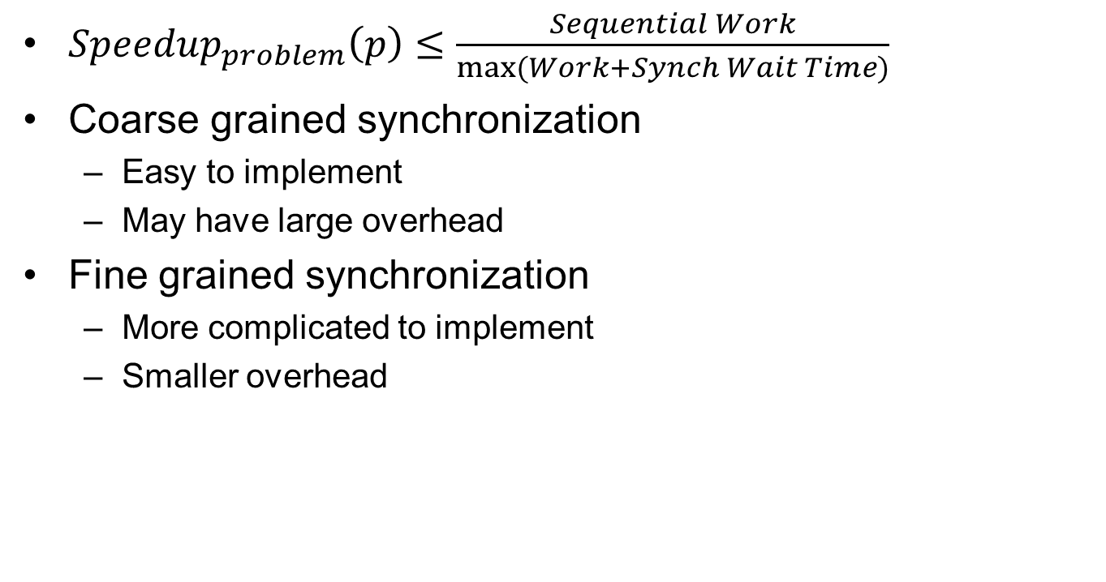
Reducing serialization
${Speedup}_{problem}\left(p\right)≤\frac{Sequential Work}{\max{(Work+Synch Wait Time)}}$
Coarse grained synchronization
Easy to implement
May have large overhead
Fine grained synchronization
More complicated to implement
Smaller overhead

Slide 16
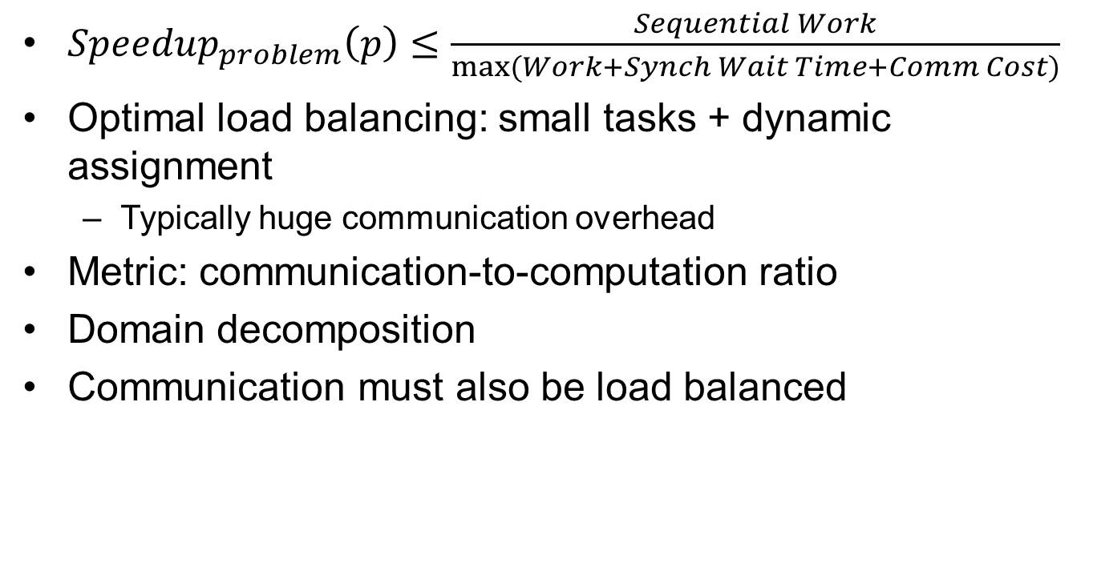
Reducing communication
${Speedup}_{problem}\left(p\right)≤\frac{Sequential Work}{\max{(Work+Synch Wait Time+Comm Cost)}}$
Optimal load balancing: small tasks + dynamic assignment
Typically huge communication overhead
Metric: communication-to-computation ratio
Domain decomposition
Communication must also be load balanced

Slide 17
Rules of Thumb
Distributed computing economics (Jim Gray)
1999
2003
2008
Designing distributed systems:
Jeff Dean (LADIS keynote)

Slide 18
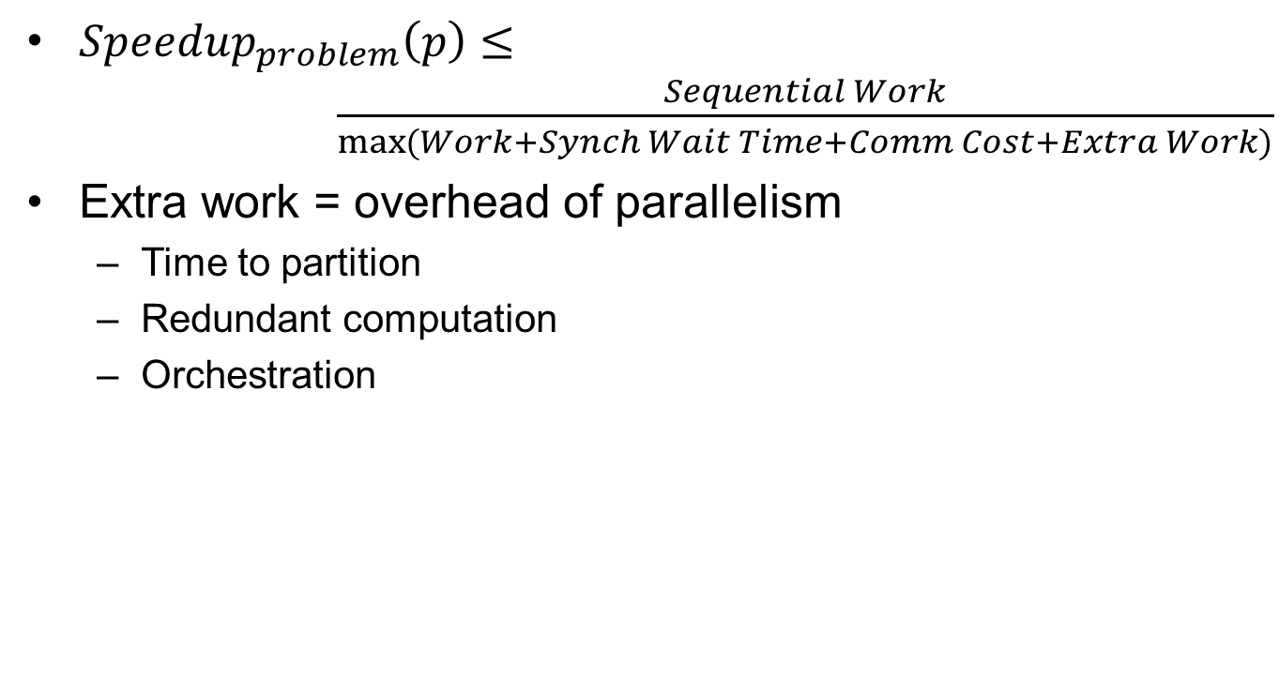
Reducing Extra Work
${Speedup}_{problem}\left(p\right)≤ \frac{Sequential Work}{\max{(Work+Synch Wait Time+Comm Cost+Extra Work)}}$
Extra work = overhead of parallelism
Time to partition
Redundant computation
Orchestration

Slide 19
Outline
Partitioning for performance
Orchestration for performance

Slide 20
Reducing inherit communication
Exploit temporal locality (working set)
Blocking
E.g. matrix multiplication
Exploit spatial locality
Best strategy depends on problem size, algorithmic partitioning, implementation issues, parallel architecture…
Must be structured to fit underlying parallel architecture

Slide 21
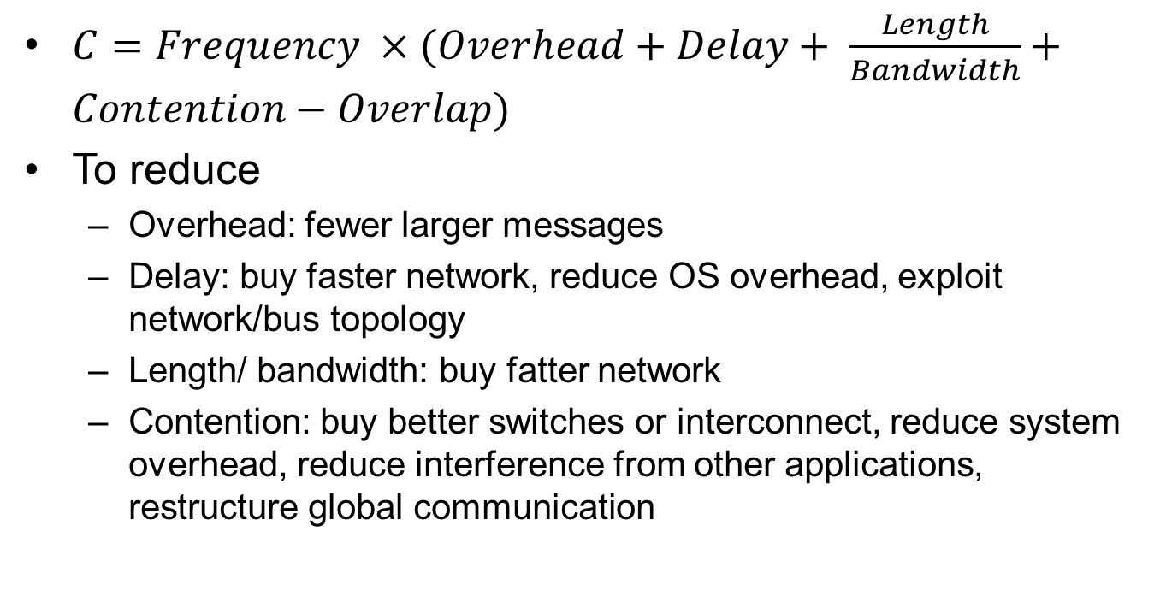
Communication cost
$C=Frequency ×(Overhead+Delay+ \frac{Length}{Bandwidth}+Contention−Overlap)$
To reduce
Overhead: fewer larger messages
Delay: buy faster network, reduce OS overhead, exploit network/bus topology
Length/ bandwidth: buy fatter network
Contention: buy better switches or interconnect, reduce system overhead, reduce interference from other applications, restructure global communication

Slide 22
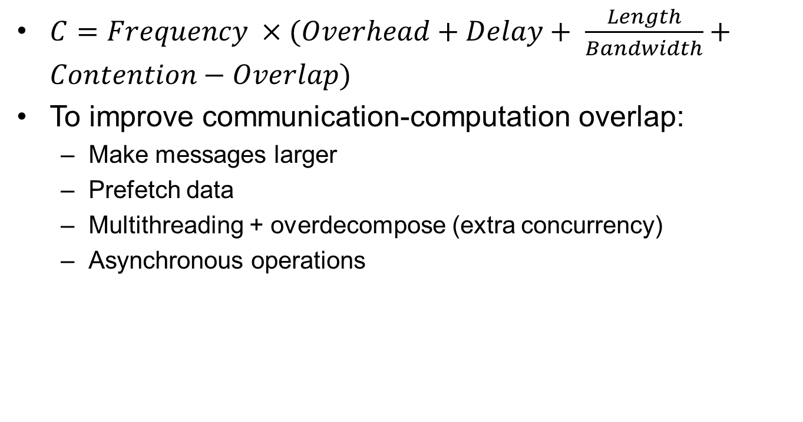
Communication cost (2)
$C=Frequency ×(Overhead+Delay+ \frac{Length}{Bandwidth}+Contention−Overlap)$
To improve communication-computation overlap:
Make messages larger
Prefetch data
Multithreading + overdecompose (extra concurrency)
Asynchronous operations

Slide 23
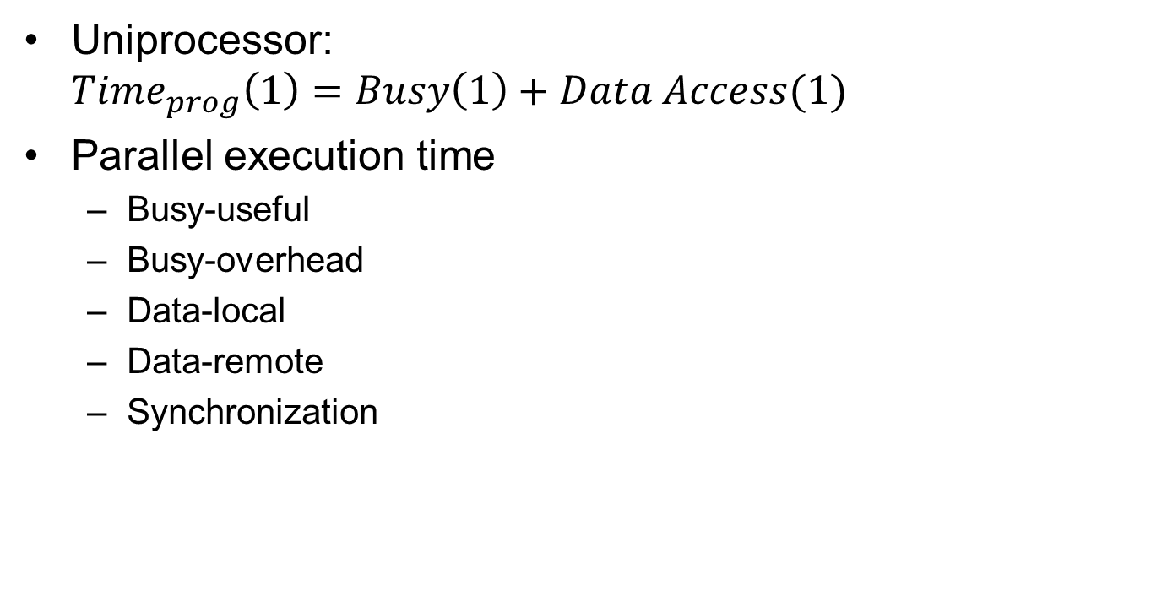
Processor view
Uniprocessor: ${Time}_{prog}\left(1\right)=Busy\left(1\right)+Data Access(1)$
Parallel execution time
Busy-useful
Busy-overhead
Data-local
Data-remote
Synchronization
Notes:
Fig. 3.13

Slide 24

A performance model
$${Speedup}_{problem}\left(p\right)≤\frac{Busy\left(1\right)+{Data}_{local}\left(1\right)}{{Busy}_{useful}(p{)+{Data}_{local}\left(p\right)+Synch\left(p\right)+{Data}_{remote}(p)+{Busy}_{overhead}(p)}}$$

Slide 25
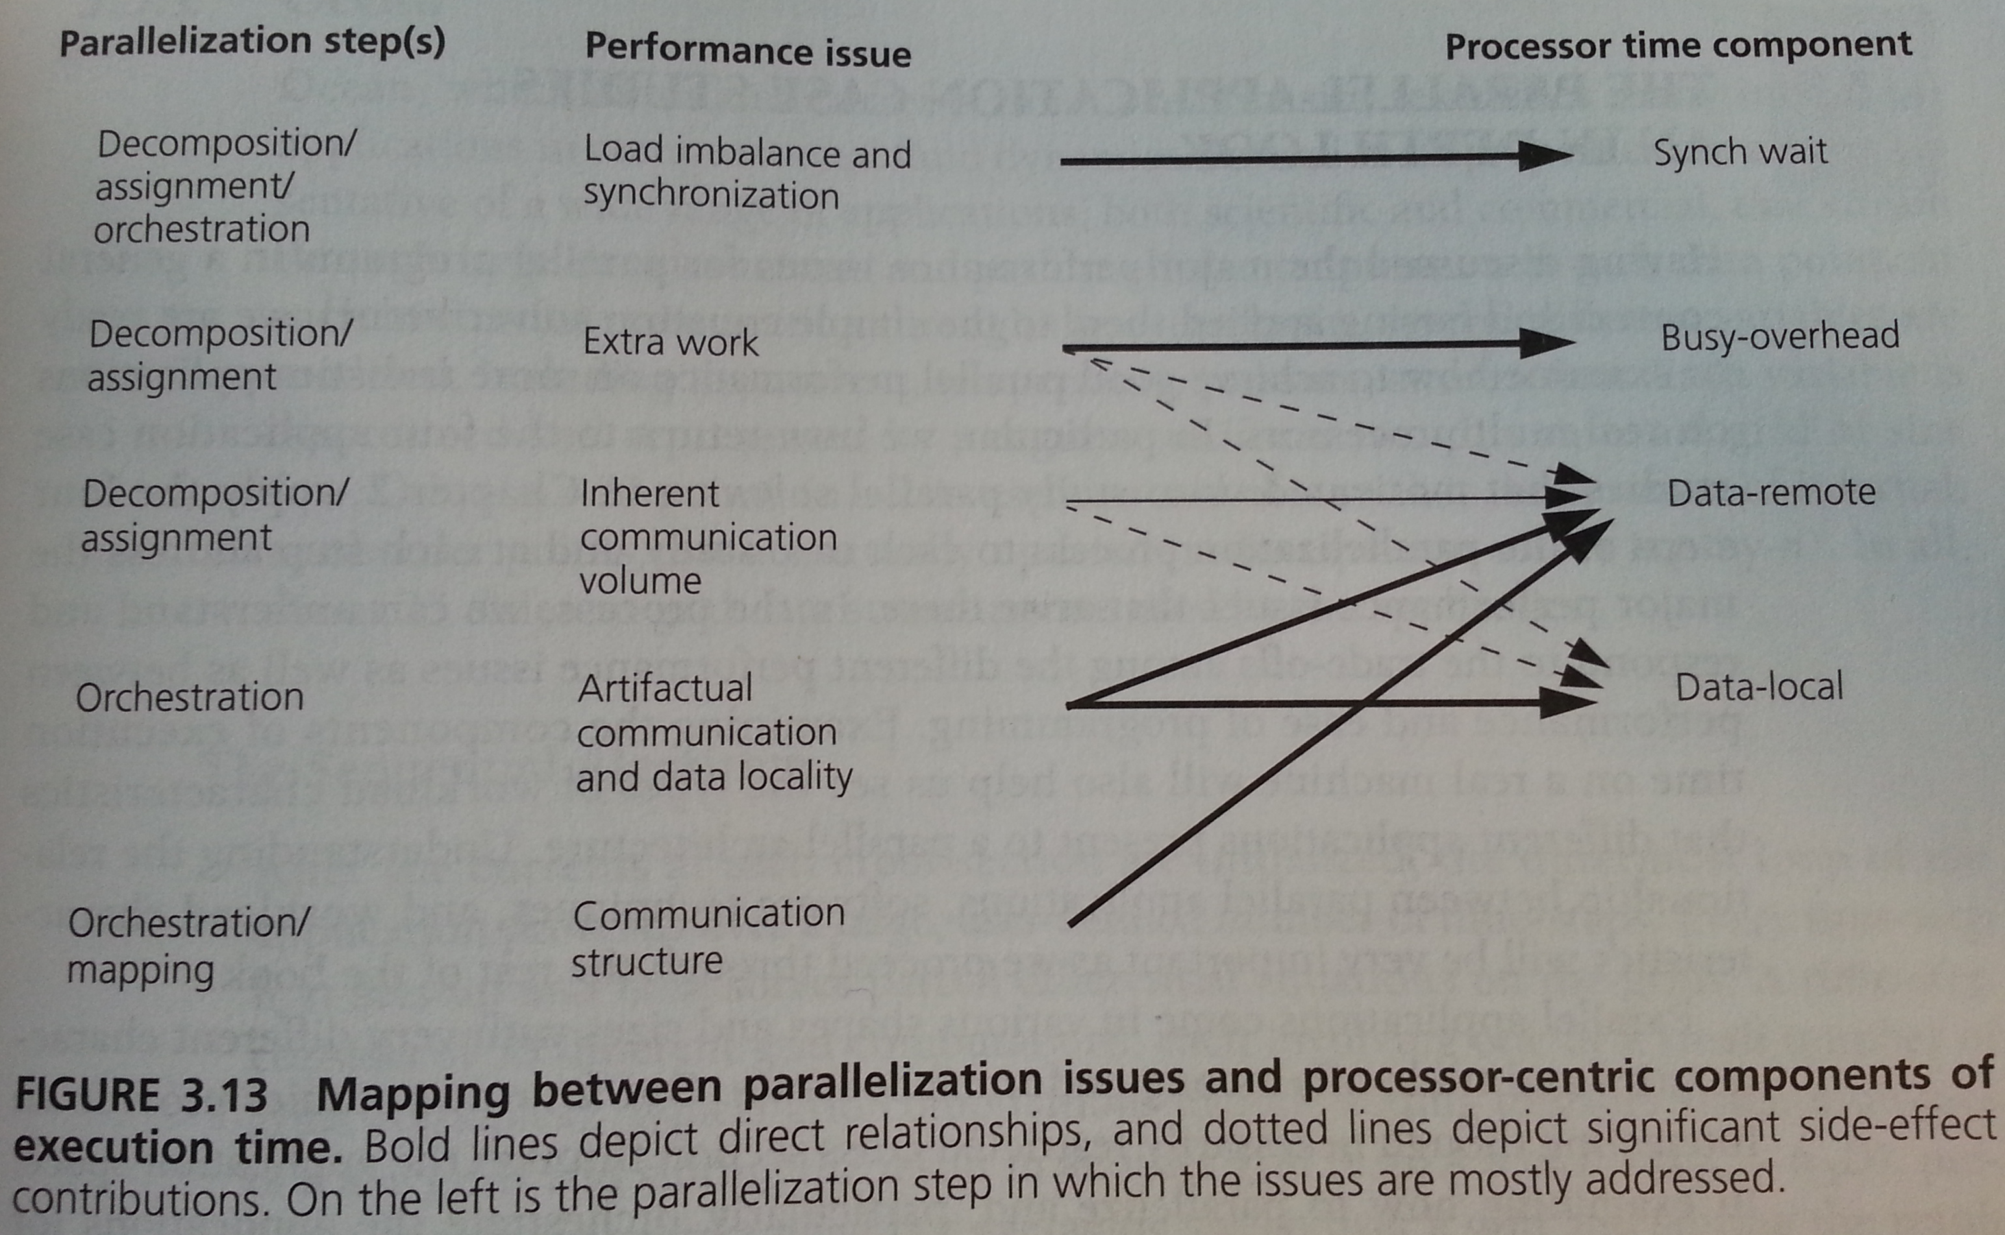

Slide 26
Summary
Partitioning for performance
Algorithmic
Commonly used design patterns
Orchestration for performance
Linda and MongoDB programming models
Rules of thumb metrics

