Slide 1
Image Processing Techniques for Microscopy Data – Tutorial 1
A. Pofelski, I. C. Bicket and J. P. Bronze de Firmino

Slide 2
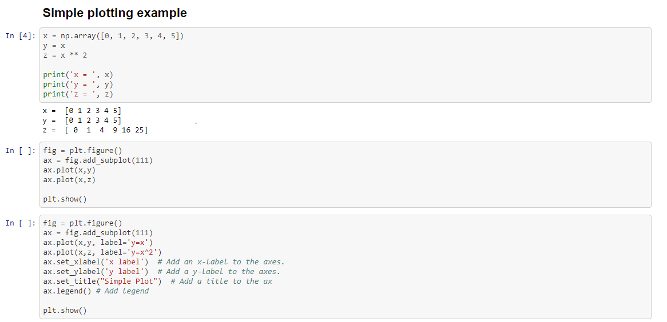
Jupyter notebook
JupyterLab ➔ https://jupyter.org
Open-source web-based Interactive notebook adapted for scientific computing
The notebook is a simple file including text and code executable in a web browser and sharable to anyone
Cell
Output
File example ➔ Test_process.ipynb
Data processing
Data visualization
Machine learning
Simulations
…

Slide 3
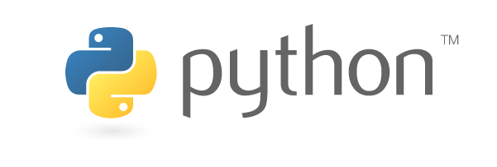
Python (https://www.python.org)
Object oriented programming language
Open-source
Large number of users with rich libraries
Massively used in scientific community
Lots of free resources to learn how to code

Slide 4
Two options for today
Interactive tutorial
Download the files in the CCEM_tutorials repository and execute the notebook yourself in your own environment ➔
https://github.com/slimpotatoes/CCEM_tutorials
Follow the binder link and use the notebook interactively in your browser ➔
Link provided live in the webinar
Requirements
Python installed
Jupyter notebook installed
Python libraries installed:
Numpy
imageio
matplotlib
matplotlib_scalebar
Compatible web browser
Requirement
Compatible web browser
The Python and Jupyter environment are provided by binder and should run smoothly for todays demo. However, it is still recommended to have your own Python and Jupyter for future uses.

