Slide 1
CHAPTER 1.
INTRODUCTION

Slide 2
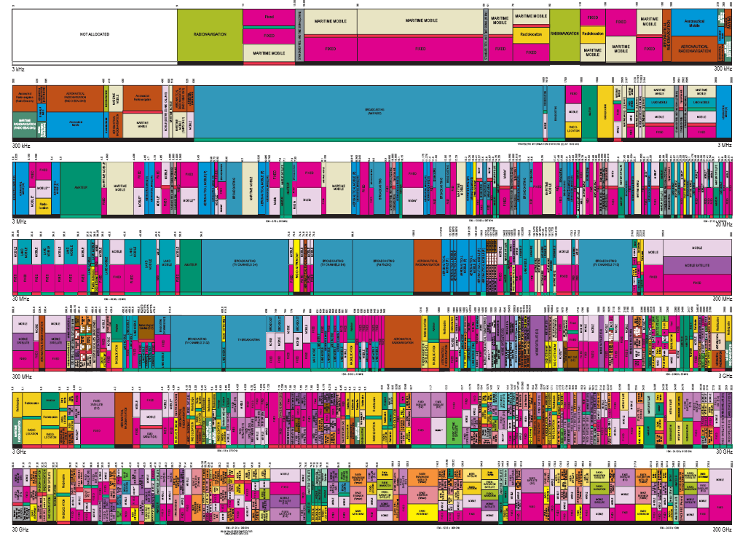
FIXED SPECTRUM ASSIGNMENT

Slide 3
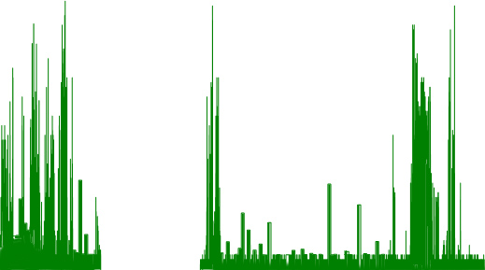
Fixed Spectrum Utilization
Maximum Amplitudes
Heavy Use
Heavy Use
Amplitude (dBm)
Sparse Use
Medium Use
Frequency (MHz)

Slide 4
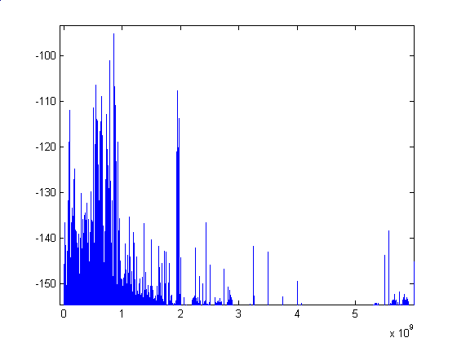
Fixed Spectrum Utilization
PSD (Power Spectrum Density)
GHz
Freq (GHz) | 0~1 | 1~2 | 2~3
Utilization(%) | 54.4 | 35.1 | 7.6
3~4 | 4~5 | 5~6
0.25 | 0.128 | 4.6
Measurements show that there is wide range of spectrum utilizations
across 6 GHz of spectrum

Slide 5
Problems of Fixed Spectrum Utilization
Spectrum usage is concentrated on certain portions of the spectrum
A significant amount of the spectrum remains unutilized.
According to FCC (Federal Communication Commission):
Utilization of the fixed spectrum assignment is approx.
15-85% based on temporal and geographical variations
→ Limited Available Spectrum and Inefficient Spectrum Usage!

Slide 6
COGNITIVE RADIO NETWORKS; DYNAMIC SPECTRUM ALLOCATION NETWORKS (DSANs); xG INITIATIVE
Dynamic Spectrum
Allocation

Slide 7
OVERALL VIEW
Applications
Adaptive
Protocol
Suite
TCP/UDP
IP
MAC
Error Control
Physical
Dynamic Spectrum
Allocation
WiMAX
Wireless LANs & MANs
Cellular
(2,3,4,5G)
Sensor
Networks
Mesh Networks

Slide 8
COGNITIVE RADIO
A “Cognitive Radio” is the key enabling technology for Dynamic Spectrum Access!!
Capability to use or share the spectrum in an opportunistic manner.
“BANDWIDTH HARVESTING”
Dynamic spectrum access techniques allow the CR to operate in the
best available channel.

Slide 9
SPECTRUM MANAGEMENT FRAMEWORK
1) Determine which portions of the spectrum is available and detect the
presence of licensed users when a user operates in a licensed band
(Spectrum Sensing)
2) Select the best available channel (Spectrum Decision)
3) Coordinate access to this channel with other users (Spectrum Sharing)
4) Vacate the channel when a licensed user is detected

Slide 10
CRN COMMUNICATION FUNCTIONALITIES
Application Control
QoS Requirements
Spectrum
Mobility
Function
Application
Spectrum
Decision
Function
Handoff Delay, Loss
Transport
Reconfiguration
Routing Information
Routing Information/
Reconfiguration
Network Layer
Scheduling
Information/
Reconfiguration
Link Layer
Delay
Spectrum
Sharing
Link Layer
Spectrum
Sensing
Physical Layer
Sensing
Information
Sensing Information / Reconfiguration
Handoff Decision, Current and Candidate Spectrum Information

Slide 11
BUILDING BLOCK: SOFTWATE DEFINED RADIO
SDRs: perform the majority of signal processing in the digital domain using programmable DSPs and hardware support
Some signal processing is still done in the analog domain, such as in the RF and IF circuits
Get the software close to the antenna
Software defines the waveforms
Replace analog signal processing with digital signal processing
Some of the slides are from presentations by Eric Bloom and John Ackermann. Thank you.

Slide 12
WHY SDR?
Flexible
Reduced Obsolescence
Enhances Experimentation
Brings Analog and Digital World Together
Quicker time to market
Multiple personalities (chameleon)
New things are possible:
Multiple channels at the same time
Better spectrum utilization
“Cognitive Radios”

Slide 13
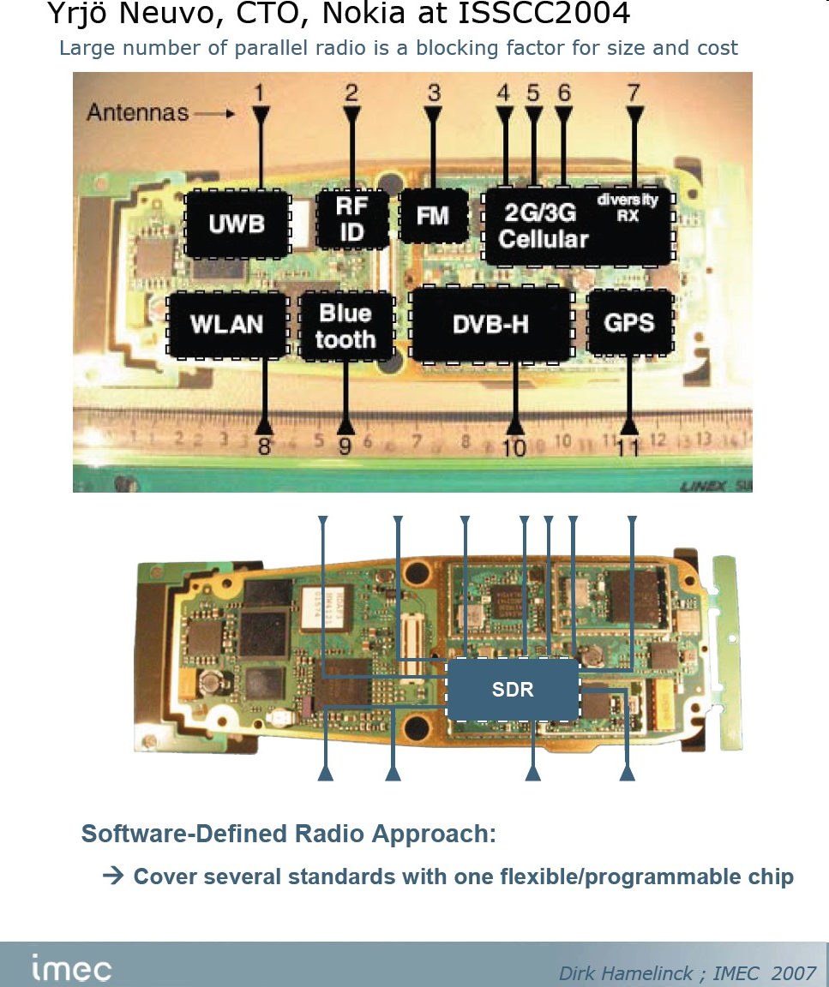
New Breed of Radio
Reprogrammable
Multiband/Multimode
Networkable
Simultaneous voice, data, video
Full convergence of digital networks and radio science

Slide 14
Disadvantages
Higher power consumption than dedicated ASIC approach
More MIPS required
Higher cost (today), but potential for lower cost in the future
Multi-band operation limited by antennas

Slide 15
SOFTWARE ARCHITECTURE: GNU RADIO
GNU Radio: a library of signal processing blocks & the glue to tie it all together
The programmer builds a radio by creating a graph (as in graph theory)
Vertices: signal processing blocks
Edges represent the data flow between them
The signal processing blocks are implemented in C++
Conceptually, blocks process infinite streams of data flowing (input ports to output ports)
Blocks' attributes: the number of input and output ports as well as the type of data
The most frequently used types are short, float and complex
Some blocks have only output ports or input ports (as data sources and sinks)
There are sources that read from a file or ADC, and sinks that write to a file, DAC or graphical display
About 100 blocks come with GNU Radio
Writing new blocks is not very difficult

Slide 16
Dial tone generator
Dial Tone Output
#!/usr/bin/env python
from gnuradio import gr
from gnuradio import audio
def build_graph ():
sampling_freq = 48000
ampl = 0.1
fg = gr.flow_graph ()
src0 = gr.sig_source_f (sampling_freq, gr.GR_SIN_WAVE, 350, ampl)
src1 = gr.sig_source_f (sampling_freq, gr.GR_SIN_WAVE, 440, ampl)
dst = audio.sink (sampling_freq)
fg.connect ((src0, 0), (dst, 0))
fg.connect ((src1, 0), (dst, 1))
return fg
if __name__ == '__main__':
fg = build_graph ()
fg.start ()
raw_input ('Press Enter to quit: ')
fg.stop ()
src0
dst
src1

Slide 17
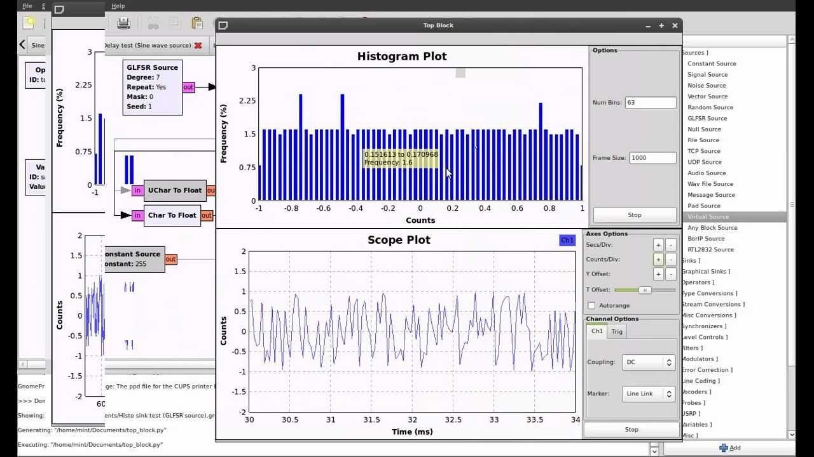
GNU Radio now has a nice GUI

Slide 18
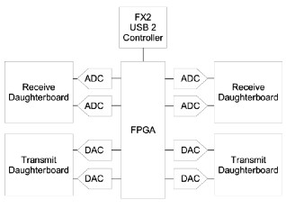
UNIVERSAL SOFTWARE RADIO PERIPHERAL
USB 2.0 interface
4 High-Speed AD Converters (64 MS/s, 12-bit Analog Devices AD9862)
4 High-Speed DA Converters (128 MS/s, 14-bit) to generate signals up to about 50 MHz (same chip as above)
Altera EP1C12 Q240C8 "Cyclone" FPGA for high bandwidth math, and to reduce the data rates to something you can squirt over USB2
Lots of digital, serial, and low speed analog IO for controlling daughterboards
2 Daughterboard slots to hold any RF receiver interface or tuner
2 Daughterboard slots to hold any RF transmitter

Slide 19
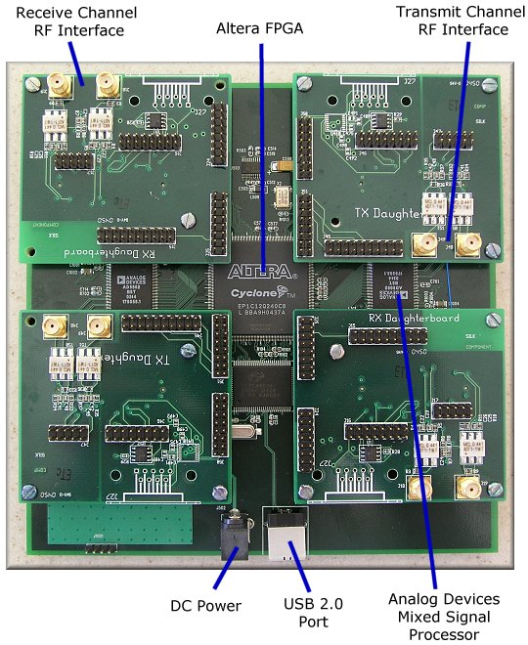
Universal Software Radio Peripheral (USRP)

Slide 20
GNU Radio resources
Home page (links to source code)
http://www.gnu.org/software/gnuradio
Mailing list
discuss-gnuradio-request@gnu.org
Archive
http://mail.gnu.org/mailman/listinfo/discuss-gnuradio
Open source hardware
http://www.opencores.org/projects/pci
PCI bridges, ethernet, memory controllers, etc.

