Slide 1
CHAPTER 2.
COGNITIVE RADIO
SCL’18
ECE592-076

Slide 2
WHAT IS A COGNITIVE RADIO?
A “Cognitive Radio” is a radio that can
change its transmitter parameters based on
interaction with the environment in which it
operates. (Federal Com Commission’05)
FCC (Non-Federal Use of the Spectrum)
SCL’18
ECE592-076

Slide 3
WHAT IS A COGNITIVE RADIO?
A radio or system that senses its operational EM environment and can dynamically and autonomously adjust its radio operating parameters to modify system operation, such as maximize throughput, mitigate interference, facilitate interoperability and access secondary markets.
NTIA (National Telecom and Info Administration)’05
US Department of Commerce: (NTIA) (FEDERAL USE OF THE SPECTRUM)
SCL’18
ECE592-076

Slide 4
SPECTRUM REGULATION
EXAMPLE:
SPECTRUM FROM 322-3,100 MHz:
NTIA regulates 22%
FCC regulates 35%
Shared NTIA/FCC regulates 42%
SCL’18
ECE592-076

Slide 5
WHAT IS A COGNITIVE RADIO?
A radio or system that senses and is aware of its operational environment and can dynamically and autonomously adjust its radio operating parameters accordingly.
ITU (Wp8A working document)’05
SCL’18
ECE592-076

Slide 6
WHAT IS A COGNITIVE RADIO?
A type of radio that can sense and autonomously reason about its environment and adapt accordingly.
This radio could employ knowledge representation, automated reasoning, and machine learning mechanisms in establishing conducting or terminating communication or networking functions with other radios.
CRs can be trained to dynamically and autonomously adjust its operating parameters.
IEEE 1900.1 Group
SCL’18
ECE592-076

Slide 7
HOW ABOUT???
A RADIO THAT IS COGNITIVE !!!!
SCL’18
ECE592-076

Slide 8
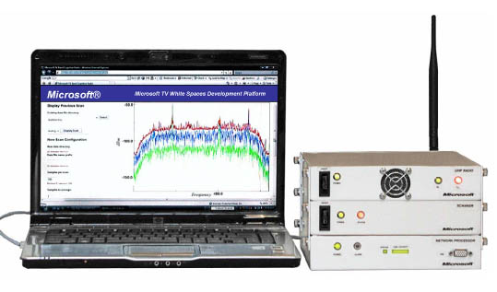
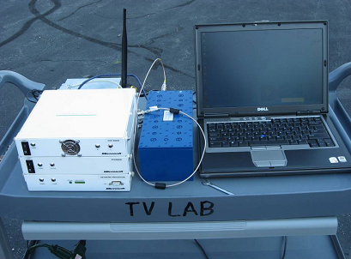
Microsoft, Google, Dell, HP
KNOWS: Kognitiv Networking Over White Spaces
http://research.microsoft.com/netres/projects/KNOWS/
Prototypes designed to identify wireless microphone, NTSC and Digital TV signals
Undergoing testing at FCC
SCL’18
ECE592-076

Slide 9
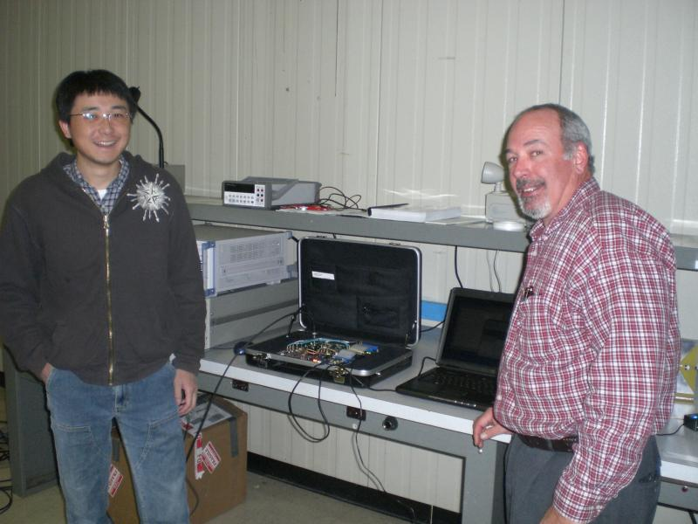
Adaptrum’s Testbed
http://www.adaptrum.com/home
Experiments undertaken in the region of 500 MHz - 700 MHz
Undergoing testing at FCC
SCL’18
ECE592-076

Slide 10
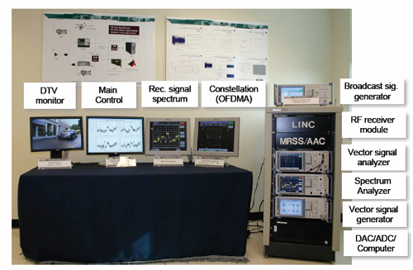
Georgia Tech: OCRA Testbed
http://www.ece.gatech.edu/research/labs/mag/cognitive_radio.htm
SCL’18
ECE592-076

Slide 11
ADVANTAGES OF COGNITIVE RADIO
Senses RF Environment and modifies frequency, power or modulation
Allows for Real Time Spectrum Management
Significantly Increases Spectrum Efficiency
SCL’18
ECE592-076

Slide 12
Possible CR Functionalities
Dynamic Frequency Selection (DFS)
Adaptive Modulation
Adaptive Transmit Power Control
Adjust transmit parameters based on location spectrum sharing between a licensee and a third party
Other functionalities are being developed as technology progresses
SCL’18
ECE592-076

Slide 13
Spectrum Hole Concept
Power
Spectrum Hole
Frequency
Time
Spectrum occupied by Licensed users
SCL’18
ECE592-076

Slide 14
Ultimate Objective of Cognitive Radio
CR enables the usage of temporally unused spectrum
→ Spectrum Hole or White Space.
If this band is further used by a licensed user, CR moves to another spectrum hole or stays in the same band
Alters its transmission power level or modulation scheme to avoid interference
SCL’18
ECE592-076

Slide 15
MAIN CHARACTERISTICS OF CR
A. Cognitive Capability
B. Reconfigurability (SDR)
SCL’18
ECE592-076

Slide 16
Cognitive Capability
SPECTRUM AWARENESS!!
Capture or sense the information
(e.g., licensed user’s activity) from radio environment
Capture the temporal and spatial variations in radio environment
Avoid interference to other users
Identification of unused spectrum portions at a specific time or location
Selection of best spectrum and appropriate operating parameters
SCL’18
ECE592-076

Slide 17
Reconfigurability
(SDR Functionality)
SDR is a reconfigurable wireless system in which tx parameters (operating frequency band, modulation mode, and protocol) can be controlled dynamically.
The adjustability function is achieved by SW controlled signal processing algorithms
SDR is the key component to implement CRs
SCL’18
ECE592-076

Slide 18
Main Functions of Software Defined Radios
Multiband Operation:
Tx over different spectrums
e.g., cellular bands, ISM Band, TV band.
Multistandard Support:
e.g., GSM, WCDMA, cdma2000, WiMAX, WiFi, LTE, LTE-A
SCL’18
ECE592-076

Slide 19
Main Functions of Software Defined Radios
Different Air Interfaces within the same Standard:
e.g., IEEE 802.11a, 802.11b, 802.11g, or IEEE802.11n
Multiservice Support (e.g., within WiFi standard)
e.g., cellular systems, Broadband Wireless Internet access
Multichannel Support
(tx and rx on multiple freq. bands simultaneously)
SCL’18
ECE592-076

Slide 20
SUMMARY
SDR enables
* to be dynamically programmed to transmit and receive on a variety
of frequencies according to the radio environment and
* to use different transmission access technologies supported by its
hardware design
SCL’18
ECE592-076

Slide 21
Physical Architecture of Cognitive Radios
Data
Input
Data
Output
Receive
Modem
Radio Front-End
(RF)
Analog-to-Digital Converter
(A/D)
Baseband Processing
Data Processing
Transmit
Control Signal (Parametrization)
(SDR)
(Reconfiguration)
SCL’18
ECE592-076

Slide 22
Cognitive Radios
Most components (data processing, AD converter, baseband processing) are similar to classical transceivers
Difference:
Each component can be controlled from the protocols in the upper layers or can be reconfigured.
SCL’18
ECE592-076

Slide 23
Physical Architecture of Cognitive Radios
Each component can be reconfigured via a control bus to adapt to the time-varying RF environment.
Radio front-end receives analog signals from the antenna
This analog signal is filtered by a bandpass filter to obtain the signal in the desired frequency
SCL’18
ECE592-076

Slide 24
Physical Architecture of Cognitive Radios
This signal is amplified and processed to generate an in-phase
(I) path and a quadrature (Q) path by shifting the phase by {-pi/2}
Both I and Q path signals are then converted to digital data
Sampling rate of A/D must be chosen to satisfy the conditions of
Nyquist’s sampling theorem
NOTE:
Sampling rate and parameters of analog and digital filters as well as signal processing algorithms can be reconfigured to the operating frequency band and the wireless air interface technology
SCL’18
ECE592-076

Slide 25
Physical Architecture of Cognitive Radios
A “Wideband Sensing Capability” of the RF front-end
→ mainly related to RF hardware technologies such as
wideband antenna, power amplifier, and adaptive filter
RF hardware for CR should be capable of tuning to any part of a
large range of the frequency spectrum
SCL’18
ECE592-076

Slide 26
Physical Architecture of Cognitive Radios
(Wideband RF/Analog Front-End Architecture)
Wideband Antenna
Analog-to-Digital Converter
Low Noise Amplifier
Channel Selection Filter
LNA
Mixer
AGC
A/D
RF Filter
Automatic Gain Control
∼
VCO
PLL
RF Front End
SCL’18
ECE592-076

Slide 27
Some Basics
PASSBAND:
Allocated spectrum for each system,
e.g., WiFi → 2.4 GHz; 3G → 2GHz;
2G → 900 & 1800 MHz, etc.
SCL’18
ECE592-076

Slide 28
Physical Architecture of Cognitive Radios
  Power Spectrum Density
  (PSD)
PSD of the received licensed signal
Available
Channel
Band of interest
...
...
  Frequency
Baseband (low freq.)
(A/D Conversion/Signal Processing)
Pass-band (high freq.)
(for communications)
SCL’18
ECE592-076

Slide 29
Components of Cognitive Radio RF Front-End
RF Filter:
selects the desired band by bandpass filtering the received RF signal
Low Noise Amplifier (LNA):
  amplifies the desired signal while simultaneously minimizing noise component
Pass-Band Signals
Band of Interest
  PSD
...
...
Baseband
Pass-band
  Frequency
SCL’18
ECE592-076

Slide 30
Components of Cognitive Radio RF Front-End
Baseband Conversion
  Objective: Process and A/D convert the signal easily
  Needs Mixer, PLL, and VCO
Baseband signal
Pass-band signal
  PSD
...
...
Baseband
(low freq.)
Pass-band
f_{c}
  Frequency
SCL’18
ECE592-076

Slide 31



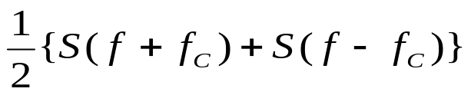
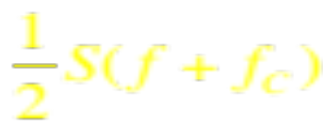
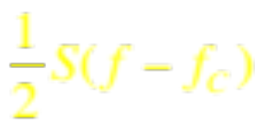



Preliminaries: Baseband Conversion
Time Domain
Frequency Domain
Passband signal
Fourier Transform
Need to generate this signal for the baseband conversion
Pass-band signal
  Frequency
Baseband signal
SCL’18
ECE592-076

Slide 32
Components of Cognitive Radio RF Front-End
Mixer
  Pass-band signal is mixed (multiplied with s(t)) with a locally generated signal (with frequency f_{c}) and converted to the baseband
SCL’18
ECE592-076

Slide 33
Components of Cognitive Radio RF Front-End
Voltage-Controlled Oscillator (VCO)
  Generates a signal at a specific frequency fc to mix with the pass-band signal (generates the cosine function)
  This procedure converts the passband signal to the baseband signal.
SCL’18
ECE592-076

Slide 34
Components of Cognitive Radio RF Front-End
Phase Locked Loop (PLL)
  Ensures that a signal is locked on a specific frequency f_{c} and can also be used to generate precise frequencies with fine resolution.
SCL’18
ECE592-076

Slide 35
Components of Cognitive Radio RF Front-End
Channel Selection Filter:
  Used to select the desired channels and to reject the adjacent channels
  PSD
...
...
Baseband
Pass-band
SCL’18
ECE592-076

Slide 36
Components of Cognitive Radio RF Front-End
Automatic Gain Control (AGC) :
Average output signal level is fed back to adjust the gain to
an appropriate level for a range of input signal levels.
(i.e., maintain the constant gain)
SCL’18
ECE592-076

Slide 37
Cognitive Radio RF Front-End Architecture
DATA PROCESSING
→ See SPECTRUM MANAGEMENT FRAMEWORK!!!
SCL’18
ECE592-076

Slide 38
Challenges of Developing CR RF Front-End
Wideband RF antenna receives signals from various transmitters operating at different power levels, bandwidths, and locations.
→ the RF front-end must be able to detect a weak signal
in a large dynamic range.
→ Requires a multi GHz speed A/D converter with
high resolution → infeasible!!
SCL’18
ECE592-076

Slide 39
Possible Solution
This necessitates the dynamic range of the signal to be reduced before A/D conversion
→ can be achieved by tunable notch filtering of strong signals
SCL’18
ECE592-076

Slide 40
Alternative Approach: Directional Antennas
Use multiple antennas such that signal filtering is performed in the spatial domain rather than in the frequency domain.
Multiple antennas can receive signals selectively using beam-forming techniques.
f₁
f₂
Licensed User f₁
f₁
f₁
Licensed User f₂
f₂
f₂
SCL’18
ECE592-076

Slide 41
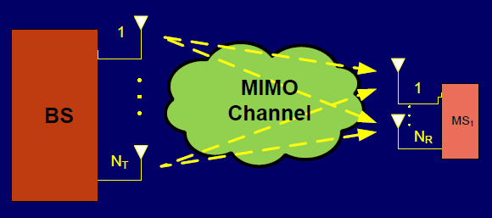
MULTIPLE-INPUT MULTIPLE-OUTPUT (MIMO) TECHNIQUES
Higher capacity
Higher spectral efficiency
Larger number of users (high throughput)
Improved coverage
Tx range without increasing BW demands or tx power
SCL’18
ECE592-076

Slide 42
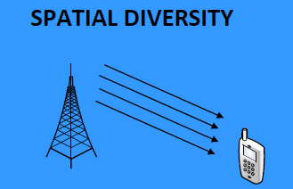
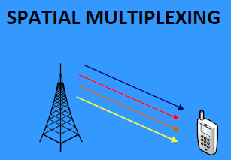
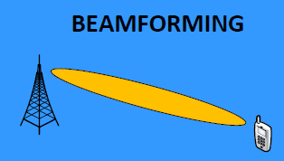
MIMO TECHNIQUES
Basic Modes of Operation
Single User MIMO (SU-MIMO)
Several Replicas of Same Data Stream
Several Data Streams
Directional Beam Pattern
Improved
Reliability
Increased Data
Rates
Extended
Coverage
SCL’18
ECE592-076

Slide 43
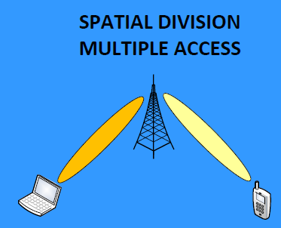
MIMO TECHNIQUES
Basic Modes of Operation
Multiple User MIMO (MU-MIMO)
Multiple users served on the same frequency-time resource
Increased number of supported users
SCL’18
ECE592-076

Slide 44
MIMO for LTE-A
Major Improvements over LTE
Novel Features:
  Antenna Configuration
    8x8 in DL; 4x4 in UL
  Dynamic SU/MU-MIMO Switching
    Fast timescale adaptation transparent to higher layers
  Advanced beamforming and scheduling techniques
    Proprietary and implementation-specific
  Implications on reference signals, feedback design, precoding codebooks, MIMO detector, etc.
    Very active research is being carried out
SCL’18
ECE592-076

Slide 45
MIMO LIMITATIONS
Improvements by a factor proportional to # antennas at Tx & Rx
No problem on the BS side but
handheld devices very limited in size (and also power consumption)
Placing several antennas in the device with the appropriate antenna
spacing may not be feasible.
SCL’18
ECE592-076

Slide 46
MIMO FOR LTE-A
Research Challenges: Massive MIMO
Potential benefits:
  Serve large of users
  Improve cell-edge performance
  Reduce consumed power and interference
Challenges:
  PILOT CONTAMINATION:
Main performance-limiting factor causing multi-cell channel
estimation impairments due to non-orthogonal pilots
  Detector Complexity
  Mobility management for very narrow beamforming
SCL’18
ECE592-076

Slide 47
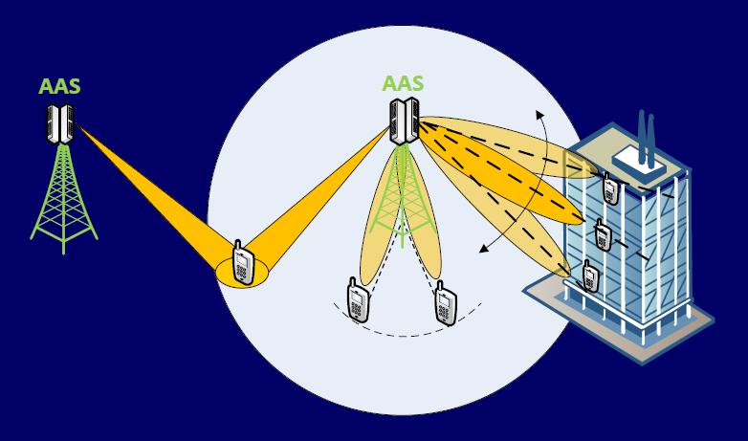
MIMO FOR LTE-A
FULL-DIMENSION MIMO
Main new MIMO technology for (Rel-12)
  Enables 3D Beamforming (BF)
Vertical Beamforming based on Active Antenna Systems (AAS)
  Integration of active and passive components
  Enables full utilization of spatial domain (Azimuth & elevation)
New techniques can be enabled
  Sector-specific/user-specific elevation BF
FD-MIMO allows vertical beam adaptation and well-focused cooperation
SCL’18
ECE592-076

Slide 48
MIMO FOR LTE-A
Research Challenges: 3D Channel Modeling (for REL-12)
Traditional channel model assume paths concentrated in two dimensions
  Not valid for 2D antenna arrays (needed for physical space limitations)
Azimuth and elevation directions need to be taken into account in the signal propagation path
  Need to include 2D multipath fading and large-scale fading
correlation with elevation statistics
Feedback Enhancements, Reference Signals, Codebook Design
Further optimizations in all three elements
Adaptation for future support of FD-MIMO
SCL’18
ECE592-076

