Slide 2
















$$B$$
$$m$$
$$θ_{B}$$
$$T$$
$$T$$
$$A$$
$$m$$
$$y_{B}$$
$$T$$
$$θ_{A}$$
$$y_{A}$$
$$l$$
$$O_{1}$$
$$l$$
$$O_{2}$$
$$l$$

Slide 3
Mode 1
Mode 2

Slide 4









$$A_{1}$$
$$B_{1}$$
$$C_{1}$$
Mode 1
$$A_{2}$$
$$B_{2}=0$$
Mode 2
$$C_{2}$$
$$A_{3}$$
$$C_{3}$$
Mode 3
$$B_{3}$$

Slide 5
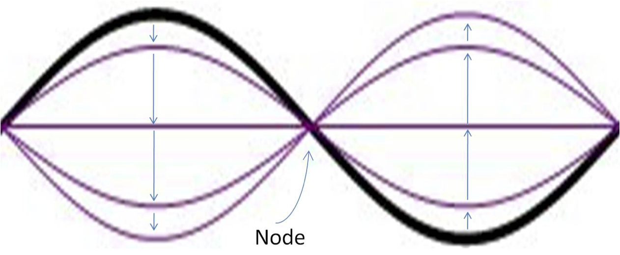

Slide 6
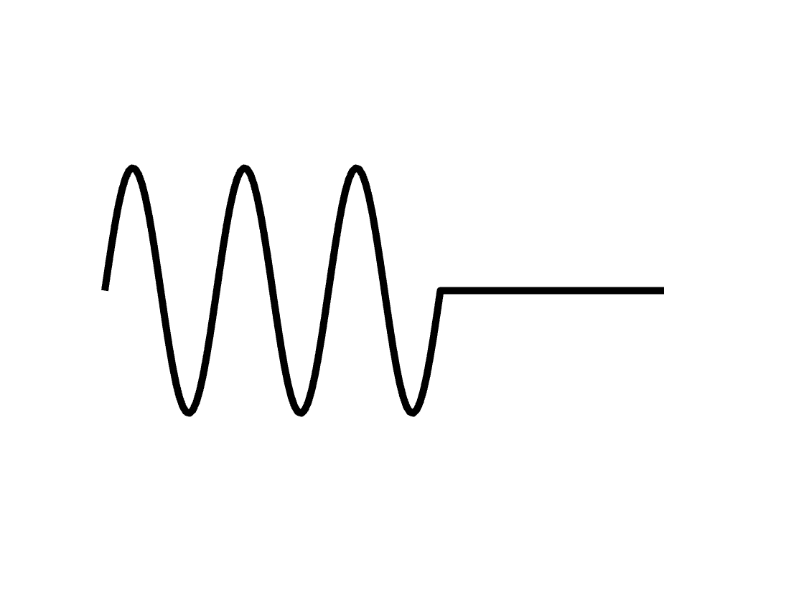

Wave motion direction
Hand motion direction

Slide 7
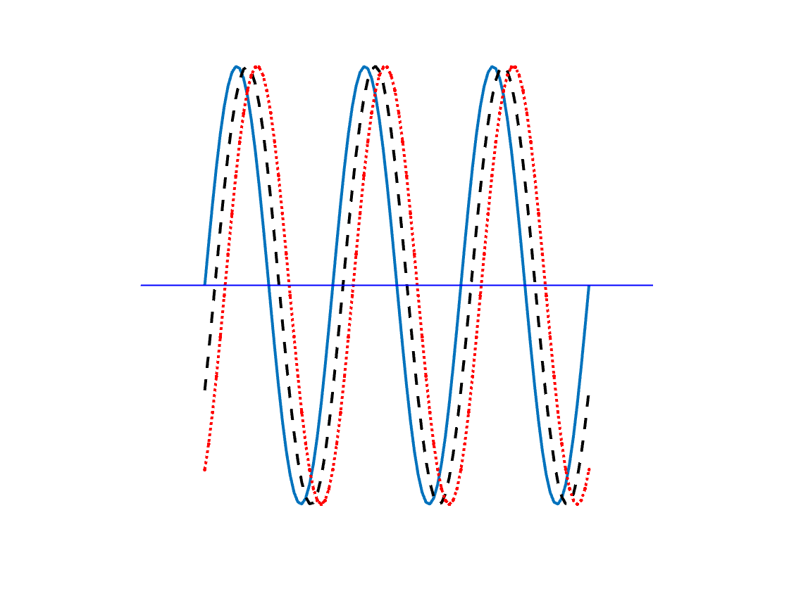

$$λ$$
Amplitude
Wave Direction

Slide 8


$$\vec{k}$$
$$\hat{u}$$

Slide 9
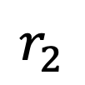
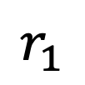
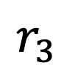
$$r_{3}$$
$$r_{2}$$
$$r_{1}$$

Slide 10

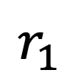
$$r_{2}$$
$$r_{1}$$

Slide 12

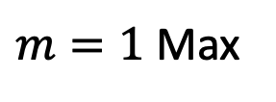


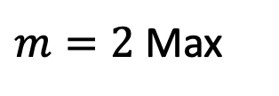

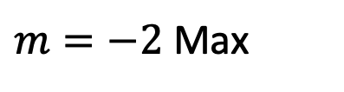

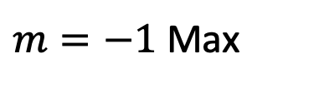

$m=2$ Max
$$λ$$
Min
$m=1$ Max
Min
$$θ_{2}$$
$$b$$
$$θ_{1}$$
Central
Max
$$θ_{−1}$$
$$θ_{−2}$$
Min
$m=−1$ Max
Min
$m=−2$ Max

Slide 13
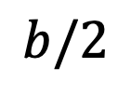



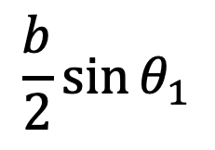
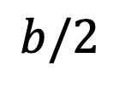
n = 2 Minimum
$$y$$
n = 1 Minimum
$$b/2$$
$$θ_{1}$$
Central
Maximum
$$O$$
$$b/2$$
$$\frac{b}{2}\sin{θ_{1}}$$
n = -1 Minimum
n = -2 Minimum

Slide 14







$$P$$
$$2.5 cm$$
$$10 cm$$
$$0.5 cm$$
$$O$$
$$3.5 cm$$
$$Q$$

Slide 15



$$∆x$$
$$A$$
$$∆ψ$$

Slide 16
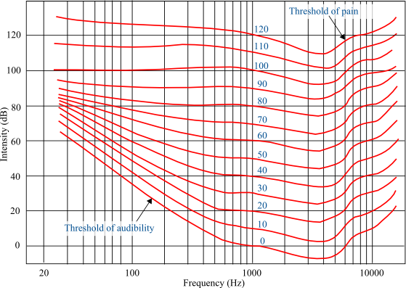
https://upload.wikimedia.org/wikipedia/commons/5/50/FletcherMunson_ELC.png

Slide 17
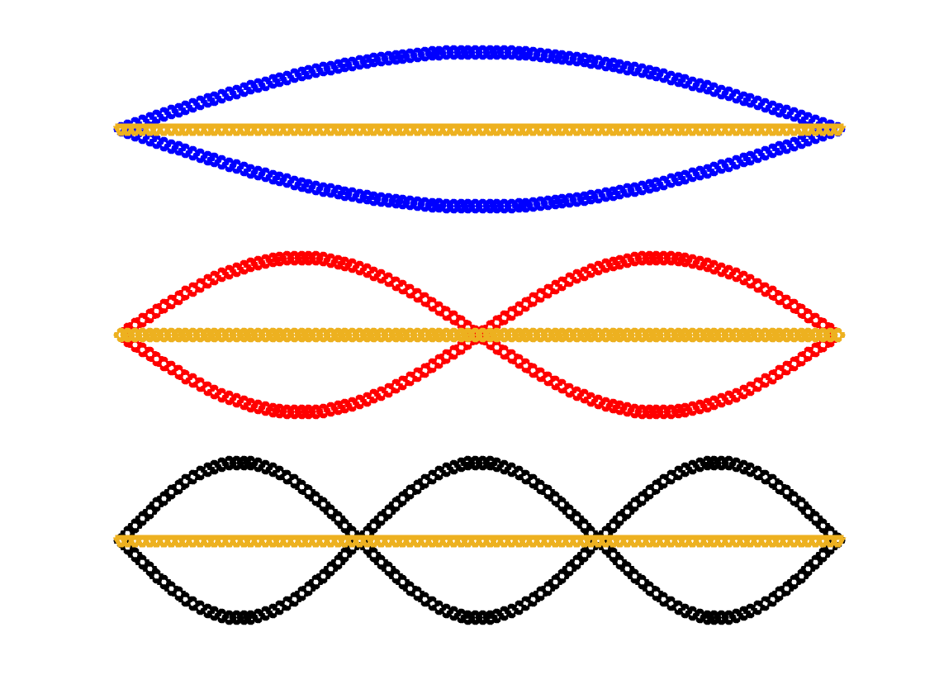


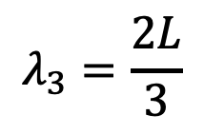

Anti-node
$$λ_{1}=2L$$
$$L$$
Anti-node
Anti-node
$$λ_{2}=L$$
Node
Anti-node
Anti-node
Anti-node
$$λ_{3}=\frac{2L}{3}$$
Node
Node

Slide 18
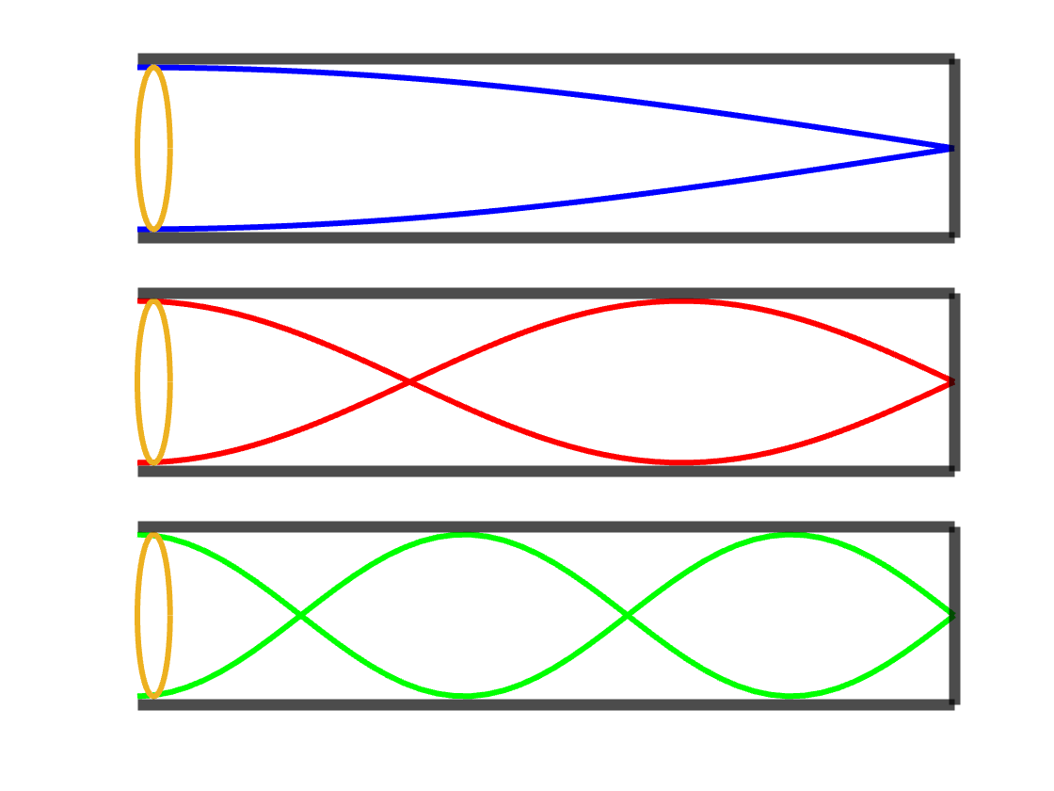
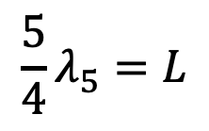
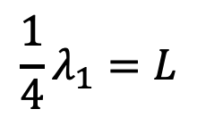
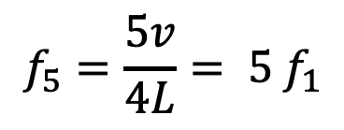
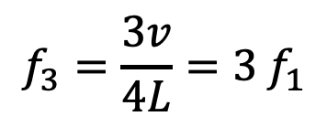

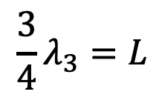

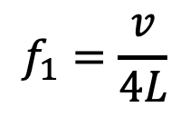

$${\frac{1}{4}λ}_{1}=L$$
$$Fundamental or First Harmonic$$
$$f_{1}=\frac{v}{4L}$$
$$\frac{3}{4}λ_{3}=L$$
$$Third Harmonic$$
$$f_{3}=\frac{3v}{4L}=3 f_{1}$$
$$\frac{5}{4}λ_{5}=L$$
$$Fifth Harmonic$$
$$f_{5}=\frac{5v}{4L}= {5 f}_{1}$$

Slide 19
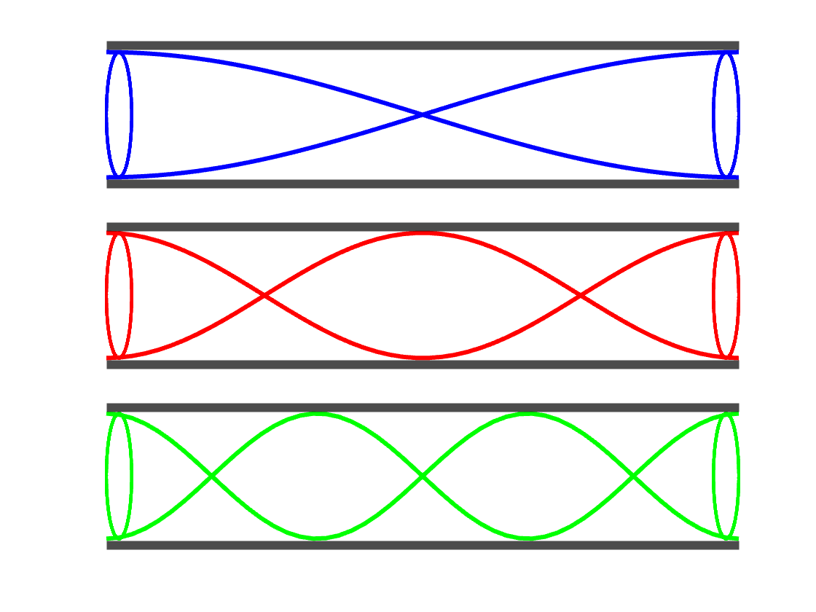
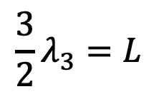
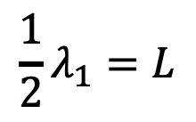
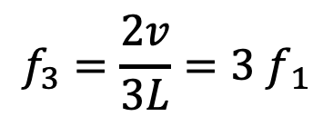
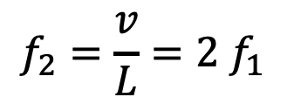



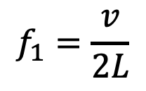
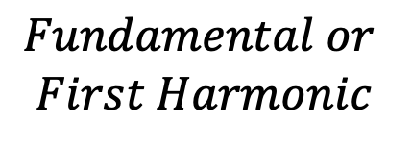
$${\frac{1}{2}λ}_{1}=L$$
$$Fundamental or$$
$$First Harmonic$$
$$f_{1}=\frac{v}{2L}$$
$$λ_{2}=L$$
$$Second Harmonic$$
$$f_{2}=\frac{v}{L}=2{ f}_{1}$$
$$\frac{3}{2}λ_{3}=L$$
$$Third Harmonic$$
$$f_{3}=\frac{2v}{3L}=3{ f}_{ 1}$$

