Slide 1
Spam Control on the Web
Paul M. Winkler
PyGotham II
June 2012

Slide 2
The Problem
Comment / post spam evolves
There will never be a silver bullet
Old projects in maintenance mode get increasingly hard to keep spam-free

Slide 3
"An Internet service cannot be considered truly successful until it has attracted spammers."
- Rafe's law
http://rc3.org/2006/10/20/rafes-law/

Slide 4
The Story of Btwlzyq
Tracking a resourceful spammer on http://communityalmanac.org.

Slide 5
Story of ...
TODO

Slide 6
Existing Solutions
A brief taxonomy / survey
See also appendix B - prior art.

Slide 7
Existing Solutions: Form Modifiers
Captcha (obtrusive)
Other problem solving (obtrusive)
Honeypot Fields (unobtrusive)
By design, only useful against bots.

Slide 8
Content Filtering Services
Remote APIs:
Bayesian filters
IP blacklist
Good: Unobtrusive. Large training set.
Bad: Network overhead. Reliabilty.

Slide 9
Content filters: Local
Bayesian filters and IP blacklists, but also:
IP throttling
Other metadata filtering: link counting, admin users, …
Good: Unobtrusive. Low I/O overhead. Reliable.
Bad: Requires training.

Slide 10
Misc filters
Greylisting?
http://douglas.mayle.org/greylisting-comments

Slide 11
Summary
Lots of solutions
None are sufficient alone
Complement each other
n solutions == n APIs
n APIs integrate into m web apps == aaargh

Slide 12
Trac SpamFilter plugin - a flexible approach
"all of the above" approach
  14 filters and 3 captchas
extensible, easy to code new filters
highly configurable
  select filters
  assign karma scores to filters (positive = good)
  set minimum karma needed for posting

Slide 13
Trac SpamFilter plugin (cont)
Records possible spam in database for moderation
Moderation UI: rough but useful
Moderation includes training
Lots of tests

Slide 14
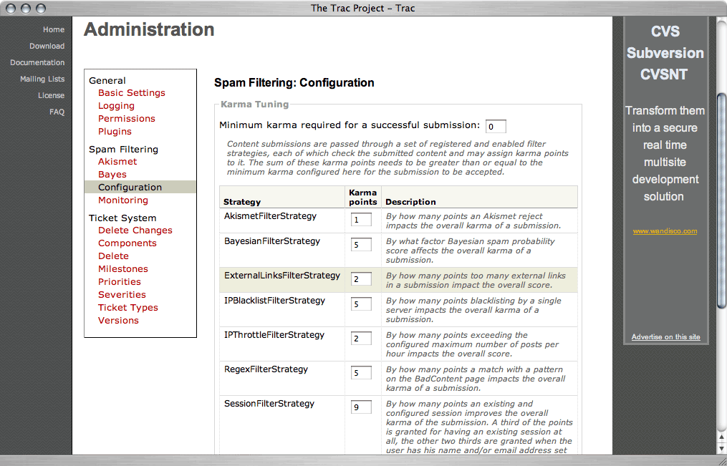

Slide 15
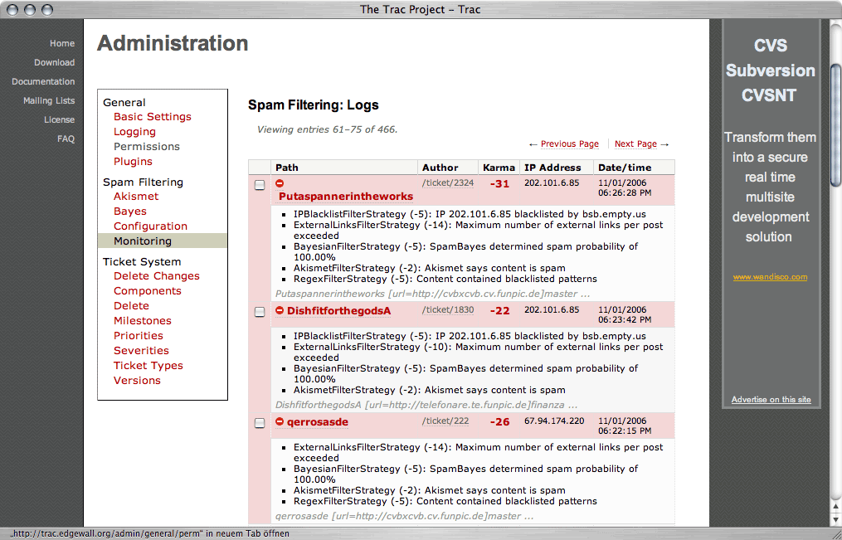

Slide 16
It only works with Trac.
Bummer.

Slide 17
About the Trac plugin
http://www.cmlenz.net/archives/2006/11/managing-trac-spam
SpamAssassin has a similar multi-filter strategy, but is designed for use with email, not web:
http://wiki.apache.org/spamassassin/BlogSpamAssassin

Slide 18
Hamage Control
Goal: Decoupling Trac SpamPlugin from Trac
Prototype
URL

Slide 19
Filters - remote
stopforumspam.py
akismet.py
blogspam.py
defensio.py
extlinks.py
httpbl.py
ip_blacklist.py
linksleeve.py
typepad.py

Slide 20
Filters - local
regex.py
bayes.py
extlinks.py
ip_blacklist.py
ip_regex.py
ip_throttle.py
session.py

Slide 21
Captcha
recaptcha.py
image.py (uses PIL)
expression.py ("what is three plus twelve") … looks unfinished

Slide 22
Hamage Control: modes of operation
Python library API
WSGI middleware
Hybrid
  WSGI in front for cheap / non-interactive tests
  Low-level API for integrating with forms
Native integration with every framework
  noooo

Slide 23
Python API: FilterSystem
TODO:
Make a filtersys with a dict config
Call test()

Slide 24
Python API: Filters

Slide 25
Python API: Registering filters
We use "entry points" (TODO link)
Example from setup.py for a filter TODO
Example from setup.py for a backend TODO

Slide 26
WSGI Middleware
Request: Client POST → hamage (filtering) → application
Response: application response→ hamage (form field and error message injection) → client

Slide 27
Demo
Django running via wsgiref server, behind WSGI middleware
Again with an alternate WSGI config

Slide 28
Wish List: RESTful web service?
Use with any language
Scale independently
Would love to do this
… later

Slide 29
Performance & Scaling
Run cheapest filters first; allow them to short-circuit.
Parallelize slow filters (eg. network IO)
  How?
Asynchronous operation

Slide 30
More about async
Use case: speed
Use case: moderation
  Integration just got tougher
  Feedback just got really hard
    Don't bother?

Slide 31
More on logging
Remember Btwlzyq?
Consistency matters

Slide 32
Parting shot
<a href="http://example.com" rel="nofollow">
buy my cheap replica rolexes</a>
No page rank for you buddy

Slide 33
Appendix A. Links
Hamage Control:https://github.com/slinkp/hamage
These slides: http://slinkp.com/~paul/pygotham2/spam_control_slides_pygotham2.odp
Trac plugin: http://trac.edgewall.org/wiki/SpamFilter

Slide 34
Appendix B. Prior Art
  Python packages related to spam. Too many for one slide, see https://gist.github.com/2896944#file_prior_art.txt

