Slide 1
SDP Project
Francesco Guardiani
Matricola 946952

Slide 2
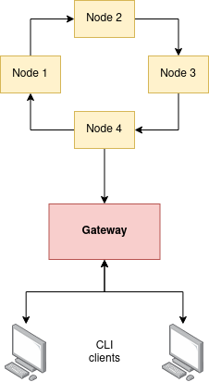
Architecture
Modules:
sdp-common
sdp-node
sdp-gateway
sdp-gateway-client
sdp-client

Slide 3
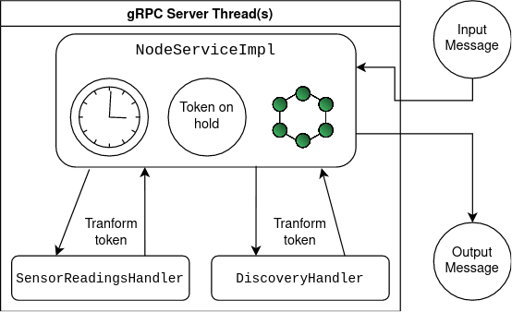
Node - Message handling

Slide 4
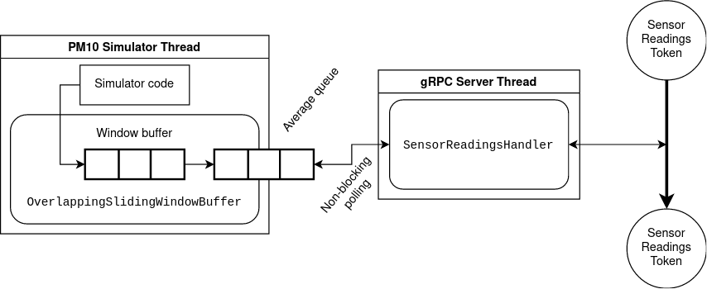
Node - PM10Simulator integration

