Slide 1
IR LED and photodiode
inserted from rear, legs bent
through 90 degrees, and fixed
with epoxy.
Front
Rear
Side
Hole set at 10mm from base
as specified by ‘rules’
3mm hole
Detail re. modifications to aluminium maze pegs to incorporate photodiode and led for automatic start/stop detection.
A.Wilcox 2004 c. TIC
Milled channel

Slide 2
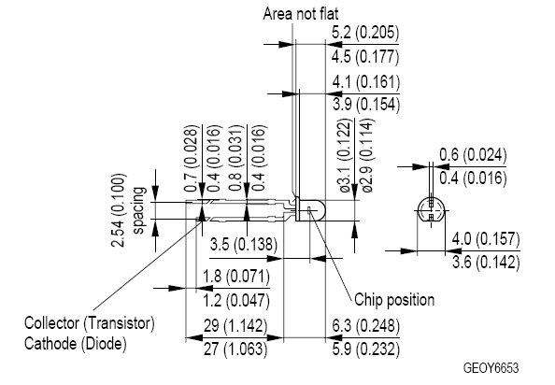
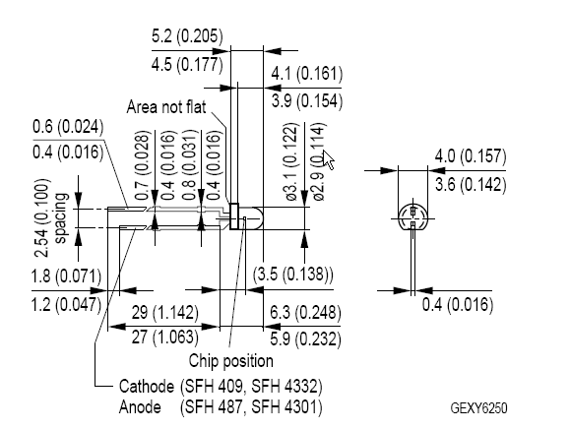
SFH309FA = Phototransistor = Receiver
Long = Emitter = BLUE wire
Short = flat = Collector = YELLOW wire
Yellow
Blue
SFH409 = IR LED = Transmitter
Long = Anode = RED wire
Short = flat = Cathode = GREEN Wire
Green
Red

