Slide 1
Design of a plant to produce Methacrylic acid and
2-Hydroxyethyl Methacrylcate
22CHE142
Nidhi Kulkarni

Slide 2
Summary
Capacity – 20,000 Tonnes per annum
Process – 2 step Oxidation of isobutene to methacrylic acid , esterification of Methacrylic acid with Ethylene oxide.

Slide 3
Feed to the reactor
Cannot be a mixture of C4 compounds
Butadiene and other alkenes reduce the catalyst activity
Pure isobutene from MTBE

Slide 4
List of equipments
Equipment | Description | Type
R201 | Oxidation reactor | Multi tubular packer bed
R202 | Oxidation reactor | Multi tubular packer bed
C301 | Quencher | Direct contact using water
C203 | Crystallizer
Filter
T204 | Extraction column | Packed column
T302 | Distillation column | Plate column
T303 | Distillation column | Packed column
T304 | Distillation column | Packed column
R305 | Esterification reactor | Cstr (gas-liq)
T306 | Distillation column | Packed column

Slide 5
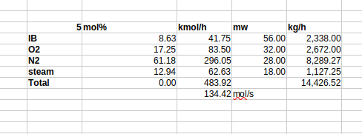
Feed to the reactor
Heated to 350 K

Slide 6
Reactor design parameters
Type of reactor – Multi-tubular packed bed
Catalyst size – 30 mm
Tube internal diameter – 20-30 mm
Catalyst particle density – 1900 kg/m3
Catalyst bulk density – 2400 kg/m3
Catalyst specific area – 3.4 m2/g
Pore volume – 0.72 g/m3
References – US20070049769A1,

Slide 7

Rate equation (update)
k_r = 3.22e-11; units of mol, atm, s, m2
k0_oxd = 7.23e-12; units of mol, atm, s, m2
Ea_oxd = -142; kJ/mol
Ea_red = -52; kJ/mol, x = 0.8, y=0.37
To convert rate constant to mol, s, kg units multiply by specific area
Specific area = 3.4 * 1000 m2/kg

Slide 8

Rate equation for side reactions

Slide 9

Reactor conditions
Temperature – 350 °C
Pressure – 2.2 bar abs
Isothermal reactor, 6.9 MW of cooling required to maintain isothermal conditions
Selectivities:

Slide 10
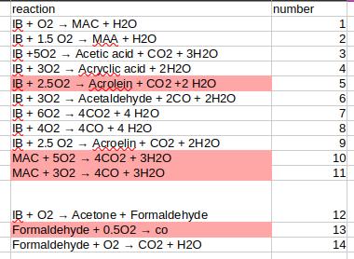
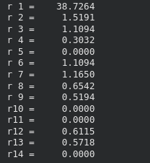
Extent of reactions

Slide 11
Mass balance across the bed
 | initial | SO AT ANY POINT IN THE PBR Z
FMAC | 0 | FIB0*Xa*Ya
FS | 0 | FIB0*Xa*Yb
FCO | 0 | FIB0*Xa*Yc*4
FCO2 | 0 | FIB0*Xa*Yd*4
FIB | FIB0 | FIB0*(1-Xa)
FO2 | FO20 | FO20 – (FIB0*Xa*Ya – FIB0*4.75*xa*Yb – FIB0*Xa*Yc -FIB0*Xa*Yd*6/4)
FINERTS | Finerts | Finerts
FH2O | FH2O0 | FH2O0 + FIB0*Xa*Ya + Fib0*Xa*Yb + FiB0*Xa*Yc*4 + FiB0*Xa*Yd*4
Total | FT0 | FT0 + FIB0Xa(6Yc + 5.5Yd – 3.75Yb)

Slide 12
Design equation
FA_0 is the molar flow rate of limiting reactant, in this Isobutene
FA_0 = 41.75 kmol/h = 11.6 mol/s
Target conversion is 99.4% and selectivity for methacrolein is 83%
In the rate equation, we substitute the values for partial pressure
P_i = mole fraction ⨉ Total pressure
Using the flow rates in terms of the selectivity and conversion to write the mole fraction

Slide 13
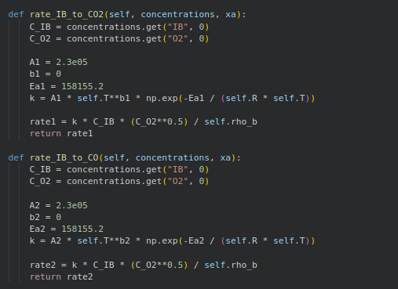

Slide 14
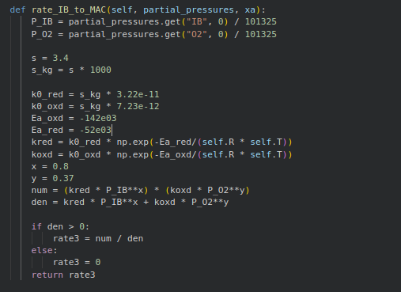

Slide 15
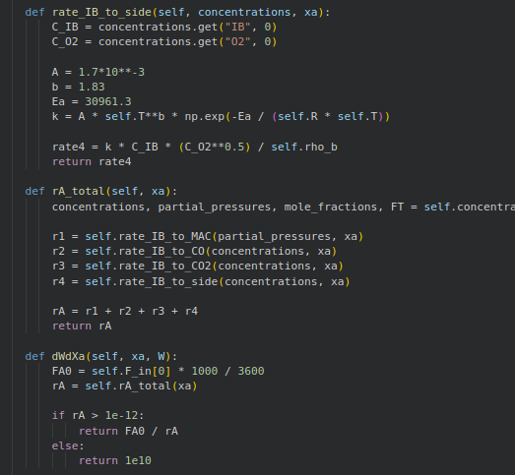

Slide 16
Final design
Number of tubes – 1819
Tube internal diameter – 27.75 mm
Weight of catalyst – 21,618.89 kg (21 ton)
Length of tube - 12 m
Total bed volume – 10.41 m3
Pressure drop – 29,978.13 Pa

Slide 17
Tube parameters
Tube layout – square
Tube OD: 31.75 mm
Tube ID: 27.75 mm
Tube wall thickness: 2.0 mm
Tube pitch: 39.69 mm
Pitch ratio: 1.250

Slide 18

Shell parameters
Shell ID: 1180 mm
Shell OD: 1196 mm
Shell wall thickness: 8.00 mm

Slide 19
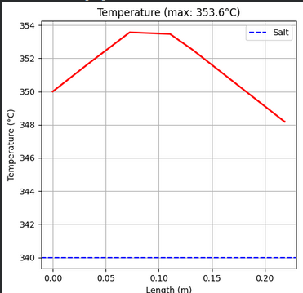
Temperature profile
Temperature rise = Q/Fcp
Temperature rise = 252K

Slide 20
Utility for cooling
LiNaKNO3 salt
Melting temperature – 401 K
Overall heat transfer coefficient – 151.3 W/m2K
(htube = 10.9 W/m²K, hshell = 187.89 W/m²K)

Slide 21
Mass transfer parameters
Length of tube to diameter of particle ratio is 400, implying Plug flow conditions
Bulk diffusivity ( λ > ra )

Slide 22
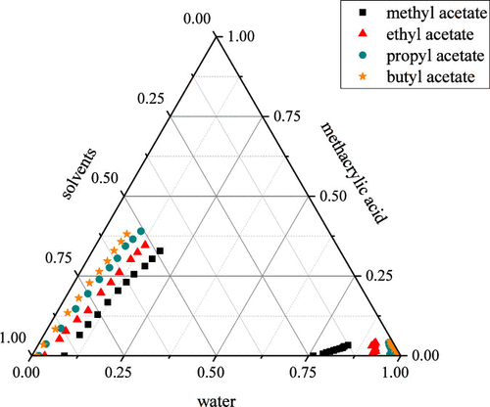
LLE solvent
Solvent chosen - Butyl Acetate
Dissociation coefficient for Butyl acetate is 9-10
Polymerization inhibitor – MEHQ (300 ppm)
Temperature 13 °C

Slide 23
Feed stream
Feed | mol% | kmol/h | mw | kg/h | wt%
MAA | 10.55 | 24.70 | 86.00 | 2,124.00 | 35.04
MAC | 0.07 | 0.17 | 70.00 | 12.14 | 0.20
acrylic acid | 0.14 | 0.32 | 72.00 | 23.40 | 0.39
acetic acid | 1.43 | 3.36 | 60.00 | 201.48 | 3.32
water | 87.81 | 205.64 | 18.00 | 3,701.49 | 61.06
Total |  | 234.19 |  | 6,062.51 | 0.00

Slide 24
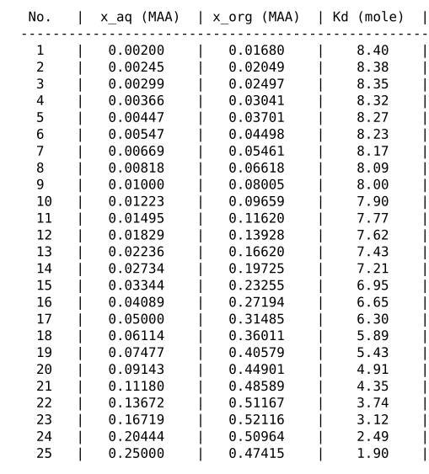
LLE data
Required parameters -
MAA in extract phase > 2000 kg/h

Slide 25
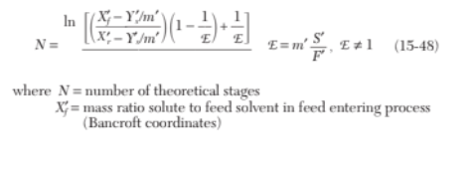
S/F Ratio
Design basis: 1.5 × S_min; S_min=1/K_D(MAA)
Mass basis – S/F = 3.3
Solvent required – 20,001 kg/h
Number of stages calculated using kremser’s equations
N = 4

Slide 26
Extract and raffinate
Component | Extract (Organic out) | Raffinate (Aqueous out)
MAA (Methacrylic acid) | 2,066.7 | 57.3
Methacrolein (MAC) | 12.0 | 0.0
Acrylic acid | 22.9 | 0.1
Acetic acid | 201.0 | 0.0
Water | 986.2 | 2,714.8
n-Butyl Acetate (solvent) | 18,568.0 | 1,433.3
Total mass flow (kg/h) | 21,856.8 | 4,205.5

Slide 27
HAZOP for reactor
Parameter | Deviation | Key Causes | Key Risks | Safeguards
Catalyst Activity | High | Fresh/overactive catalyst | Hotspots, runaway, low selectivity | Temp monitoring, controlled startup
Catalyst Activity | Low | Aging, poisoning | Low conversion, explosion risk downstream | GC monitoring, replacement plan
Temperature Profile | Hotspot | Maldistribution, high activity | Tube failure, runaway | Multi-point thermocouples
Temperature Profile | Cold spot | Low temp, deactivated catalyst | Poor conversion, delayed runaway | Temp control, feed check
Outlet Composition | High COx | High temp, excess O2 | Over-oxidation, inefficiency | Online analyzers
Outlet Composition | Low Methacrolein | Low activity/temp | Low yield, flammable off-gas | GC, ratio control

Slide 28
HAZOP for reactor
Parameter | Deviation | Key Causes | Key Risks | Safeguards
Pressure | High | Outlet blockage | Rupture, leaks | PSV, pressure interlocks
Pressure | Low | Leaks, compressor failure | Air ingress, explosion | Gas detectors, isolation
Space Velocity | High | High flow | Low conversion, explosion risk | Flow limits, alarms
Space Velocity | Low | Low flow | Over-oxidation, hotspots | Flow + temp control
Pressure Drop | High | Fouling, coking | Flow restriction, damage | DP monitoring
Pressure Drop | Low | Channeling, catalyst loss | Poor conversion, bypassing | DP alarms, inspection

