Slide 1
Object-Oriented Programming
Programming Project #2
郭建志

Slide 2
Background
Wireless ad hoc network without GPS
Every node only has the local information (i.e., its neighbors’ information) and the destination’s information
destination
source

Slide 3
Background
Wireless ad hoc network without GPS
Every node only has the local information (i.e., its neighbors’ information) and the destination’s information
destination
source

Slide 4
Naïve Routing Scheme: AODV (BFS)
AODV: ad hoc on-demand distance vector routing
Broadcast RREQ from the source to all nodes
Each node records the hop distance to the source
Send RREP from the destination to the source along the path
3
destination
2
4
3
6
1
4
1
2
2
6
7
5
1
6
7
1
3
3
4
5
source
1
3
6
2
5
4

Slide 5
Naïve Routing Scheme: AODV (BFS)
AODV: ad hoc on-demand distance vector routing
Broadcast RREQ from the source to all nodes
Each node records the hop distance to the source
Send RREP from the destination to the source along the path
3
destination
2
4
3
1
4
1
2
2
5
1
6
1
3
3
4
5
source
1
3
2
5
4

Slide 6
Naïve Routing Scheme: AODV (BFS)
AODV: ad hoc on-demand distance vector routing
Advantage: Shortest path guaranteed
Disadvantage: Broadcast storm problem Scalability issue
destination
6
1
5
source
3
2
4

Slide 7
Naïve Routing Scheme: AODV (BFS)
AODV: ad hoc on-demand distance vector routing
Advantage: Shortest path guaranteed
Disadvantage: Broadcast storm problem Scalability issue
destination
How about abstract the network first?
Construct a backbone network
Only use AODV on the backbone network
6
1
5
source
3
2
4

Slide 8

Abstract the Network: Backbone Network
Dominating set (DS) is a subgraph ($D$) of a graph ($G$) such that every vertex not in $D$ is adjacent to one member of $D$

Slide 9

Abstract the Network: Backbone Network
Dominating set (DS) is a subgraph ($D$) of a graph ($G$) such that every vertex not in $D$ is adjacent to one member of $D$
Connected dominating set (CDS)

Slide 10

Abstract the Network: Backbone Network
Dominating set (DS) is a subgraph ($D$) of a graph ($G$) such that every vertex not in $D$ is adjacent to one member of $D$
Connected dominating set (CDS)
How to construct a minimum CDS?

Slide 11
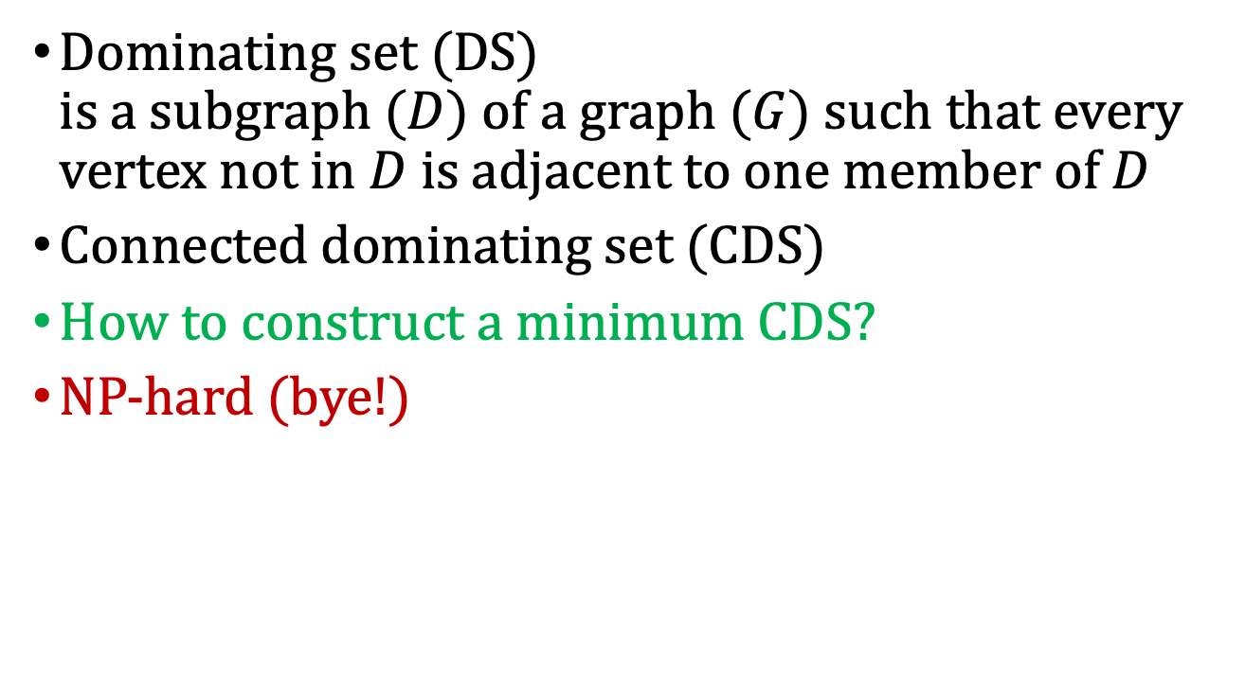
Abstract the Network: Backbone Network
Dominating set (DS) is a subgraph ($D$) of a graph ($G$) such that every vertex not in $D$ is adjacent to one member of $D$
Connected dominating set (CDS)
How to construct a minimum CDS?
NP-hard (bye!)

Slide 12
Abstract the Network: Backbone Network
How to construct a minimum CDS?
NP-hard → many approximation algorithms
But, here we do not focus on approximation

Slide 13
Abstract the Network: Backbone Network
Our method: Step 1. Construct a maximal independent set (MIS) 1. All nodes are marked active
1
10
7
5
11
3
4
13
6
8
12
9
2

Slide 14
Abstract the Network: Backbone Network
Our method: Step 1. Construct a maximal independent set (MIS) 2. If a node has a smaller ID than its neighbors, then it becomes a node of MIS
1
10
7
5
11
3
4
13
6
8
12
9
2

Slide 15
Abstract the Network: Backbone Network
Our method: Step 1. Construct a maximal independent set (MIS) 3. All of its neighbors are marked inactive
1
10
7
5
11
3
4
13
6
8
12
9
2

Slide 16
Abstract the Network: Backbone Network
Our method: Step 1. Construct a maximal independent set (MIS) 4. Repeat 1-3 and ignore the inactive nodes
1
10
7
5
11
3
4
13
6
8
12
9
2

Slide 17
Abstract the Network: Backbone Network
Our method: Step 1. Construct a maximal independent set (MIS) 4. Repeat 1-3 and ignore the inactive nodes
1
10
7
5
11
3
4
13
6
8
12
9
2

Slide 18
Abstract the Network: Backbone Network
Our method: Step 1. Construct a maximal independent set (MIS) 1. All nodes are marked active 2. If a node has a smaller ID than its neighbors, then it becomes a node of MIS 3. All of its neighbors are marked inactive 4. Repeat 1-3 and ignore the inactive nodes 5. All the nodes in MIS join the CDS (not connected yet)

Slide 19

Abstract the Network: Backbone Network
But, here we do not focus on approximation
Our method: Step 2. Connect two nodes $u, v$($id\left(u\right)≤id(v)$) in the DS with $d\left(u,v\right)≤3$ with a shortest path from $u$ to $v$ using AODV
1
1
10
1
7
1
5
11
3
1
2
4
13
2
3
3
6
8
2
12
3
9
2
3
2

Slide 20

Abstract the Network: Backbone Network
But, here we do not focus on approximation
Our method: Step 2. Connect two nodes $u, v$($id\left(u\right)≤id(v)$) in the DS with $d\left(u,v\right)≤3$ → the visited nodes also join the CDS
1
10
7
5
11
3
4
13
6
8
12
9
2

Slide 21

Abstract the Network: Backbone Network
But, here we do not focus on approximation
Our method: Step 2. Connect two nodes $u, v$($id\left(u\right)≤id(v)$) in the DS with $d\left(u,v\right)≤3$ → repeat the connection for each node in MIS
1
10
7
5
11
3
4
13
6
8
12
9
2

Slide 22
Abstract the Network: Backbone Network
But, here we do not focus on approximation
Our method: Step 3. Construct routing tables for nodes in CDS
1
10
7
5
11
3
4
13
6
8
12
9
2

Slide 23
Abstract the Network: Backbone Network
Routing: Every node in CDS is the proxy node of itself Every node not in CDS selects the neighboring node with the smallest ID in CDS to be its proxy node
1
10
7
Node 1’s proxy is node 1
5
11
3
4
13
Node 5’s proxy is node 1
6
8
12
9
2

Slide 24
Abstract the Network: Backbone Network
Routing: 1. If node 5 wants to route a packet to node 6, find the proxy node of 6 → node 2 2. Send to node 5’s proxy and then send to node 6’ proxy, and finally reach node 6
1
10
7
5
11
3
4
13
6
8
12
9
2

Slide 25
Programming Project #1: AODV
Input:
Number of nodes and links
A set of nodes and a set of links
Routing pairs (source, destination)
Procedure:
Find the CDS
Use AODV to construct the routing table in nodes of CDS
Route the packet for each pair
Output:
Routing paths for all pairs

Slide 26
Programming Project #1: AODV
Requirement:
RREQ is sent toward the node with a smaller ID if there are multiple nodes with the same hop count
Construct the routingTable before routing
class node { public: unsigned int sendTo (int dstID); // return next private: <any type> routingTable; unsigned int id; }
node *sensor = new [num]; unsigned cur_id = srcID; while (cur_id != dstID){ cur_id = sensor[cur_id].sendTo(dstID); }

Slide 27
Input Sample: std cin
Format:
#nodes #undirectedLinks
linkID firstNodeID secondNodeID
…
#requestFlows
flowID sourceID destinationID
…
下次揭曉，先自己設計input

Slide 28
Input Sample: std cin
Format:
#nodes #undirectedLinks
linkID firstNodeID secondNodeID
…
#requestFlows
flowID sourceID destinationID
…
13 15
0 0 3
1 0 4
2 0 6
3 0 9
4 1 3
5 1 5
6 1 8
7 1 11
8 2 10
9 4 5
10 6 7
11 7 8
12 7 12
13 9 10
14 10 11
2
0 4 12
1 0 8
2 5 9
3 11 4
0
9
6
4
10
2
3
12
5
7
11
8
1

Slide 29
Output Sample: std cout
Format:
flowID firstNode secondNode … lastNode
…
下次揭曉，用自己設計input產生答案

Slide 30
Output Sample: std cout
Format:
flowID firstNode secondNode … lastNode
…
0 4 0 6 7 12
1 0 3 1 8
2 5 1 3 0 9
3 11 1 3 0 4
0
9
6
4
10
2
3
12
5
7
11
8
1

Slide 31
Note
神人期限(分數=100): 5/12 Tue (待調整)
繳交期限(分數上限90): 5/19 Tue (待調整)
超過一天扣 10 分
上傳 E-course2
C++ Source code
Show a good programming style

Slide 32
Routing Tables of Nodes for AODV
Every node has a routing table
For example, the table of node 0 is
Destination | Next
2 | 6
4 | 9
… | …
6
2
4
9
0

