Slide 1
Deep Learning Project
WASSIM SLITI
MOHAMED FARJAOUI

Slide 2
Task 1

Slide 3
Plan
Task1
In this task, we will define a model based on the pretrained EfficientNetV2 model to classify images into cancer and no cancer
In this task we will not start from scratch, we will begin by examining this work Skin Cancer Detection With Android App | Complete Project - Buff
ML

Slide 4
Plan
Task1
First, we downloaded the data used in the previous work which is a dataset with 40 image contain two classes :
-0 Benign
-1 Malignant
with 30 images in Train Dataset and 10 in Valid Dataset
Because this dataset is so small, we need to use data augmentation before training to optimize the performance of our model.

Slide 5
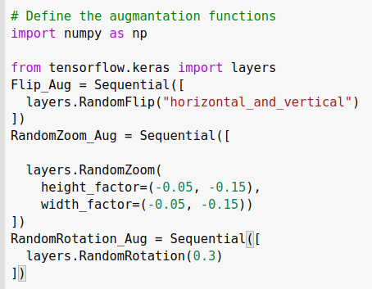
Plan
Task1
Data Augmantation :
-Horizontal and Vertical Filp
-Random Zoom
-Random Rotation

Slide 6
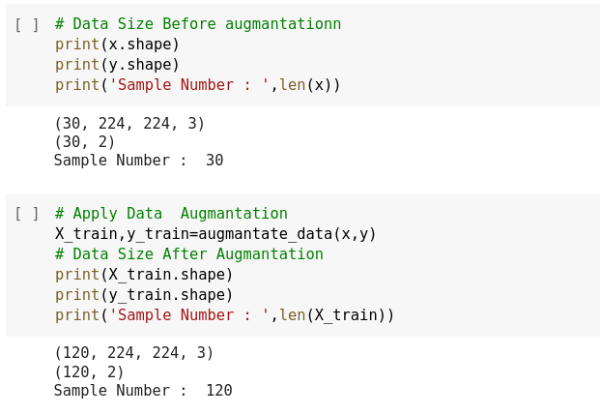
Plan
Task1
Before Data augmantation :
-30 images in train Data
After Data augmantation :
-120 images in train Data

Slide 7
Plan
Task1
Modeling :
-Transfer Learning of top layers of EfficientNetv2’s feature extractor
( feature_extractor.trainable = False )
- we added one extra hidden layer(512) compared to the previous work
- we also used batch normalization , dropout
- batch = 16

Slide 8
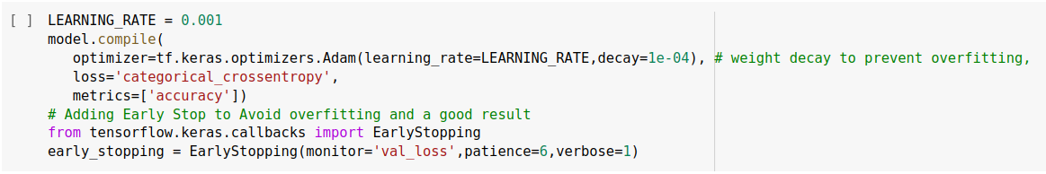
Plan
Task1
Modeling :
also we used weight decay, early stopping, to train our model

Slide 9
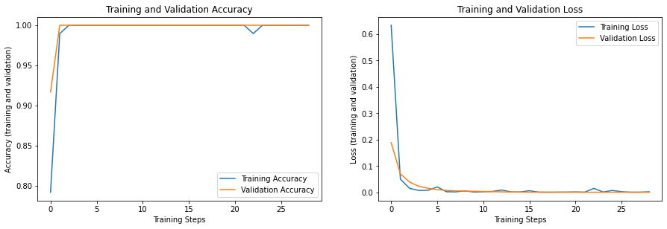
Plan
Task1
Training :

Slide 10
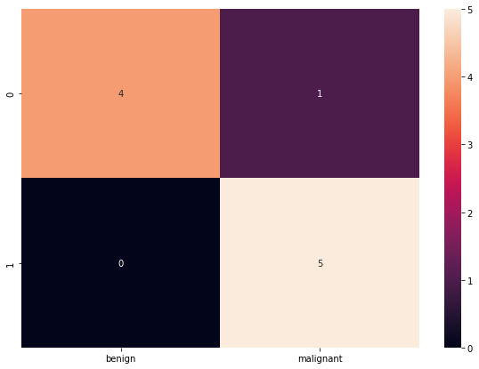
Plan
Task1
Evaluate our Model :
Accuracy: 0.9000

Slide 11
Task 2

Slide 12
Plan
Task 2
For this task, we started searching for a benchmark dataset for lesion detection (object detection) and segmentation (instance segmentation)
After several hours of searching, we decided to use the ISIC Challenge Datasets
link : https://challenge.isic-archive.com/data/#2017

Slide 13
Plan
Task 2
ISIC Challenge Datasets
Train Data :
- 2000 lesion images in JPEG
-2000 binary mask images in PNG format.
Valid Data :
- 180 lesion images in JPEG
- 180 binary mask images in PNG format.

Slide 14
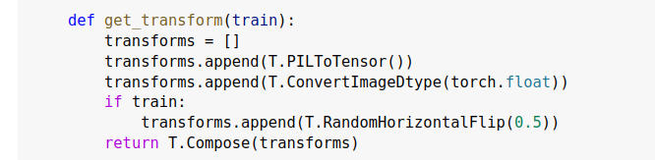
Plan
Task 2
ISIC Challenge Datasets
Also we applied some Data transformation methodes .

Slide 15
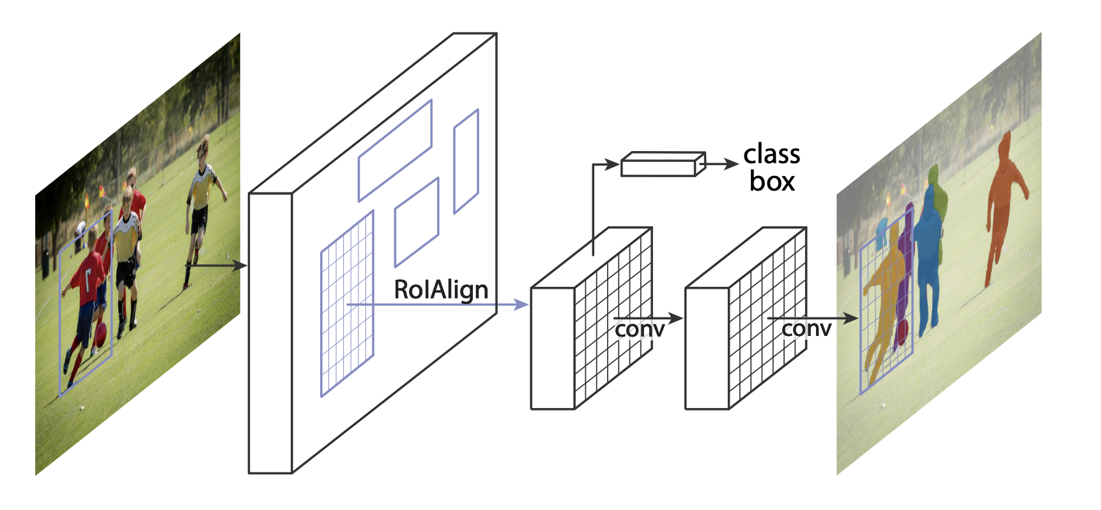
Plan
Task 2
Mask-RCNN is based on top of Faster R-CNN. Faster R-CNN is a model that predicts both bounding boxes and class scores for potential objects in the image.
Output :
-bbox
-masks

Slide 16
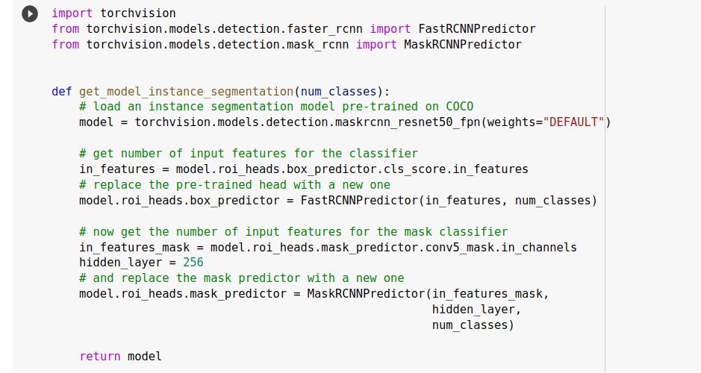
Plan
Task 2
Model

Slide 17

Plan
Task 2
Training
To train Mask-RCNN model with ISIC Challenge Datasets we used colab pro environment
Epoch = 10
Batch = 16
lr = 0.00005

Slide 18
Plan
Task 2
Evaluation :
Box (Detection ) :
- mAP calculated at IOU threshold 0.5 : 0.922
- mAP calculated at IOU threshold 0.75 : 0.685
- mAP calculated at IOU threshold 0.5-0.95 :0.622

Slide 19
Plan
Task 2
Evaluation :
Mask (segmentation) :
- mAP calculated at IOU threshold 0.5 : 0.916
- mAP calculated at IOU threshold 0.75 : 0.641
- mAP calculated at IOU threshold 0.5-0.95 :0.607

Slide 20
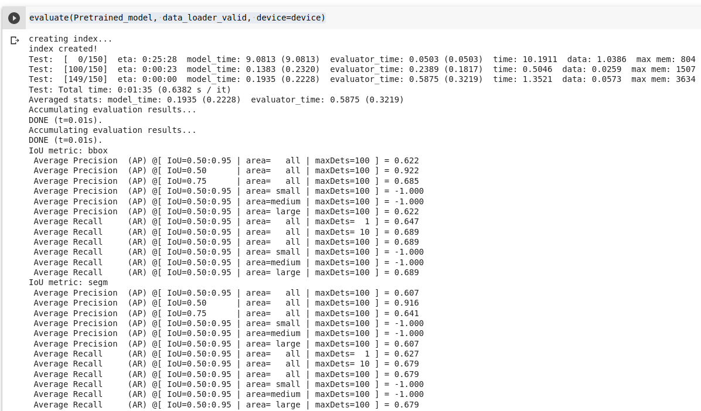
Plan
Task 2
Evaluation

Slide 21
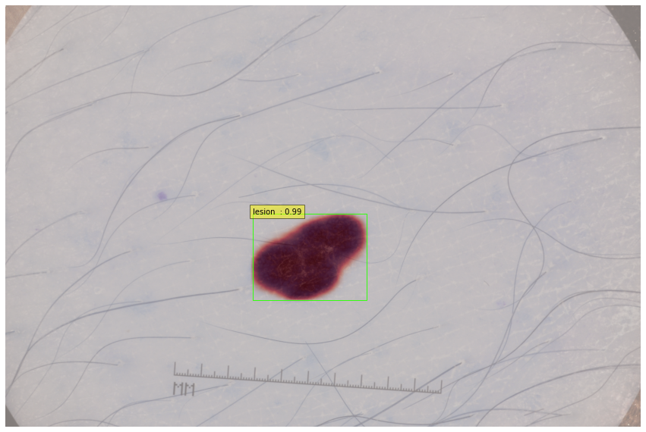
Plan
Task 2
Test

Slide 22
Task 3

Slide 23
Plan
Task 3
Dataset Preparation :
We will utilize yolov7 for lesion detection and segmentation in this task, although the data annotation for yolov7 differs from maskrcnn annotation.
So ,before starting training yolov7 with ISIC Challenge Datasets we need first to make it compatible with yolov7 model

Slide 24
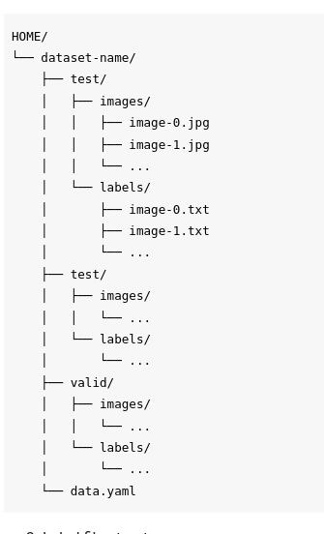
Plan
Task 3
Yolo v7 pytorch txt annotation format :
For YOLOv7 segmentation models, we will use the YOLO v7 PyTorch format.
Dataset directory contains images and labels divided into three parts - train, test and validation sub-sets. In addition, there should be a data.yaml file in the dataset root directory.

Slide 25
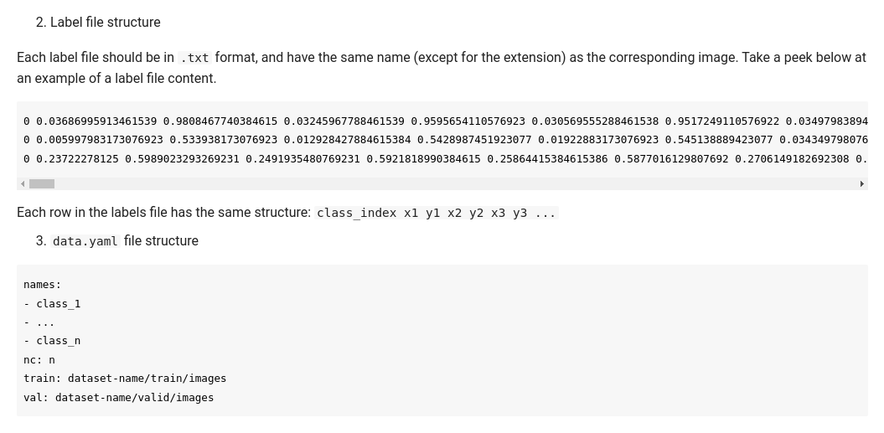
Plan
Task 3
Yolo v7 pytorch txt annotation format :

Slide 26
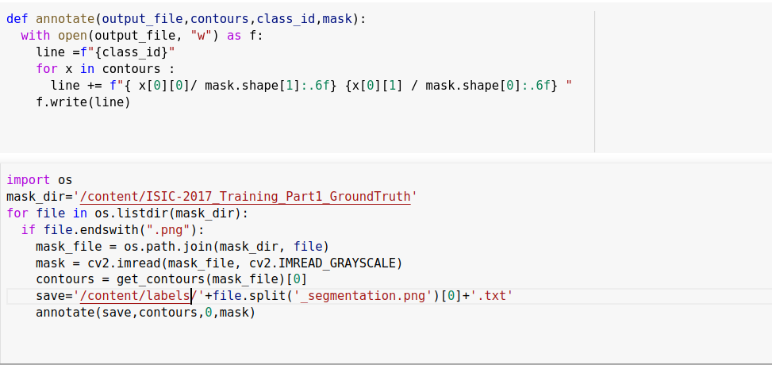
Plan
Task 3
to solve this problem we wrote a python script that transforms png masks annotation to Yolo v7 txt format

Slide 27
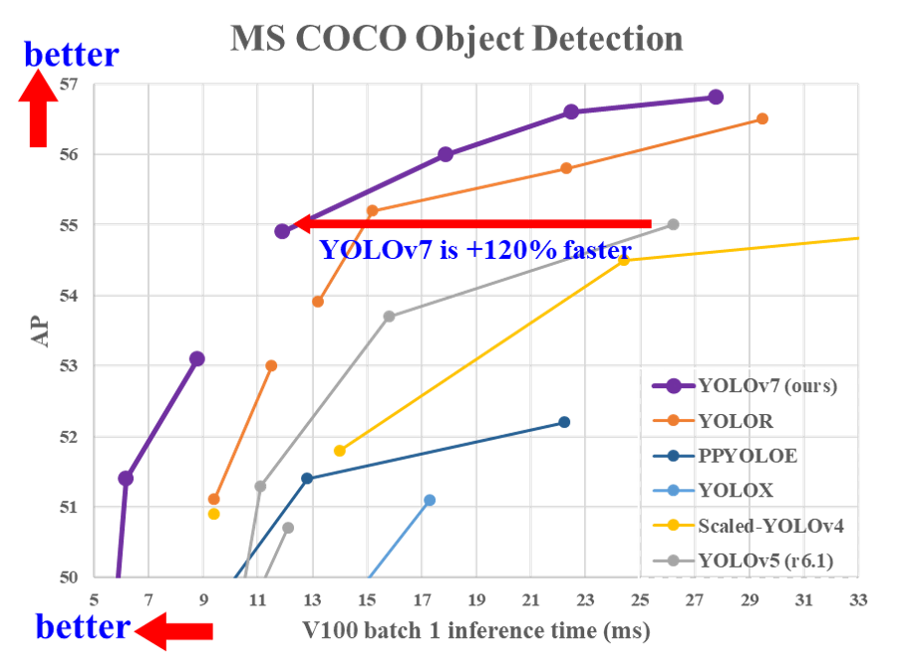
Plan
Task 3
Yolo v7 Performance compared with other solutions

Slide 28
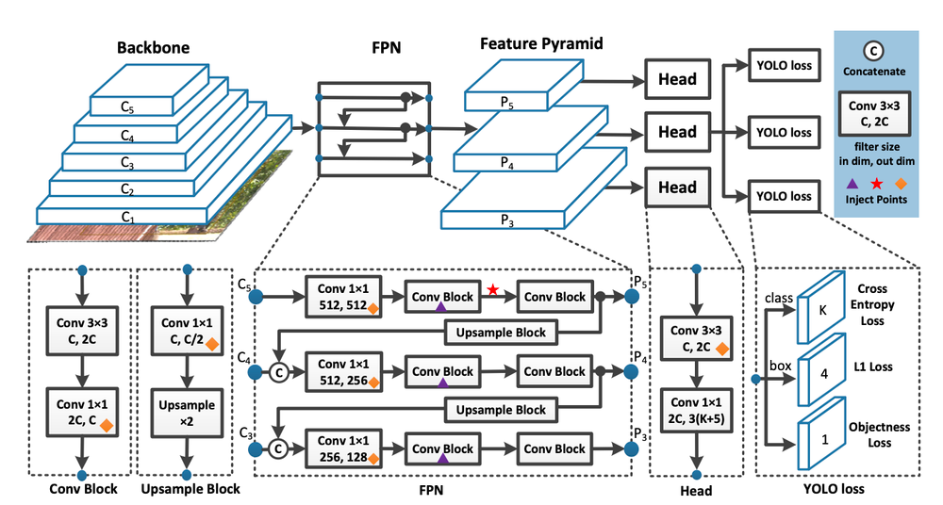
Plan
Task 3
Yolo v7 Architecture :

Slide 29
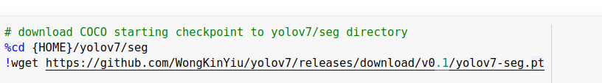
Plan
Task 3
Training :
we will use the pre-trained COCO model weight and then train it for lesion detection and segmentation

Slide 30
Plan
Task 3
Training
To train Yolo v7 model with ISIC Challenge Datasets we used colab pro environment
Epoch = 100
Batch = 16
lr0=0.01 ( lr variable)
momentum=0.937
weight_decay=0.0005

Slide 31
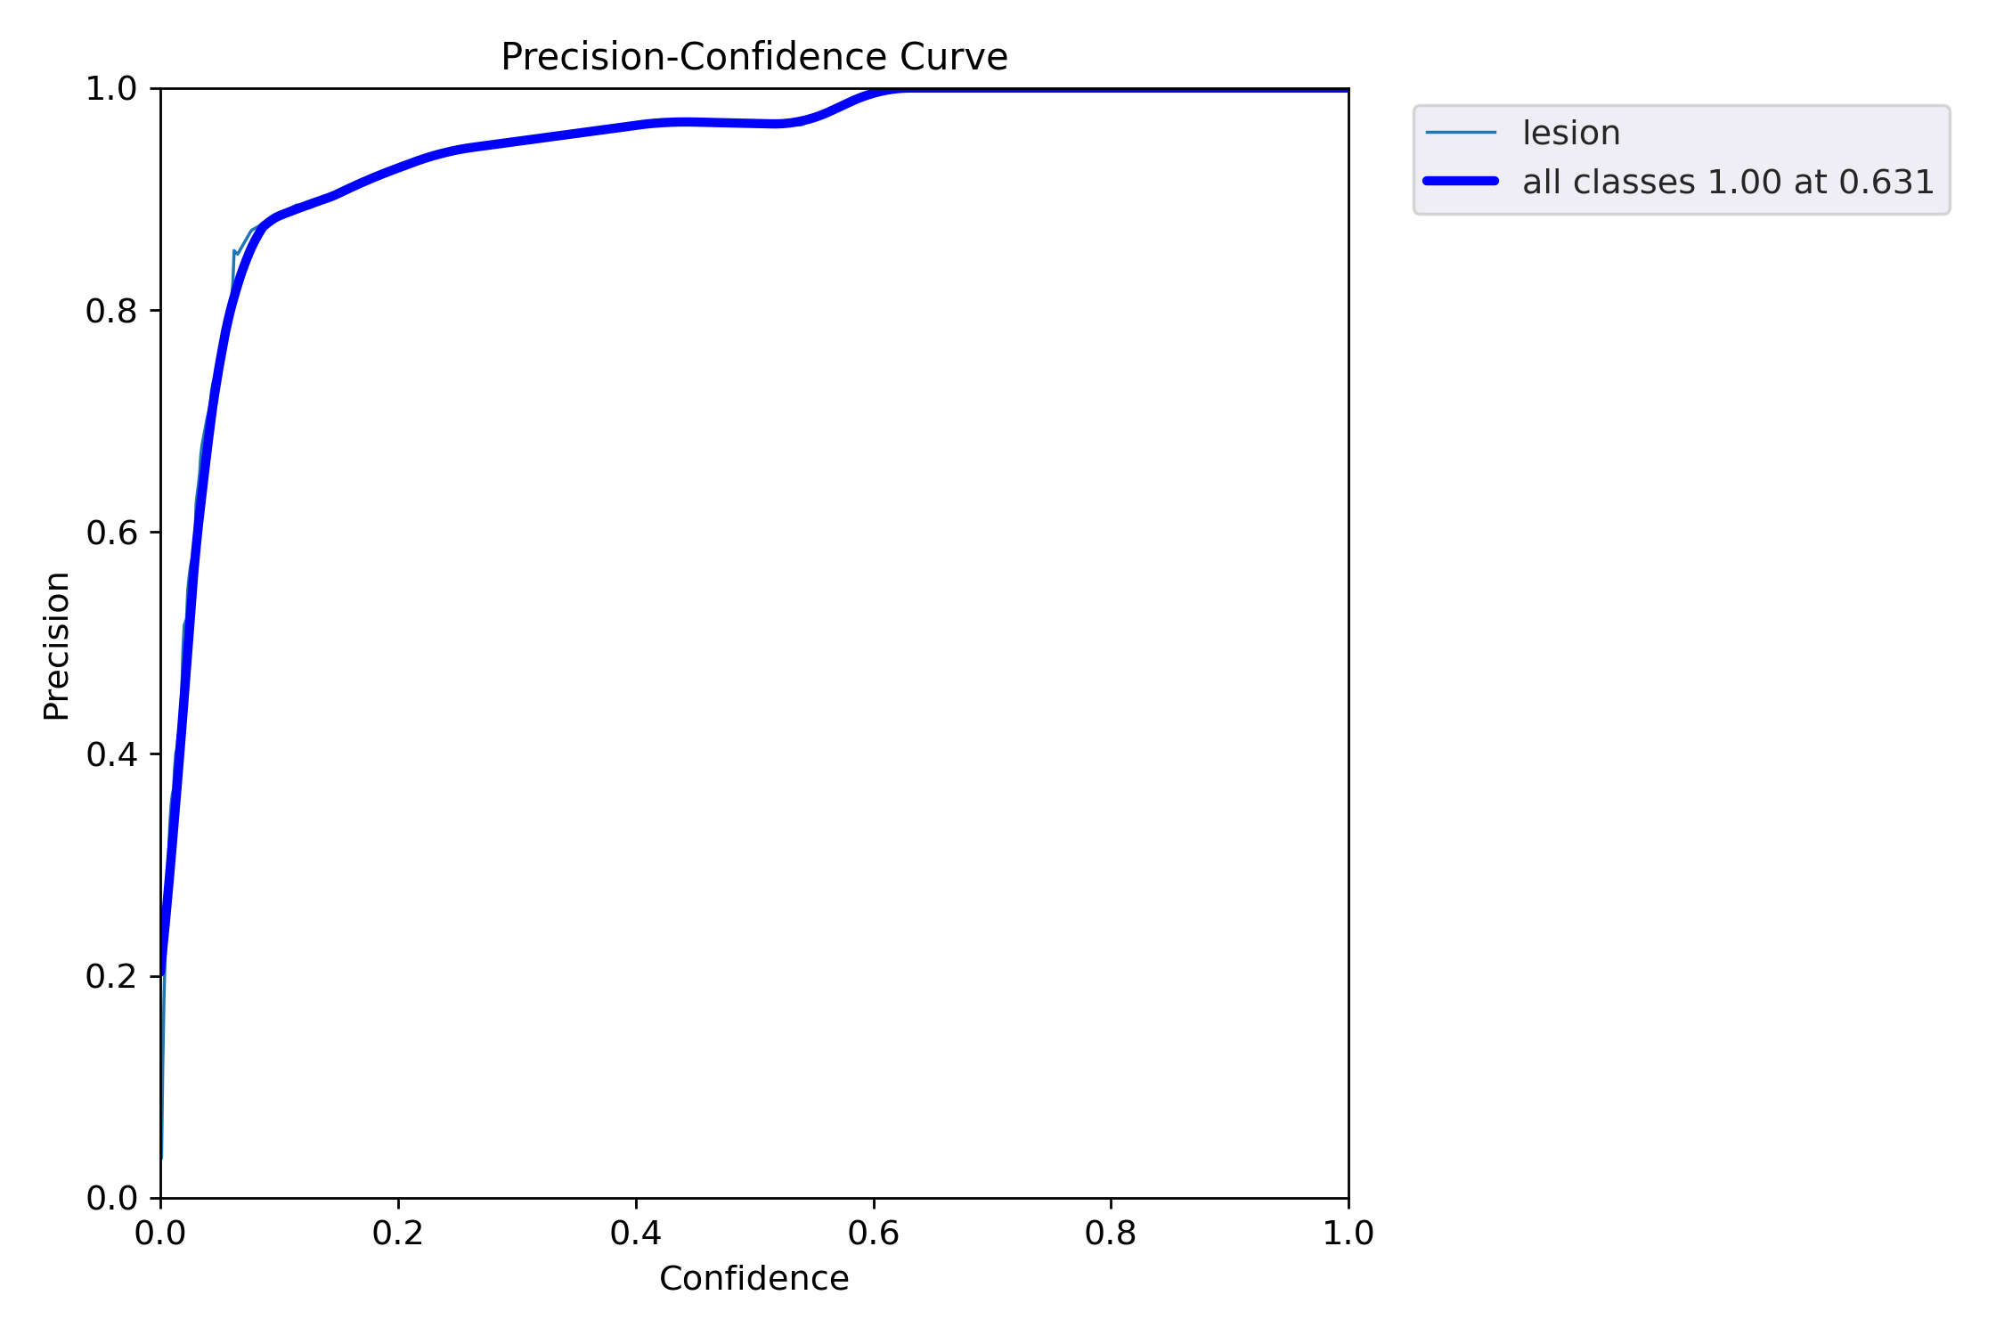
Plan
Task 3
Train :
Mask Precision evolution during training

Slide 32
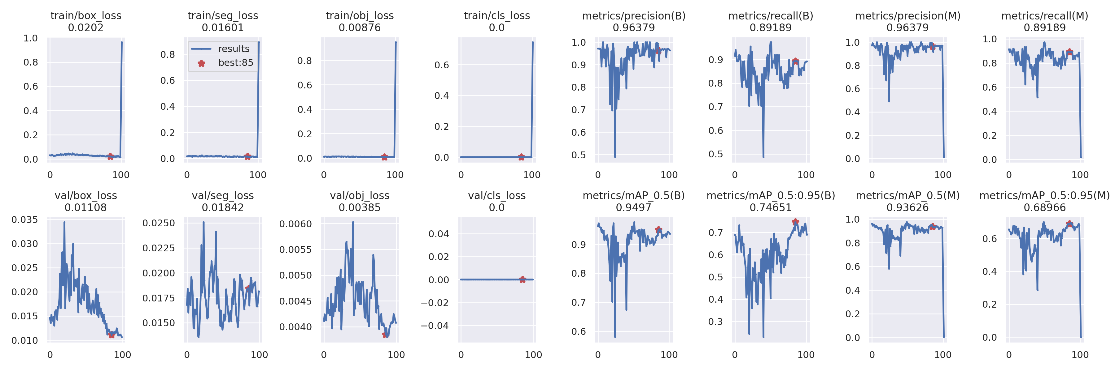
Plan
Task 3
Train :

Slide 33
Plan
Task 3
Evaluation :
Box (Detection ) :
- Precision :0.964
- Recall :0.892
- mAP calculated at IOU threshold 0.5 : 0.95
- mAP calculated at IOU threshold 0.5-0.95 :0.747

Slide 34
Plan
Task 3
Evaluation :
Mask (Segmentation ) :
- Precision :0.964
- Recall :0.892
- mAP calculated at IOU threshold 0.5 : 0.936
- mAP calculated at IOU threshold 0.5-0.95 :0.69

Slide 35
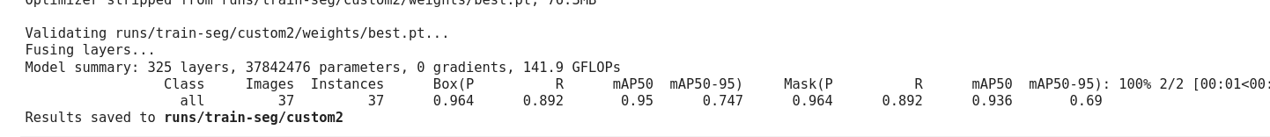
Plan
Task 3
Evaluation :

Slide 36
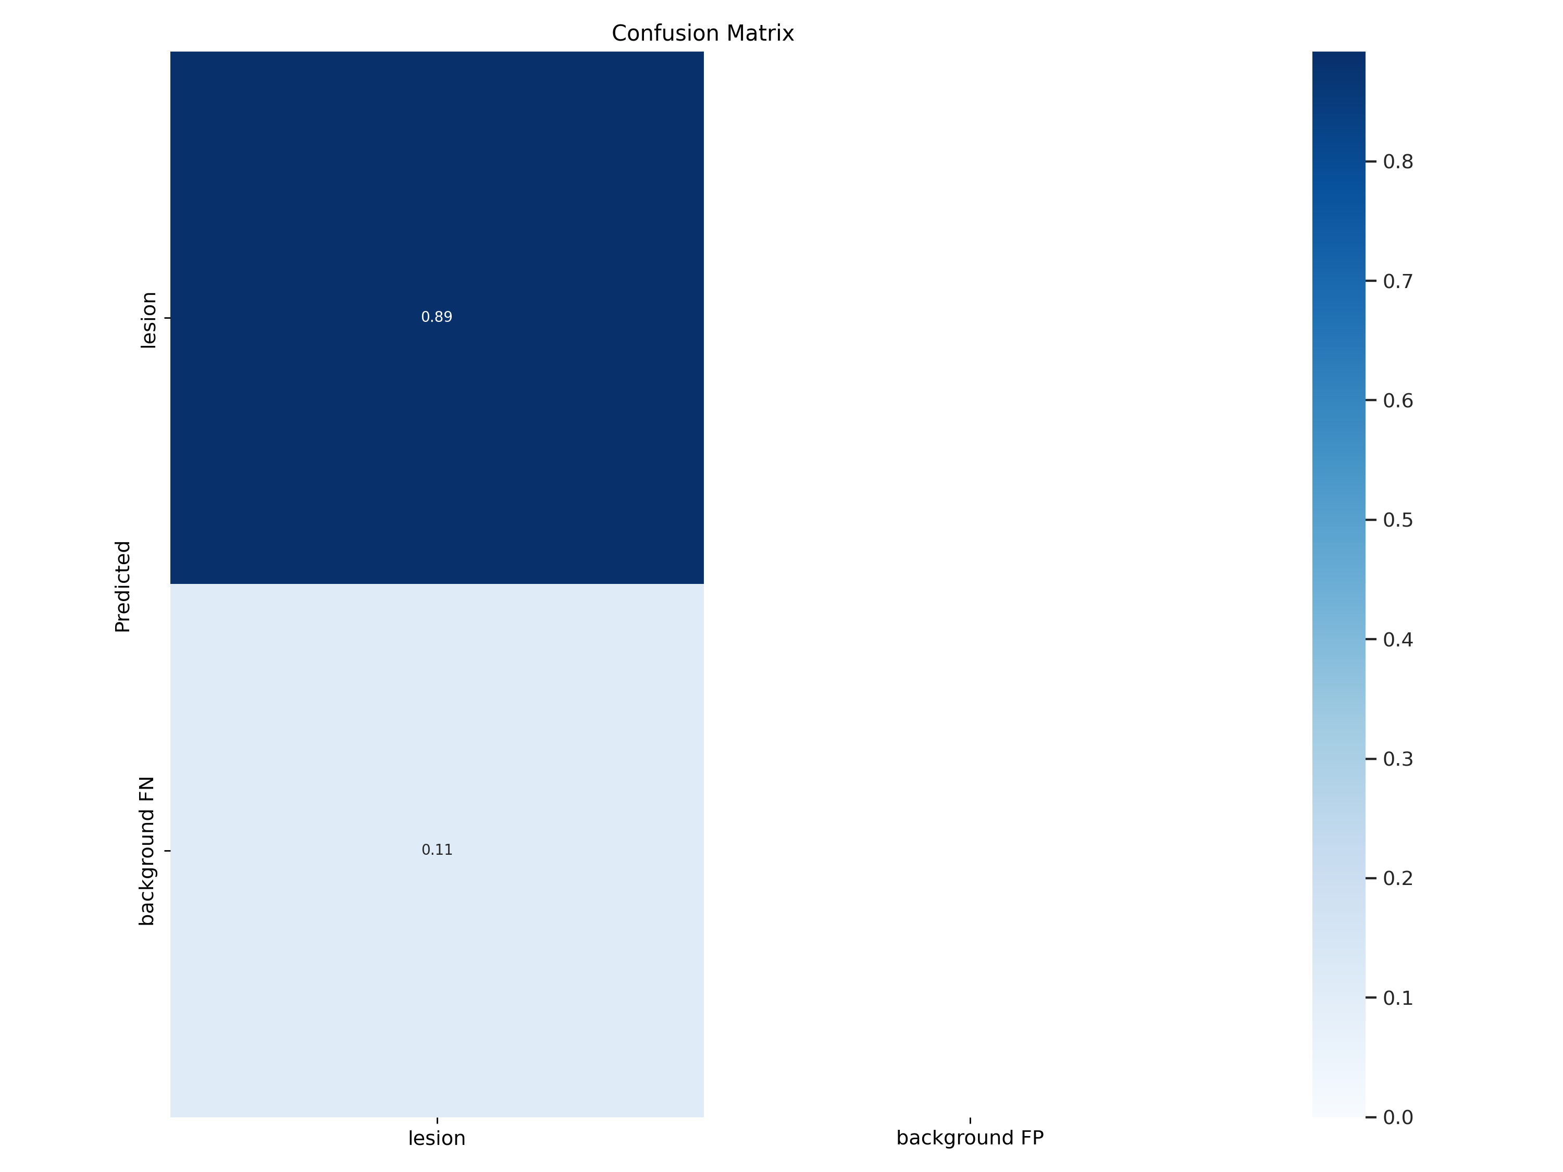
Plan
Task 3
Evaluation :

Slide 37
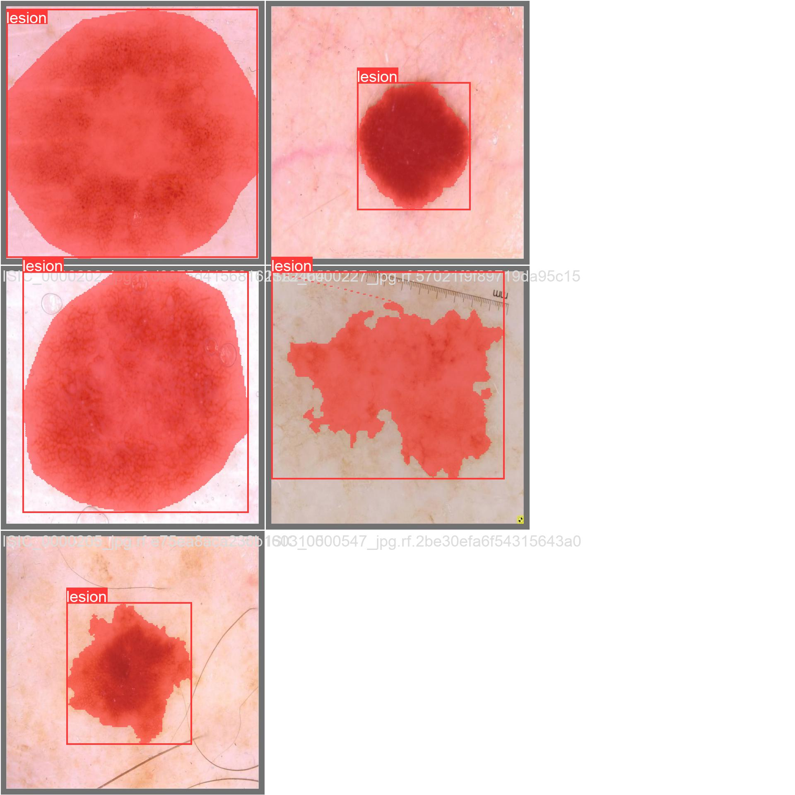
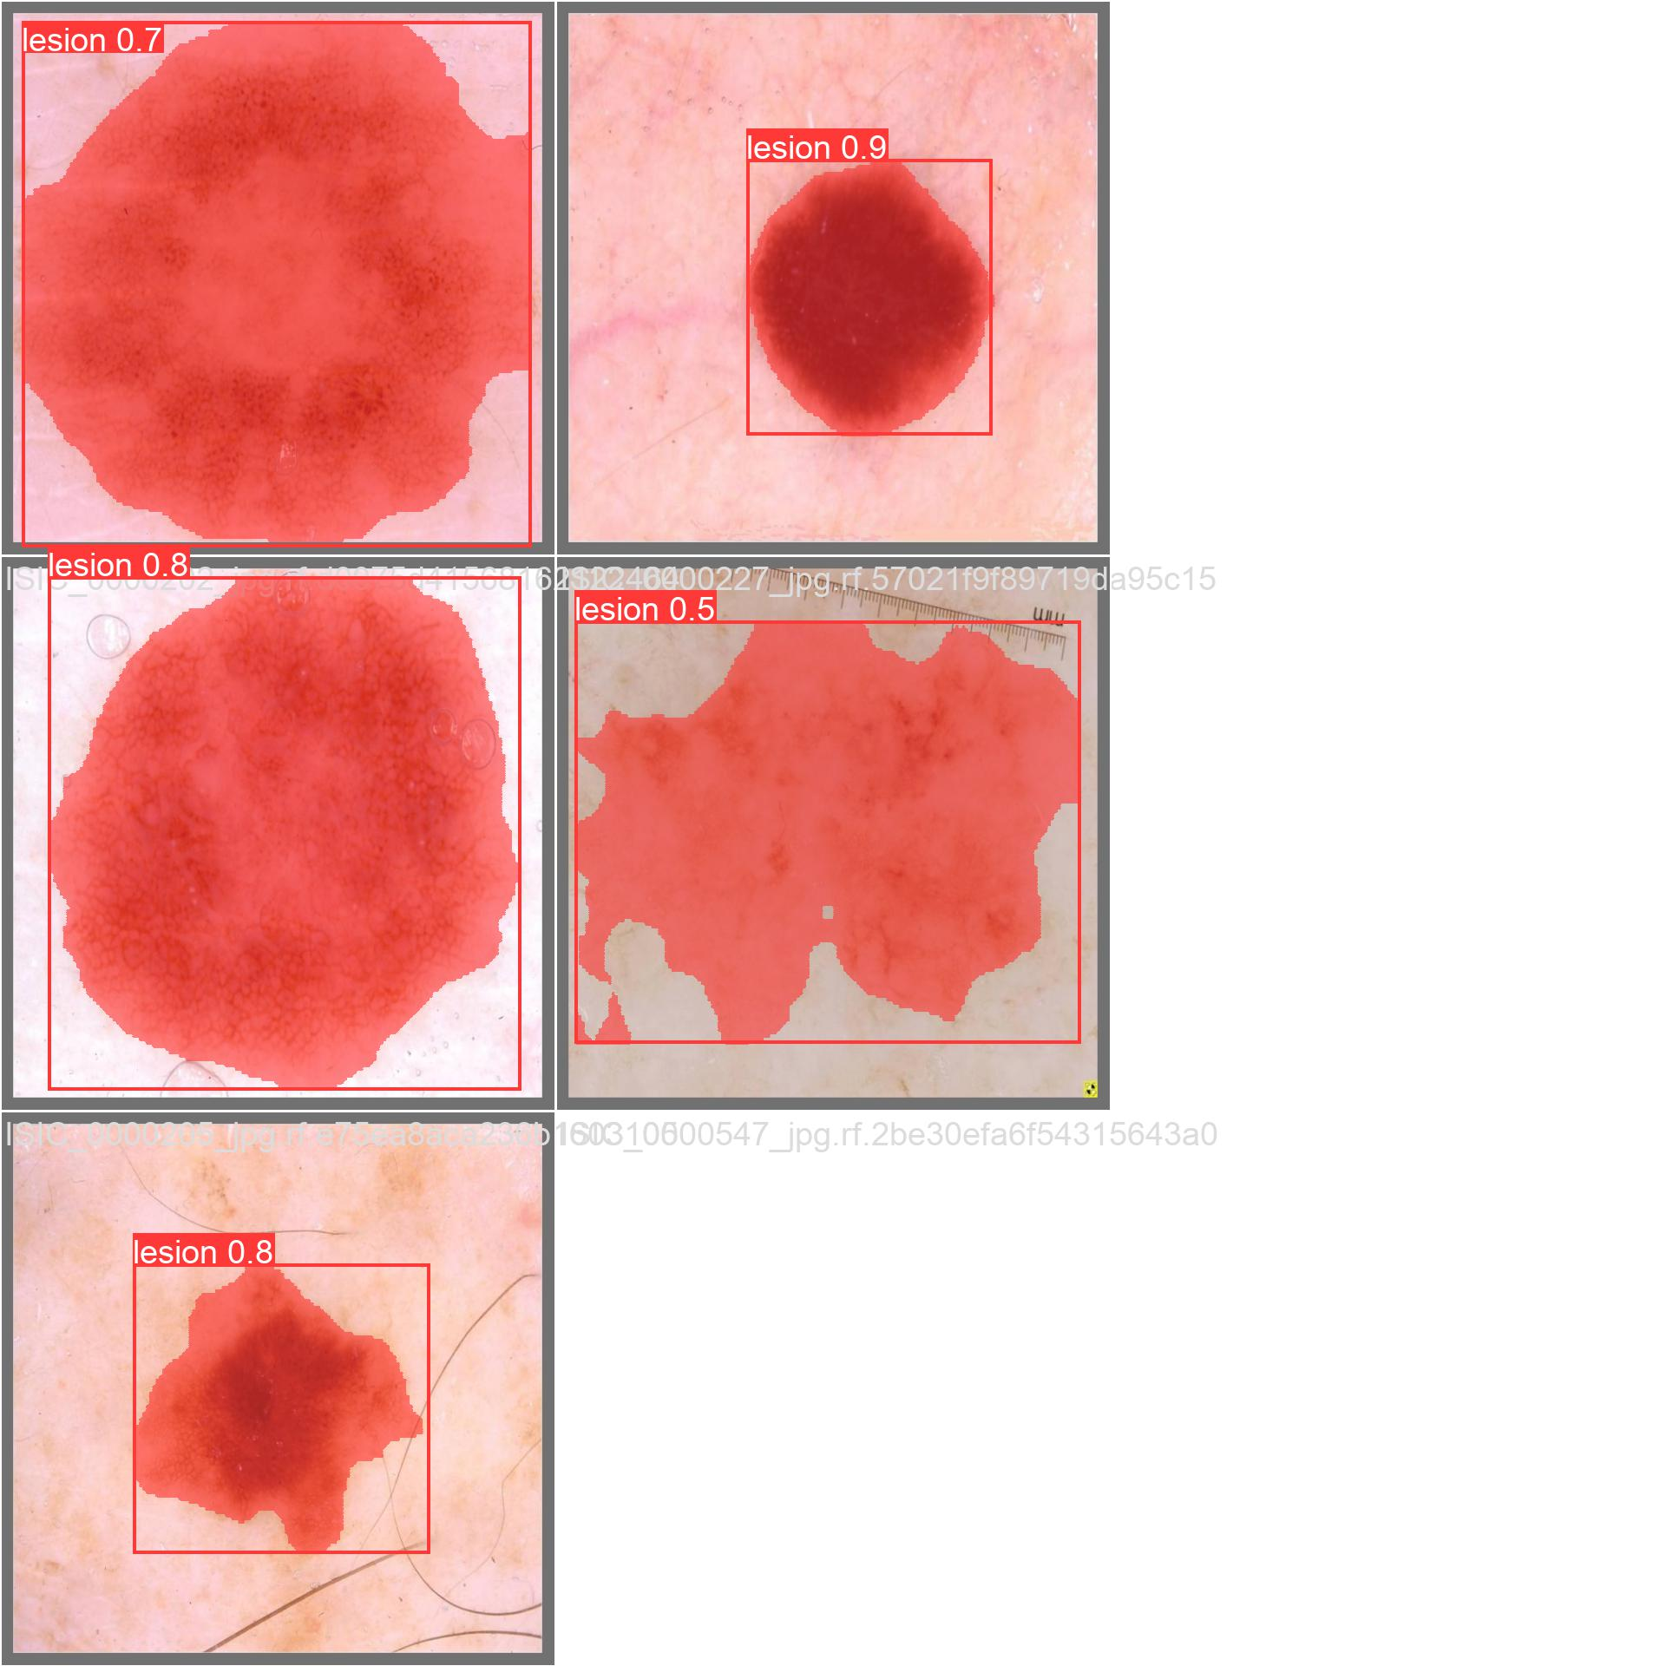
Plan
Task 3
Label
Vs
Model Prediction
Test :

Slide 38
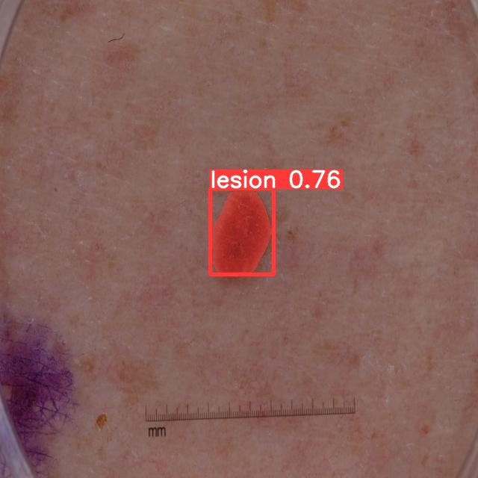
Plan
Task 3
Test :

Slide 39
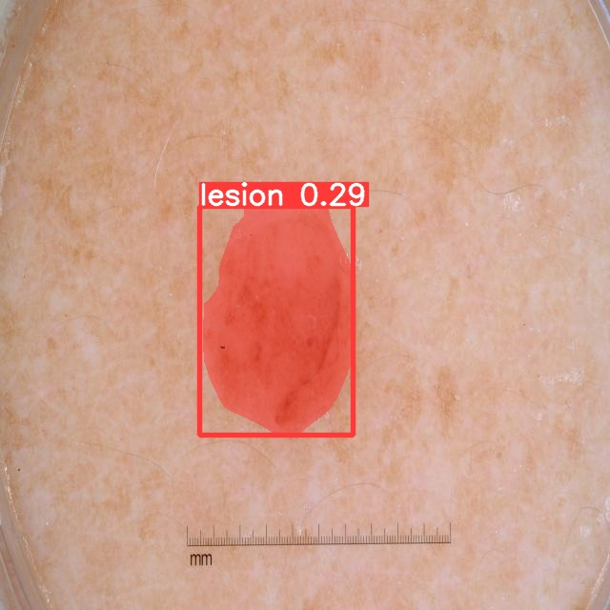
Plan
Task 3
Test :

Slide 40
Thank you for your attention
Notes:
The main contribution of this innovative work is to create a predictive system of hematological cell detection.
The result was validated by the supervising doctor and comparable to the work done in the thesis supervised by the him, the accuracy was increased by 47%.
comparing with other existing works in this field our project present an innovation because it detect classify and count almost all blood cell with a high precision

