Slide 1
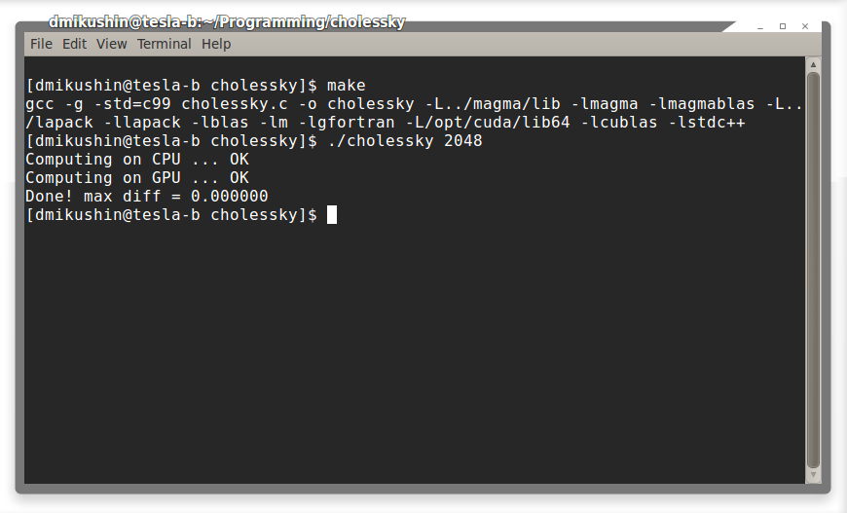
Using Cholessky decomposition on GPU

Slide 2
Libraries with internal support of GPUs
CUDA-kernels invocation is performed inside library calls, so user does not need to use CUDA explicitly
Data transfer between host and GPU is also performed automatically sometimes

Slide 3
Libraries with GPU support
CUBLAS, CUFFT, CUSPARSE, CURAND
PLASMA, MAGMA
...

Slide 4
Cholessky example pipeline
Generate a random matrix
Produce a matrix with diagonal domination
Perform Cholessky decomposition on CPU (lapack)
Perform Cholessky decomposition on GPU (magma)
Compare the results

Slide 5
Compile the libraries
Source code of required libraries is already hosted on server
LAPACK
# Load the source code of lapack from repository into your folder
marcusmae@teslatron:~$ svn co http://tesla.parallel.ru/svn/lapack
# Compile the library
marcusmae@teslatron:~$ cd lapack/
marcusmae@teslatron:~/lapack$ make clean && make

Slide 6
Compile the libraries
Source code of required libraries is already hosted on server
MAGMA
# Load the source code of lapack from repository into your folder
svn co http://tesla.parallel.ru/svn/magma
# Compile (-j2 – use two compile processes in parallel)
marcusmae@teslatron:~$ cd magma/
marcusmae@teslatron:~/magma$ make clean && make -j2

Slide 7
Compile the sample itself
marcusmae@teslatron:~$ cd cholessky/
marcusmae@teslatron:~/cholessky$ make clean && make

Slide 8
Results
# the correct result (GPU version and CPU version do match)
marcusmae@teslatron:~/cholessky$ ./cholessky 4096
Computing on CPU ... OK
Computing on GPU ... OK
Done! max diff = 0.000000
# incorrect result (GPU version and CPU version are not matching)
marcusmae@teslatron:~/cholessky$ ./cholessky 4096
Computing on CPU ... OK
Computing on GPU ... OK
Done! max diff = 4032.119629

Slide 9
References
http://icl.cs.utk.edu/magma/

