Slide 1



Simulation of high enthalpy flow
in porosities using SPH
Projet de Fin d'Etude
Oliver Oberinger
Advisors:
Prof. Hans G. Hornung (Caltech)
Prof. Dr.-Ing. Nikolaus A. Adams, Sergej Litvinov, M.Sc. (TUM)
Responsible at ISAE:
Jérémie Gressier (Professeur SUPAERO)

Slide 2
Outline
Framework of my thesis
Introduction and basic idea of SPH
Generic structure of an SPH code
The developed code(s)
Overview of validation cases
Presentation of example results
Remaining work
Future prospects
Toulouse, October 8th
PFE Oliver Oberinger
1
Notes:
Explain, why SPH is used for porosity simulation
→ relatively easy to implement BC for porosities by
Immobilizing particles

Slide 3
Framework of my project
Experiment (Prof. Hornung):
Hypersonic flow over slender cone with porous walls
Result:
Porosities damp certain acoustic instabilities
→ long term objective (Prof. Adams):
Numerical simulation of the entire configuration
for a better understanding of phenomena in action
First Step:
Simulating the flow in the porosities with SPH
(Smoothed Particle Hydrodynamics)
Toulouse, October 8th
PFE Oliver Oberinger
2
Notes:
Explain, why SPH is used for porosity simulation
→ relatively easy to implement BC for porosities by
Immobilizing particles

Slide 4
Introduction to SPH
Conceived in late 1970s for astro-physical problems
Particle method (Lagrangian description)
- discretization points moving with matter (fluid/solid)
- no meshing needed
Meanwhile applications in various fields:
- elasticity and fracture of solids, liquid flows, gas dynamics
- various visualizations for entertainment industry
→ facilitates porosity implementation (boundary conditions)
Toulouse, October 8th
PFE Oliver Oberinger
3
Notes:
Particle method--> no meshing: HUGE advantage for
Astrophysical applications (hughe simulation domains with big gradients)
Now understandable why boundary implementation may be easy: particle immobilization
Applications scientific/nonscientific
Elasticity/fracture: high deformations easy to handle

Slide 5
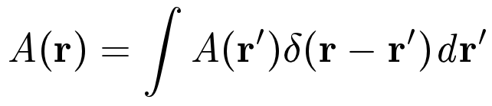
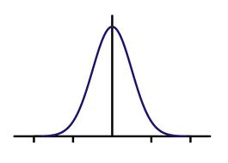
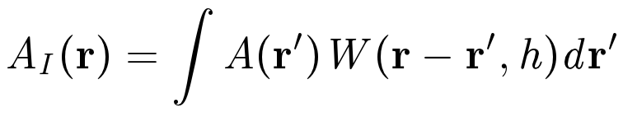
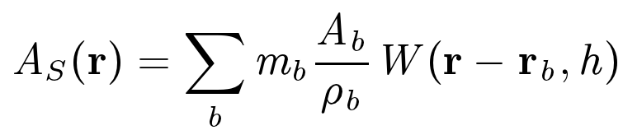
SPH approximations
SPH based on integral interpolation:
1) exact integral representation of a function
2) integral approximation of a function
3) particle approximation (discretization)
h
W
Δx
c h
h: smoothing length
W is called kernel function (smoothing function)
and needs to have special properties...
Toulouse, October 8th
PFE Oliver Oberinger
4
Notes:
As for any numerical scheme:
Express derivatives with quantities at discrete points only

Slide 6
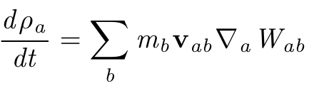
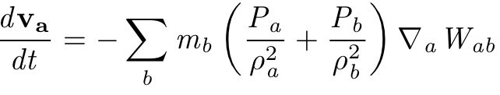
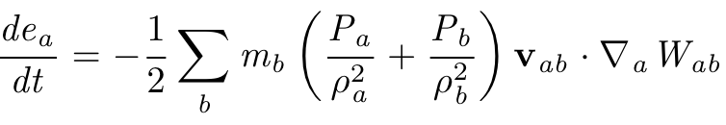
SPH form of fluid dynamic equations
SPH continuity equation:
SPH momentum equation:
SPH energy equation:
→ sum over neighbor particles to calculate change rates
Toulouse, October8th
PFE Oliver Oberinger
5
Notes:
As for any numerical scheme:
Express derivatives with quantities at discrete points only

Slide 7
Basic structure of an SPH- code
Simulation Setup
Main computation loop
(repeated for each time step)
Nearest Neighboring Particle Search
Kernel Function and
Kernel Derivative Calculation
Calculation of Density, Momentum
And Energy Change Rate
Update Values (time-stepping)
Output Module
Toulouse, October 8th
PFE Oliver Oberinger
6
Notes:
No boundary particles taken into account
---> according to this scheme I have developped two codes:
one: simple1D code,
modieifaction of an incompressible 2D multiphase SPH code... (already available at the institute of Aerodynamics at Munich)

Slide 8
Developed Codes
1D compressible SPH code
- very basic structure
- to get familiarized with SPH
2D compressible SPH code
- based on incompressible multi-phase code
- more sophisticated: boundary conditions, neighbor search
- viscosity & heat conduction implementations
Toulouse, October 8th
PFE Oliver Oberinger
7

Slide 9
Test Cases - Overview
inviscid compressible flow
- 1D shock-tube
- 1D Wave-Propagation
viscous compressible flow
- Taylor-Green Flow
pure heat conduction
- Slab
All combined
- compressible Couette flow
Toulouse, October 8th
PFE Oliver Oberinger
8
Notes:
As for any numerical scheme:
Express derivatives with quantities at discrete points only

Slide 10
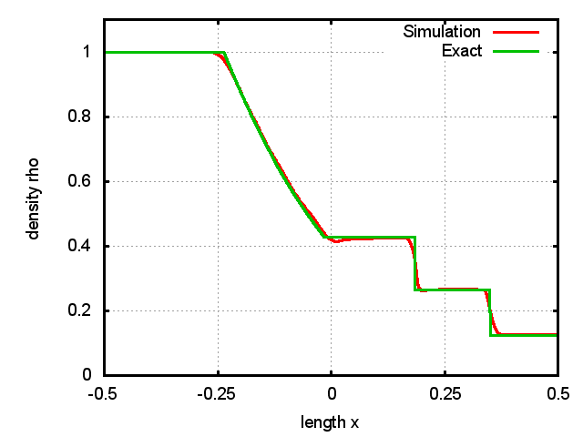
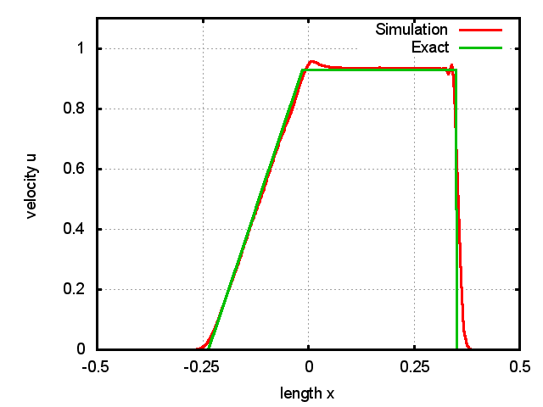
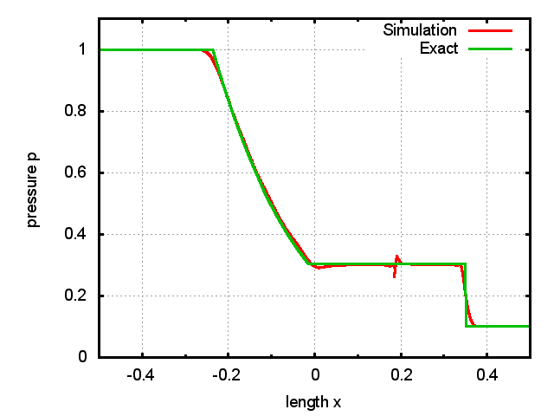
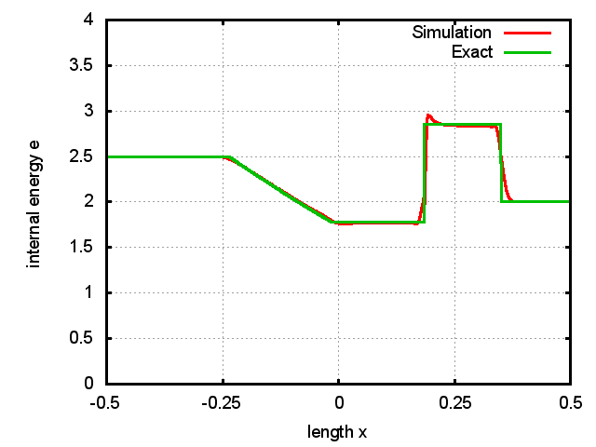
1D Shock - tube
Toulouse, October 8th
PFE Oliver Oberinger
9
Notes:
As for any numerical scheme:
Express derivatives with quantities at discrete points only
With shocktube 1D2D particle distribution
Constant mass/constant spacing
Perturbation study (to see how SPH works for disordered initializations)

Slide 11
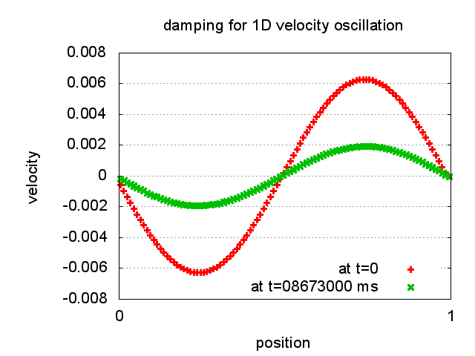
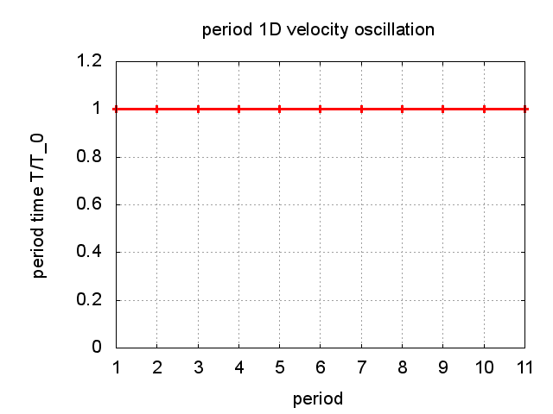
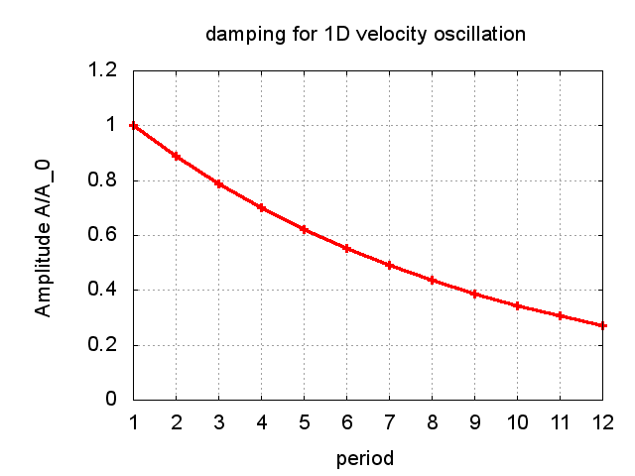
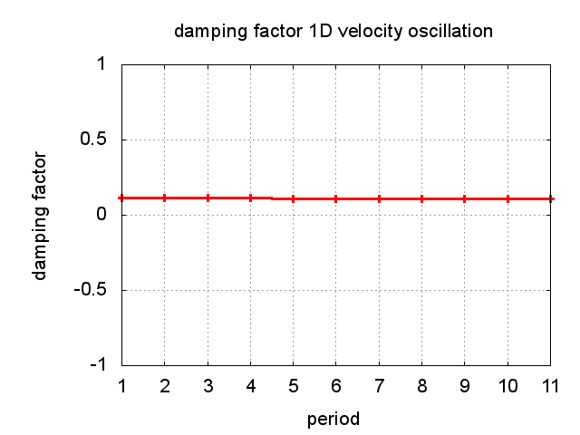
1D Wave-Propagation – incl. art. visc.
Quality of results depends on ratio h/delta_x
Toulouse, October 8th
PFE Oliver Oberinger
10
Notes:
Damping very strong, less if art. Visc. Activated for compressions lnly (as is the case for shock tube
Besides in leterature means to reduce art.visc. Away from shocks

Slide 12
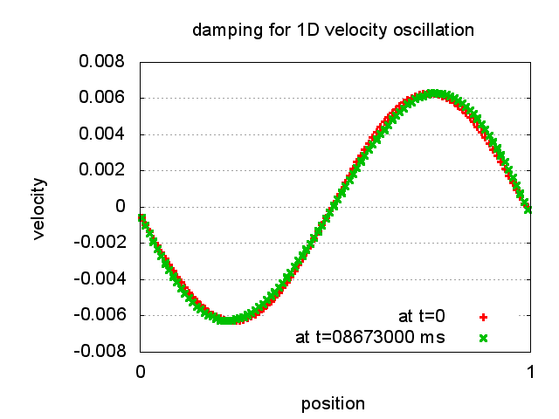
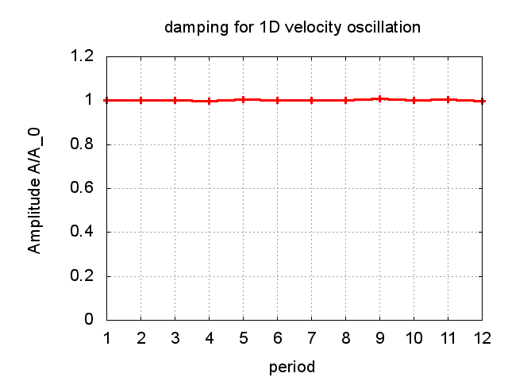
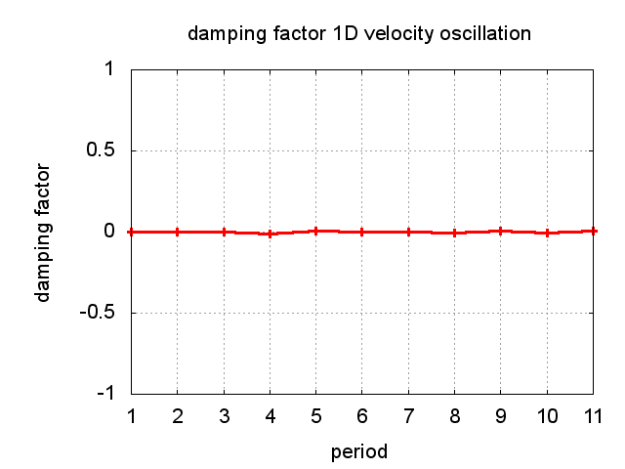
1D Wave-Propagation – w/o art. visc.
Toulouse, October 8th
PFE Oliver Oberinger
11
Notes:
Some words on artificial viscosity:
Needed for shock—tube simulation: stabilizes numerical allgorithm (dampes oscillations AND prevents interoenetation of particles
Quality of results (mesured by constantness of T and damping factor)
Damping actor defined as (A_n-A_(n+1))/A_n

Slide 13
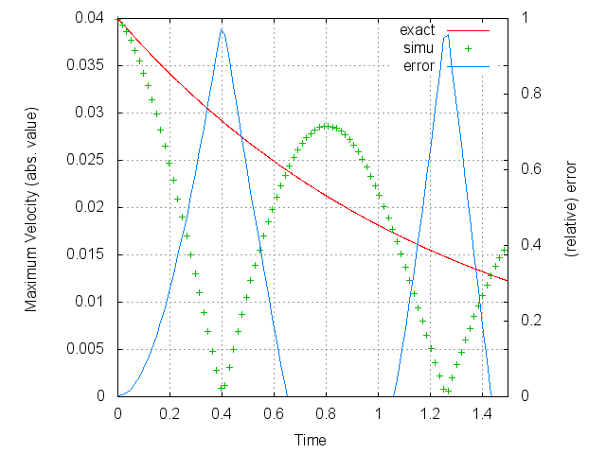
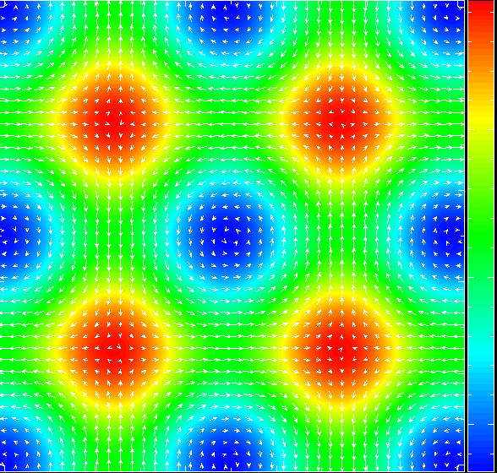
Taylor-Green flow (viscosity test)
Analysis of velocity decay of vortices
y
p
x
→ work in progress!
Toulouse, October 8th
PFE Oliver Oberinger
12
Notes:
Viscosity implemented before this test (in the first place : visc=cte)
Test does not work yet (either implementation error or model not good)
BTW: viscosity serious problem for SPH, as 2nd derivatives problem->
Many different models (mostly incompressible though)
From literature: Particularely for SPH taylor green: low Re-numbers better than high ones (if initialization is done from regular lattice)
Other possibility: initialization from relaxed particle positions

Slide 14
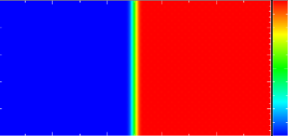
Pure Heat-Conduction
slab (2D)
y
T
(=e)
T
x
Animation-Link
(initial phase)
Animation-Link
(complete simu-time)
Toulouse, October 8th
PFE Oliver Oberinger
13
Notes:
Independent of rest (as no flow problem)
(discontinuity smeared due ti interpolation method)
Slab with initial temperature jump
Works just fine with adiabatic BC
Next tests with isothermal BC
And real 2D conduction

Slide 15
To do until end of thesis
Find error in const. viscosity implementation
Derive and implement a formulation for variable viscosity
Finish validation-process with compressible Couette-flow
Finally compute flow through porosities
… finish writing the thesis
Toulouse, October 8th
PFE Oliver Oberinger
14
Notes:
Damping very strong, less if art. Visc. Activated for compressions lnly (as is the case for shock tube
Besides in leterature means to reduce art.visc. Away from shocks

Slide 16
Future prospects
Coupling of SPH and grid-based methods
Simulation of whole configuration:
Hypersonic flow over slender cone with porosities
Toulouse, October 8th
PFE Oliver Oberinger
15
Notes:
Damping very strong, less if art. Visc. Activated for compressions lnly (as is the case for shock tube
Besides in leterature means to reduce art.visc. Away from shocks

Slide 17

Many thanks for your attention
Questions?
Toulouse, October 8th
PFE Oliver Oberinger
16
Notes:
Damping very strong, less if art. Visc. Activated for compressions lnly (as is the case for shock tube
Besides in leterature means to reduce art.visc. Away from shocks

