Slide 1
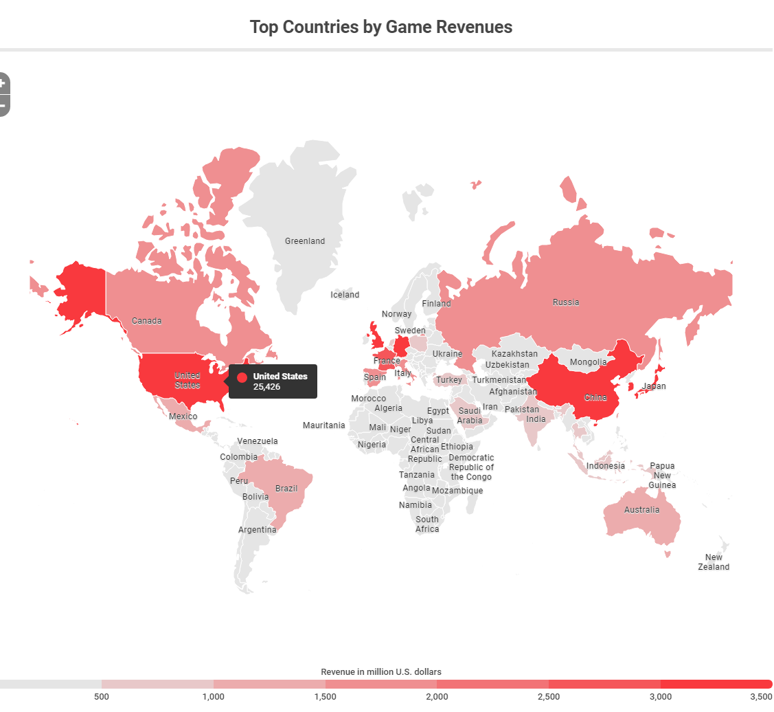
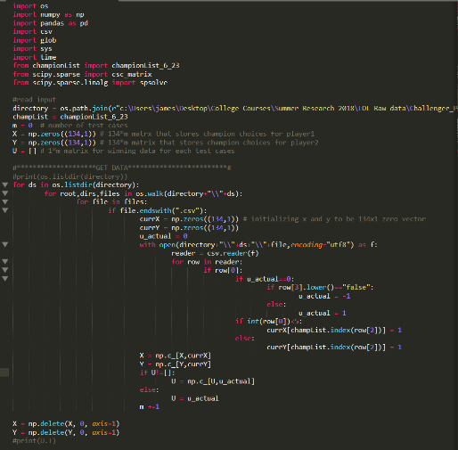
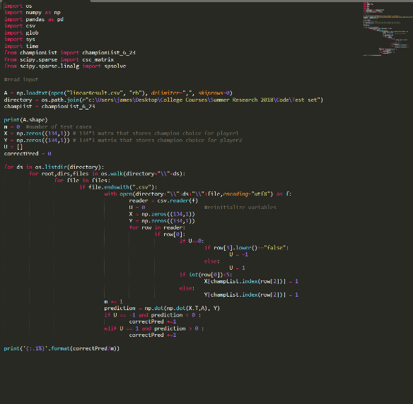
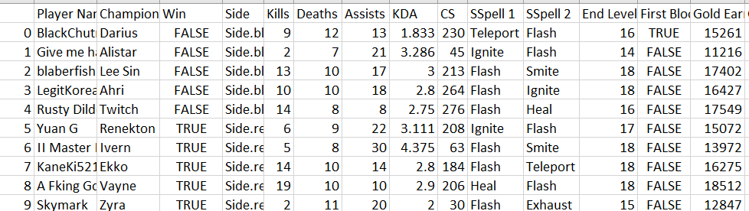
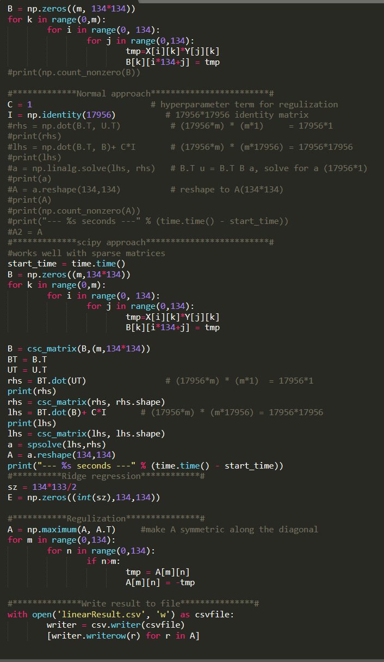
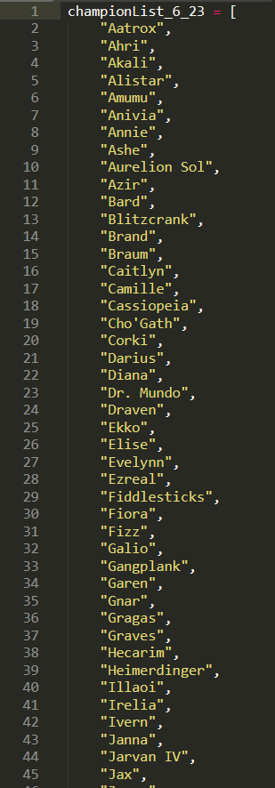
Trinity University
Using Artificial Intelligence an Game Theory to Improve Balance in Game Design
AUTHOR: Shiyu Liu, Albert Xin Jiang
^{Funding} Source: Murchison Summer Undergraduate Fellowship (SURF)
Problem
A lot of games nowadays, especially online competitive games, follow some similar patterns: they have various champion choices for gamers, and keep updating the game with patches to try to balance the game. This, however, is time consuming, inefficient and sometimes annoying for gamers. Sometimes these patches might even exacerbate the balance problem instead of fixing them.
Method & Model
Assuming a Linear relationship between champion choices and winning. We created two 134 x 1 vector X and Y for team red and team blue. Then the outcome u is calculated by u = X.T A Y, where A is a 134 x 134 matrix that each entry of A is linearly correlated to X and Y.
We form a data matrix B (K x 17956) , where
B_k, ij = x^k_i* y^k_j.
Solving the linear system B.T u = B.T B a to minimize
|u- B a|^2.
Linear programming to zero-sum game max_x min_y x^T A y
Importance of Gaming Industry
-The video games market is expected to be worth over 90 billion USD by 2020 from nearly 78.61 billion in 2017 (BestTheNews), 2016
- There are more than 2.5 billion video gamers from all over the world ( The European Mobile Game Market, 2016)
My experience
- narrow down research directions/ topics
fine-tuning the research proposal & method
Learning of Machine learning and AI; Difference between hard-coded AI and “intelligent” AI
Prediction vs Statistics
Our Prediction: (from patch 6.23 to 7.2) | LOL patch 8.10
Mid: Yasuo | Mid: Yasuo
Jungle: Twitch | Jungle: Malphite
Bot: Jinx | Bot: Xayah
Support: Thresh | Support: Rakan
Top: Darius | Top: Kayle
Abstract
We try to study the problem of balance in the design of computer games, which is most apparent in multiplayer games like League of Legends, Starcraft but also in single player games as well. In our research we specifically analyze the champion choices in the game League of Legend. We first use machine learning techniques by fitting a linear regression model for our data set. Then, we use game theoretical concepts to find the optimal strategy for both side of the game (thus the Nash Equilibrium) to find what collections of champions are optimal to select for each team. And by analyzing the result, we try to offer suggestions on how to improve balance of the game.
Data Format
Code
Result
Nearly 60% accuracy for predicting the winning team for random test sets
Optimal selection of champions from different positions (mid, bottom, top, support and jungle)
Better Understanding of AI and ML, use of python build-in libraries for input reading, matrix multiplication, matrix equation solving etc.
Limitations of our Research
- 95.7% training set accuracy vs 74.8% test set accuracy
Random data selection
Linear Regression Model
Variables considered
What’s next?
Different models: logistic reg, neural networks…
More reasonable data from high-tier competitions
Take more variables into consideration
Putting More regulations to our model
Continue research and develop new research direction in AI, ML and DL

