Slide 1
Non-projective Dependency Parsing using Spanning Tree Algorithm
R98922004 Yun-Nung Chen
資工碩一 陳縕儂

Slide 2
Reference
Non-projective Dependency Parsing using Spanning Tree Algorithms (HLT/EMNLP 2005)
Ryan McDonald, Fernando Pereira, Kiril Ribarov, Jan Hajic

Slide 3
Introduction

Slide 4
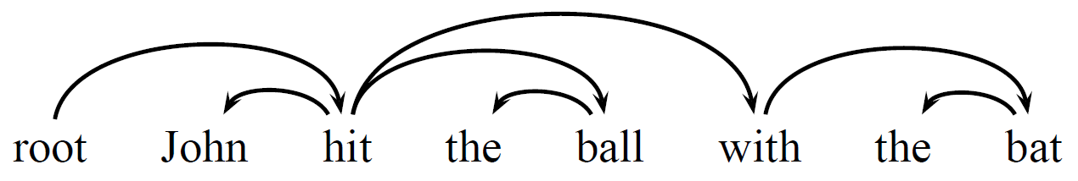
Example of Dependency Tree
Each word depends on exactly one parent
Projective
Words in linear order, satisfying
Edges without crossing
A word and its descendants form a contiguous substring of the sentence

Slide 5
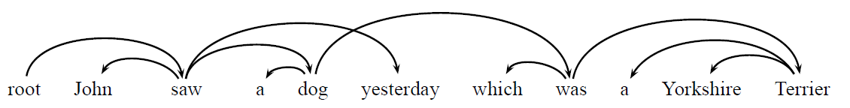
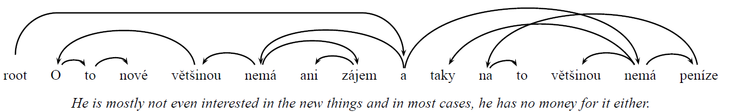
Non-projective Examples
English
Most projective, some non-projective
Languages with more flexible word order
Most non-projective
German, Dutch, Czech

Slide 6
Advantage of Dependency Parsing
Related work
relation extraction
machine translation

Slide 7
Main Idea of the Paper
Dependency parsing can be formalized as
the search for a maximum spanning tree in a directed graph

Slide 8
Dependency Parsing and Spanning Trees

Slide 9
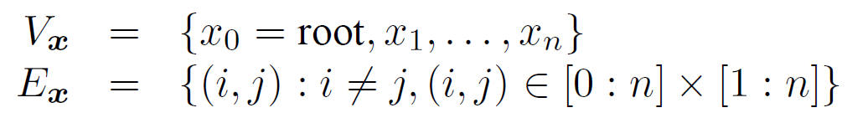
Edge based Factorization (1/3)
sentence: x = x₁ … x_{n}
the directed graph G_{x} = ( V_{x} , E_{x} ) given by
dependency tree for x: y
the tree G_{y} = ( V_{y} , E_{y} )
V_{y} = V_{x}
E_{y} = {(i, j), there’s a dependency from x_{i} to x_{j} }

Slide 10
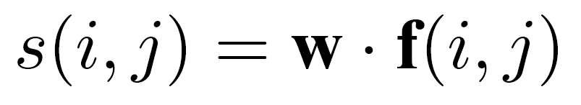
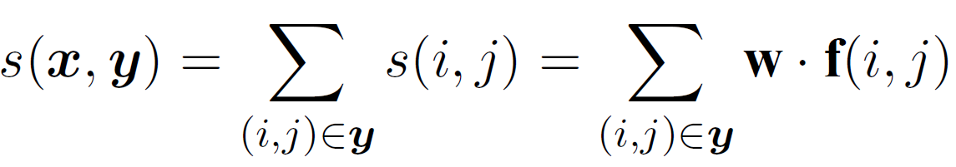
Edge based Factorization (2/3)
scores of edges
score of a dependency tree y for sentence x

Slide 11
Edge based Factorization (3/3)
x = John hit the ball with the bat
y₁
root
y₂
root
y₃
root
hit
ball
John
John
ball
with
John
hit
with
ball
with
the
bat
the
hit
bat
the
bat
the
the
the

Slide 12
Two Focus Points
How to decide weight vector w
How to find the tree with the maximum score

Slide 13
Maximum Spanning Trees
dependency trees for x
= spanning trees for G_{x}
the dependency tree with maximum score for x = maximum spanning trees for G_{x}

Slide 14
Maximum Spanning Tree Algorithm

Slide 15
Chu-Liu-Edmonds Algorithm (1/12)
Input: graph G = (V, E)
Output: a maximum spanning tree in G
greedily select the incoming edge with highest weight
Tree
Cycle in G
contract cycle into a single vertex and recalculate edge weights going into and out the cycle

Slide 16
Chu-Liu-Edmonds Algorithm (2/12)
x = John saw Mary
G_{x}
9
10
30
root
0
Mary
saw
9
20
30
John
11
3

Slide 17
Chu-Liu-Edmonds Algorithm (3/12)
For each word, finding highest scoring incoming edge
G_{x}
9
10
30
root
0
Mary
saw
9
20
30
John
11
3

Slide 18
Chu-Liu-Edmonds Algorithm (4/12)
If the result includes
Tree – terminate and output
Cycle – contract and recalculate
G_{x}
9
10
30
root
0
Mary
saw
9
20
30
John
11
3

Slide 19
Chu-Liu-Edmonds Algorithm (5/12)
Contract and recalculate
Contract the cycle into a single node
Recalculate edge weights going into and out the cycle
G_{x}
9
10
30
root
0
Mary
saw
9
20
30
John
11
3

Slide 20

Chu-Liu-Edmonds Algorithm (6/12)
Outcoming edges for cycle
G_{x}
9
10
30
root
0
Mary
saw
9
20
30
John
11
3

Slide 21

Chu-Liu-Edmonds Algorithm (7/12)
Incoming edges for cycle
,
G_{x}
9
10
30
root
0
Mary
saw
9
20
30
John
11

Slide 22
Chu-Liu-Edmonds Algorithm (8/12)
x = root
s(root, John) – s(a(John), John) + s(C) = 9-30+50=29
s(root, saw) – s(a(saw), saw) + s(C) = 10-20+50=40
G_{x}
9
40
10
30
root
0
Mary
saw
9
20
29
30
John
11

Slide 23
Chu-Liu-Edmonds Algorithm (9/12)
x = Mary
s(Mary, John) – s(a(John), John) + s(C) = 11-30+50=31
s(Mary, saw) – s(a(saw), saw) + s(C) = 0-20+50=30
G_{x}
9
40
30
root
0
Mary
saw
30
20
30
11
John
31

Slide 24
Chu-Liu-Edmonds Algorithm (10/12)
Reserving highest tree in cycle
Recursive run the algorithm
G_{x}
9
40
30
root
Mary
saw
20
30
30
John
31

Slide 25
Chu-Liu-Edmonds Algorithm (11/12)
Finding incoming edge with highest score
Tree: terminate and output
G_{x}
9
40
30
root
Mary
saw
30
John
31

Slide 26
Chu-Liu-Edmonds Algorithm (12/12)
Maximum Spanning Tree of G_{x}
G_{x}
10
40
30
root
Mary
saw
30
John

Slide 27
Complexity of Chu-Liu-Edmonds Algorithm
Each recursive call takes O(n²) to find highest incoming edge for each word
At most O(n) recursive calls
(contracting n times)
Total: O(n³)
Tarjan gives an efficient implementation of the algorithm with O(n²) for dense graphs

Slide 28
Algorithm for Projective Trees
Eisner Algorithm: O(n³)
Using bottom-up dynamic programming
Maintain the nested structural constraint
(non-crossing constraint)

Slide 29
Online Large Margin Learning

Slide 30
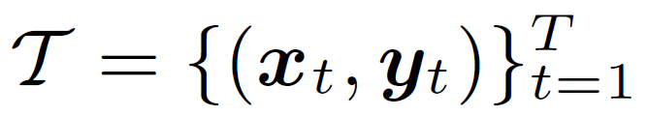
Online Large Margin Learning
Supervised learning
Target: training weight vectors w between two features (PoS tag)
Training data:
Testing data: x

Slide 31
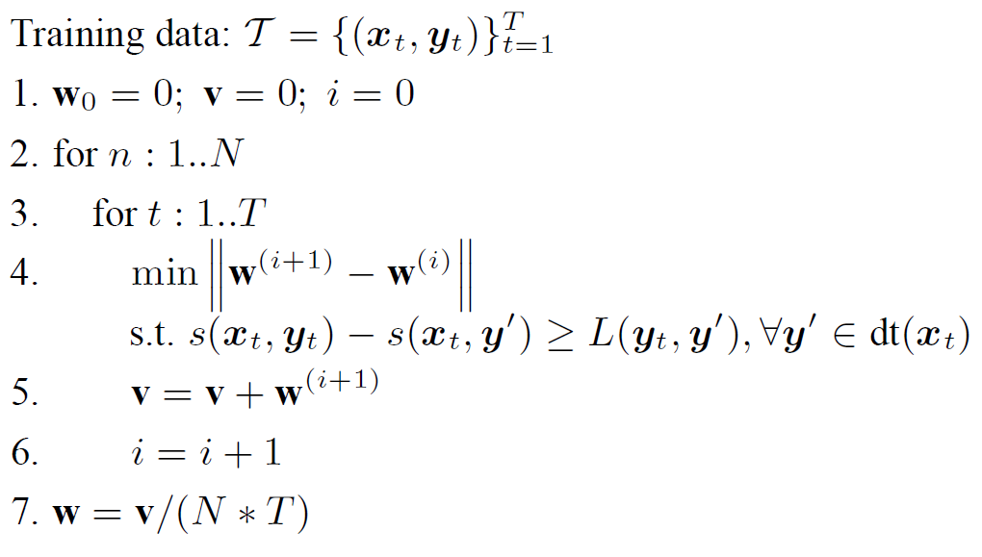
MIRA Learning Algorithm
Margin Infused Relaxed Algorithm (MIRA)
dt(x): the set of possible dependency trees for x
keep new vector as close as possible to the old
final weight vector is the average of the weight vectors after each iteration

Slide 32
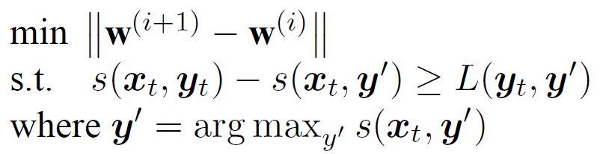
Single-best MIRA
Using only the single margin constraint

Slide 33
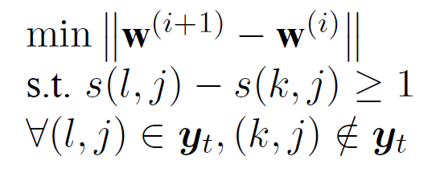
Factored MIRA
Local constraints
correct incoming edge for j
other incoming edge for j
correct spanning tree
incorrect spanning trees
→ More restrictive than original constraints
→ a margin of 1
→ the number of incorrect edges

Slide 34
Experiments

Slide 35
Experimental Setting
Language: Czech
More flexible word order than English
Non-projective dependency
Feature: Czech PoS tag
standard PoS, case, gender, tense
Ratio of non-projective and projective
Less than 2% of total edges are non-projective
Czech-A: entire PDT
Czech-B: including only the 23% of sentences with non-projective dependency

Slide 36
Compared Systems
COLL1999
The projective lexicalized phrase-structure parser
N&N2005
The pseudo-projective parser
McD2005
The projective parser using Eisner and 5-best MIRA
Single-best MIRA
Factored MIRA
The non-projective parser using Chu-Liu-Edmonds

Slide 37
Results of Czech
COLL1999 O(n⁵)
N&N2005
McD2005 O(n³)
Single-best MIRA O(n²)
Factored MIRA O(n²)
Czech-A (23% non-projective)
Accuracy | Complete
82.8 | -
80.0 | 31.8
83.3 | 31.3
84.1 | 32.2
84.4 | 32.3
Czech-B (non-projective)
Accuracy | Complete
- | -
- | -
74.8 | 0.0
81.0 | 14.9
81.5 | 14.3

Slide 38
Results of English
English projective dependency trees
Eisner algorithm uses the a priori knowledge that all trees are projective
McD2005 O(n³)
Single-best MIRA O(n²)
Factored MIRA O(n²)
English
Accuracy | Complete
90.9 | 37.5
90.2 | 33.2
90.2 | 32.3

Slide 39
Thanks for your attention! ☺

