Slide 1


NYC RESTAURANT Data
GROUP 4 – Project 1

Slide 2
About the Data
Our data contains information regarding restaurant inspections for permitted food establishments in NYC
Dataset includes address, cuisine description, inspection date, type, action, violation code, and description.
Data covers all of NYC and starts January 1, 2010 thought August 29, 2017

Slide 3
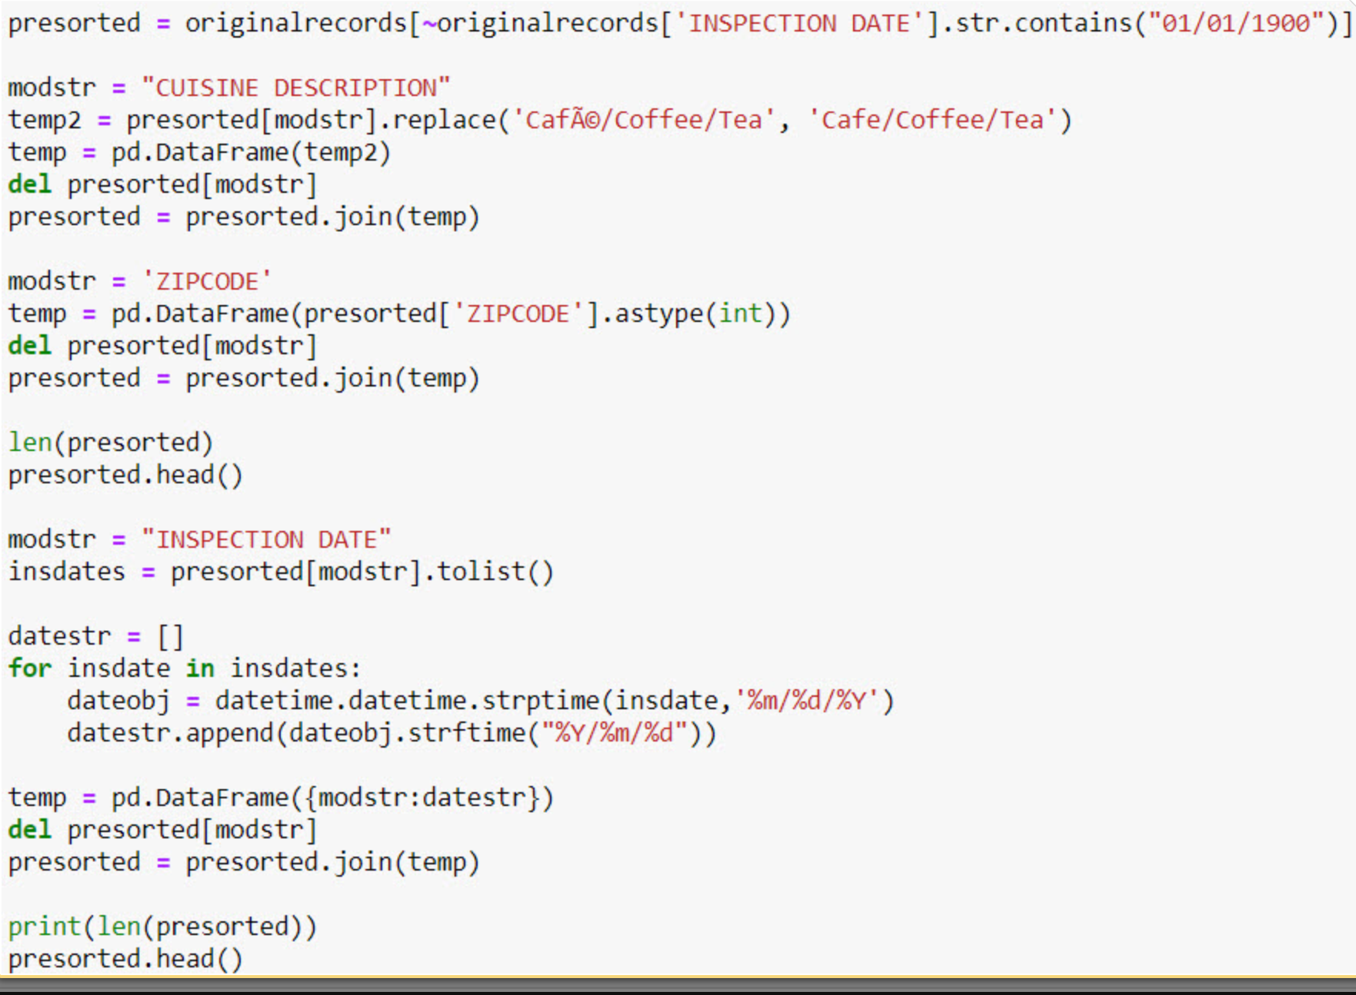
Data cleanup

Slide 4
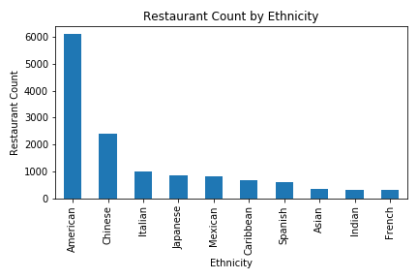
What is the distribution of restaurants by ethnicity?

Slide 5
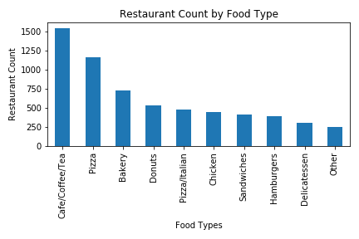
What is the distribution of restaurants by food type?

Slide 6
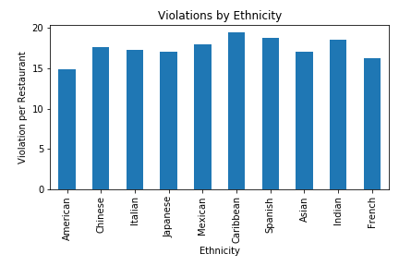
Are there more violations based on ethnicity

Slide 7
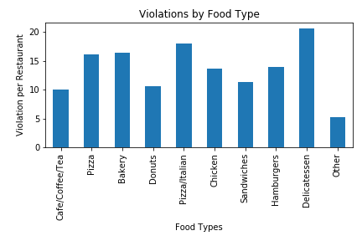
Are there more violations based on food type

Slide 8
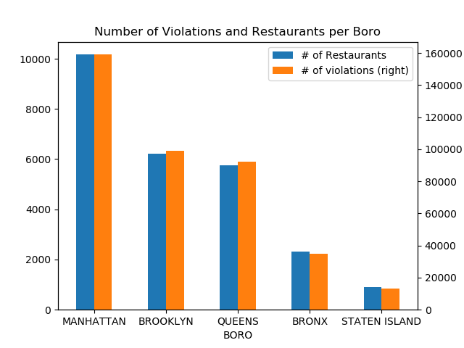
How many violations and restaurants per boro?

Slide 9
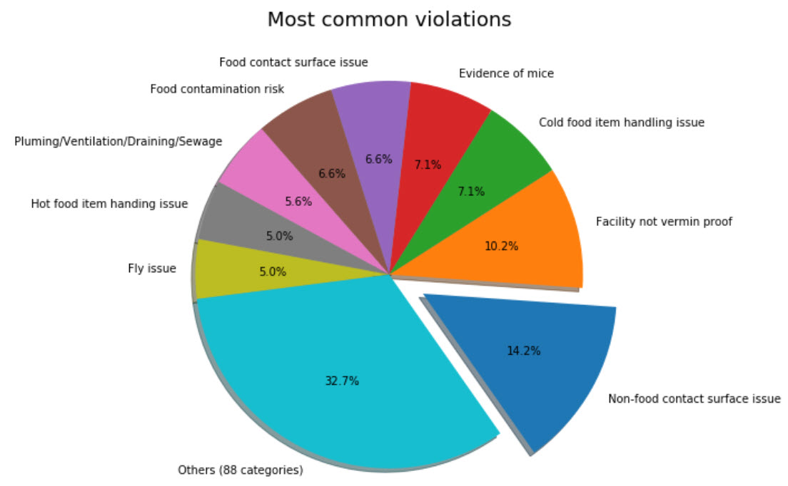
What are the most common violation types?

Slide 10
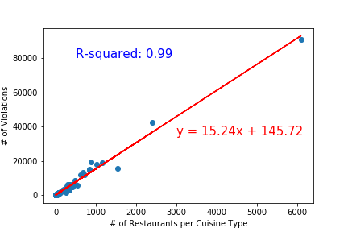
Is there a correlation between cuisine types and violations?

Slide 11
summary
Relevant correlations between restaurant count and violations
No other significant correlations between comparisons done
Found most common violations committed by restaurants
Found which type of restaurant is most dominant

Slide 12
Questions?

