Slide 1



#about @TAI Kickoff meeting
Ljubljana, 28.11.2024.

Slide 2
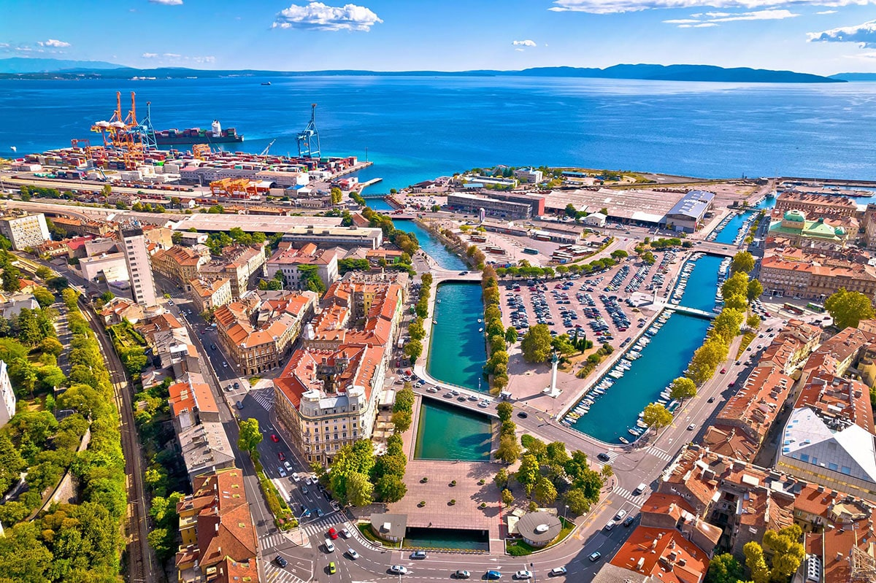
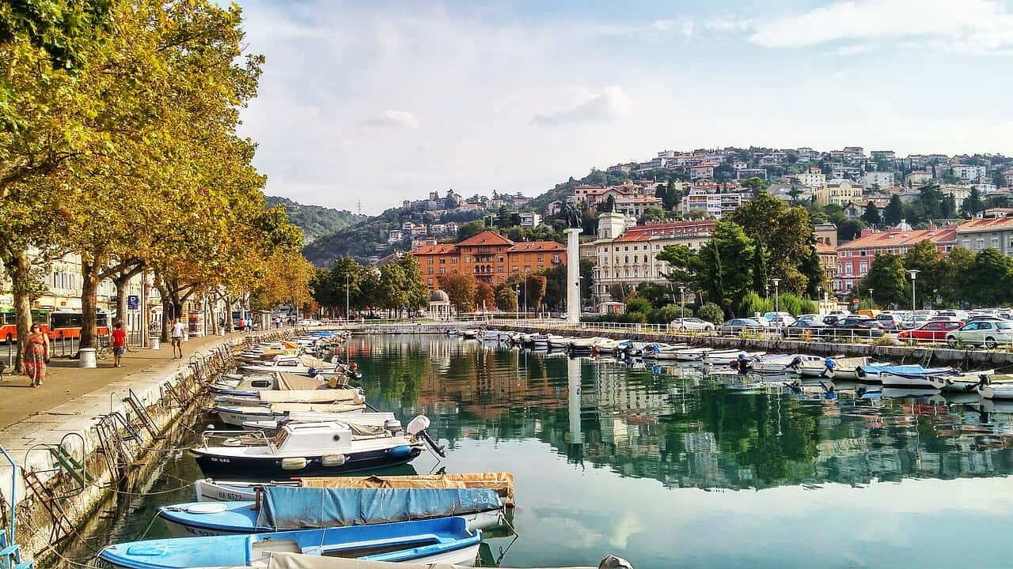
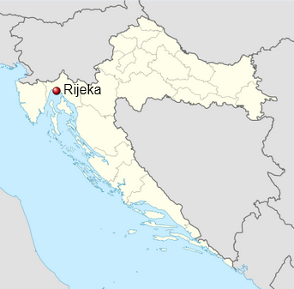
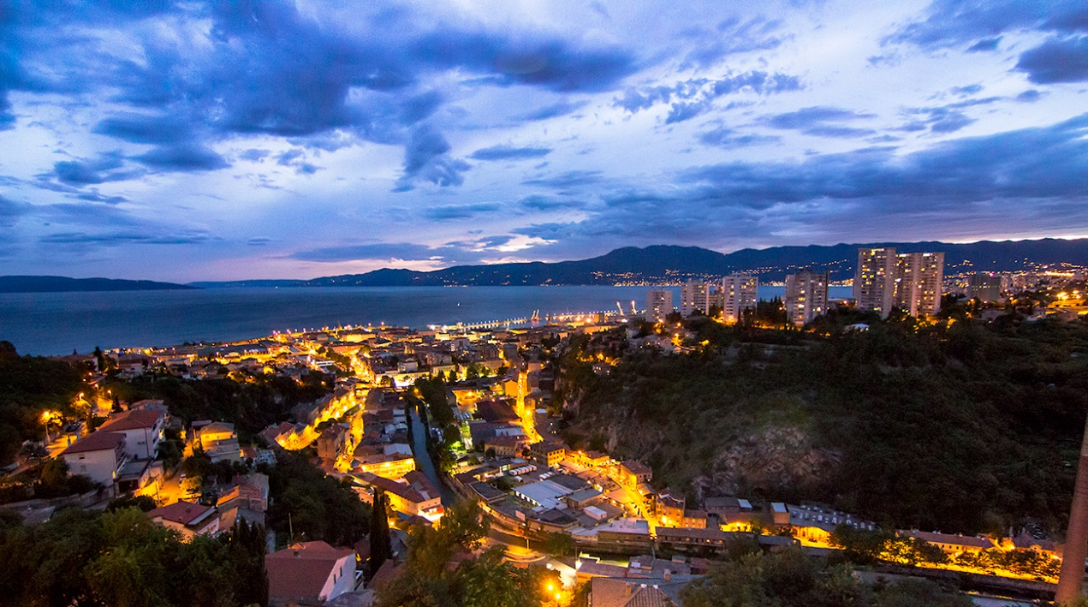
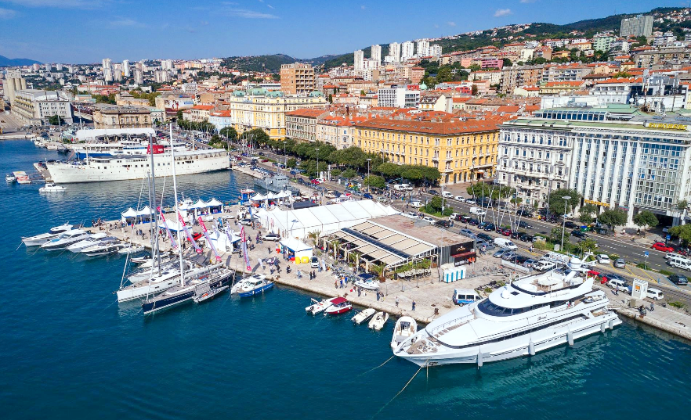
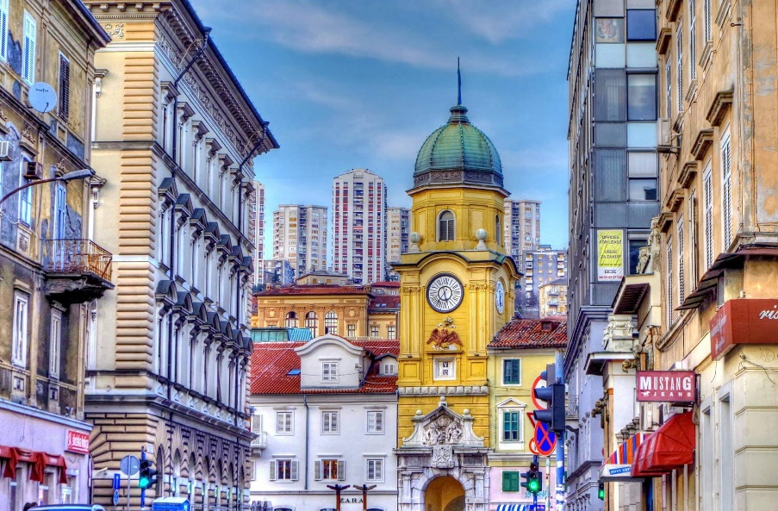
Rijeka

Slide 3

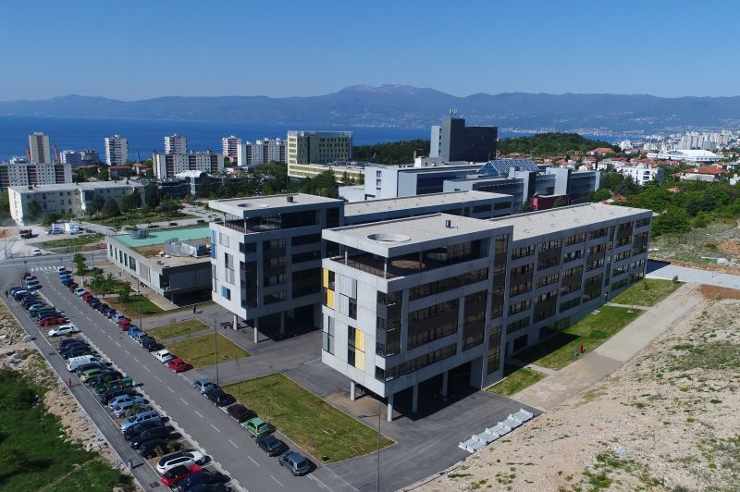
University of Rijeka
Founded in 1973
16 academic units
160+ study programmes
16k+ students
~1700 employees, ~1000 researchers
Member of YUFE (Young Universities for the Future of Europe) and YERUN (Young European Research Universities Network)

Slide 4
University of Rijeka
Constituents
Academy of Applied Arts (APURI)
Faculty of Biotechnology and Drug Research (FABIL)
Faculty of Civil Engineering (GRADRI)
Faculty of Dental Medicine (FDMRI)
Faculty of Economics and Business (EFRI)
Faculty of Engineering (RITEH)
Faculty of Health Care Studies (FZSRI)
Faculty of Humanities and Social Studies (FFRI)
Faculty of Informatics and Digital Technologies (FIDTRI)
Faculty of Law (PRAVRI)
Faculty of Maritime Studies (PFRI)
Faculty of Mathematics (FOMRI)
Faculty of Medicine (MEDRI)
Faculty of Physics (OFRI)
Faculty of Teacher Education (UFRI)
Faculty of Tourism and Hospitality Management (FMTU)

Slide 5
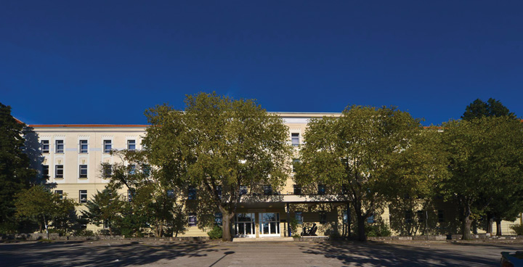
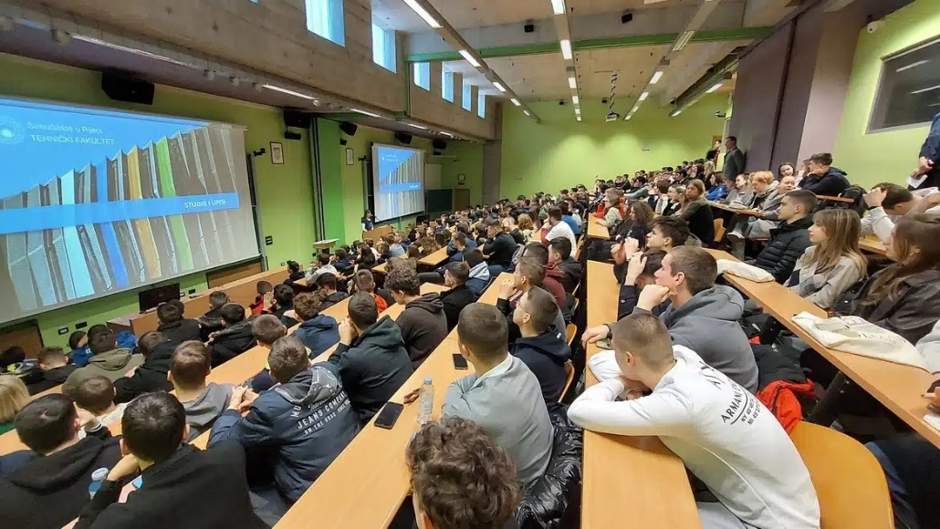
Faculty of Engineering
Founded in 1960
11 departments, 37 sections and 50 laboratories
Study programmes
Mechanical Engineering
Naval Architecture
Electrical Engineering
Computing (Computer Engineering)
Mechatronics and Robotics
~1500 students
Team working on TAI

Slide 6
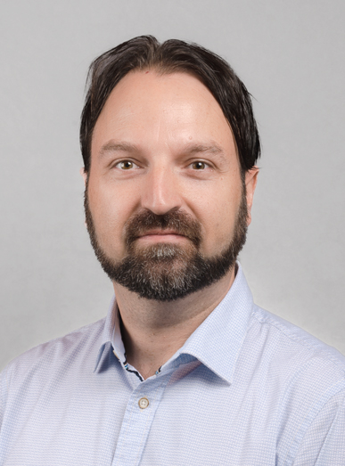
UNIRI/RITEH Team working on TAI (1/3)
Sandi Ljubić, PhD
Professor
Research:
Human-Computer Interaction (HCI)
mobile HCI
predictive modelling and evaluation
text entry methods
sensor-based interaction augmentation
sensor fusion in HCI
biometric features in HCI
Teaching: Human-Computer Interaction, Mobile Application Development, Database Systems, Object Oriented Programming
ERASMUS+ projects: ICCT, BLISS, TRAINEE, TAI, SUStrainable, TSAAI

Slide 7
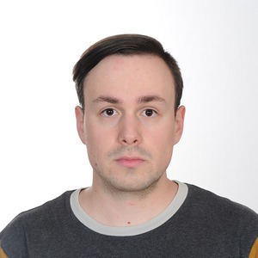
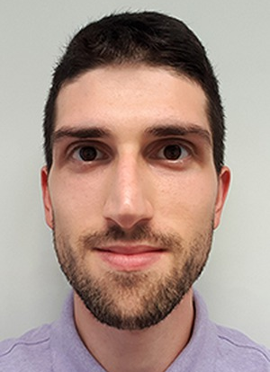
UNIRI/RITEH Team working on TAI (2/3)
Luka Batistić, PhD
Postdoc
Research: HCI, Brain-Computer Interfaces, digital signal processing
Teaching: Embedded Systems, Computer Architecture, Programming
Alen Salkanović, MSc.
Research and Teaching Assistant
Research: HCI, sensor fusion in HCI, biometric features in HCI
Teaching: Mobile Application Development, Database Systems, Object Oriented Programming

Slide 8
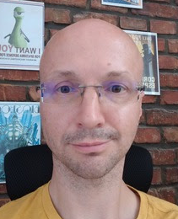
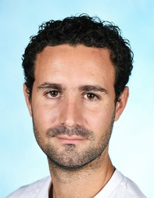
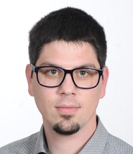
UNIRI/RITEH Team working on TAI (3/3)
Ivan Štajduhar, PhD
Professor
Research: Artificial Intelligence, Machine Learning
Teaching: Introduction to AI, Machine Learning, Advanced Algorithms and Data Structures
ERASMUS+ projects: TSAAI, BLISS, TRAINEE, TAI
Goran Mauša, PhD
Associate Professor
Research: Machine Learning, Applied Soft Computing (in software engineering and peptide chemistry)
Teaching: Introduction to OOP, Software Engineering, Evolutionary Computing
ERASMUS+ projects: Sustrainable, TRAINEE, TAI
Franko Hržić, PhD
Postdoc (visiting researcher @Harvard)
Research: Artificial Intelligence, Machine Learning, Computer Vision
Teaching: Introduction to AI, Machine Learning, Programming
ERASMUS+ projects: BLISS, TRAINEE, TAI

Slide 9
Looking forward to TAI with all of you. #thanks
Ljubljana, 28.11.2024.

