Slide 1
Chapter 7 – Harmonic Progressions
MUS 112 – Molloy College
March 22, 2017

Slide 2
Sequence & Imitation
Sequence
A pattern that is repeated immediately in the same voice but that begins on a different pitch class.
Tonal
keep the pattern in a single key, which means that modifiers of the intervals (major, minor, and so on)
Real
transposes the pattern to a new key
Modified
the repetitions of the pattern are neither tonal nor real
Imitation
Repetition between two or more voices
Can be tonal, real, or modified

Slide 3
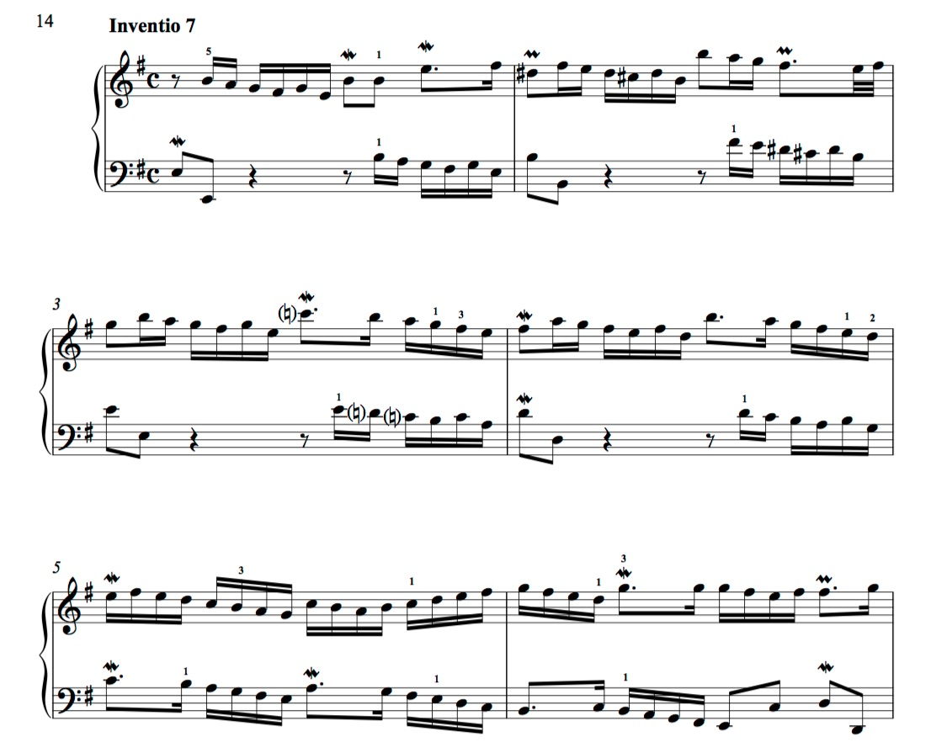

Slide 4
Circle of Fifths Progression
A sequential pattern where the roots of chords move be descending fifths.

Slide 5
The I and V chords
The root progression of down a 5th is the most basic progression in tonal music.
We find it when moving from V to I.
or functionally speaking: Dominant to Tonic

Slide 6
The II Chord
If we extend our circle of fifths back one chord, we arrive at the II chord.
II pulls so strongly to the dominant chord that it functions is called pre-dominant

Slide 7
The VI chord
If we extend our circle of fifths back one chord, we arrive the VI chord.
It pulls strongly to the ii chord
vi – ii –V – I

Slide 8
III chord
Back another 5th brings us to the III chord
III leads to VI
iii – vi – ii – V – I
HOWEVER!
iii is a fairly rare harmony in the major mode. I⁶ is much more common
Both have ^3 in the bass

Slide 9
VII chord
Back another fifth bring us to the viiº chord
This is where the pattern changes.
viiº acts as a substitute for V, so it pulls towards I.
viiº has a dominant function

Slide 10
The IV chord
The IV chord has a pre-dominant function and moves to V or viiº
It can prolong the pre-dominant function by moving to ii before moving to V.
On occasion it can move towards I in a plagal progression.

Slide 11
Common Exceptions
Deceptive cadence, V to vi
iii to IV

