Slide 1
Chapter 8 Triads in First Inversion
MUS 112 – Wednesday March 29
Molloy College

Slide 2
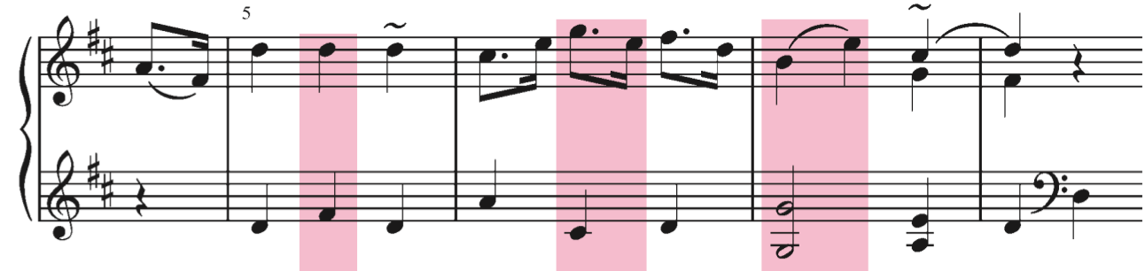
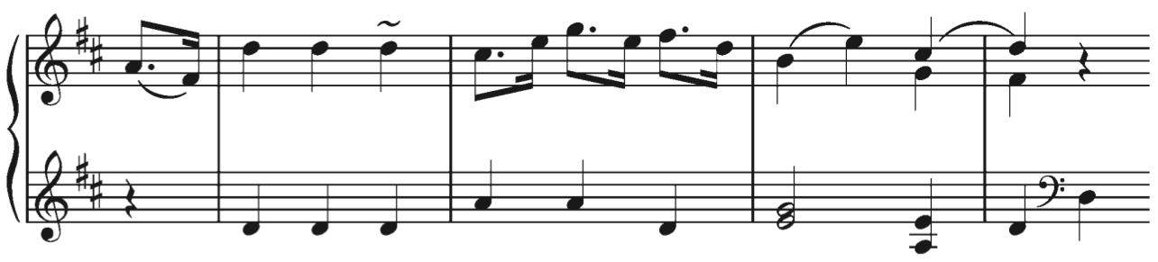
First Inversion Triads
Most chord progressions will contain at least one chord in first inversion
This is not a necessity, but it is very common

Slide 3
Bass Arpeggiation
One way in which first inversion triads often originate is through bass arpeggiation.
In the previous example, we saw that the bass line was improved with arpeggiation without changing the harmony.
We often see fast arpeggios are used to create accompianment figures in piano music.
i.e. Alberti bass
When this happens, the lowest note in the bass is considered to be the bass voice, with the other notes in the arpeggio filling the role of inner voices.
It helps to create a “textural reduction” of such music.

Slide 4
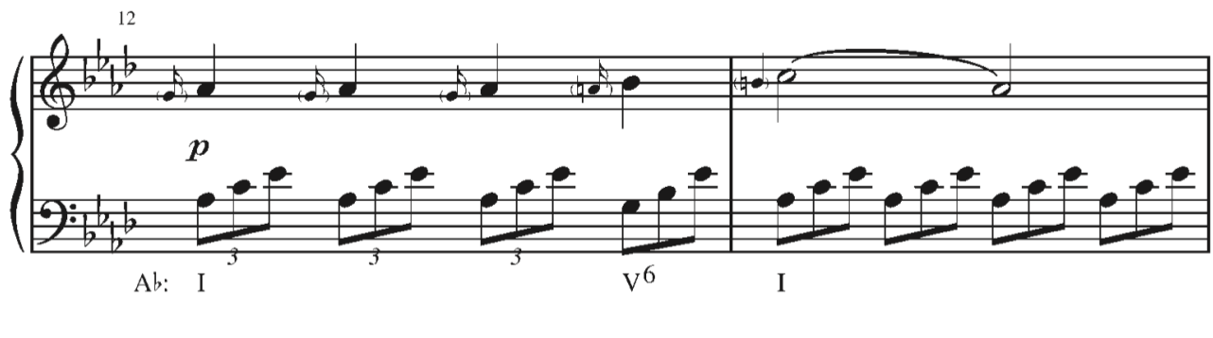
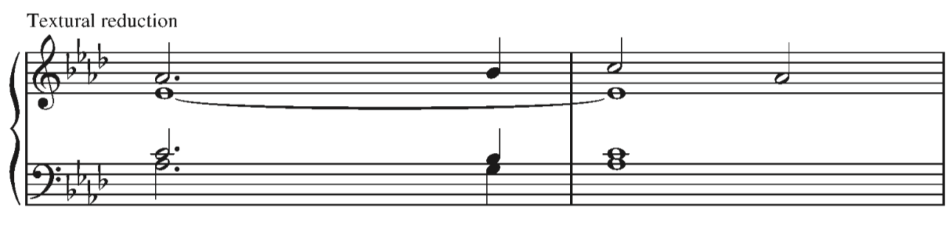

Slide 5
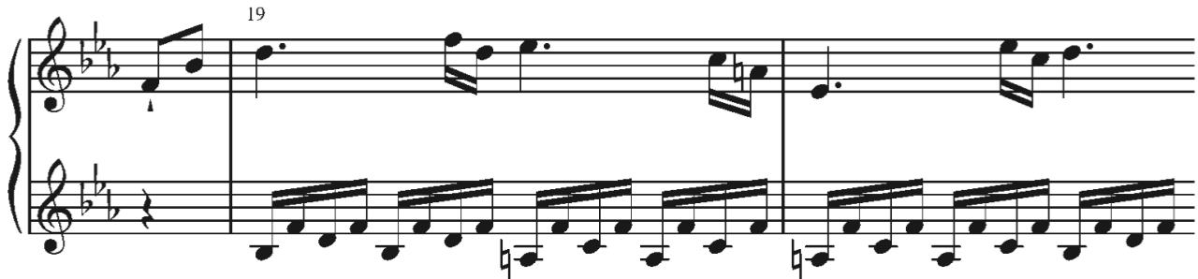
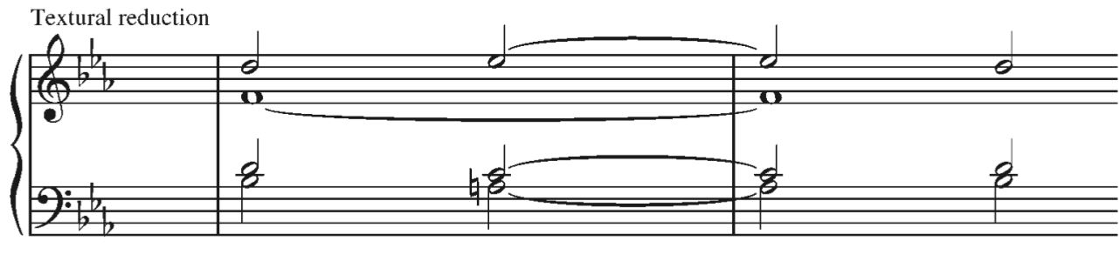

Slide 6
Substituted First Inversion Triads
There are three reasons that we may substitute a root position triad with a first inversion triad.
To improve the contour of the bass line.
To provide a greater variety of pitches in the bass line.
To lessen the weight of V and I chords that do not serve as the goals of harmonic motion.

Slide 7
viiº in First Inversion
Diminished triads are always written in first inversion.
Historically, composers sought to avoid having any dissonant interval between an upper voice and the bass voice.
Writing a viiº⁶ avoids this issue.
This applies to iiº⁶ as well.

Slide 8
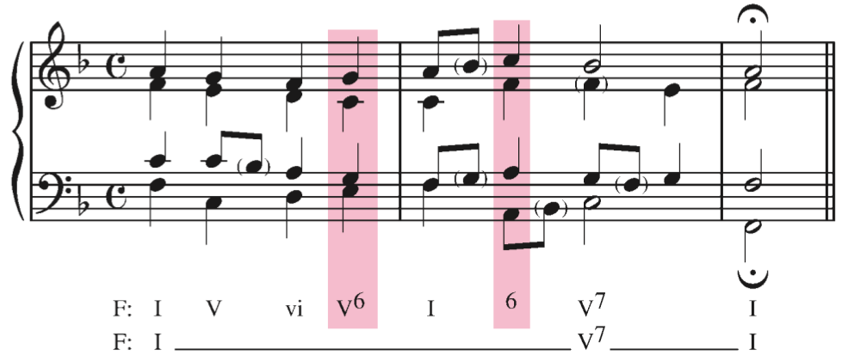
The V⁶ allows the stepwise motion of the bass line to continue and also lessens the effect of this interior V–I progression.
The I⁶ in the second measure provides variety and allows the bass to imitate the soprano figure from the previous beat

Slide 9
Part-writing with first inversion chords
All previous guidelines apply
Doubling
Root-position chords
Whenever possible double the root.
First-Inversion chords
Double whichever note allows for the smoothest part-writing
Avoid Doubling the leading tone.
Why?
A doubled leading-tone implies parallel octaves.
^7 pulls so strongly to ^1 that even if both leading-tones do not resolve up by step we will hear it as likely happening.

