Slide 1
Saudi Arabia

Slide 2
Introduction
Ever since Crown Prince Mohammad bin Salman (MBS) has become second in line to the Saudi Arabian Crown, many have hoped the Kingdom would open up to modernity and liberalize their society and economy.
While there has been a lot of progress and plenty of controversy since MBS rose to power, it is important to look beyond narratives and understand what is actually happening on the ground in the Kingdom.
By using Foursquare data we will analyze the evolving consumption patters of the people of Saudi Arabia. As a positive control I will look at Mecca’s consumption patterns versus the rest of Saudi Arabia’s cities.
Since Mecca is visited by over two million tourists every year, it must have the most international venues to serve the tourists coming in.
If many cities have similar consumption patters as Mecca we can conclude that the whole Kingdom is opening up to the outside world.

Slide 3
Background
By examining the most popular venues in Saudi Arabia’s largest cities and comparing them to what is popular in Mecca, I hope to understand how the people of Saudi Arabia are changing.
I will first take the top 11 cities in terms of population, using each city’s respective latitude and longitude data.
From there I will query the Foursquare API to return a list of the most popular venues in each city.
By using KNN I will analyze which cities are most alike, if most cities are similar to Mecca we can conclude that the Kingdom is modernizing.

Slide 4
Who is this project for
This project will be most important to investors looking to invest in Saudi Arabia. Because the economy has so heavily relied on oil production and the society is dominated by Wahhabism, not much is known about the Kingdom.
Investors have many legitimate reasons to be suspicious of MBS’s reforms especially considering recent controversies regarding the Jamal Khashoggi murder.
A year ago MBS went to many western countries hoping to garner investments on the promise that the kingdom would modernize.
I hope that this project will provide unbiased data on whether the Kingdom is opening.

Slide 5
Methodology
Using the Foursquare API I will query a list of the most popular venues from each of Saudi Arabia’s largest cities. I will then use KNN to group these cities.
Since Mecca is visited by about 2 million tourists completing their hajj the venues in the city must cater to people of very different backgrounds.
If the KNN algorithm shows that other cities such as Riyadh have similar consumption patters then we can conclude that the kingdom as a whole is becoming more international and the reforms MBS has promised are taking root.

Slide 6
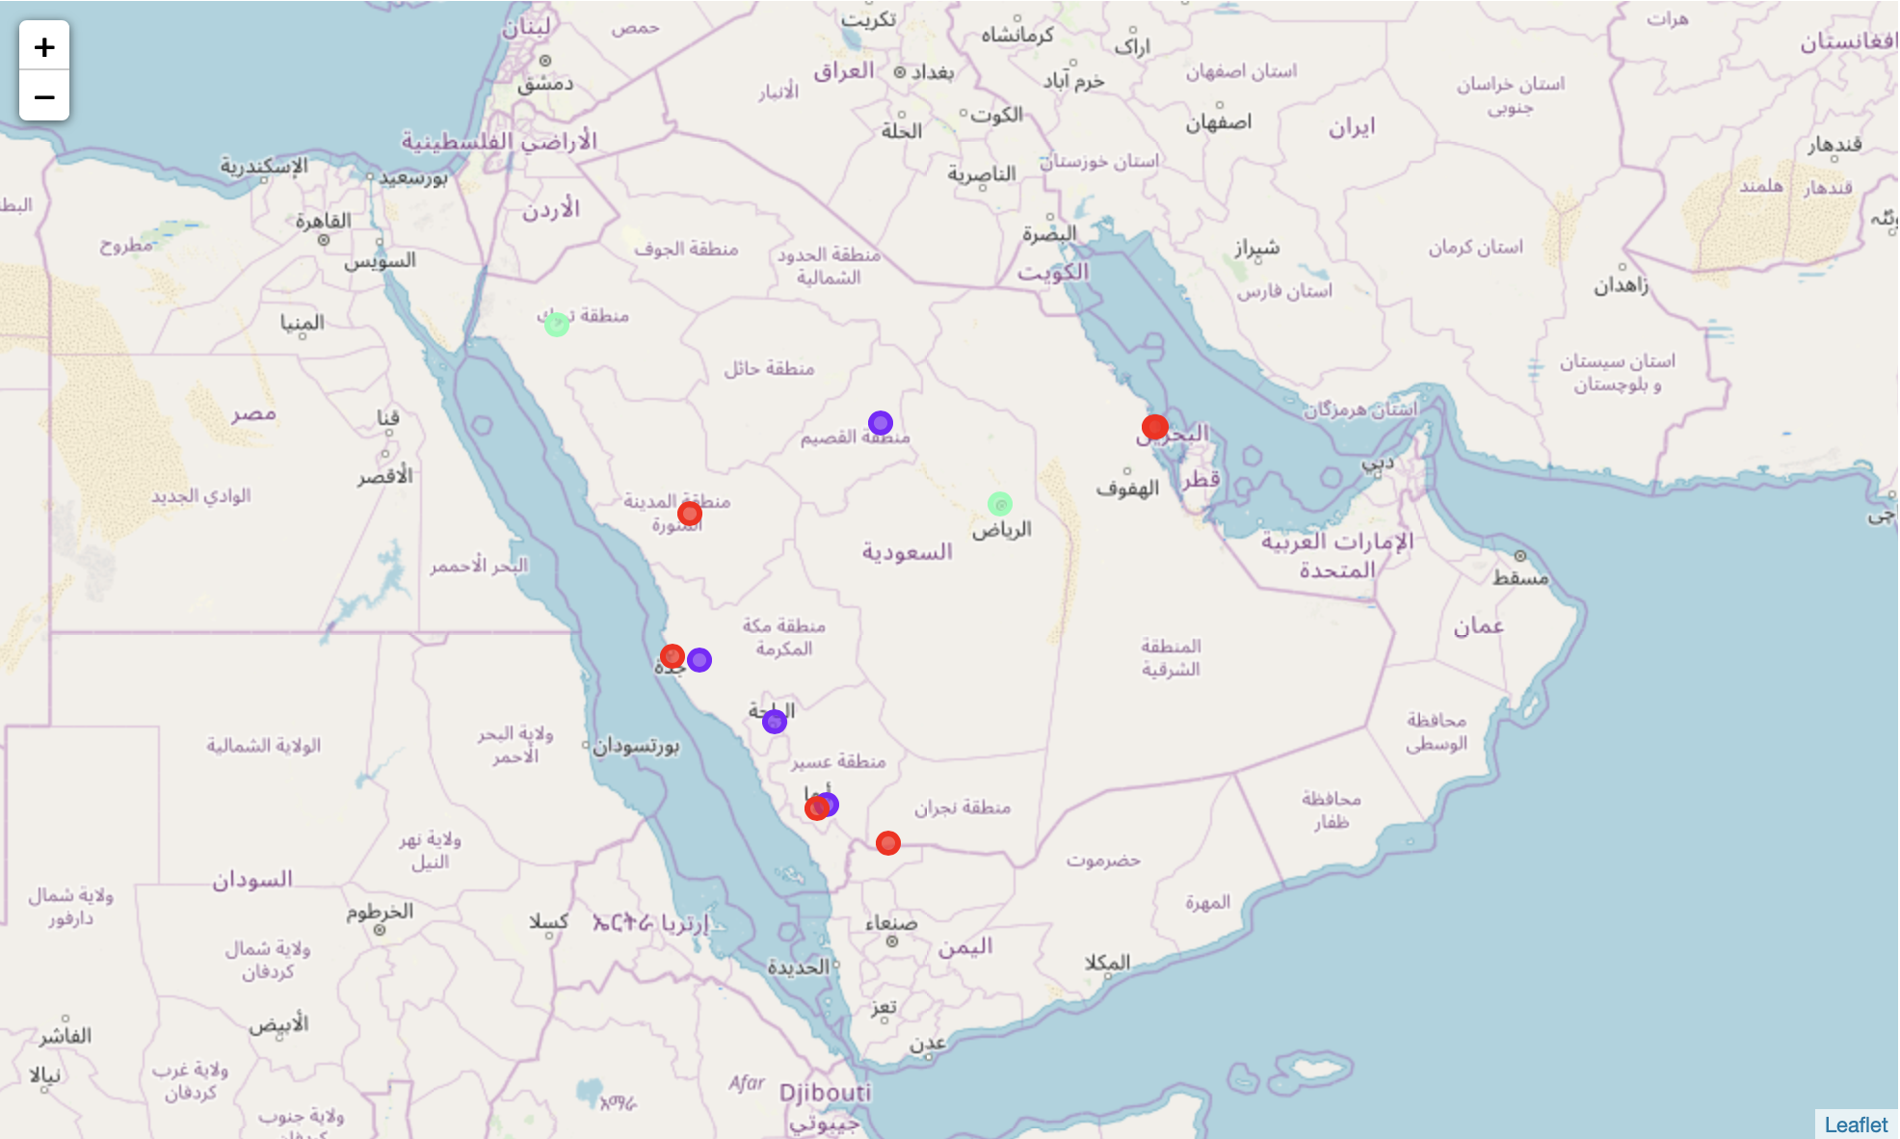
Results
There were 3 clusters of the data and Mecca was found in the second cluster.
Cluster 1 Returned
Jeddah
Medina
Damman
Abha
Al-Khobar
Najran
Cluster 2 returned:
Mecca
Buraidah
Khamis Mushait
Al Bahah
Cluster 3 returned:
Riyadh
Tabuk

Slide 7
Discussion
Neither Jeddah or Riyadh were in the same cluster as Mecca. Considering these are the 3 most populated cities in the Kingdom and given the hypothesis about Mecca’s consumption patterns, it does not appear that Jeddah and Riyadh are opening up as much as Mecca is.
Instead it looks like popular venues are similar in coastal towns and there is no relation between Mecca and Riyadh or Jeddah.

Slide 8
Conclusion
Based off the data from Saudi Arabia and the foursquare API, it does not look like the other major cities are becoming more international like Mecca.
Instead popular venues look to be more related to where the cities are located within the Kingdom. Coastal cities and inland cities are more related respectively.
A further step that could be taken would be to analyze historical data for each of these cities. This could be carried into the future which might show the modernization trend a couple of years from now.

