Slide 1
Bombster
Piotr, Wen, Dariusz, Roberto

Slide 2
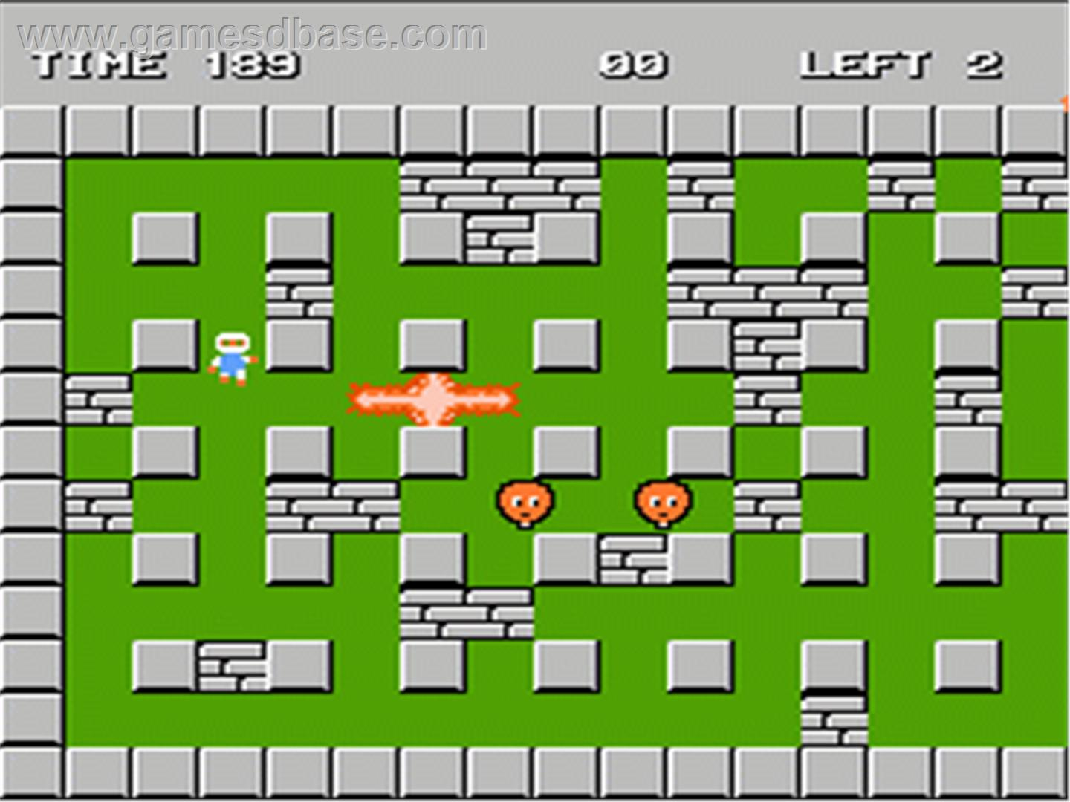
Inspiration

Slide 3
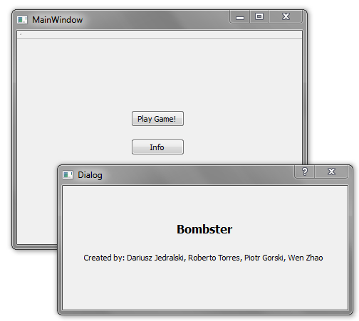
Current Start Screen and Info

Slide 4
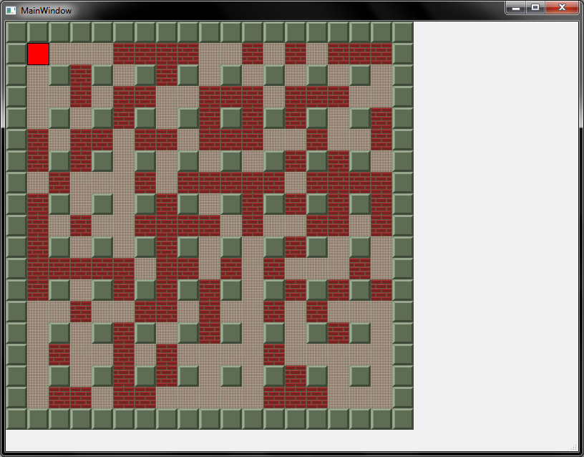

Current State

Slide 5
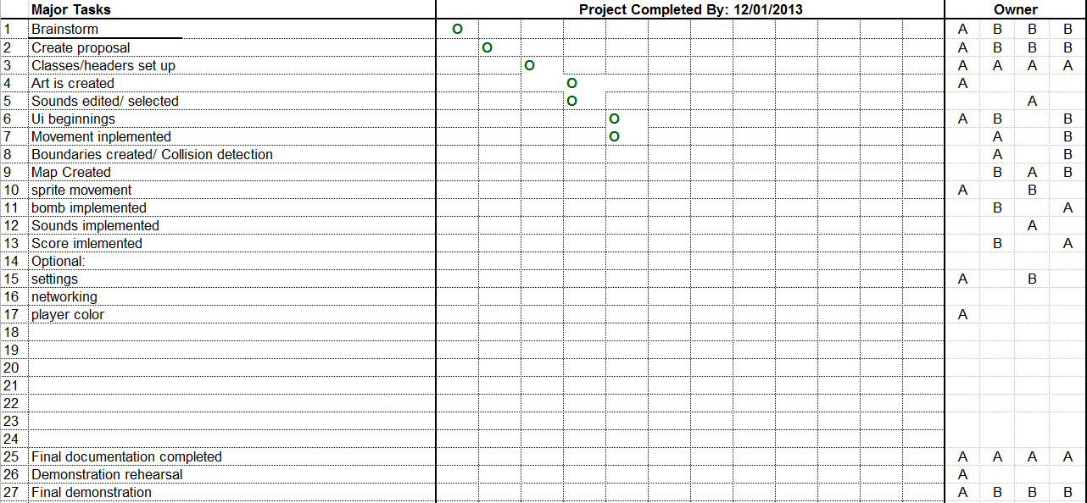
Tasks

Slide 6
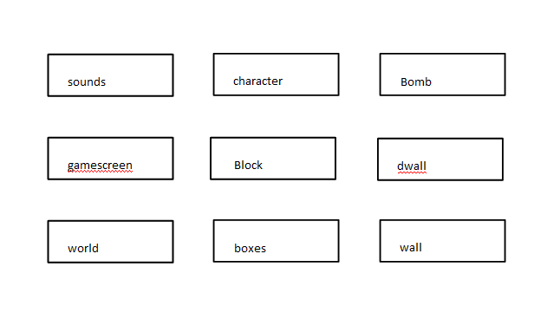
Class Relationships

Slide 7
QT classes currently used
world
#include <QFont>
#include <QPen>
#include <QBrush>
#include <QWidget>
#include <QtGui>
#include <QPainter>
#include <QKeyEvent>
#include <QImage>
infoscreen
#include <QDialog>

Slide 8
QT classes currently used (cont)
block/character/bomb
#include <QPainter>
#include <QImage>
sounds
#include <QApplication>
#include <QMediaPlayer>
#include <QSound>
#include <QtCore>
gamescreen
#include <QMainWindow>
#include <QKeyEvent>
#include <QTimer>

Slide 9
What Works and What Doesn't
Working
Graphics
Controls
Movement
Not Working
Music
Collision Detection

Slide 10
Questions / Suggestions
?

Slide 11

The End

