Slide 1

Approval Tests Applied
Yauheni Sivukha

Slide 2
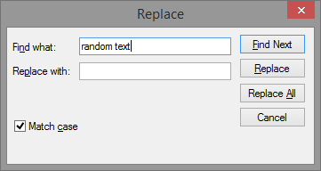
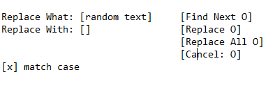
Positional Correlation

Slide 3
Continuous Delivery
Commit
Auto Test
Live
Release Pusher

Slide 4



Perceptual Diff

Slide 5
Continuous Delivery
Commit
Test
Live
Release Pusher
Approvals

Slide 6
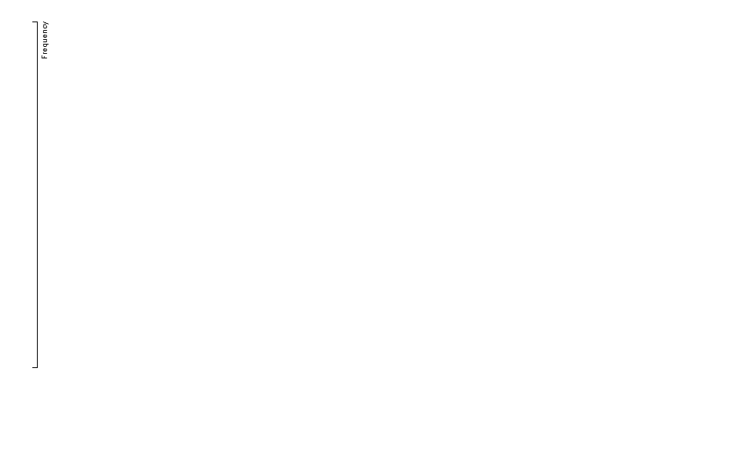
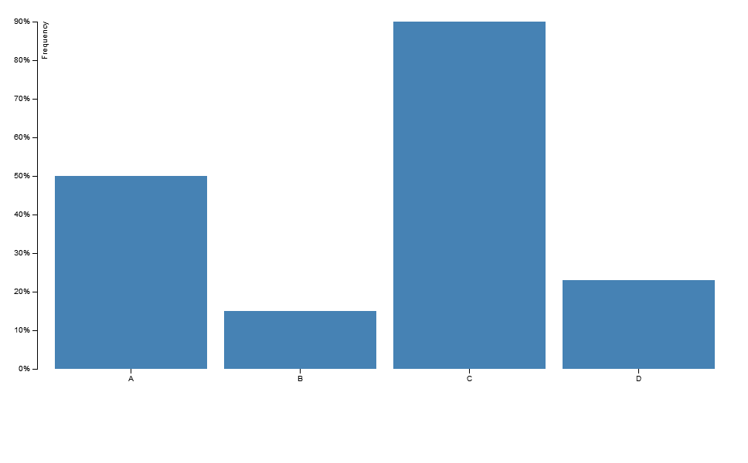
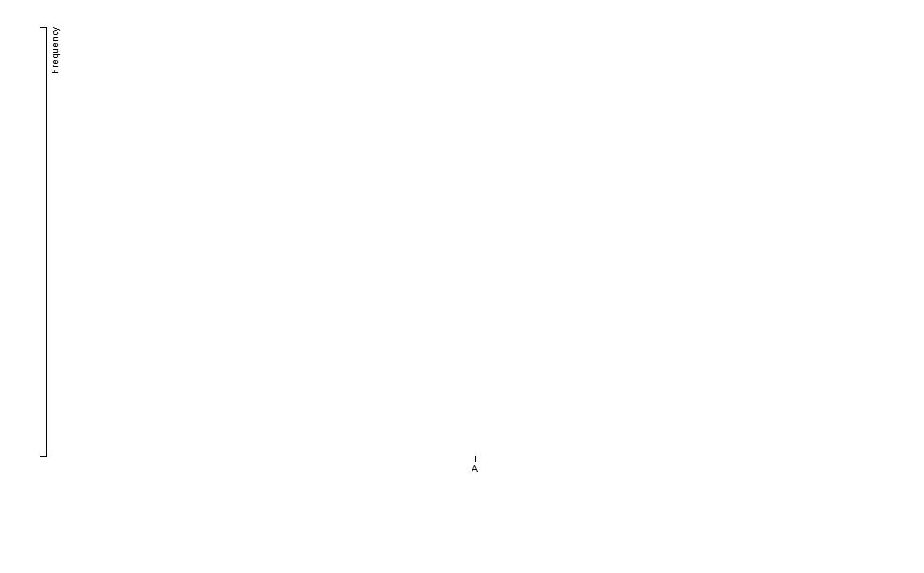
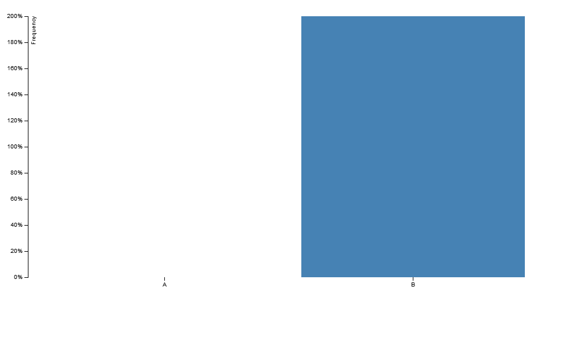
Refactoring
[]
[{'A', 0.5},
{'B', 0.15},
{'C', 0.9},
{'D', 0.23}]
[{'A', 0}]
[{'A', -1},
{'B', 2}]

Slide 7
Links
Llewellyn Falco: https://twitter.com/LlewellynFalco
Official site: http://approvaltests.sourceforge.net/
CD with approvals: https://www.youtube.com/watch?v=UMnZiTL0tUc
Examples from presentation: https://github.com/slmoloch/SEC
UI Automation DSL with approvals: http://slmoloch.blogspot.com/2014/03/using-approvals-in-automated-ui-tests.html

Slide 8
Thank You.
Contacts:
yauheni_sivukha@epam.com

