Slide 1
GetMyVet Platform
UI – Design & Prototype Proposal
V1.0, Feb 2017

Slide 2
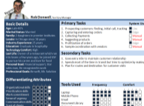
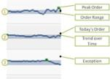
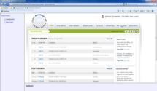

GMV Proposal – UI Design & Prototype
Analyze
Profiles & Personas
Design & Develop
Paper Sketches/ Wireframes
Test & Refine
Test Plan & Cases
Scenarios
Task Analysis
Data Gathering
Low Fidelity Prototypes
Detailed Design/ Prototype
Style Guides & Documentation
Templates & Repositories
Development of HTML/ CSS
Review Checklist
Feedback Implementation
Usability Testing
Implement and Re-test
User Centered Design Process
Process Libraries
User Persona
DESCRIPTION: Detail characteristics of users which directly or indirectly influence the application or business goals.
Purpose: Real-life association to act as reference for “who we are designing for”
INPUTS
Stakeholder interviews and validation of user profile created.
User observations – direct & indirect.
OUTPUT
User Personas
Interaction Design Patterns
DESCRIPTION: Element and flow level patterns for usage across various interface levels and modules
Purpose: Have working prototype of task flows for UC validation and sign-off.
INPUTS
Current application access
Optimized task flows
Navigational Schema
OUTPUT
Interaction design patterns
UI library elements
In Scope:
UI Mockup / HTML Clickable prototype for search, discovery, purchase and post-purchase process for buyer/seller and wellness/procedures products
Functionality as defined in the Journey Requirements workbook
Search Procedure
Search Wellness
Discovery
Discovery Additional Info
Vet Registration ( Excluding Servicing & Pricing )
Pet Owner Registration ( Excluding Activities, Finances & Insurance, My Pet Corner, Newsfeed )
Rapid Prototyping
DESCRIPTION: Element & layout pattern definition using automated tools
Purpose: Have working prototype of task flows for UC validation and sign-off.
INPUTS
Signed-off Visual Design
Page content
UI library elements
OUTPUT
Working prototype of “key” task flows
User Validation
DESCRIPTION: Test and validate task flows, visual design and interaction with actual prototype
Purpose: Get early sign-off on artifacts created before progressing to code
INPUTS
Working prototype
UC meetings/ focus groups.
OUTPUT
Change list for design/ task flows
Signed-off prototype

Slide 3
Plan, Activities, Deliverables
Team Roles:
UI Specialist
Business Analyst
Responsibilities:
Create wireframes
Create Visual Design
Create clickable HTMLs focusing on the user navigation
Focus on creating the assets for key interaction patterns
Deliverables:
Wireframes ( Visio files )
Visual Designs ( Images )
HTMLs ( HTML, JS )
Tools:
UXPin ( Prototyping tool )
Sketch ( Visual Design )
Assumptions:
Review feedbacks are expected from GMV within 2 business days
Availability of GMV SME for product clarifications
The iterations on the deliverables are limited to the duration of the project

Slide 4
Appendix A
Functional View
Technology View
Tentative Timeline for GMV – Phase I build

Slide 5
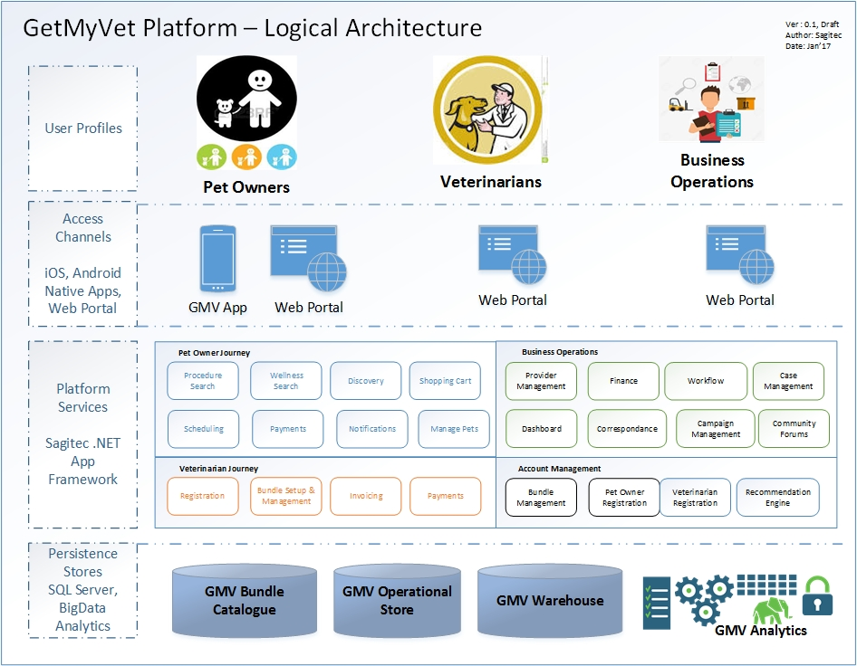
GetMyVet Platform – Functional View
The solution will be cloud hosted ( AWS ) and integrated with appropriate cloud services for monitoring, availability and scalability.
Initial focus is to build mobile app and web portal for search & discovery functionality
Later phases to focus on shopping cart and post purchase experience functionalities
Analytics to drive recommendations will be integrated with the platform in subsequent phases
Leveraging Sagitec assets like MOBIAS, Sagitec Framework, HealHub Platform can be considered along with other technology options during platform selection & finalization process
Notes:
MOBIAS
Ionic Framework
Cordova Libraries
Website
Commercially available templates
HTML/Bootstrap

Slide 6
GetMyVet Platform – Technology View
The technology choices in the view are based on market adoption and fitness for purpose with GMV requirements
The intent to choose best of the breeds technology platforms is to focus on the following:
Leverage out of the box functionalities with minimum customization
Focus on building custom components that differentiates and provides necessary capabilities need for platform evolution
Sagitec’s assets like Digital Care Management and Health Data Analytical Platforms will complement the proposed GMV technology platform
Notes:
MOBIAS
Ionic Framework
Cordova Libraries
Website
Commercially available templates
HTML/Bootstrap

Slide 7
GetMyVet – Proposed Build Plan
UI is initially proposed for 6 weeks and can be extended to address other functionalities
Outcome of UI track will be clickable HTML mockups
Technology stack finalization happens in 3rd week
Build for Phase I starts in 6th week ( 14 week duration )
Build for Phase II starts in 21st week ( 20 week duration )

Slide 8
Thank You

