Slide 1
ECPE 170 Presentation 1
Singly Linked List in C
Deletion of 5th Node
Sloan Kim

Slide 2
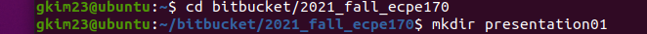
Create a directory

Slide 3
Create main.c and Makefile

Slide 4
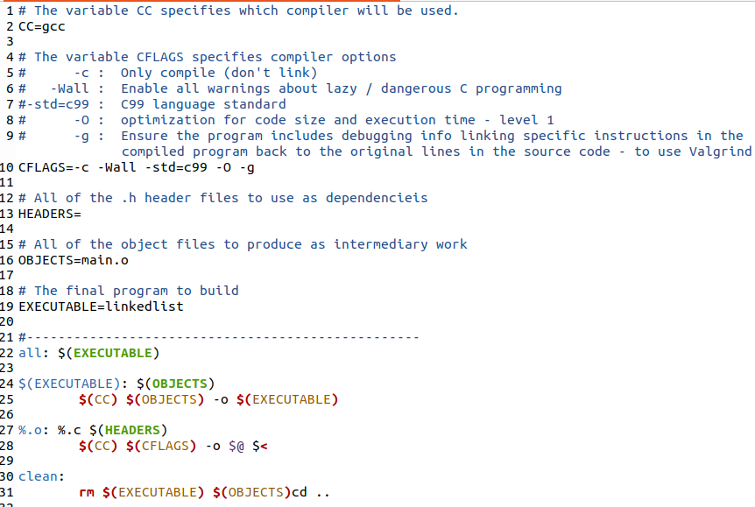

Makefile

Slide 5
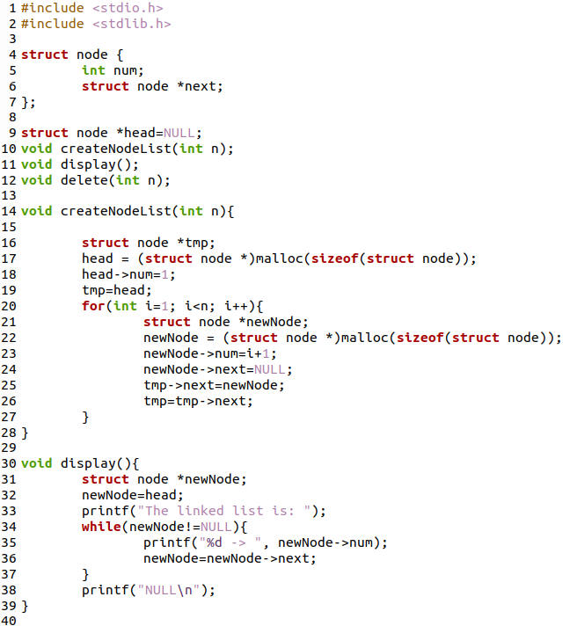
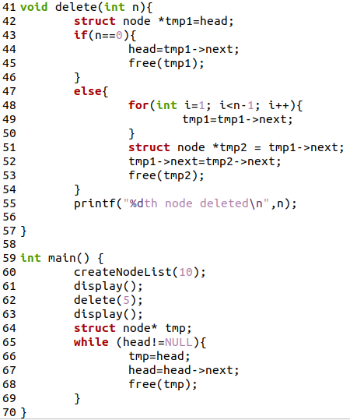

Slide 6
Create structure of node
Head node as global variable
Three functions

Slide 7
Allocate the memory for n nodes in the linked list
Display the linked list

Slide 8
Delete nth node
Making sure to free the memory of deleted node

Slide 9
Create 10 nodes linked list
Delete 5th node
Free all memory of the nodes in the linked list

