Slide 1
BRAGANZA
THE BATTLE FOR GLOUCESTER
ARTICLES OF AGREEMENT
SPECIAL THANKS TO:
Ebenezer Babson
Howard Blackburn
Joseph Foster
Robin Freeman
John Hammond
Andrew Haraden
Hannah Jumper
Masconomet
Clayton Morrissey
Judith Sargent-Murray
Thomas Niles
John Phillips
Thomasine Younger
RYAN BROS., 2015

Slide 2
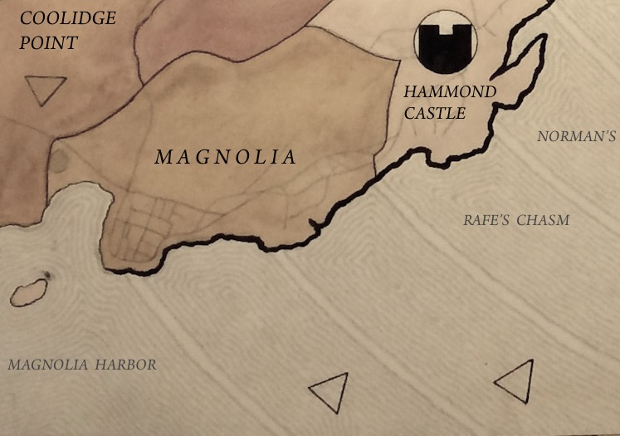



THEY THAT GO DOWN TO SEA IN SHIPS...
Gloucester, America’s oldest seaport, has erupted into civil war. Natives and pirates, witches and wharf rats, fisherman and minutemen have taken up arms against each other. Fighting rages in the streets, through the trees and out on the high seas.
Braganza is a turn-based game for 2-6 players. You command a ragtag militia fighting to capture and control territory. So storm the beaches, ride The Squam and take that hill!
CONTENTS
1 game board
1 deck of 13 Command Cards
6 sets of militias, each a different color and each consisting of 1 captain, 39 soldiers, 4 cannons and 7 flags
13 ships
10 dice, 5 red and 5 white
1 Sea Serpent
SETTING
The game takes place in Gloucester and the neighboring town of Rockport, which together make up Cape Ann. The game board is a map of the cape divided into 39 land territories and 39 sea territories. Before playing, familiarize yourself with these special features:
COMMAND POSTS: The 13 land territories stamped with a round sigil. You begin the game with a handful of Command Posts and earn reinforcements as you capture others. Control the requisite number of posts and you win the game.
STAGING POSTS: The 4 land territories and 9 sea territories stamped with a triangle. These run along the edge of the board. You stage platoons of reinforcements here.
SEA WALLS: Any coastline represented by a thick, gray line. Your fighters can move between land and sea along most of the coast, but they cannot move across sea walls.
ISLANDS: Thatcher Island is accessible only by ship. Smaller, unnamed islands are not in play.
COMMAND
POST
SEA WALL
STAGING POSTS
ISLAND
(Not in play)
YOUR FORCES
You start each game with a captain, 23 soldiers, and 2 cannons. If they fight well enough, you may earn an additional 16 soldiers and 2 more cannons, but that’s it, so choose your battles wisely.
CAPTAIN: When fighting alone, your captain is no different than a lone soldier. When fighting among soldiers, however, your captain increases their collective firepower.
SOLDIERS: Salty recruits, most effective in small groups.
CANNONS: Use to fortify your position or to smash through enemy defenses. On land, they are stationary and remain in
the same territory for the entire game. At sea, they move with ships. You can only use them in battle if you have a fighter, i.e. your captain or a soldier, occupying the in the same territory as the cannons. Otherwise, the cannons are considered abandoned. Players can commandeer and use each others’ abandoned cannons.
FLAGS: Use to claim Command Posts. The number of flags
you have on the board indicates the number of Command
Posts under your control.
3

Slide 3
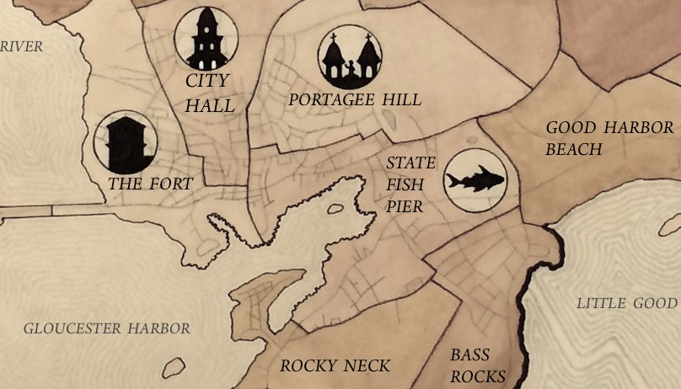
SETUP
Each player selects one of the color-coded militias. If the game has 2-5 players, select an additional militia to represent a neutral team. Choose one player to shuffle the 13 Command Cards and deal 1 card to each player. Do not deal a card to the neutral team.
Each player then rolls a die to determine the order of setup. The player who rolls highest sets up first and the other players follow, rotating clockwise around the board, to complete the steps below.
All players must complete Step 1 of setup before any player moves onto Step 2 of setup, and so on.
Place your captain, 1 cannon and 1 flag on the Command Post that has a sigil matching your Command Card’s sigil.
Place 1 flag on a second, unoccupied Command Post.
If there are 2-4 players, place 1 flag on a third, unoccupied Command Post. If there are 5-6 players, skip this step.
Place 15 soldiers among your Command Posts. No post may hold more than 8 soldiers in addition to your captain.
Add a platoon of 8 soldiers and 1 cannon to your forces. Place the platoon on an unoccupied Staging Post. If you stage the platoon at sea, place the soldiers on a ship. Place the cannon on any of your Command Posts or your ship.
In a 2-5-player game, place 4 soldiers and 1 flag from the neutral team on each Command Post that remains unoccupied.
BEGIN YOUR TURN
In 3-6-player game, the player who rolled highest during Setup moves first during gameplay, and the other players follow, again rotating clockwise. In a 2-player-game, the player who setup second moves first during gameplay.
Your turn basically consists of the following 3 steps:
1. Move your fighters.
2. Fight your enemies.
3. Stage reinforcements, if possible.
On your turn you can move some fighters and not others, fight some battles and not others, or abstain from action altogether. You must, however, complete the steps of your turn in order. You may not, for instance, jump back and forth between moving and fighting in 1 turn.
MOVE YOUR FIGHTERS
Generally, you may move your captain and soldiers across the board by land and by sea, through adjacent territories that share a border.
MOVING BY LAND
On your turn, you may move each individual fighter from the territory it occupies into an adjacent land territory. Your captain and each soldier may move once per turn. They may move as a pack into the same territory or split up and fan out into multiple territories. You may also move fighters onto ships (see MOVING BY SEA, p. 6).
Restrictions on movement by land:
Your cannons cannot move.
Each territory can hold up to 8 soldiers, 1 captain and 2 cannons.
You may not enter a territory occupied by enemy fighters.
Green can move his captain and 2 soldiers from State Fish Pier into any of the adjacent territories not occupied by enemy fighters. He can commandeer Blue’s abandoned cannons at Portagee Hill, occupy Rocky Neck and Bass Rock, team up with the soldier in Good Harbor Beach, and/or board his ship (see MOVING BY SEA, p.6). Green’s cannon cannot move.
4
5

Slide 4
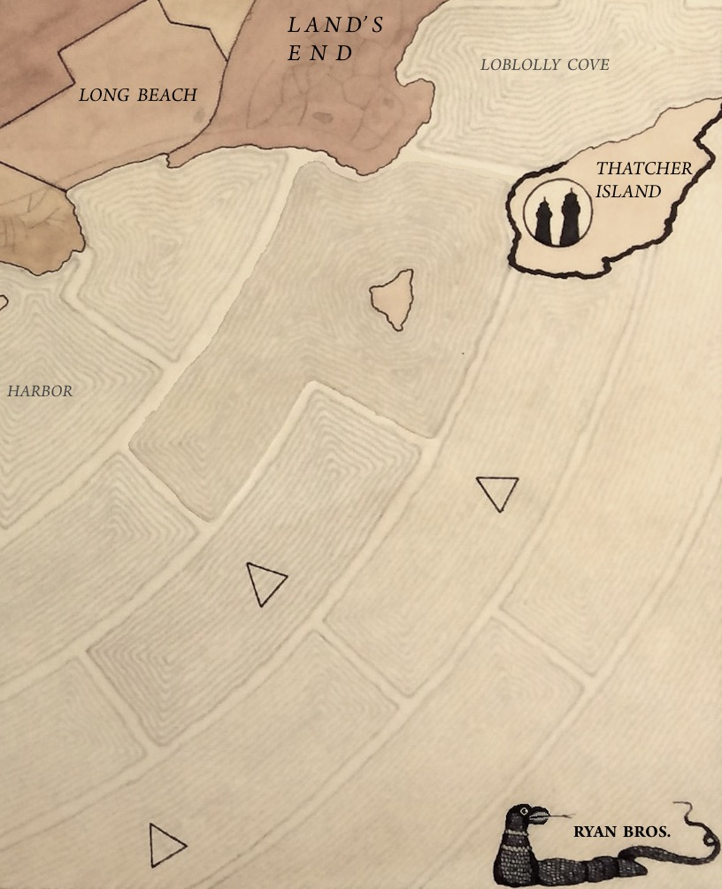
CAPTURING COMMAND POSTS THROUGH MOVEMENT
If you move into an unclaimed Command Post, place 1 of your flags on the sigil to capture the territory. If you move into another player’s unguarded Command Post, remove his or her flag and place your flag on the sigil. A post is considered unguarded if it has no fighters in it. An unguarded post may have cannons in it.
In the previous graphic, if Green moved soldiers from the State Fish Pier into Portagee Hill, he would then remove Blue’s flag and put his own on the territory.
MOVING BY SEA
You must use ships to move fighters and cannons across the sea. Ships may move 2 sea territories per turn. They also have the following special maneuvers:
DOCKING: A ship may dock and unload fighters onto an adjacent land territory, if there is room, unless the shared border is a sea wall. Unloading fighters counts as 1 of the ship’s 2 moves.
BOARDING: Fighters in a land territory may board a ship in an adjacent sea territory, if there is room, unless the shared border is a sea wall. Boarding counts as 1 of the ship’s 2 moves.
LEAPFROGGING: If your ship is adjacent to 2 land territories, fighters from 1 territory may move onto the ship, and then onto the other territory, for instance, from Annisquam to Wingaersheek. Leapfrogging counts as 2 of the ship’s 2 moves.
Restrictions on movement by sea:
Only 1 ship may occupy a given territory at a time.
A ship can hold up to 8 soldiers, 1 captain and 2 cannons at a time.
Cannons may not move from ships to land or from land to ships.
If you move all of your fighters off a ship and onto land, you must remove the ship from the board. If the ship has cannons on it, you must remove both the ship and the cannons from the board.
Fighters from one of your ships may not board another one of your ships, even if they are in adjacent sea territories.
A ship may not occupy the same territory as the Sea Serpent (see SEA SERPENT VARIATION, p. 13)
The blue dots indicate the range of Blue’s ship. It can move 1 territory northwest and offload soldiers onto Land’s End. It cannot travel immediately southwest because Red’s ship is in that territory. It also cannot offload soldiers at Thatcher Island because the shared border is a sea wall. The ship could, on this turn, move into Loblolly Cove and then, on the player’s next turn, offload troops onto Thatcher Island from the island’s northern shore, where there is no sea wall.
6
7

Slide 5

FIGHT YOUR ENEMIES
Once you have finished moving all of the fighters you want to move, you may begin battling enemies in territories adjacent to yours.
FIGHTING BLOCS
Any combination of your captain, soldiers and cannons, in a single territory, fight together as a bloc. Each of your blocs may fight, once per turn, against an enemy bloc. Multiple blocs may fight the same enemy bloc.
A bloc might consist of a lone captain or soldier, or a combination of your fighters and cannons you have commandeered from an enemy player. Cannons by themselves are not blocs and may not fight.
A bloc in a land territory may fight a bloc in an adjacent sea territory, and vice-versa, even if the shared border is a sea wall.
ROLLING THE DICE
Once you declare an attack on an enemy bloc, you and the defending player each roll dice to determine the outcome of the battle. If you attack the neutral team, any other player rolls for that team. The neutral team never moves or launches attacks.
The attacker rolls the red dice and the defender rolls the white dice.
The more dice you roll, the greater your chance of inflicting casualties. The number of dice you and the defending player roll depends on the makeup of your blocs. To determine how many dice you roll, follow this formula:
Roll 1 die for 1 soldier or 2 dice for 2 soldiers,
+ 1 die for 1 captain,
+ 1 die for each cannon.
If your bloc consists of only a captain or a soldier, you roll the minimum 1 die. A bloc consisting of your captain, 2 or more soldiers and 2 cannons yields the maximum 5 dice. After making the calculations, go ahead and roll the dice.
Blue’s captain, 3 soldiers and 1 cannon in Bayview are together a fighting bloc. Blue rolls 4 dice for the bloc: 1 for the captain, 2 for having 2 or more soldiers and 1 for the cannon. Red’s lone soldier is also a bloc, and rolls 1 die.
READING THE DICE
Simply put, evens rolled count as kills and odds rolled count as misses. After each player rolls, count the evens rolled on each side. For every even you rolled, the defending player must remove 1 fighter from his or her fighting bloc. For every even the defending player rolled, you must remove 1 fighter from your fighting bloc.
When fighting a bloc containing both a captain and soldiers, count any kills against the soldiers first.
Cannons on a land territory cannot be destroyed in battle.
If all fighters aboard a ship are killed in a battle, remove that ship, and any cannons on it, from the board.
When the dead have been removed from the board, you may launch attacks with other blocs, following the same process, in any order. Remember, each bloc may fight only once per turn.
CAPTURING TERRITORY, COMMAND POSTS IN BATTLE
If you kill all enemy fighters in a territory, you may immediately move into that territory any of the fighters from the bloc that just fought, unless the shared border is a sea wall. This is the only instance where your fighters move after fighting has commenced, in the same turn. If the territory you move into is a Command Post, remove the enemy flag and place your flag in its stead.
8
9

Slide 6
A SAMPLE BATTLE
The following is an example of a battle between 2 players.
1. Red, after moving all of his fighters, declares his first attack, from Lanesville to Bayview.
2. Red rolls 4 dice: 2 for 2 or more soldiers, 1 for the captain and 1 for the cannon. Blue rolls 2 dice: 1 for the soldier and 1 for the cannon. Red rolls 2 evens, scoring 2 kills, and Blue rolls 2 evens, scoring 2 kills.
3. The aftermath: Red has removed 2 soldiers, since kills count against soldiers before the captain. Blue has removed her soldier, but left the cannon, since cannons cannot be destroyed. Red may now choose to move his surviving captain from Lanesville into Bayview, capturing the territory and commandeering Blue’s cannon. He may then fight elsewhere on the board.
STAGE REINFORCEMENTS
If you capture a Command Post on your turn, you may, at the end of your turn, stage a wave of reinforcements on the board.
You may stage only 2 waves of reinforcements per game. If you capture 2 Command Posts in 1 turn, you may stage both waves at the same time.
A wave of reinforcements consists of 8 soldiers and 1 cannon.
To stage a wave of reinforcements, place a platoon of 8 soldiers on an unoccupied Staging Post. Use a ship to stage the soldiers at sea. Then place the cannon on any of your ships, any of your Command Posts or any other territory occupied by your fighters, as long as the location does not already have 2 cannons.
You may move your reinforcements on your next turn. In the meantime, other players may attack them while they are in staging. Your reinforcements may defend themselves if attacked.
If all of the Staging Posts are occupied, you must wait until the end of your next turn to stage reinforcements.
You must stage reinforcements as soon as you are able to.
END YOUR TURN
Your turn ends after you have moved, fought and, if possible, staged reinforcements. Your turn will naturally end once you have moved everyone possible, fought everyone possible and staged any possible reinforcements. You may also end your turn earlier, even without moving anyone, simply by declaring your turn over.
Once you end your turn, the player to your left begins his or her turn. The other players may attack your forces. If this happens, assume the role of the defender and roll dice to defend your fighters. Continue taking turns until someone wins or the game ends in a draw.
10
11

Slide 7
GAME OVER
The game ends the moment a player controls the requisite number of Command Posts to win, which are posted below.
Remember, the number of flags you have on the board indicates the number of Command Posts under your control. You control a Command Post even if you do not have any fighters occupying it.
The game can also end in a draw if:
Every fighter dies before any player captures enough Command Posts to win.
Each player abstains from moving and fighting, or cannot move and fight, for 2 consecutive turns.
SEA SERPENT VARIATION
Adding the Sea Serpent to the game helps even the odds for unlucky players who consistently roll odds. The beast, sighted in Gloucester Harbor in 1817, moves only along sea territories and has the potential to sink ships.
To play this variation, during Setup, just before the Command Cards are dealt, place the Sea Serpent token in 1 of the 4 corners of board.
GETTING TO CONTROL THE SEA SERPENT
You gain control of the serpent with a specific roll of the dice during battle. If you get to control the serpent, you do so immediately after you have rolled the dice, removed the dead and captured any territory in that battle. You may control the serpent even if you were rolling for the neutral team and even if your last fighters were just killed in battle.
You gain control of the serpent whenever:
You roll snake eyes, or two 1s, and the opposing player does not.
You roll 2 sets of snake eyes, or four 1s, and the opposing player rolls no more than three 1s.
If both players engaged in battle roll the same number of 1s at the same time, neither player may control the serpent.
CONTROLLING THE SEA SERPENT
If you control the Sea Serpent you may move it up to 2 sea territories for each pair of 1s rolled. The beast may then attack a ship in an adjacent sea territory, including a Staging Post. It may not attack land. The serpent may not occupy the same territory as a ship.
If you command the serpent to attack a ship, the player commanding that ship rolls 1 die for each fighter on board. The fighter lives if the roll comes up odd and is killed if it comes up even. If the serpent kills the last fighter on a ship, remove that ship, and any cannons on it, from the board.
You may continue the fighting part of your turn immediately after you have controlled the serpent.
TIPS AND TRICKS
Try to get reinforcements as soon as possible.
Balance your maneuvers to both capture Command Posts and block other players from doing the same.
Avoid indiscriminate fighting. Every move and soldier counts.
Share intelligence. If you see that another player can win the game, and that a third player is the only one positioned to stop her, you may alert the third player to this fact.
Flank an enemy to maximize the number of dice you roll in battle. Instead of launching an attack with 6 soldiers in 1 bloc, divide the soldiers among a few territories adjacent to the territory you plan to attack. 6 soldiers in 1 territory only roll 2 dice, but 6 soldiers fanned out across 3 territories roll a combined 6 dice.
If you have a chance to win, and the odds of victory are at least 50/50, go for it. You may not get a second chance.
NUMBER OF PLAYERS | COMMAND POSTS TO WIN
2 | 7
3 - 4 | 6
5 - 6 | 5
12
13

