Slide 1
Running high scale global services
Slobo Stipic

Slide 2

Zero to DevOps

Slide 3
Traditional service lifecycle
Monthly releases
Basic monitoring
Best effort response
Slow improvement
Dev
Test
Service
Engineering

Slide 4
DevOps service lifecycle
Code and test
Pull request
Rolling deployment
Merge to master
Gradual deployment to PROD
Running services
Quality daily releases
UX health monitoring
Rapid response
Perpetual improvement

Slide 5
What is high scale?
Multiple data centers
Multiple continents
100s of machines
Millions of active users
Many service partners

Slide 6
What is a global service?
Serves diverse population
100+ countries
100+ languages
Across multiple continents

Slide 7
Quality daily releases
Code and test
Pull request
Rolling deployment
Merge to master
Gradual deployment to PROD
Running services

Slide 8
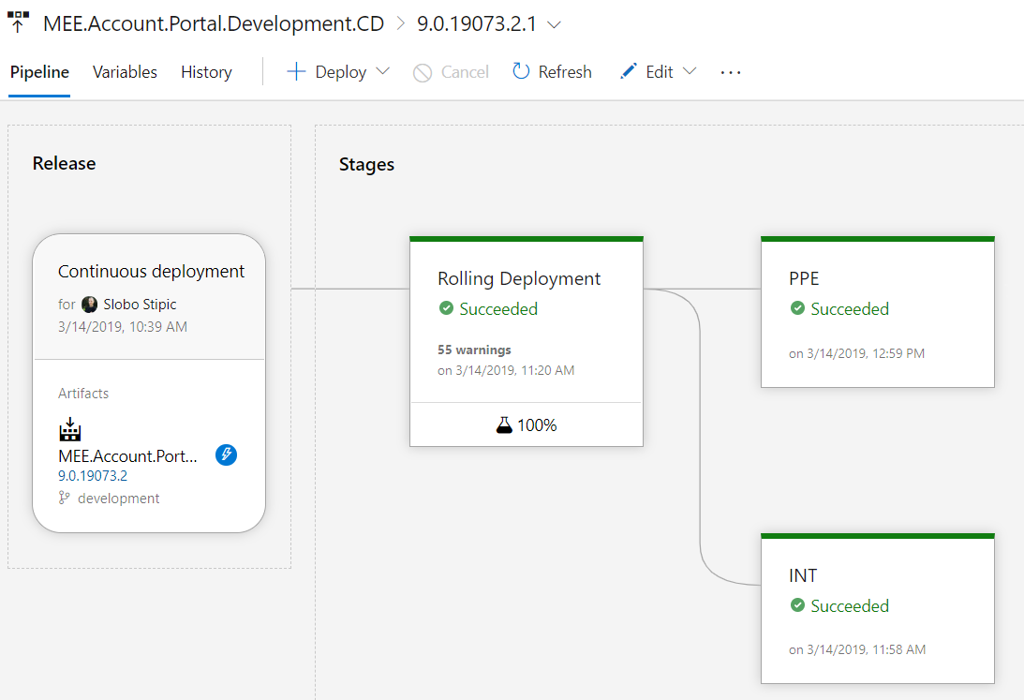
Rolling deployment with tests
Every PR completion triggers deployment to RD environment, where the suite of functional tests is executed
First chance to prevent PROD deployment from even happening

Slide 9
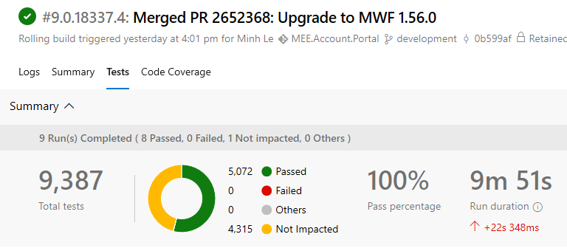
Testing
Automated, expansive, repeatable, reliable tests
Successive environments introduce slight differences
DNS, test vs. prod endpoints, secrets, certificates
Tests we run:
Unit tests (.NET, JS)
Functional tests (UI, E2E)

Slide 10
Gradual deployment
Build goes through a series of environments, prior to being available to all customers:
Rolling (triggers merge to master upon success)
Once rolling deployment is complete, it triggers manual approval to deploy further to PROD
Shadow (shadows 5% of GET traffic)
Canary (served to 1% of the users)
First set of DCs
Remainder of DCs
At each point “quality gates” are evaluated
GTM is used to route traffic between stages, load balancing, security features

Slide 11
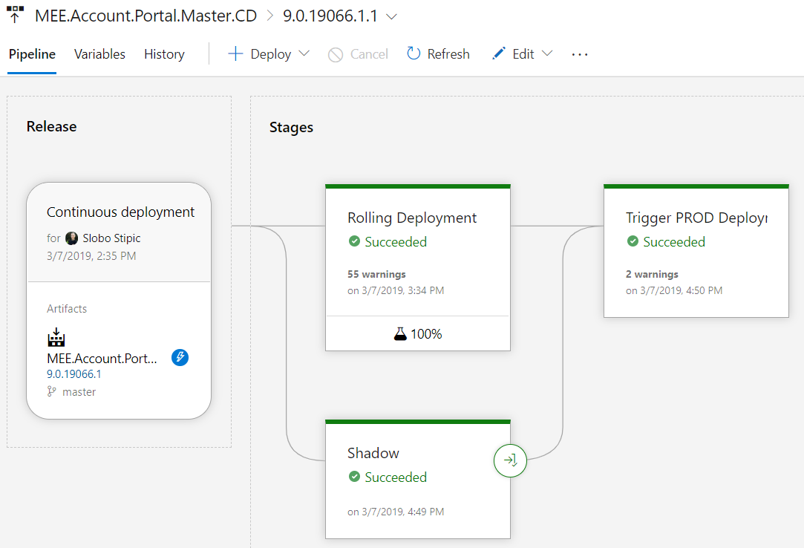
PROD Deployment pipeline

Slide 12
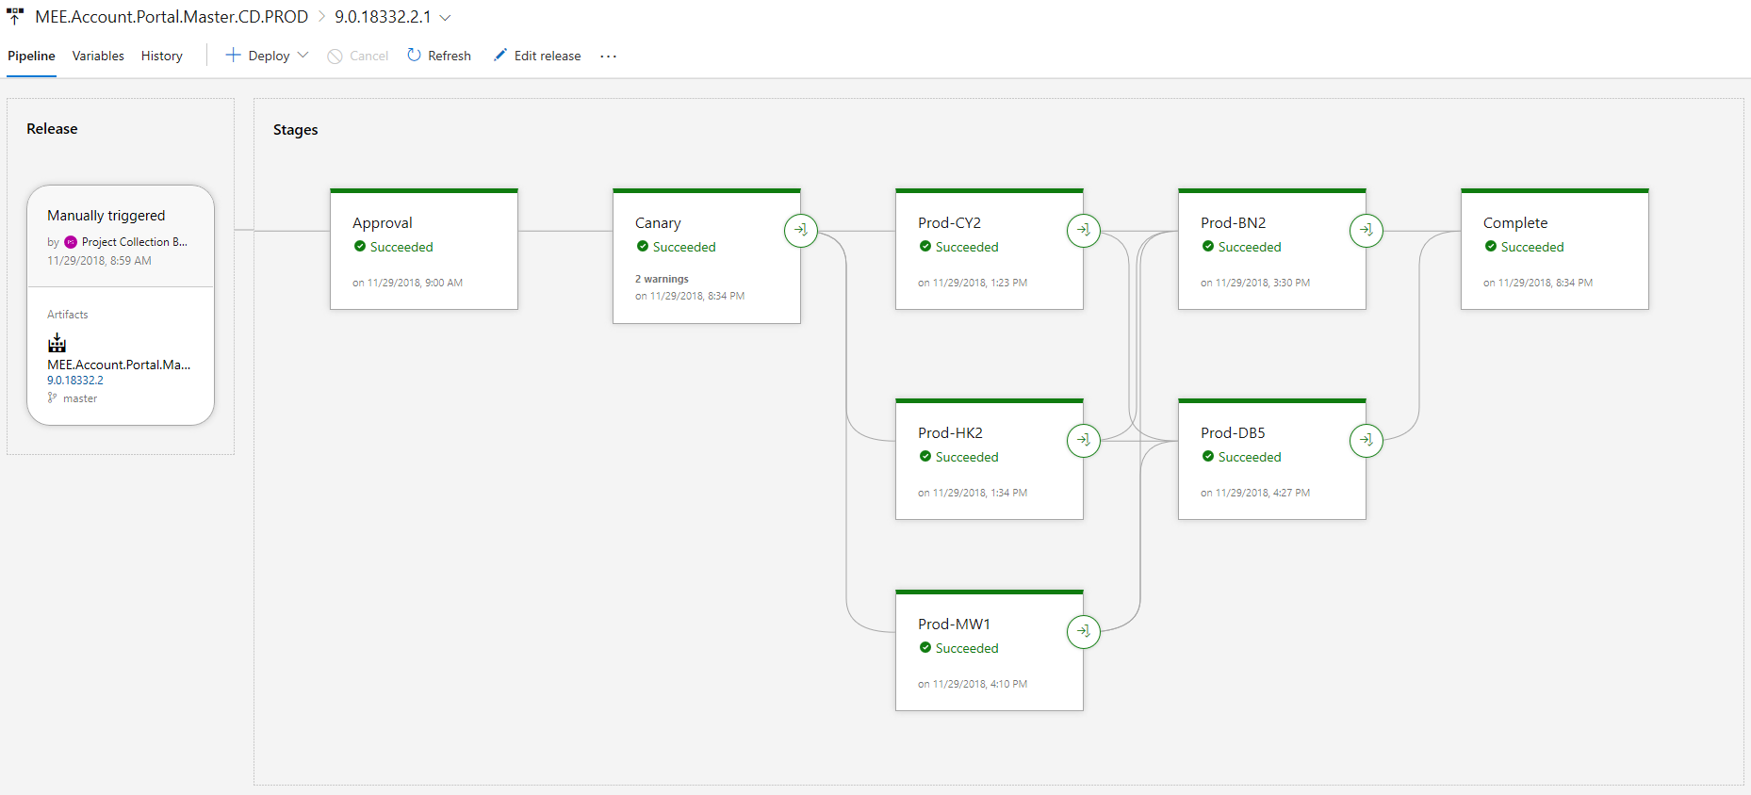
PROD Deployment pipeline

Slide 13
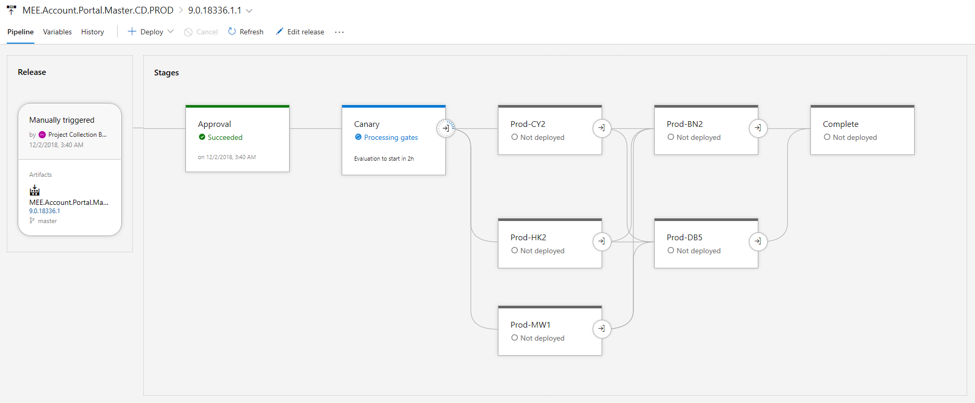
Quality gates
Watchdogs are healthy
No livesite incidents in Shadow environment
No livesite incidents in Canary and DCs that we’ve just deployed to
Notes:
Watchdogs
Runners that execute simple test cases for specific low-level functionality or a feature of high importance
If broken, indicate serious problems with the build
Can trigger repair of the environment

Slide 14
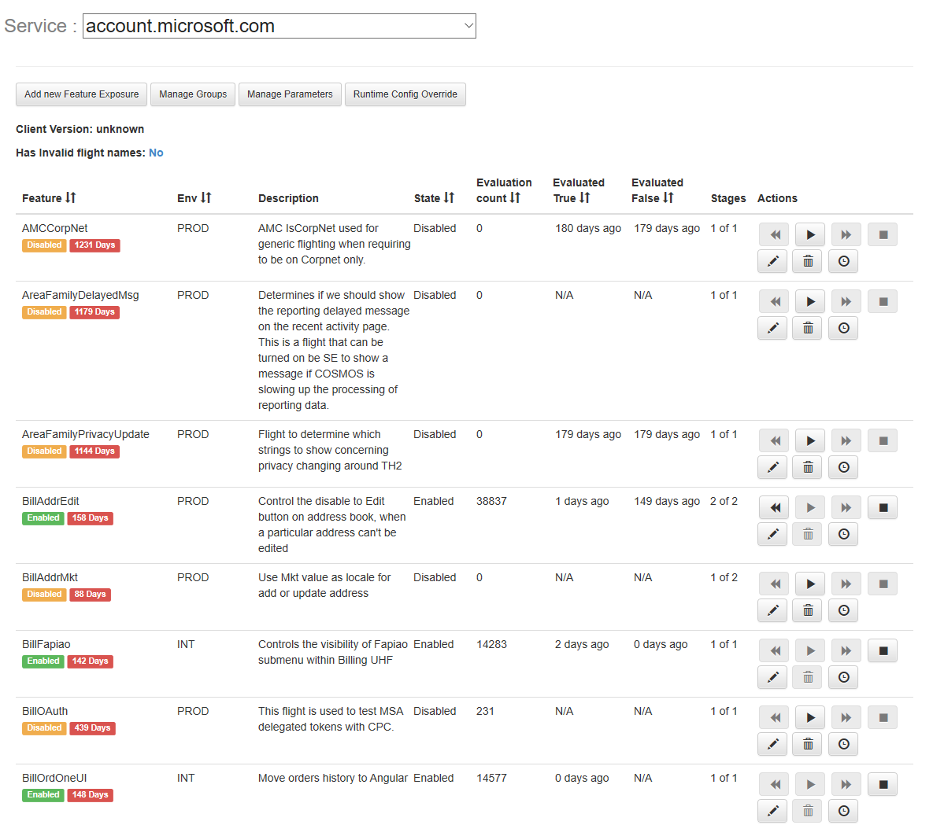
Feature exposure
Control feature exposure based on user attributes
Supports Windows Insider Quests
Feature kill-switch
Notes:
Usual order of operations:
Deploy with flight off
Enable flight for X% of the users
Monitor health
Repeat, until reached 100% of the users

Slide 15
Content Management Service (CMS)
No static content in codebase (except fatal error page)
Content changes are disconnected from product deployments
Content is feature flag aware
Localization

Slide 16
Other quality concerns
Compliance
Threat Modeling
Capacity Planning
Business Continuity Plan
Accessibility
Localization

Slide 17
UX health monitoring
Code and test
Pull request
Rolling deployment
Merge to master
Gradual deployment to PROD
Running services

Slide 18
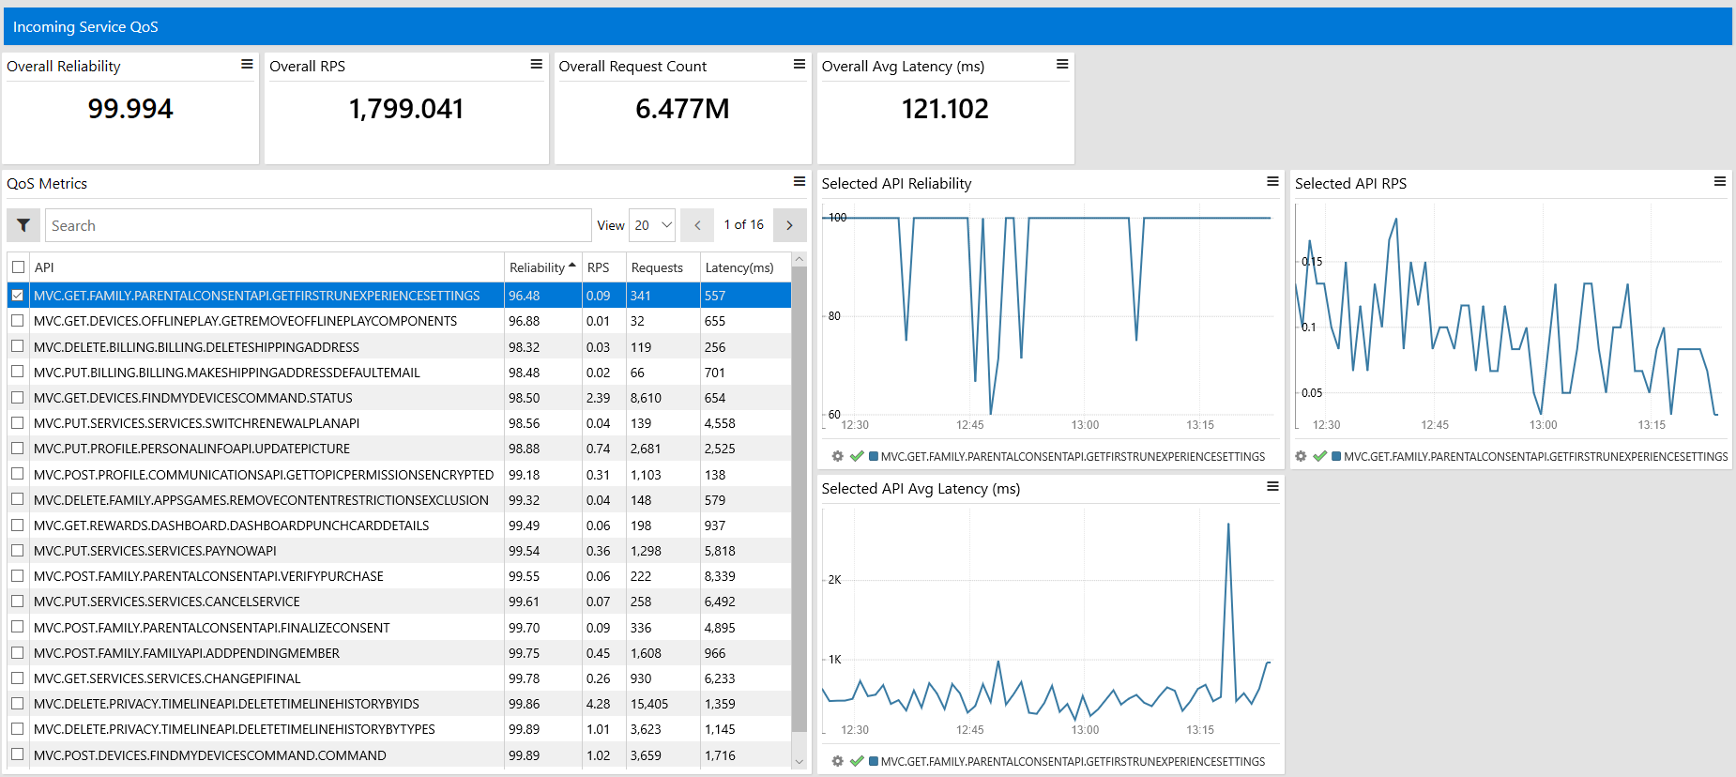
Service health – server side
Measured for each HTTPS endpoint
Errors can be QoS-impacting or not
Incoming and Outgoing Quality of Service (QoS)
Target: 99.9%
Notes:
Usual order of operations:
Deploy with flight off
Enable flight for X% of the users
Monitor health
Repeat, until reached 100% of the users

Slide 19
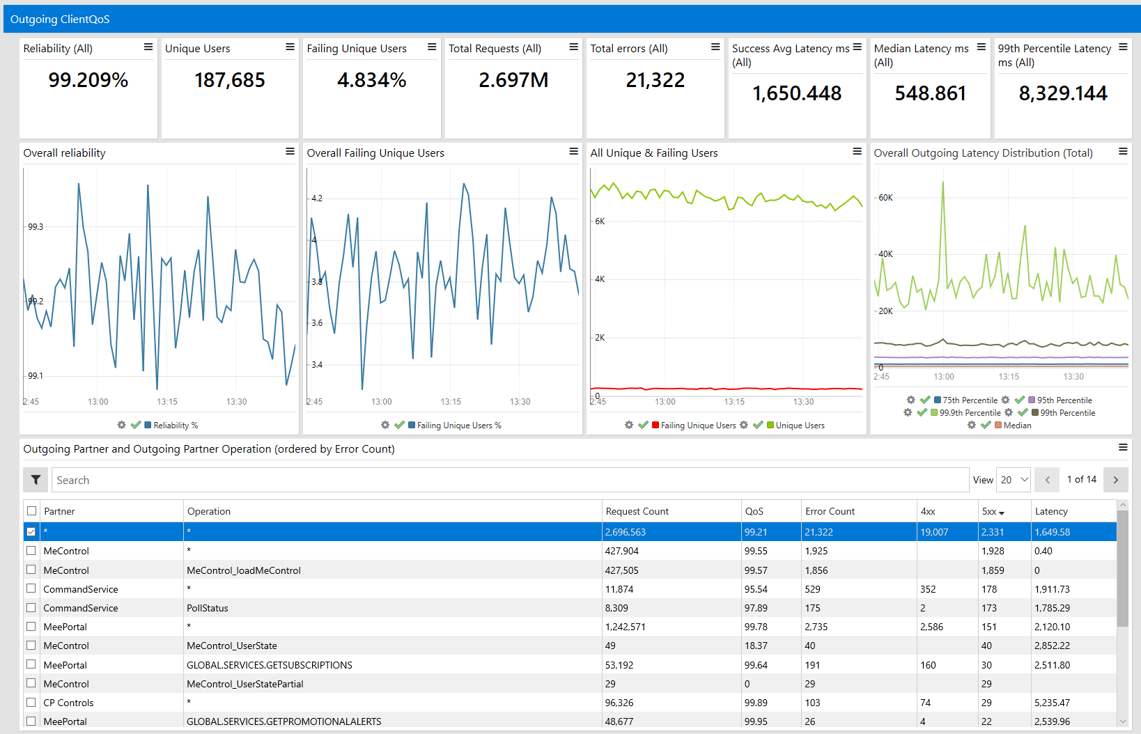
Service health – client side
Outgoing Quality of Service (QoS)
Target: 99%
Notes:
Usual order of operations:
Deploy with flight off
Enable flight for X% of the users
Monitor health
Repeat, until reached 100% of the users

Slide 20
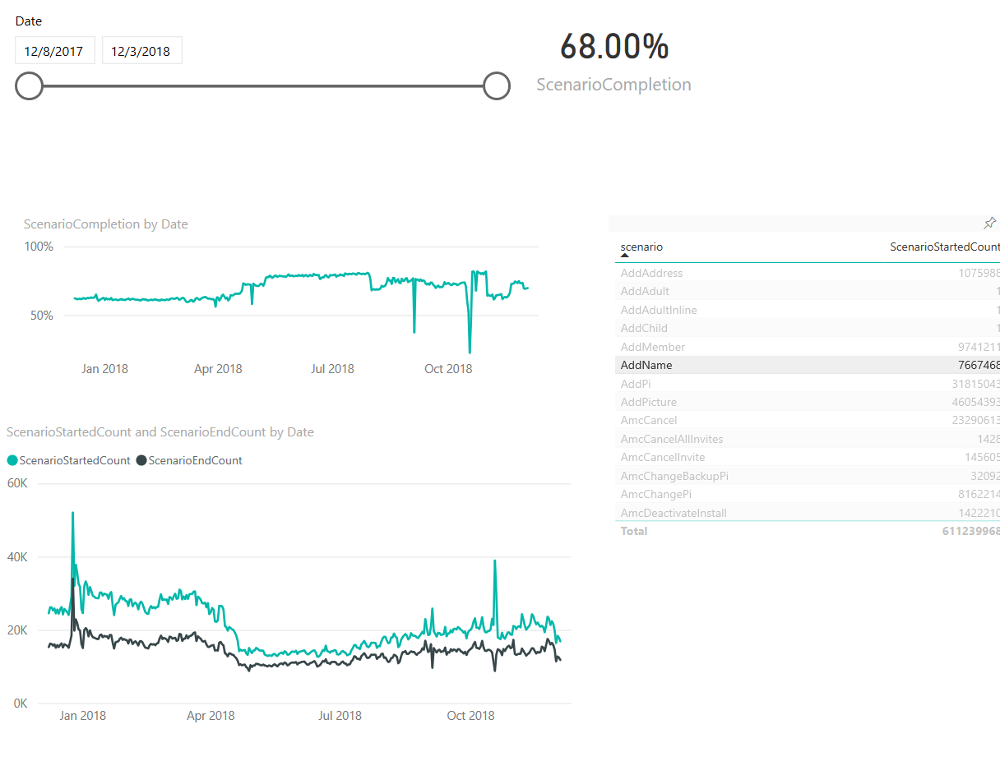
Task completion
Business Intelligence primary purpose
Once baseline is established, anomalies in signal may prompt an investigation using other tools
Notes:
Usual order of operations:
Deploy with flight off
Enable flight for X% of the users
Monitor health
Repeat, until reached 100% of the users

Slide 21
Rapid response
Code and test
Pull request
Rolling deployment
Merge to master
Gradual deployment to PROD
Running services

Slide 22
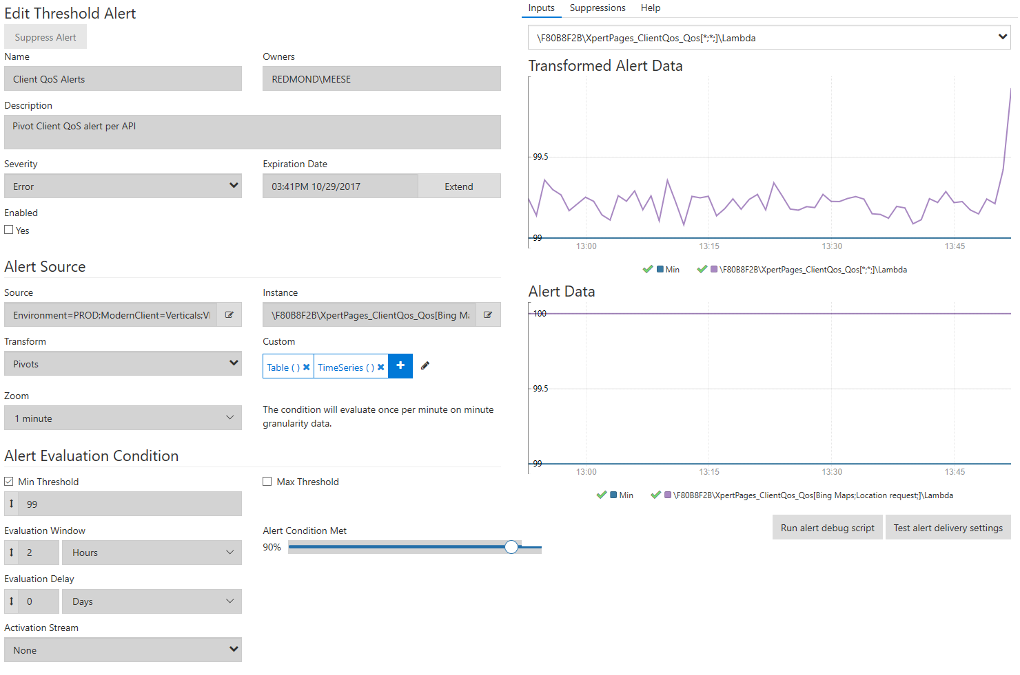
Alerts
Can have a lot of criteria
Triggers email or/and Incident
Assign severity to detected problem
SLA dependent
Notes:
Usual order of operations:
Deploy with flight off
Enable flight for X% of the users
Monitor health
Repeat, until reached 100% of the users

Slide 23
Incidents – user impacting issues
Engages Designated Responsible Individual
Manage DRI schedule
Single place for status of all Microsoft services
Complete post-mortem
Notes:
Usual order of operations:
Deploy with flight off
Enable flight for X% of the users
Monitor health
Repeat, until reached 100% of the users

Slide 24
Incident workflow
Incident created
DRI determines customer impact
Engage necessary partners
Mitigate
Post-mortem and repair items
Metrics:
time-to-detect
time-to-engagement
time-to-mitigation
This happens 24/7
Notes:
Usual order of operations:
Deploy with flight off
Enable flight for X% of the users
Monitor health
Repeat, until reached 100% of the users

Slide 25
Mitigation options
Caught during deployment? Rollback!
DC went down? Failover!
Engage partner
Turn off the feature
Publish missing content
Roll forward
CD enables us to deliver hotfix ASAP
Keep monitoring to confirm
Notes:
Usual order of operations:
Deploy with flight off
Enable flight for X% of the users
Monitor health
Repeat, until reached 100% of the users

Slide 26
Perpetual improvement
Code and test
Pull request
Rolling deployment
Merge to master
Gradual deployment to PROD
Running services

Slide 27
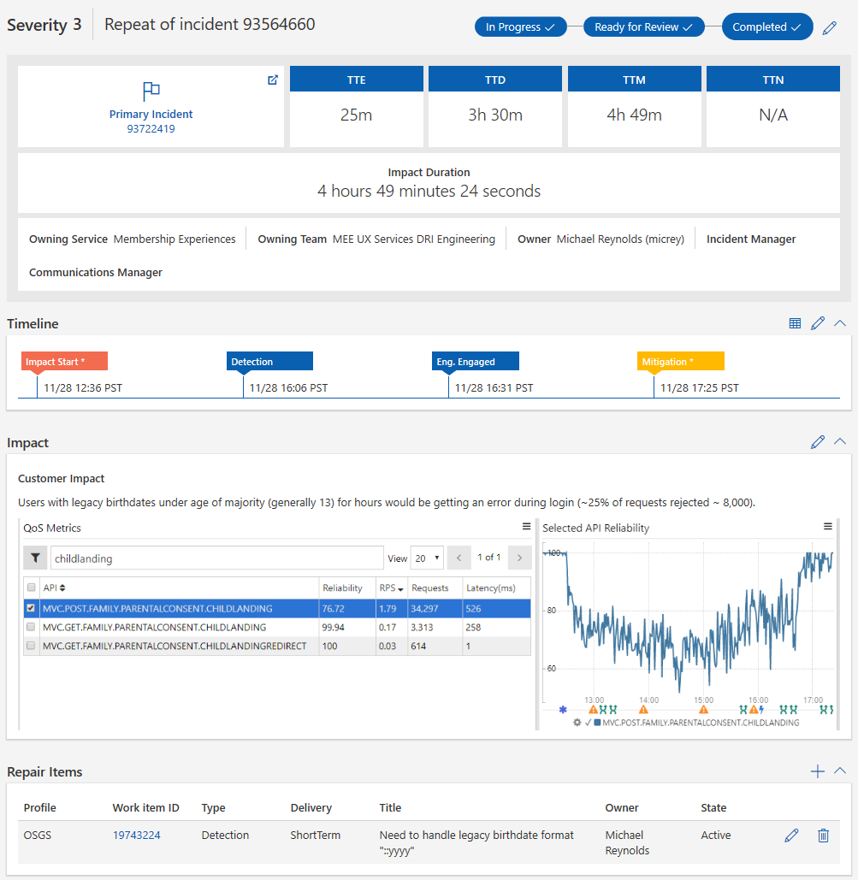
Post-mortem
Captures timeline of the incident
Root causes the problem
Repair items improve the service by preventing repeat occurrences

Slide 28
Experimentation
Cultural shift in how we approach UX design
Validates our assumptions
Supported by another service
Notes:
Usual order of operations:
Deploy with flight off
Enable flight for X% of the users
Monitor health
Repeat, until reached 100% of the users

Slide 29
Thank You!
Slides are available at devatheart.com
Hit me up with question at @slobo80
We are hiring! (in Redmond)

