Slide 1
UI Test Automation

Slide 2

Agenda
How to Run UI Tests
Architecture
Guidelines and Recommendation

Slide 3

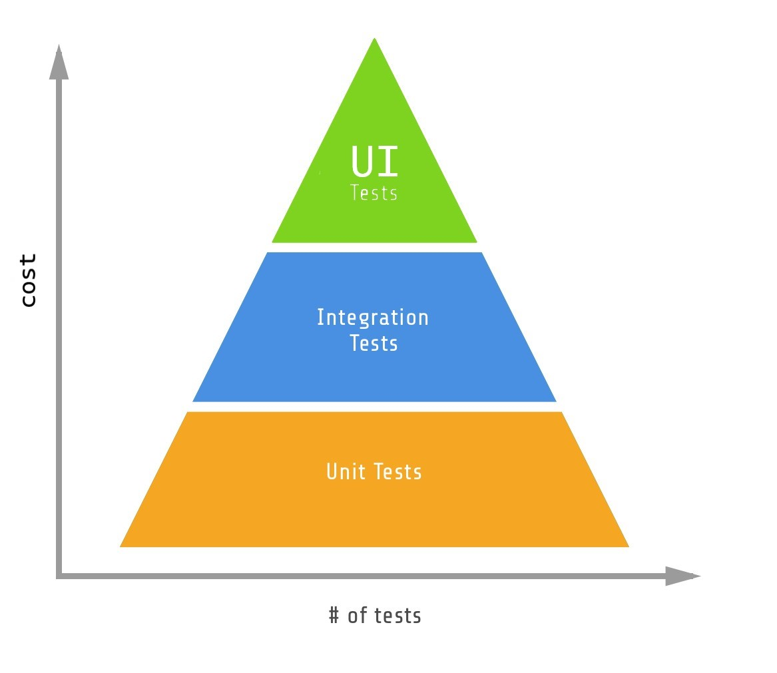
Cost of UI tests
Time consuming to write
Slow to execute
Unreliable
Fragile
Hard to maintain

Slide 4
Demo Time

Slide 5

Architecture

