Slide 1
UI Test Automation
Slobo Stipic
@slobo80
devatheart.com

Slide 2

.NET Developers Association
First Monday of the month
Next meetup: Nov 6, Microsoft campus
Topic: Inception, Workflow, to $Deployed$ Removing Chaos and Noise From Your Dev Stack
http://dotnetda.org
@netda

Slide 3

Agenda
Selenium Architecture
Guidelines and Recommendation

Slide 4
Demo Time

Slide 5
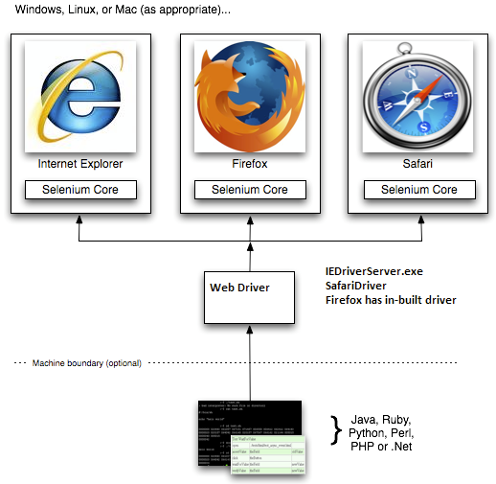
Architecture

Slide 6

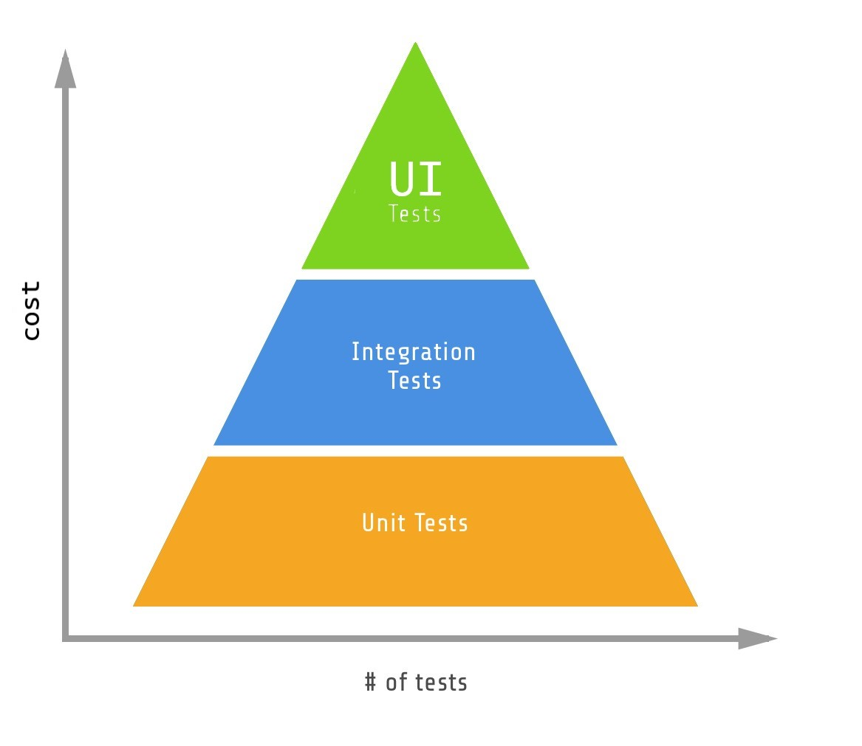
Cost of UI tests
Time consuming to write
Slow to execute
Unreliable
Fragile
Hard to maintain

Slide 7
Can I have the Code and Slides?
devatheart.com

