Slide 1


Team 1 as part of Brainster Data Science Academy and in collaboration with Kungul, tried to enable consumers to know if their skincare product contains any harmful ingredients.
Mentorship by Stefan Popov
December 2023

Slide 2
Task1
Basic text cleaning from unnecessary strings, duplicates, lower, upper case, rough analyses;
Applying word2vec NLP pre-trained model on massive Google news data used to match synonyms – solution 1;
With PubChemPy accessing chemical information from the PubChem database, which is part of the National Institutes of Health, and wich is free (NIH) – solution 2;
Task 2
Applying OCR (optical character recognition) in terms of recognizing text from image;
Barcode reader;
Training word2vec NLP on our dataset to return confident results;
Representing each distinct word with a particular list of numbers called a vector;
Mathematical function cosine similarity defines the level of semantic similarity between vectors;
See diagram of how solution is structured;

Slide 3
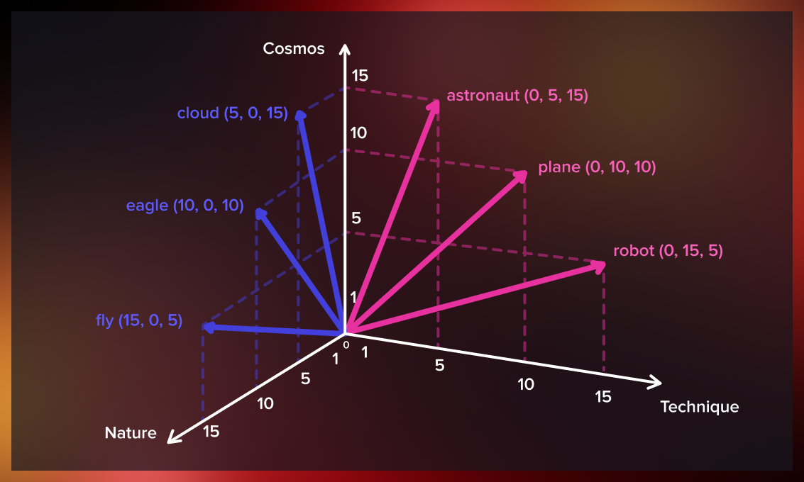
WORD2VEC
How it works?

Slide 4
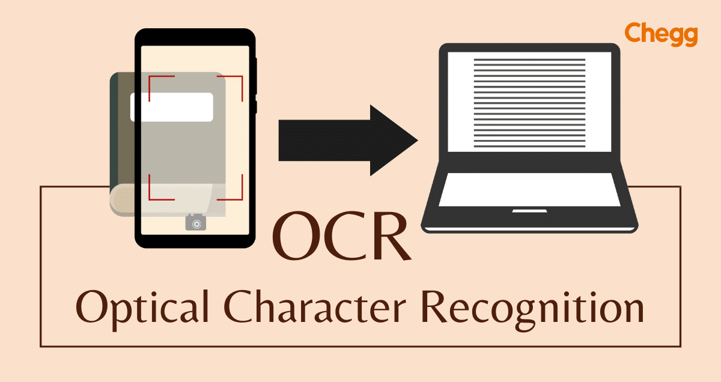

Slide 5
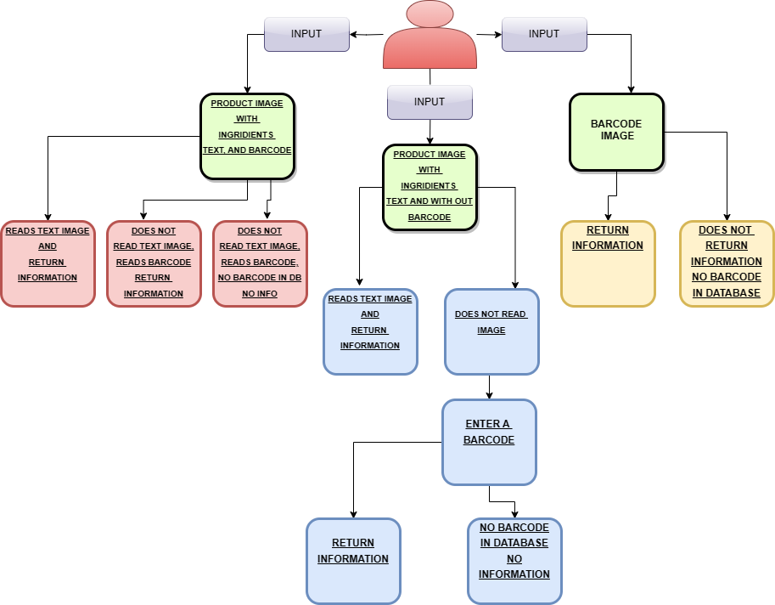

Slide 6
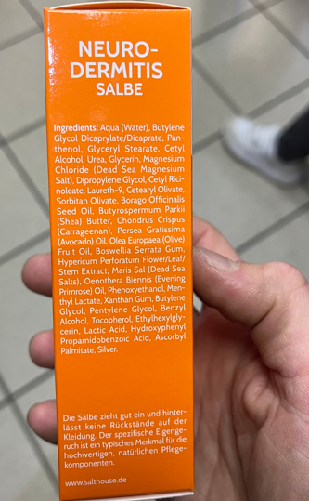
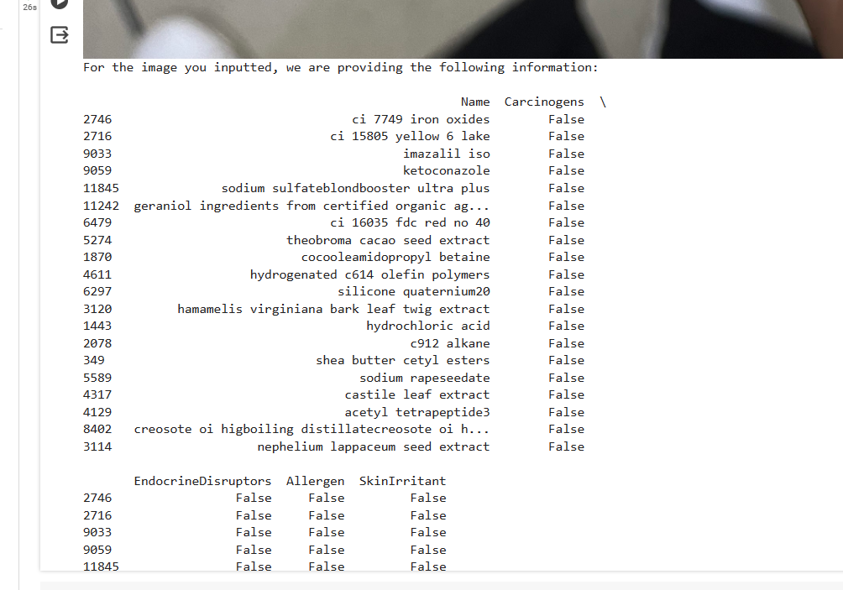
Input: text image, reads text, return result

Slide 7
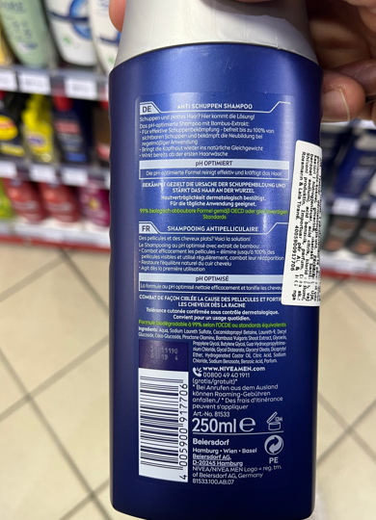
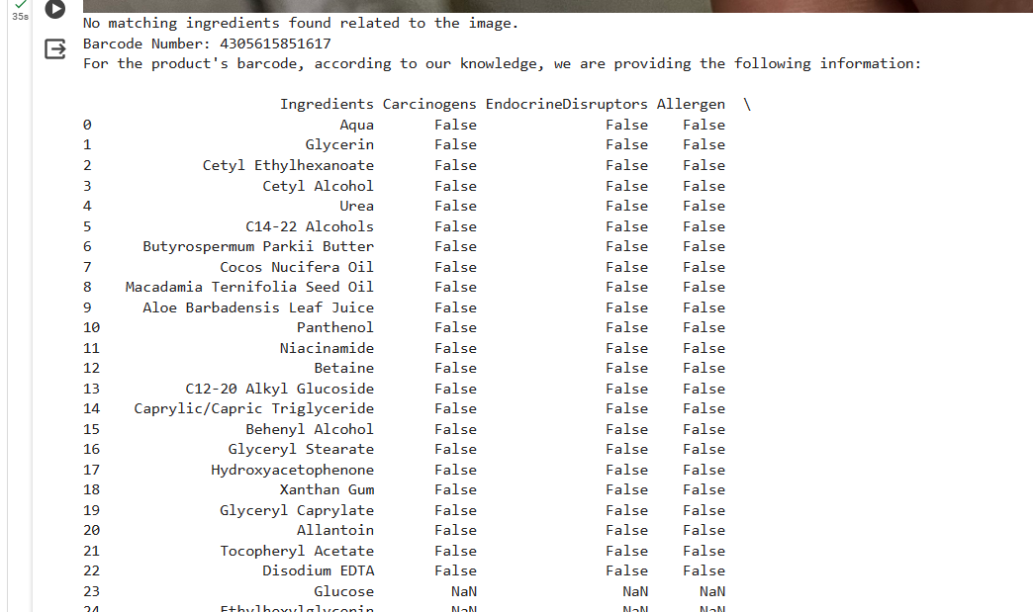
Input: text image with barcode on it, does not read text, reads barcode, return result

Slide 8
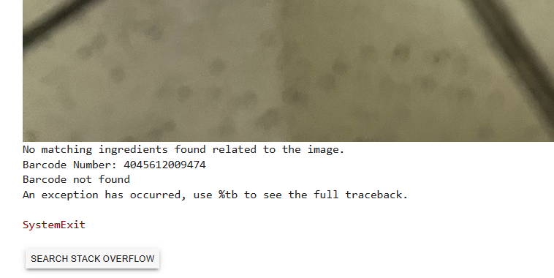
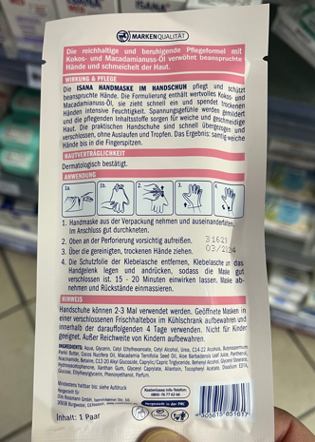
Input: text image with barcode on it, does not read text, reads barcode, no barcode in database, no result

Slide 9
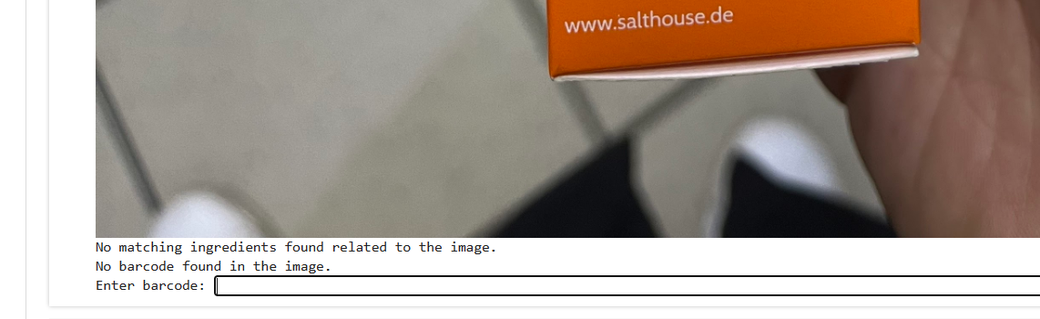
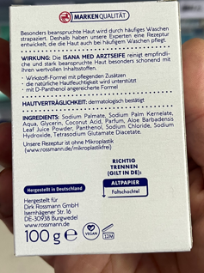
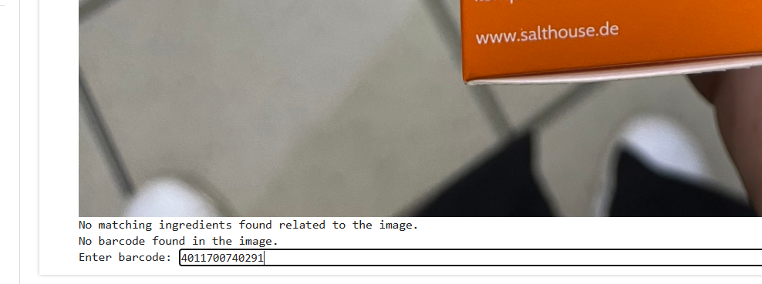
Input: text image without barcode on it, does not read text, no barcode, input barcode, return result

Slide 10
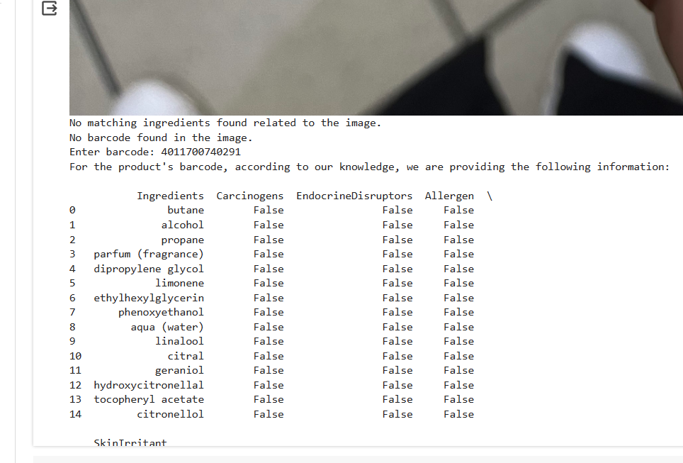

Slide 11
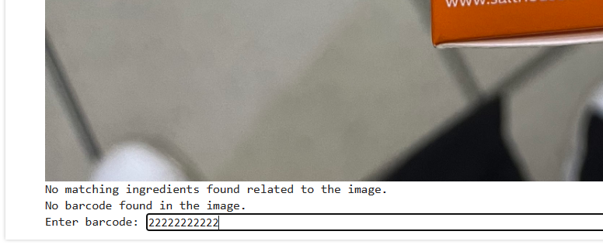
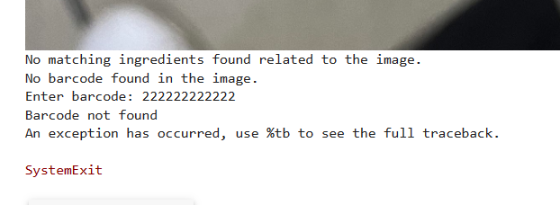
Input: text image without barcode on it, does not read text, input barcode, no barcode in database, no result

Slide 12

THANK YOU

