Slide 1
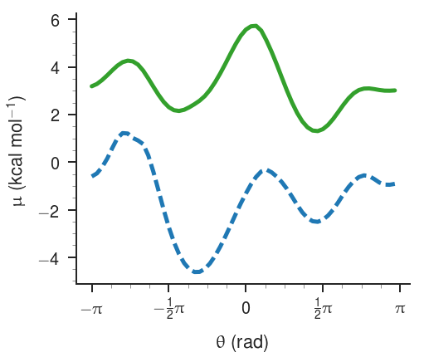
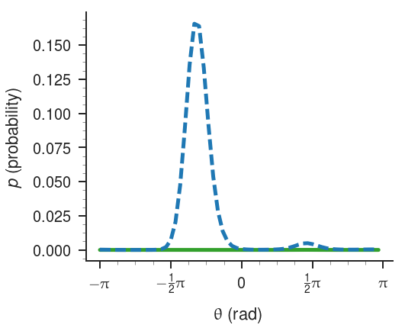
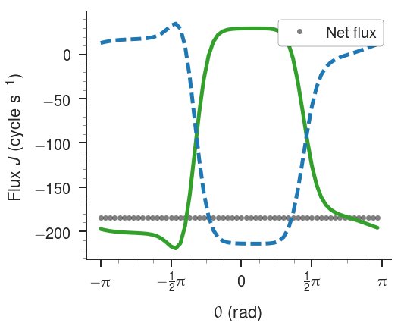
chi2THR175
The tilting method reports a very small stall load for this motor of -0.0008 kcal mol⁻¹ cycle⁻¹, despite high flux.

Slide 2
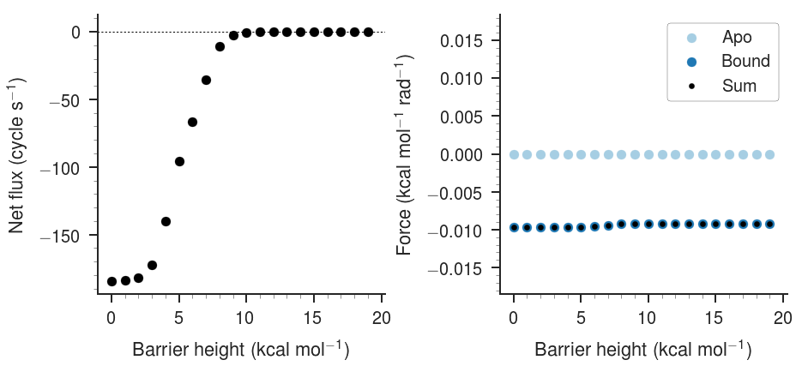
chi2THR175
A barrier of ~9 kcal mol⁻¹ at bin 20 is required to block all the flux, yet the force on the barrier is quite small.

Slide 3
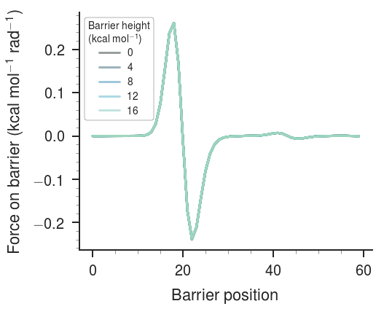
chi2THR175
The force on the barrier does not change significantly as the barrier height increases, even though the flux does!

Slide 4
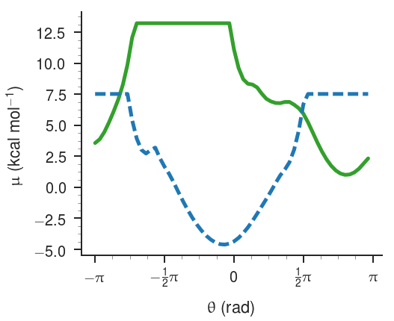
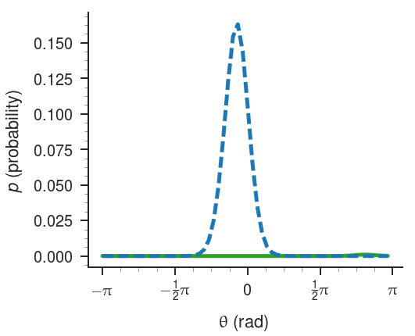
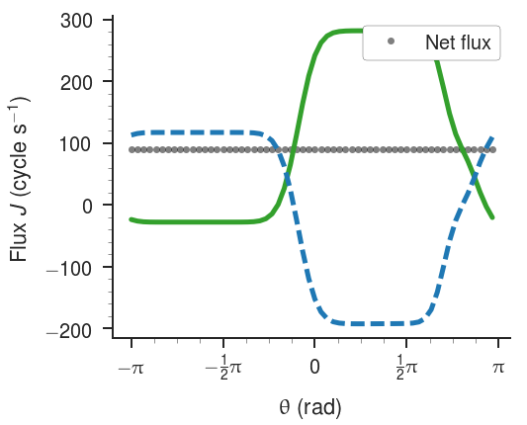
psiSER41
The tilting method reports a large stall load for this motor of 2.4 kcal mol⁻¹ cycle⁻¹.

Slide 5
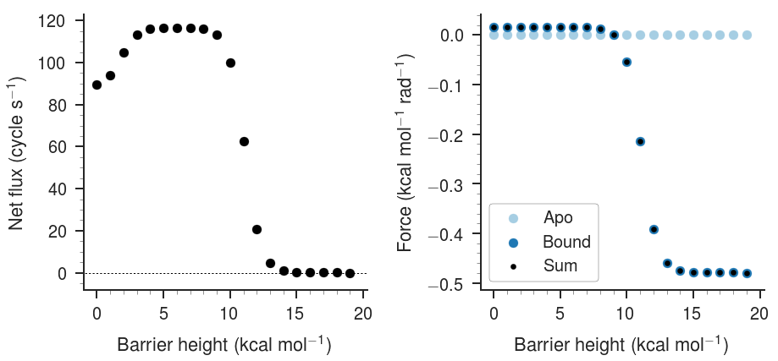
psiSER41
A barrier of ~15 kcal mol⁻¹ at bin 20 is required to block all the flux and small barriers increase the flux. The net force also changes sign!

Slide 6
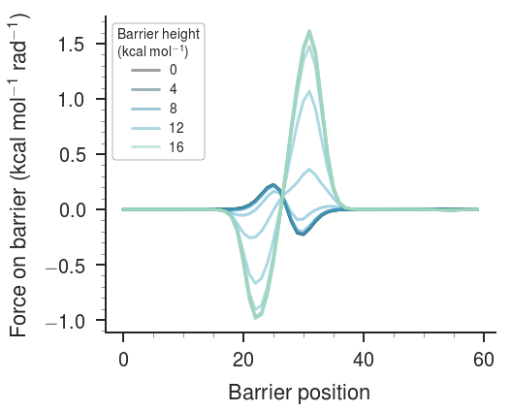
psiSER41
The change in sign and position-dependent force on the barrier can be seen clearly.

