Slide 1
Stall force

Slide 2
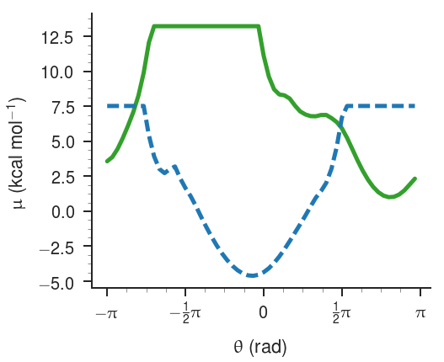
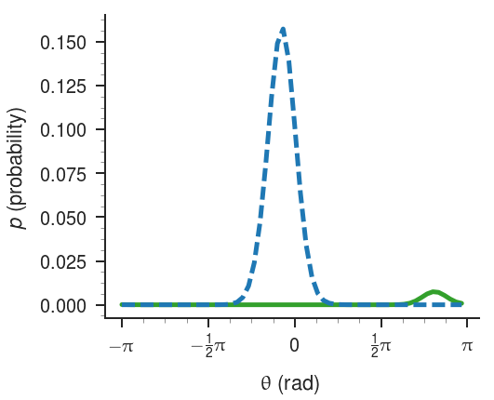
Take an example angle from ADK that generates a high amount of flux…

Slide 3
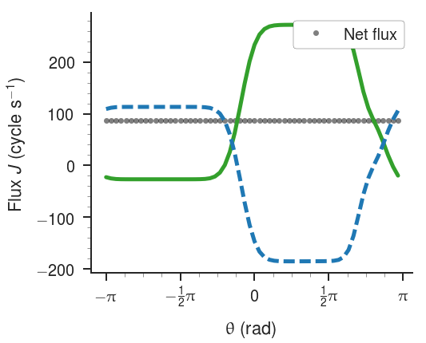

Slide 4
Stall force
Inelegant way to calculate the stall force is to apply a load that acts evenly across the entire energy landscape.

Slide 5
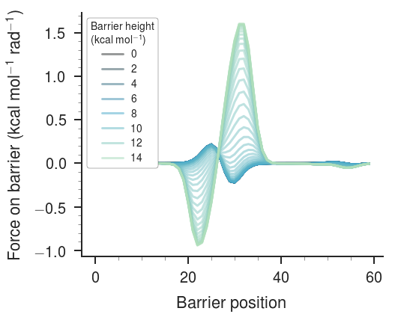
Now let’s add a barrier that blocks flux…

