Slide 1
Geometry

Slide 2
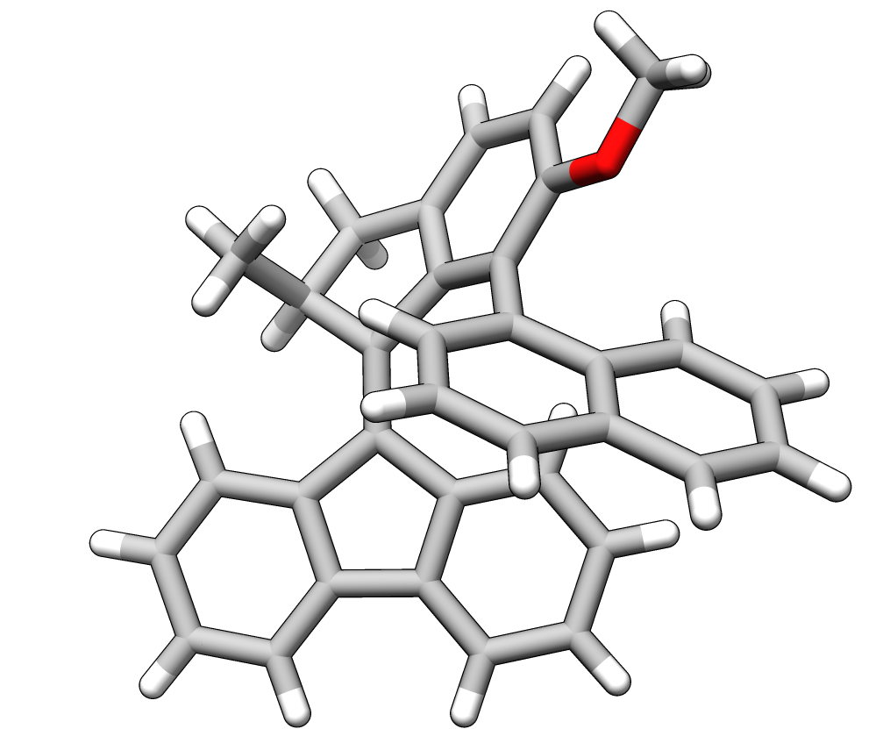

Slide 3
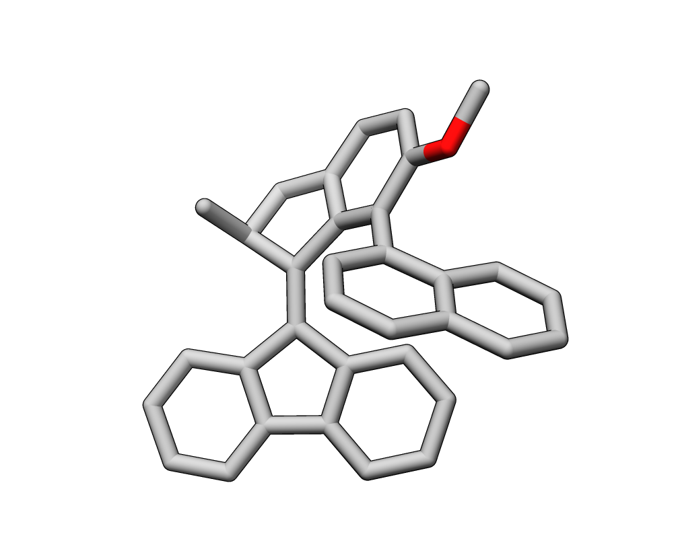

Slide 4
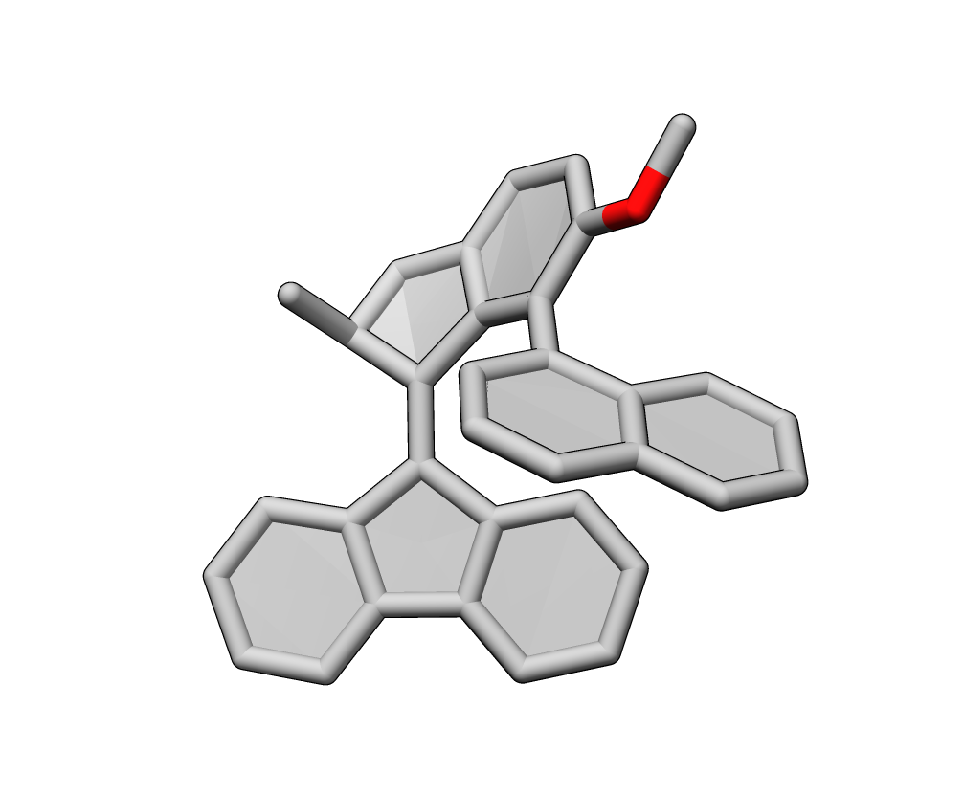
Štacko, P. et al. Locked synchronous rotor motion in a molecular motor. Science 356, 964–968 (2017).

Slide 5
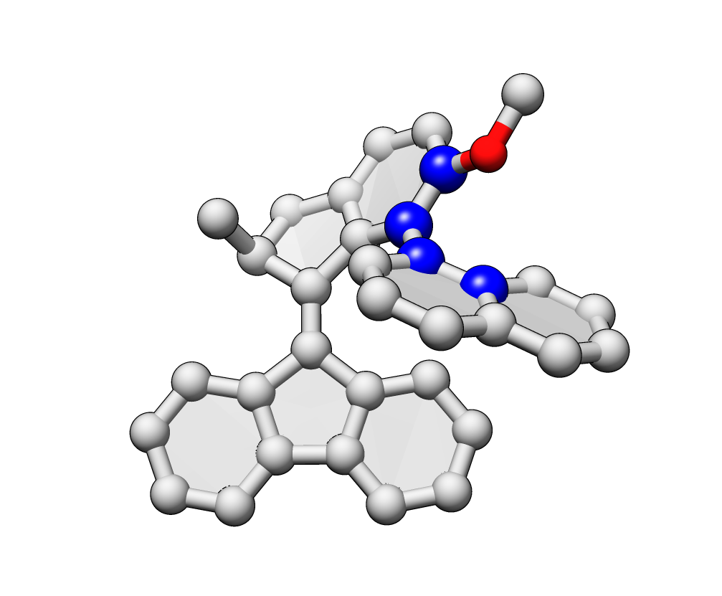
(S,M,R_{a})-1
M
S
62.4° (P helicity, syn)

Slide 6
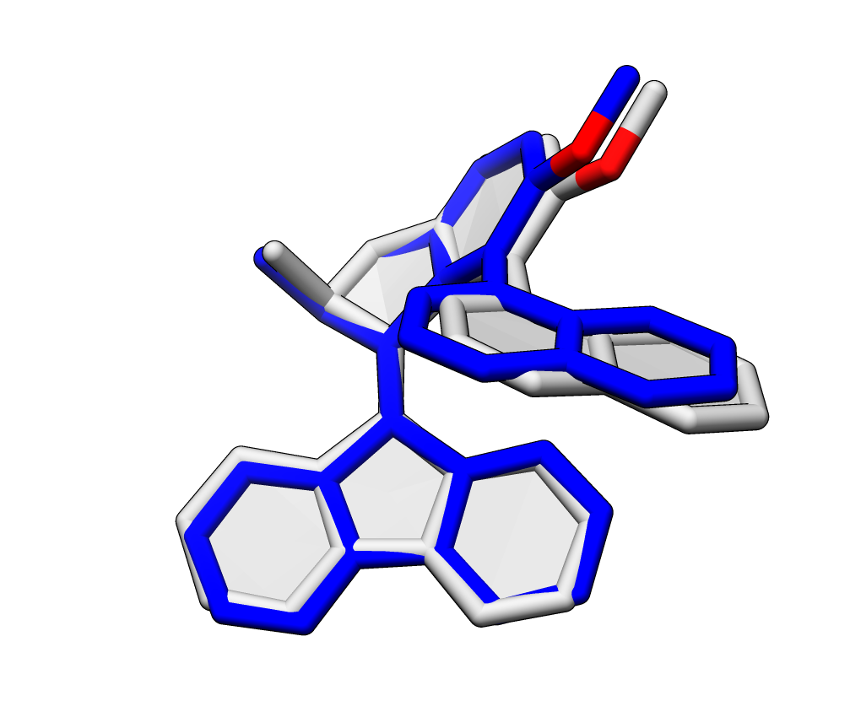
6-31G**

Slide 7
Torsion scan

Slide 8
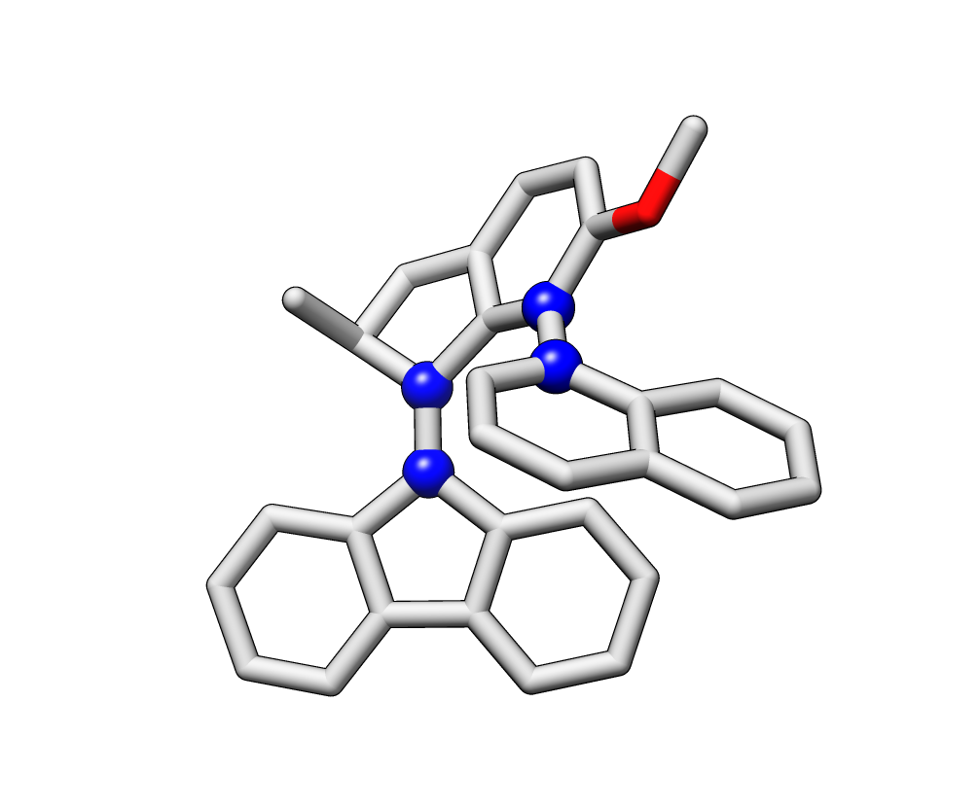
2 (C23)
1 (C25)
3 (C14)
4 (C13)

Slide 9
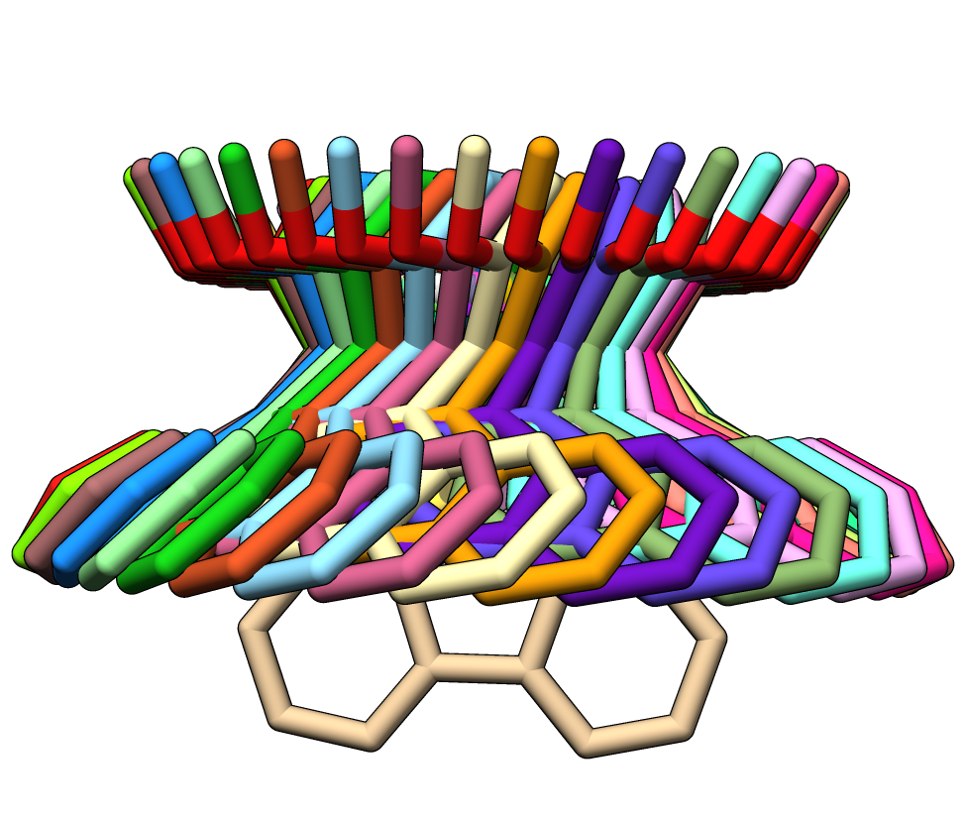
For the “locked” motion, I think both the double bond and single bond need to rotate together.

Slide 10
memory 8000 mb
molecule {
0 1
C 1.718 2.544 6.070
O 0.737 5.835 12.405
...
units Angstrom
}
dih_string = "17 4 2 5 0.001"
set optking fixed_dihedral = $dih_string
optimize('B3LYP/3-21G')

Slide 11
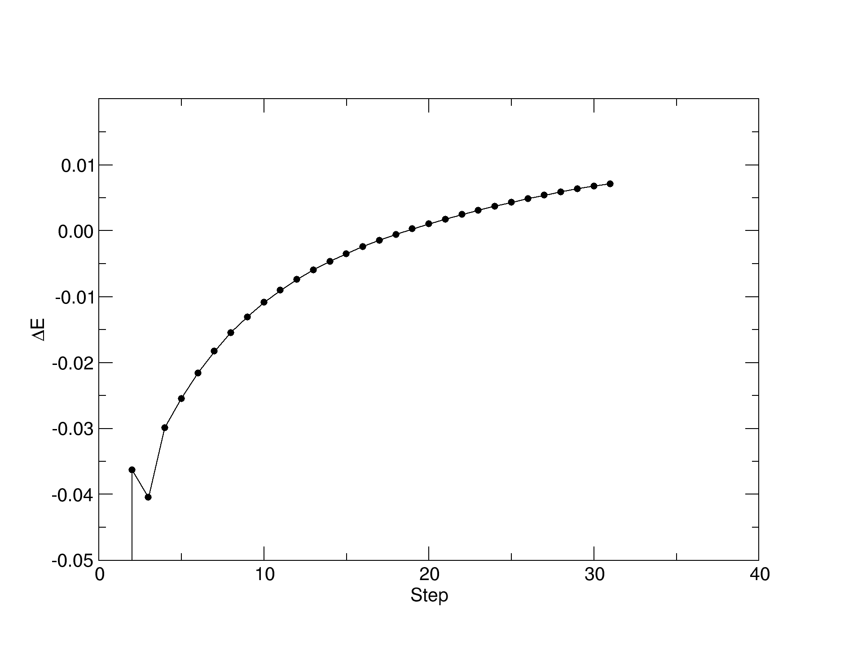
Didn’t complete B3LYP/cc-PVDZ or B3LYP/6-31G*.
Even running B3LYP/3-21G, convergence is difficult.
~8 hours on 4 cores with 8 GB

