Slide 1
Emoji checker backend
Sprint 1: conceptual model and backlog

Slide 2
The product
(what is it supposed to do?)
(what is the tech platform?)

Slide 3
Conceptual model
(conceptual model)

Slide 4
challenges

Slide 5

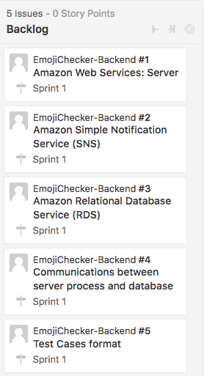
backlog
What is the architecture going to be like?
The server holds the database and notification service.

Slide 6
backlog
Designing a notification system.
Should be able to send messages to users who sign up for the app.

Slide 7
backlog
Design a database to store user information.
Contains emoji responses.
Accessible to administration team.

Slide 8
backlog
How is the scheduling going to work?
Design ways for the database and push notification service to be in sync.

Slide 9
backlog
Design ways to create smaller test cases for use in backend development.
Does not require the use of the entire application

