Slide 1
Sprint 5 Our Incredible Journey
Teamoji
Backend of emoji checker app
Notes:
Our big picture goal is to host and manage the database and all other server-side processes with which the front-end and administration teams interact.
The product is the infrastructure that the app is built upon.

Slide 2
🤓 The product 🤓
Web service which collects simple "emoji" mood responses from user clients according to a schedule defined by an administration client.
Sends SMS notifications when a survey becomes active
Provides both user and administration REST endpoints for client developers
Rejects both late and repeated user responses 🤠

Slide 3
🍜 Secret Sauce 🍜
Web browsable API makes for a pleasant development experience
Supports Emoji character codes
Scalable
Our experienced developers are available to provide support, bug fixes, and encouragement
Notes:
Character codes open up some interesting possibilities for researchers

Slide 4
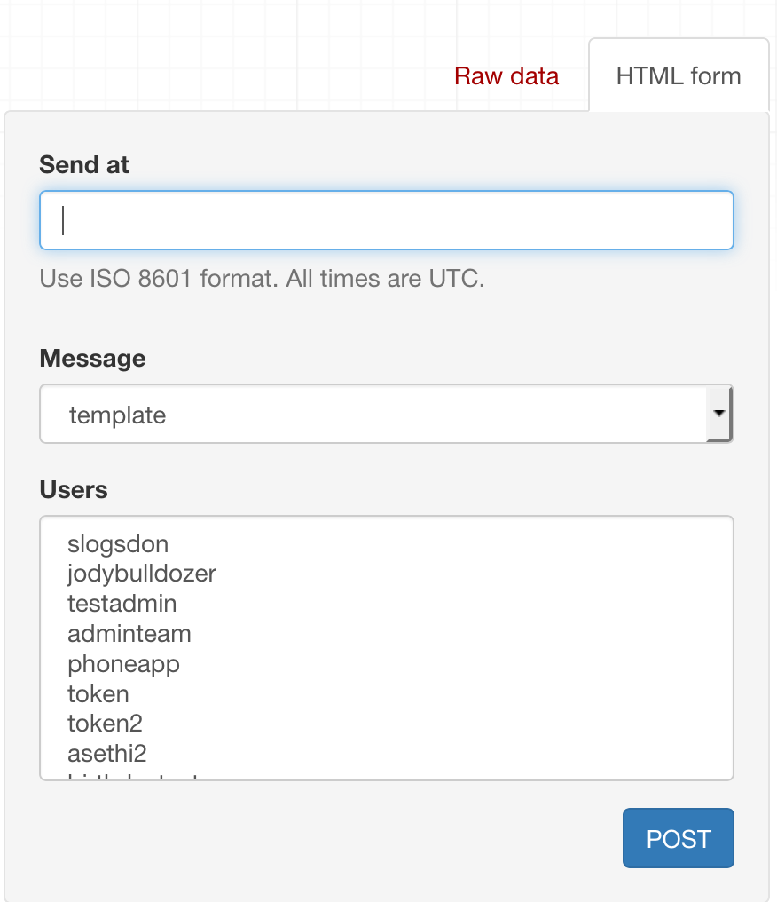
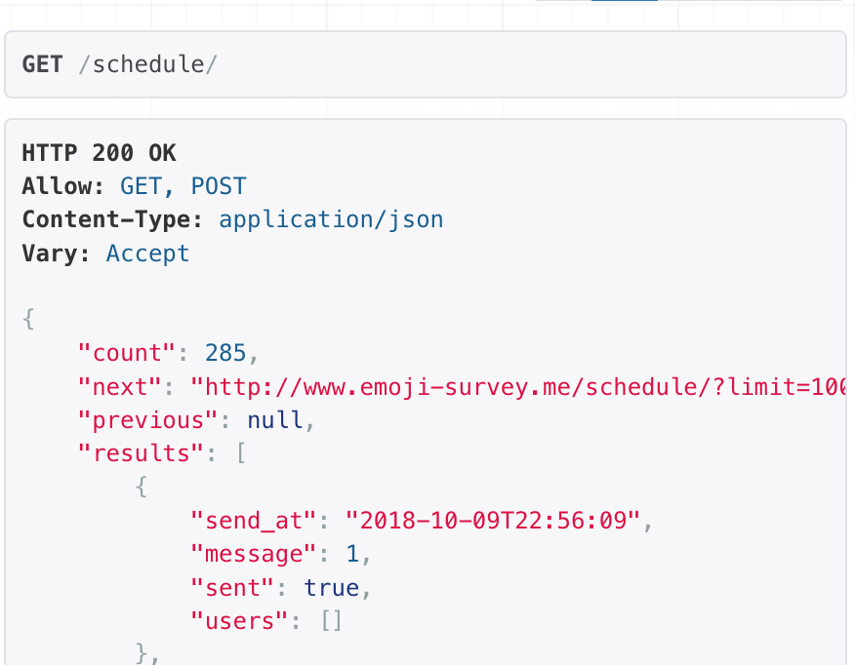
BROWSABLE API

Slide 5

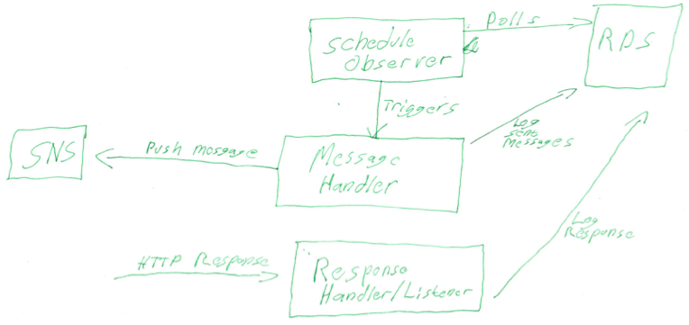
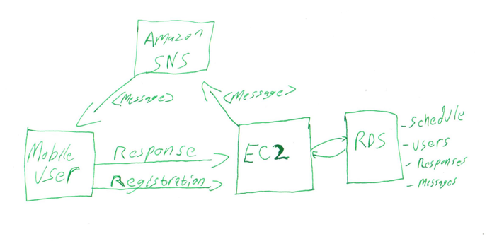
👴🏼 Original concept model 👴🏼

Slide 6
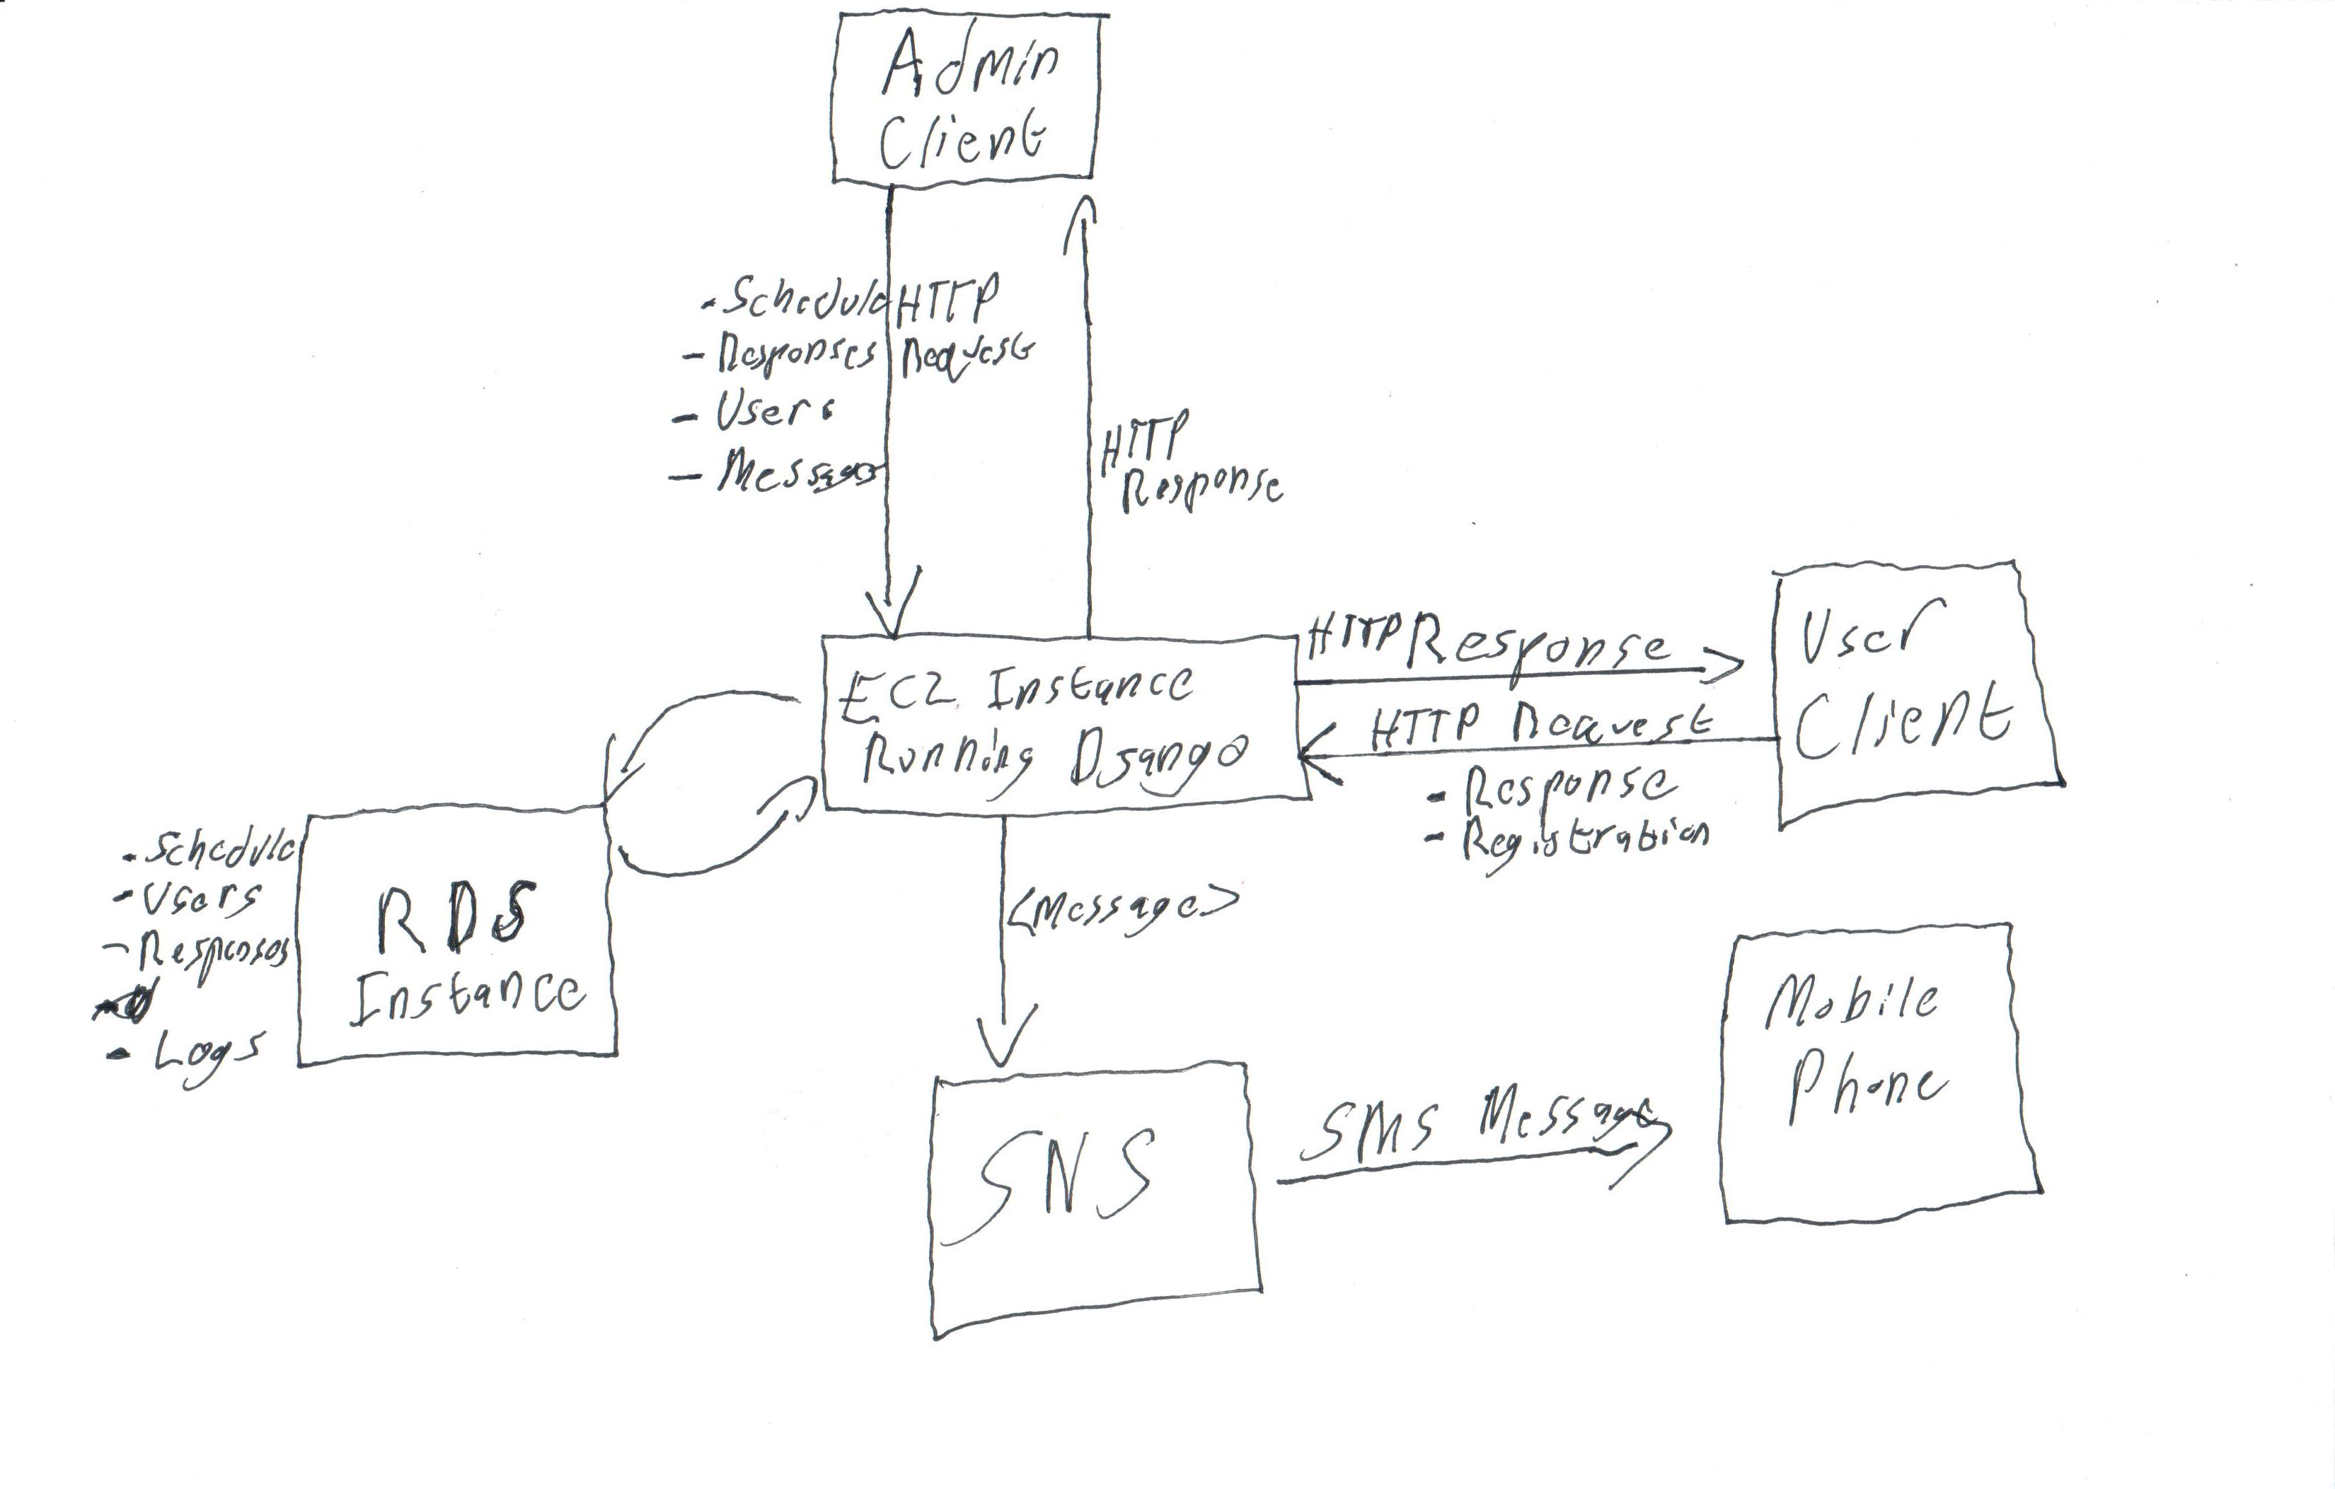
💪 new concept model 💯
Notes:
AWS RDS: database server, stores user responses and scheduling data
Django REST Framework: provides API for client and admin, sends notifications on schedule.
Amazon SNS: notifies clients via SMS when survey is available
the information in the RDS schedule table is what lets our worker know which users to notify via SMS
Admin team provides a list of user IDs and a time for the survey to go out
The server is held on an Amazon EC2

Slide 7
🌚 IMPLEMENTED features 🌚
User registration/authentication
Scheduling a survey for a list of users with an expiration timeout
Sending SMS via SNS and logging when an error occurs
Messages can include user's first and last name for personalization
Emoji storage
Response handling
Rejects late and repeated responses
User client can see list of their past responses

Slide 8
😞 Unimplemented Features 😞
Global configuration
No way for administration to turn off/on SMS sending or response checking
Notes:
* Researchers may want to accept responses from users at all times without scheduling a survey
* Similarly, they may want to not send SMS messages
* Both of these configurations exist, and have been used throughout development via hardcoded variables

