Slide 1
Prevalence in Autoimmune Disease

Slide 2
Background and Motivation of the Study
Prolactin (hormone of the pituitary gland) affects autoimmune response.
Literature suggests high levels of Prolactin can precipitate autoimmune response.
Postulate: People with hyperprolactinemia are more prone to autoimmune disease (AID).

Slide 3
Method of Study
Compare prevalence of AID between :
Prolactinoma Patients (PRL)
Non-Functioning Pituitary Adenoma Patients (NFPA)
Covariates:
Age at diagnosis
Ethnicity: Caucasian vs non-Caucasian
Largest diameter of adenoma (mm) at diagnosis
Sex

Slide 4
Descriptive Statistics
Total Number of Observations: 215

Slide 5
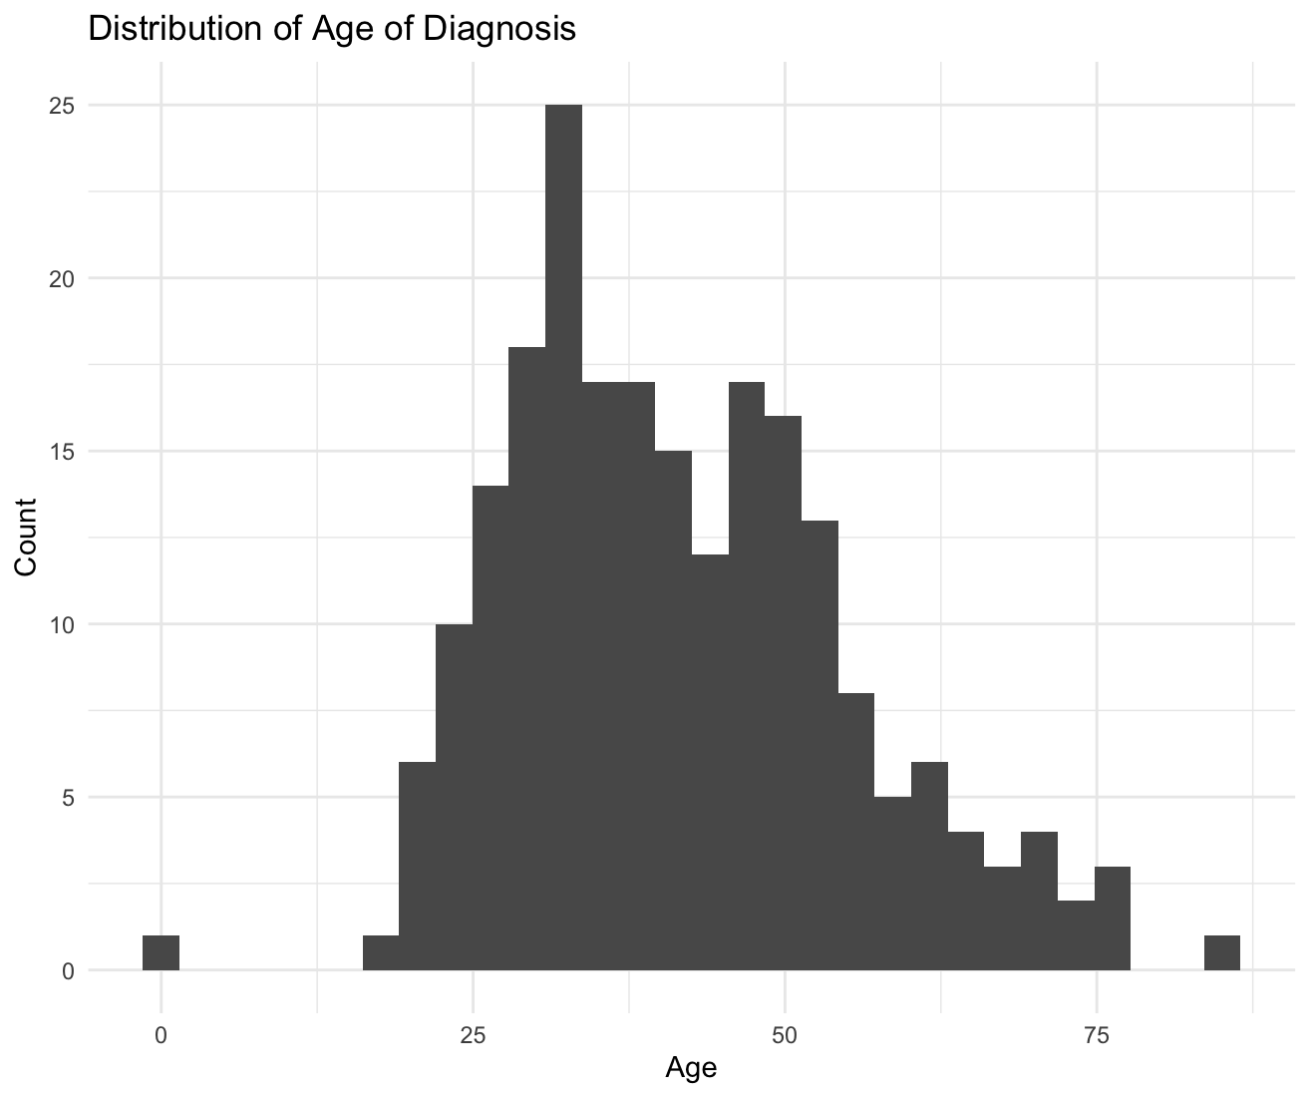
Age of Diagnosis and Sex Distributions
Age of Diagnosis was computed using the date of birth and the diagnosis date of each patient.
Sex | Count | Percentage
M | 65 | 29.8%
F | 150 | 68.8%
Data Missing | 3 | 1.4%
Mean : 41.56
Standard Deviation: 13.78

Slide 6
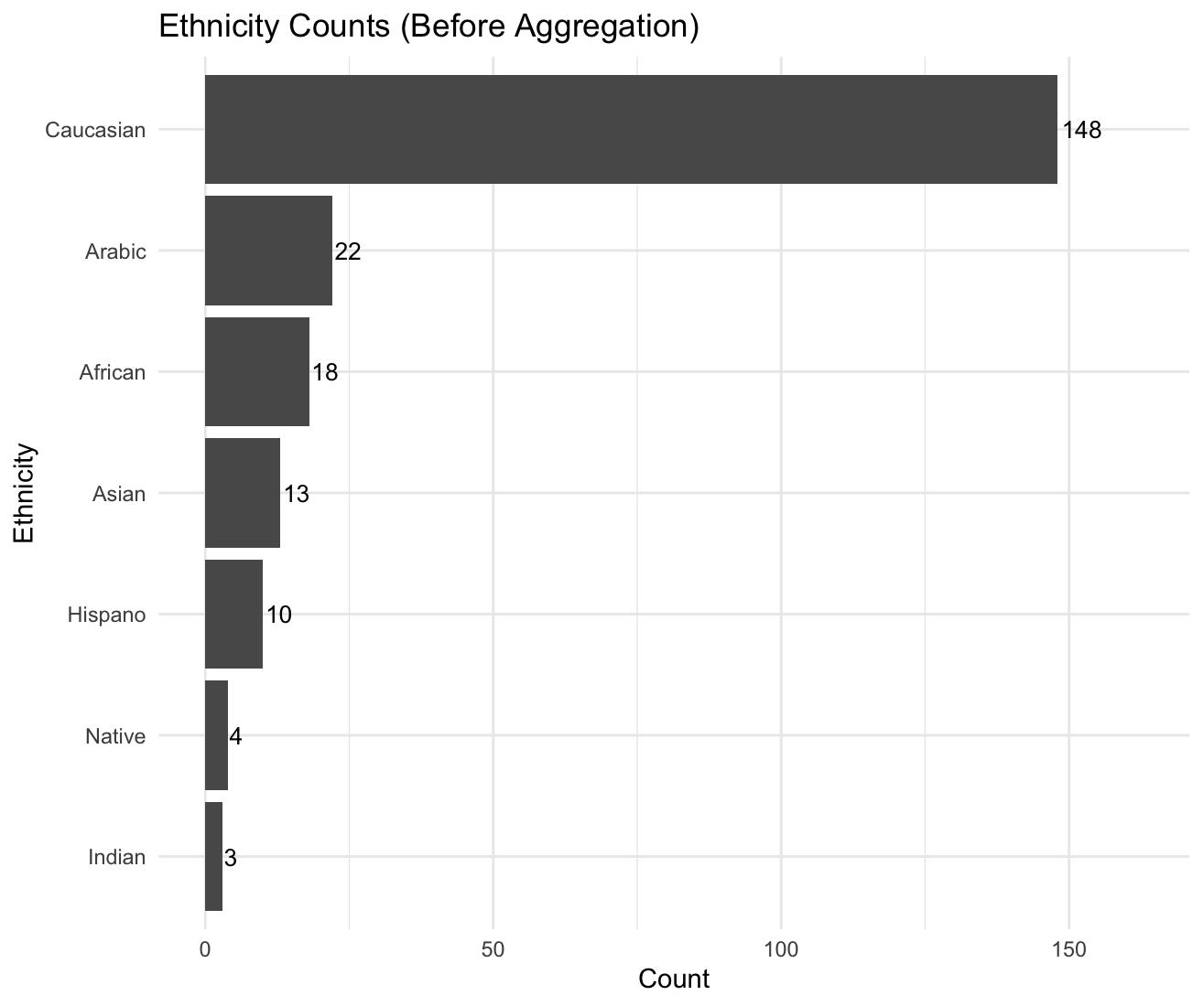
Ethnicity Counts

Slide 7
Case counts by Sex and Ethnicity
(after ethnicity aggregation)
Sex
Ethnicity
 | M | F
N | 31 | 68
Y | 34 | 82
 | Caucasian | Non-Caucasian
N | 71 | 29
Y | 77 | 41
Has Autoimmune Disease

Slide 8
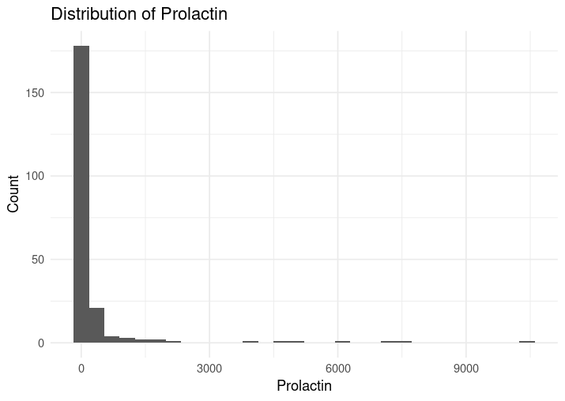
Distribution and Summary of Prolactin Levels
 | Median | IQR
AID present | 136.0 | 122.0
AID absent | 9.7 | 9.95

Slide 9
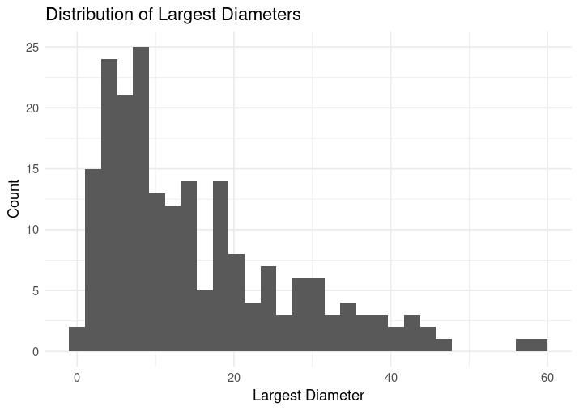
Distribution and Summary of Tumor Diameters
 | Median | IQR
AID present | 9 | 12.3
AID absent | 15 | 18

Slide 10
Assumptions and Diagnostics of Logistic Regression on Incomplete Data
We deleted every observation that had a missing field (16 missing observations)
We fit the following logistic regression model on the listwise deleted dataset:
We check the assumptions and the validity of the model on the incomplete dataset.

Slide 11
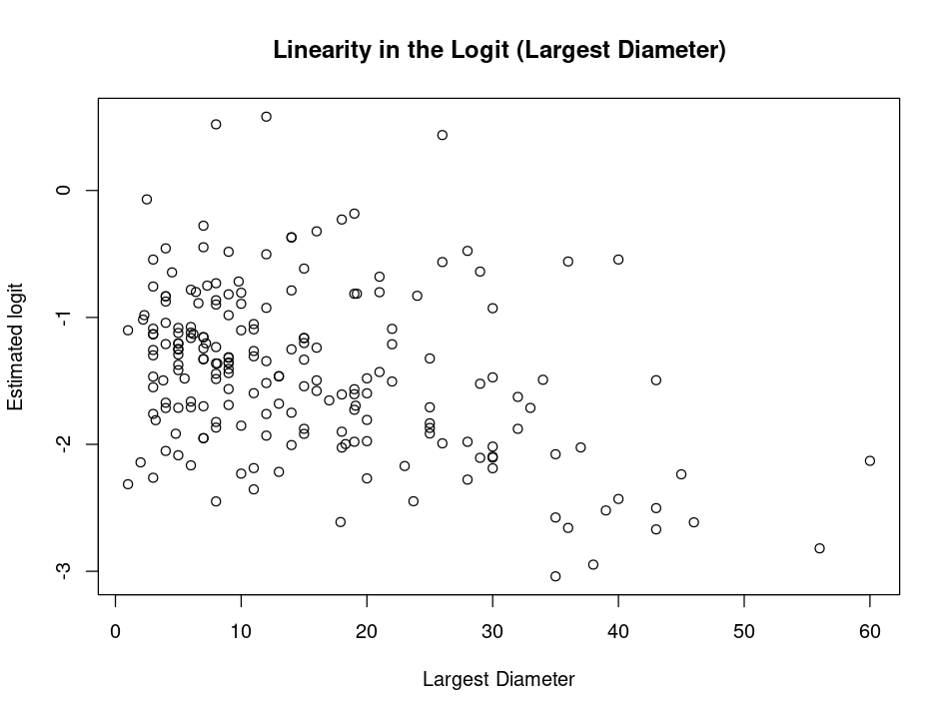
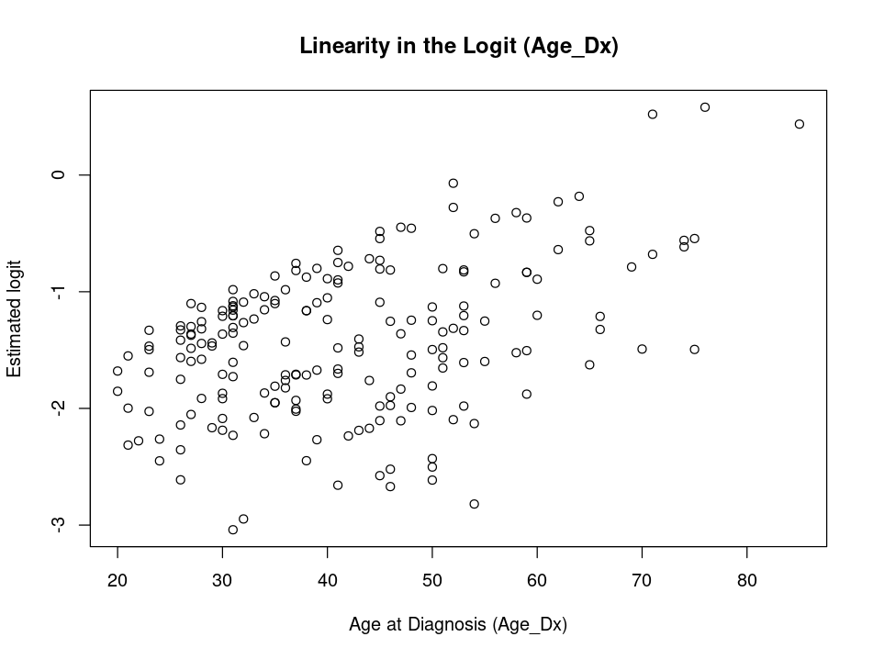
Linearity of Continuous Variables

Slide 12
Checking for Interaction Terms
We separately checked for interaction between the following variables:
Case and Age of Diagnosis
Case and Sex
Case and Largest Diameter
The t-tests for these interactions were not significant.

Slide 13
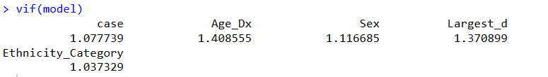
Multicollinearity
VIF all below 2
We can assume there is no multicollinearity

Slide 14
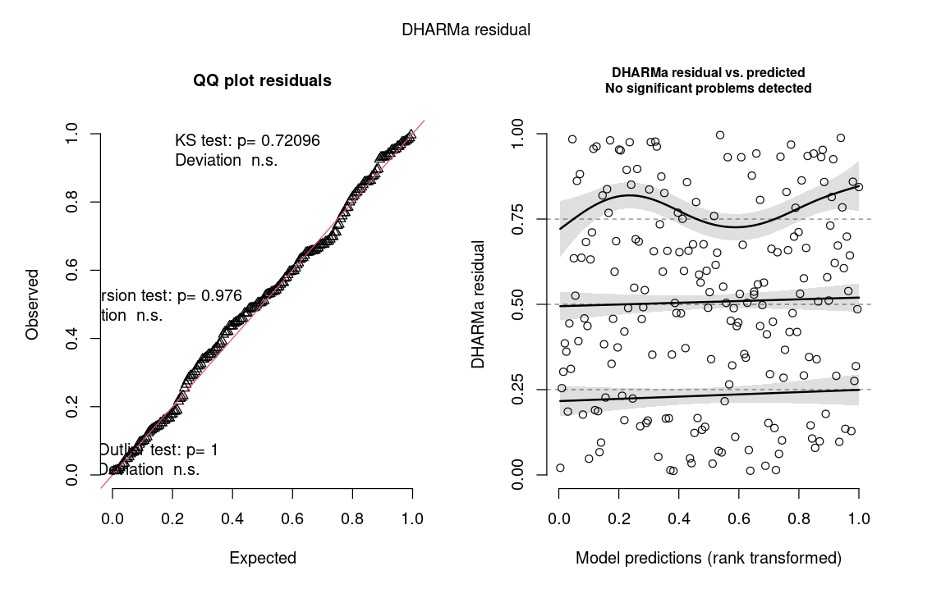
(Simulated) Residual Plots

Slide 15
Overview of Missing Data
3 values from Sex (MAR)
Binary variable → use logistic regression for imputation
16 values from Largest Diameter (MAR)
Continuous variable → use predictive mean matching for imputation
Missing data requires multiple imputation

Slide 16
Imputation Procedure
Used the R package mice for multiple imputation
Selected relevant variables, excluding non-predictive columns (line number, ID, dates)
More imputations → more precise estimates up to a point
howManyImputations: R package that automatically calculates how many imputations are needed.
Software output 4 imputations needed
Verification: Manually calculated the number of imputations needed based on von Hippel’s 2 step recipe using the quadratic rule.
Calculated ≅3.55 imputations needed
Notes:
Goal: To choose enough imputations to ensure stable, replicable results, without unnecessary computation. The required number of imputations depends on how much information is missing about the parameter.

Slide 17

Process for Calculating Number of Imputations:
Used the benchmark m=20 for a pooled imputation to get a base FMI value.
Calculated the logit of the FMI to use in calculating the upper bound of a 95% CI
Upper bound is more conservative estimate since there is only a 2.5% chance that the implied number of imputations will be too low.
Used the upper bound to calculate the inverse logit since FMI is bounded and approximately normal only on the logit scale.
Used the inverse logit value for the FMI in the imputation formula:
Notes:
Using the point estimate of the imputation runs a ~50% chance of being smaller than the true value which can lead to too few imputations.

Slide 18
Imputation Model Variables
case
Age_Dx
Sex
Ethnicity
Prolactin_Dx
Largest_d
AID_Y_N
All variables were treated as factors or continuous as appropriate.

Slide 19
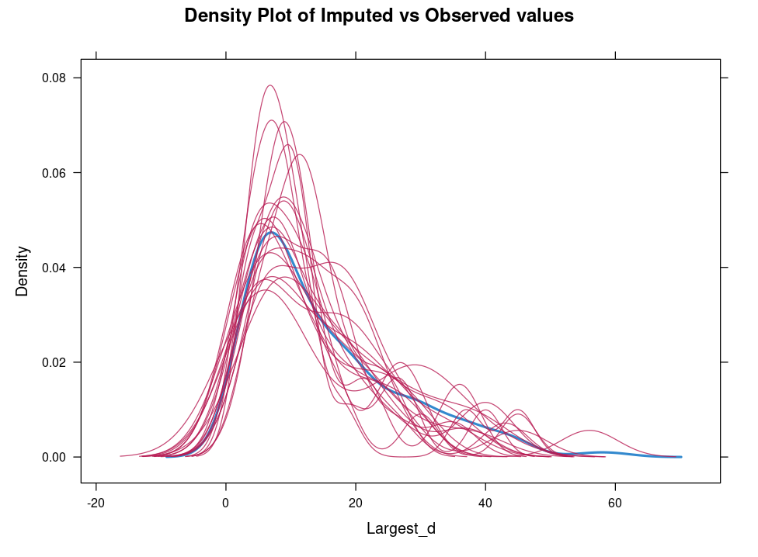
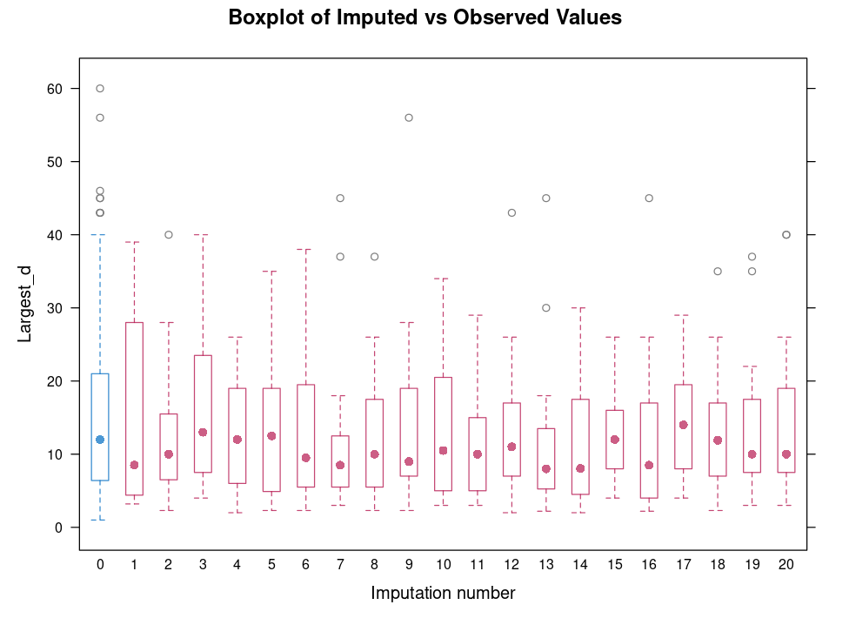
Imputation Model Diagnostics
To analyze the plausibility of the imputations, we can compare the distributions of:
The Original Data (in blue)
The Imputed Data (in red)

Slide 20
Assumptions and Diagnostics
In order to check assumptions for the model using imputed datasets, we decided to work on a single instance of imputed data to check assumptions and run diagnostics.
Reasoning: Since it’s difficult to check assumptions and run diagnostics on pooled results, going about it this way still gives us ways to assess our model without too many complications
Drawback: We lose the variability between imputations when only looking at one particular imputation,

Slide 21

Assumptions: VIF Values (Multicolinearity)
Since VIF values are all very close to 1 we can safely say there is no multicolinearity within the data

Slide 22
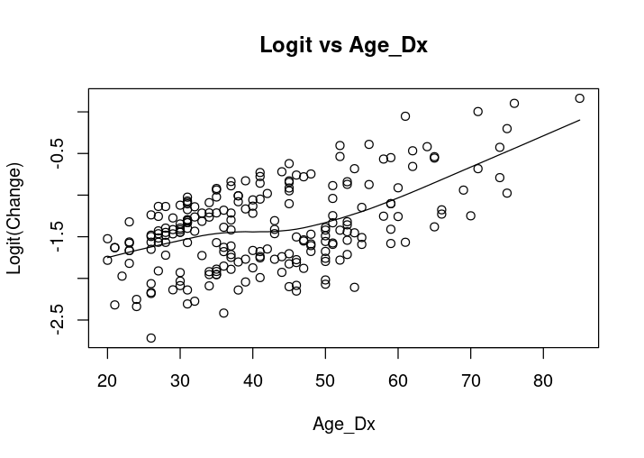
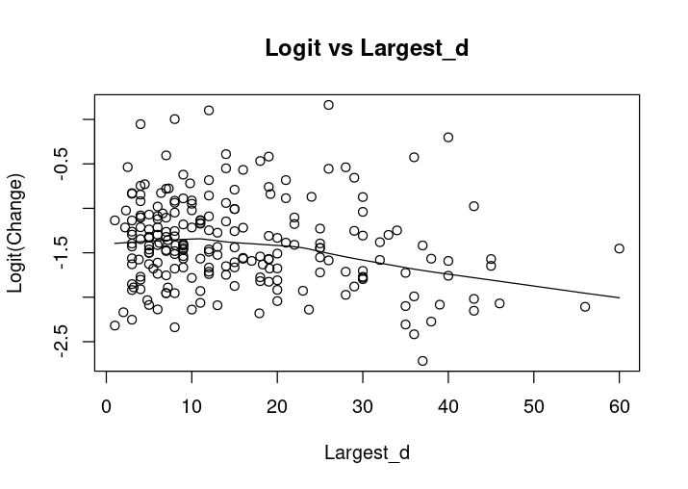
Assumptions: Linearity of Continuous Predictors
Check a few, explain procedure and drawbacks with respect to multiple imputations

Slide 23
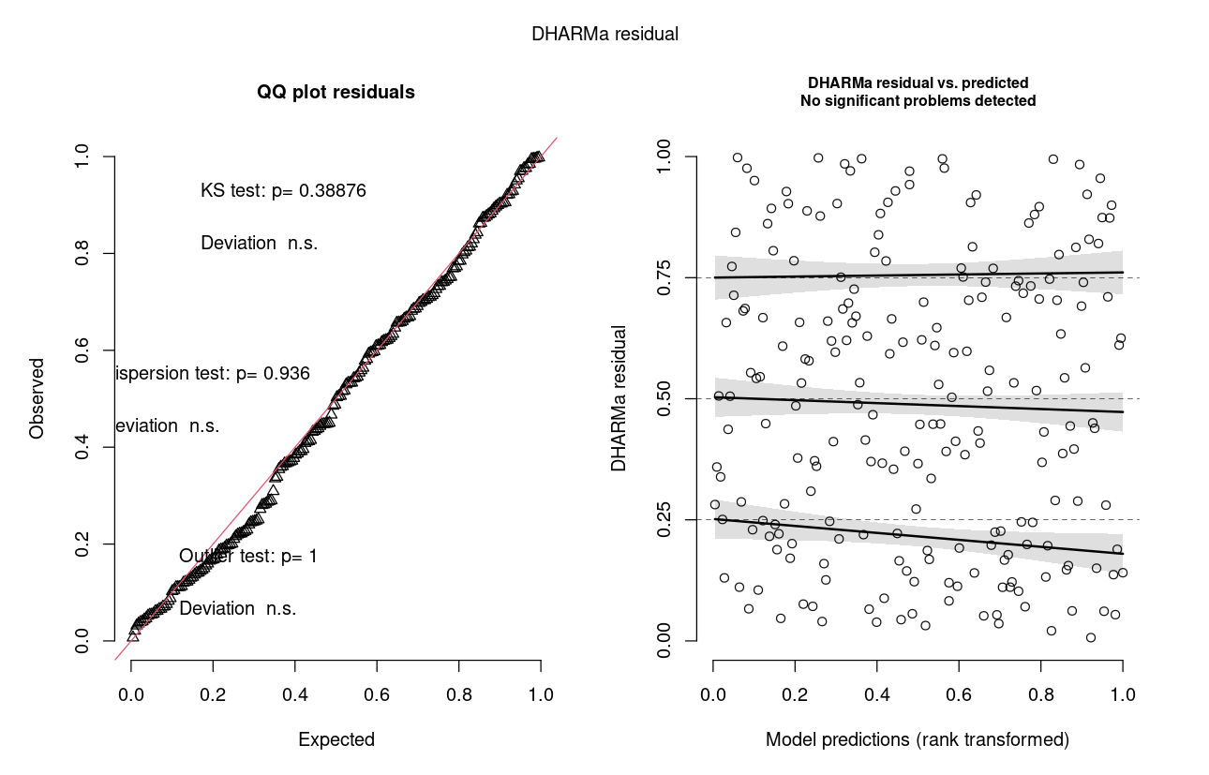
Residual Plots

Slide 24
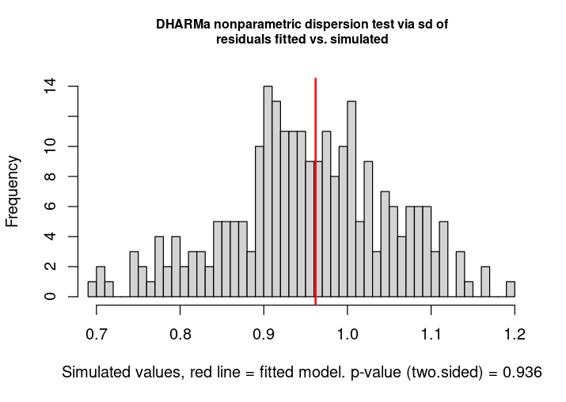
Residual Plots

Slide 25
Logistic Regression Model Specification
Outcome: AID_Y_N (binary indicator)
Model Form:
Estimation:
Model fit separately on each imputed dataset
Coefficients and standard errors pooled using Rubin’s Rules
Link Function: Logit (binomial GLM)

Slide 26
Logistic Regression Model Variables
Fit on each imputed dataset.
AID_Y_N (outcome)
case
Age_Dx
Sex
Ethnicity_Category (derived from ethnicity)
Largest_d

Slide 27
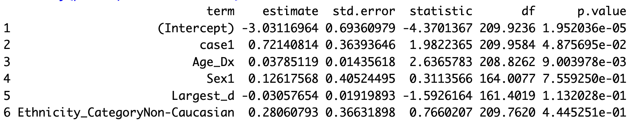
Pooled Results
Case group (case1): Significant, OR ≈ exp(0.721) ≈ 2.06
About 2x higher odds of AID for case = 1 (vs reference group)
Age at Diagnosis (Age_Dx): Significant, OR ≈ exp(0.0379) ≈ 1.039
Each additional year increases odds of AID by about 4%
Sex, largest diameter, and ethnicity category: not statistically significant in this model

Slide 28
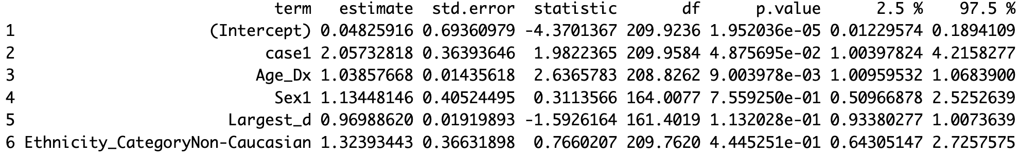
Odds Ratio Confidence Intervals
95% CI for odds ratios, predictors are statistically significant when the CI excludes 1.

Slide 29
How do we get the results given 4 imputations?
Ruben’s Rule: Assumes that the repeated parameter estimates are normally distributed
Parameter estimate: sum of the pooled mean differences
Standard error: Total variance = within imputation variance + between imputation variance
Inference: Wald statistic that follows a t-distribution with adjusted degrees of freedom
For the variable Largest_d:
Distribution is approximately symmetric
No evidence of skewedness
Slight tail deviation because of small number of imputations
Rubin’s Rule remains appropriate for imputing Largest_d

Slide 30
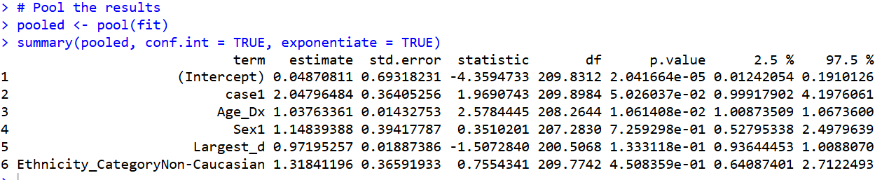
Pooled Results (100 imputations)

Slide 31
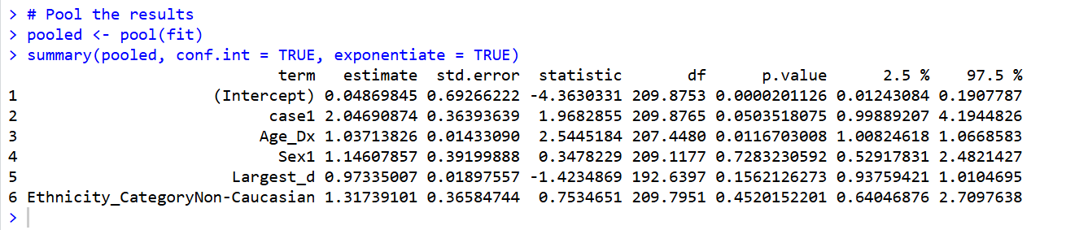
Pooled Results (20 imputations)

