Slide 1
Aggregates, the dos and don’ts do-nots
And some API best practices
API Guild meeting 4/26/19

Slide 2


Outline
Aggregates, an academic approach.
An example of a simple Aggregate
Identity API conventions

Slide 3
What is an Aggregate?
What is an Invariant?
An Aggregate is an object that represents some domain specific bounded context and its invariants.
It is the thing the business wants and should encapsulate all logic relating to it.
Something that must be true and must always be consistent within the business domain.
Think: Business rule.

Slide 4
Back to base(ics) AggregateRoot:
Aggregates will always inherit from the base class: AggregateRoot<StreamId>.
AggregateRoot is what gives us the ability to:
apply events
track changes
save those events
rehydrate aggregates
If we think AggregateRoot may need changes, we probably need to have a discussion about it as it part of our infrastructure.
The same applies for the Session, Repository and EventStore.
Our Aggregate infrastructure is an extension of the nuget package CQRSLite
Rehydrating an Aggregate:
To reapply all events that have been applied to an aggregate in the sequence that they were originally applied. User code should not worry about this, a hydrated aggregate is provided when using Session.Get()

Slide 5
Defining an Aggregate:
Stream Id:
Aggregates are identified by their stream ids.
Maintains all invariants in a private way, meaning, to modify the aggregate and its state, you must use the exposed aggregate methods to do so.
An object that contains one or more objects that when serialized in sequence, define an aggregates identity.
All lookups for a particular aggregate will use that aggregates stream id.

Slide 6
Defining an Aggregate:
Aggregate Partials
Our convention is to create partial files for each Apply method that targets a different event.
Logic
Aggregates may contain domain logic that is needed to satisfy a use case
Private instance variables, these are the invariants.
Private empty constructor, used for rehydration.
Static factory methods that user code will call to create aggregate instances.
These static factory methods will use private constructors to create aggregate instances.
Public DoSomething methods, these are how we interact with the aggregate.
Apply methods, one for each event that could be applied to an aggregate.

Slide 7
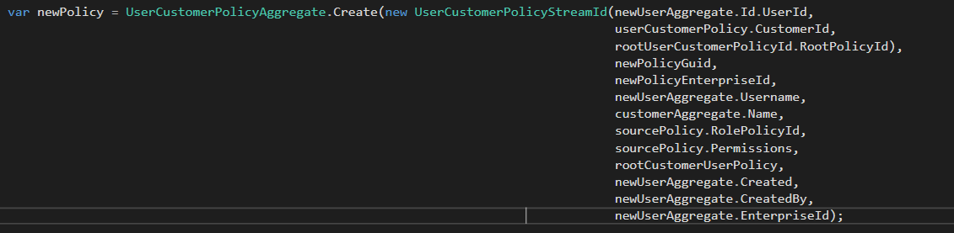
Creating an Aggregate
Uses the static factory pattern
Unavoidable because all constructors should be private.
Must use Session.Add() to begin tracking a new aggregate instance, otherwise Session.Commit() won’t save anything.

Slide 8
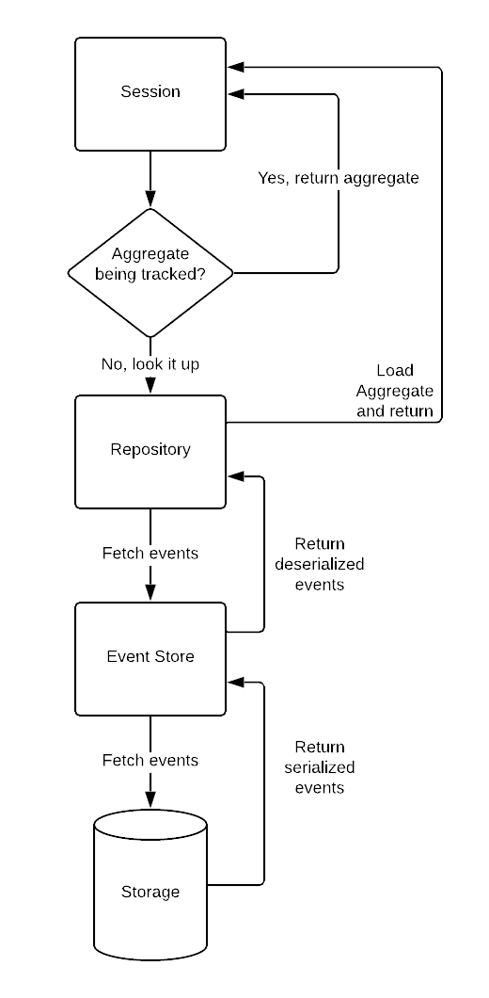
Finding an Aggregate:
ISession is the interface that user code should be using to find aggregates.
The Session caches a copy of each aggregate it looks up.
Cache is persistent for that session until commit is called, which then saves any new events that have been applied to all tracked aggregates.
Additionally you can query the session for an aggregate with a specific version

Slide 9
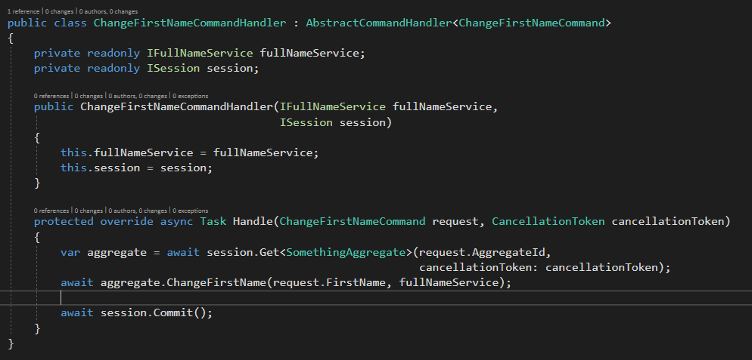
Operating on an Aggregate:
All operations on to an aggregate must go through the aggregate because all of its state should be private.
Aggregate changes will not be saved until Session.Commit() is called. Until that point all changes are only stored in memory.
Note: No return value

Slide 10
Example:

Slide 11
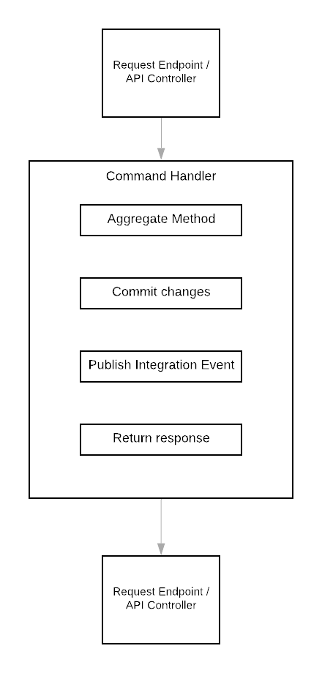
The basic request flow

Slide 12
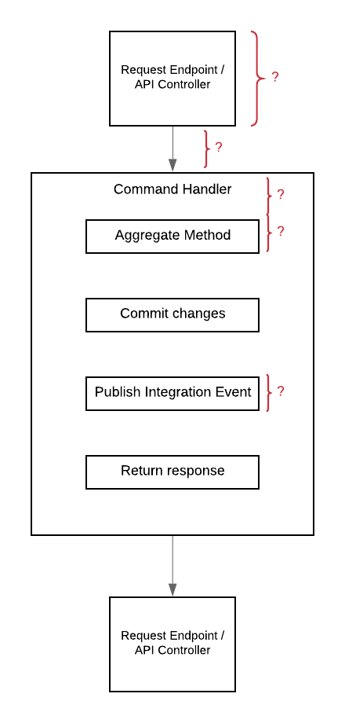
But what about these spots that are not talked about?

Slide 13
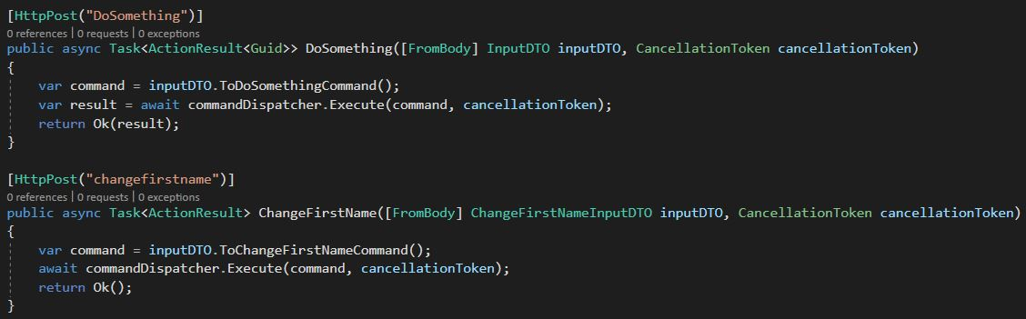
Conventions: Controller
Controller methods should take in an inputDTO that is specific to that controller method.
InputDTOs should NOT be reused
Use extension methods to map inputDTOs to command/queries.
Should contain no logic.

Slide 14
Conventions: Pipeline
middleware
Mediatr begin
We use a combination of middleware built into ASP .net Core and Mediatr to handle our api request pipeline.
Middleware sits in between a request being received by the API and before the controller method.
The Mediatr pipeline begins with the CommandDispatcher and (currently) ends with the command handler.
Creating either is straightforward but should warrant a discussion beforehand as it is part our infrastructure.
example
Mediatr end

Slide 15
Conventions: Command Handler
Command Handlers should be thought of more as process managers. They manage dependencies, mappings and facilitate operations, but don’t actually do any work.
All the work should be carried out by the aggregates.

Slide 16
Conventions: Publishing Integration Events
The IdentityIntegrationService is a service layer that allows command handlers to easily interact with MassTransit & RabbitMq
MassTransit and RabbitMq are entire subjects of their own

Slide 17
References
http://dddcommunity.org/library/vernon_2011/
https://www.dofactory.com/net/factory-method-design-pattern
https://github.com/jbogard/MediatR
https://github.com/gautema/CQRSlite

