Slide 1
Service communication over HTTPS in Docker
Devops Guild 11/3/2020

Slide 2
Presentation Objectives
Bring to light a developer problem and demonstrate the learning process taken to achieve a desired solution.
Agenda:
Address the problem
Propose solution
Develop proof of concept
Recap of lessons learned

Slide 3
The Problem
Ensure Identity API is enforcing HSTS headers
Insert diagram to show current https -> http traffic flow through load balancer
Check to see if load balancers are listening on ports other than 443

Slide 4
The Problem
Ensure Identity API is enforcing HSTS headers
Roadblocks:
Production environment differs from Development environment
Examples: docker, load balancer, multi-instance
Local development usually has this setting turned off because https is not enforced
Https development not set up (except for auth)

Slide 5
The Solution
Setup docker-compose to mimic “Production” environment
A docker-compose environment will produce load balancers and forwarded header behavior similar to AWS.
Roadblocks:
Learn docker-compose
Learn how to load balance services in docker-compose
Learn OpenSSL
Learn how certificates work
Learn how to create/modify certificates
Learn how OUR certificates work
Learn how docker containers interact with certificates
Learn that different distributions of linux handle certificates differently
Learn how to use Docker networks to communicate between containers
Learn how to get docker containers to communicate over https
Learn how the proper way to enable HSTS in dotnet core
Figure out why nothing is working
Cry

Slide 6
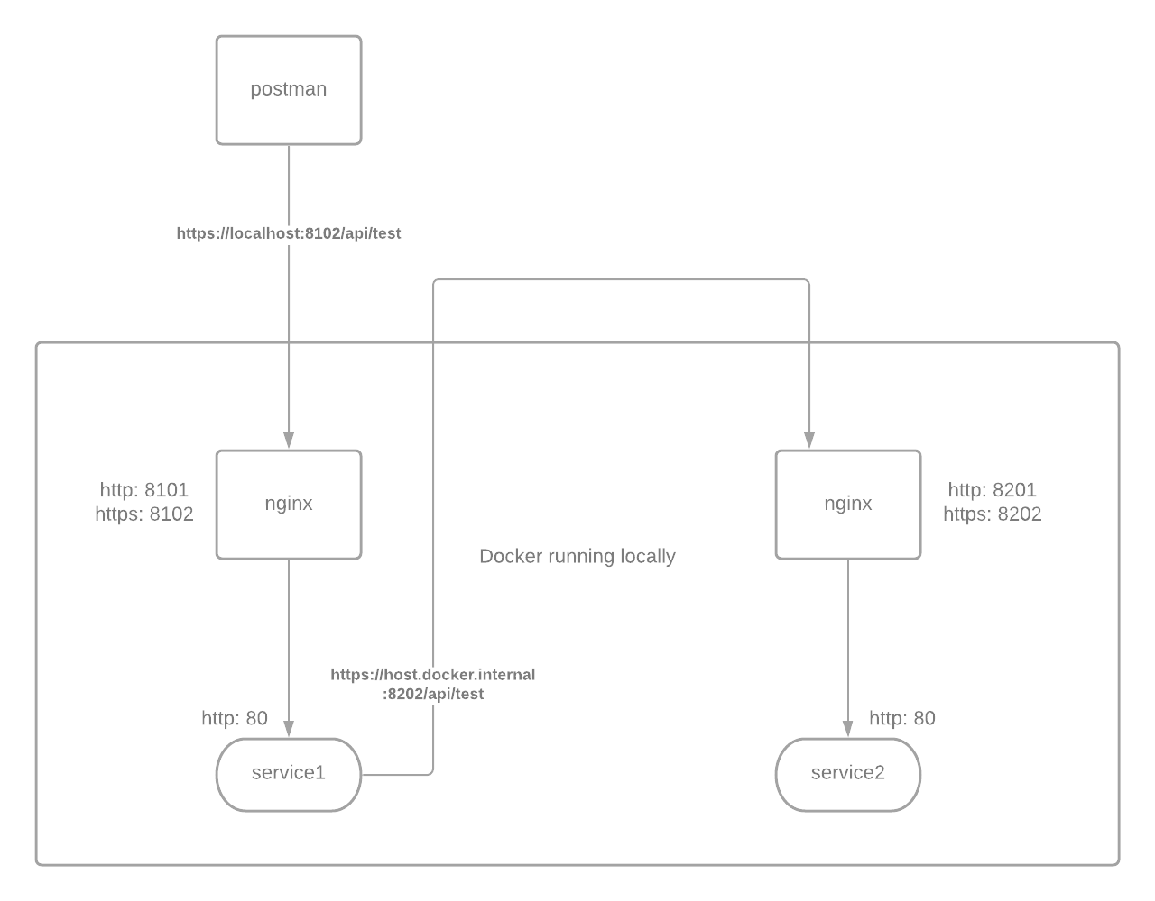
The Solution
Setup docker-compose to mimic “Production” environment
Things to note:
NGINX is terminating SSL connections
(because of that)
NGINX must forward the correct headers
Service 1 communicates with Service 2 over HTTPS

Slide 7
The Solution
Step 1 of proof of concept
Postman should communicate with Service 1 over HTTP.
Service 1 should communicate with Service 2 over HTTP.

Slide 8
The Solution
Step 1 Demo
Notes:
Turn on postman certificate validation: Settings -> SSL certificate validation
Checkout request headers in logs
Files to note:
Nginx.conf
Docker-compose.yml
Docker-compose.override.yml
Dockerfile

Slide 9
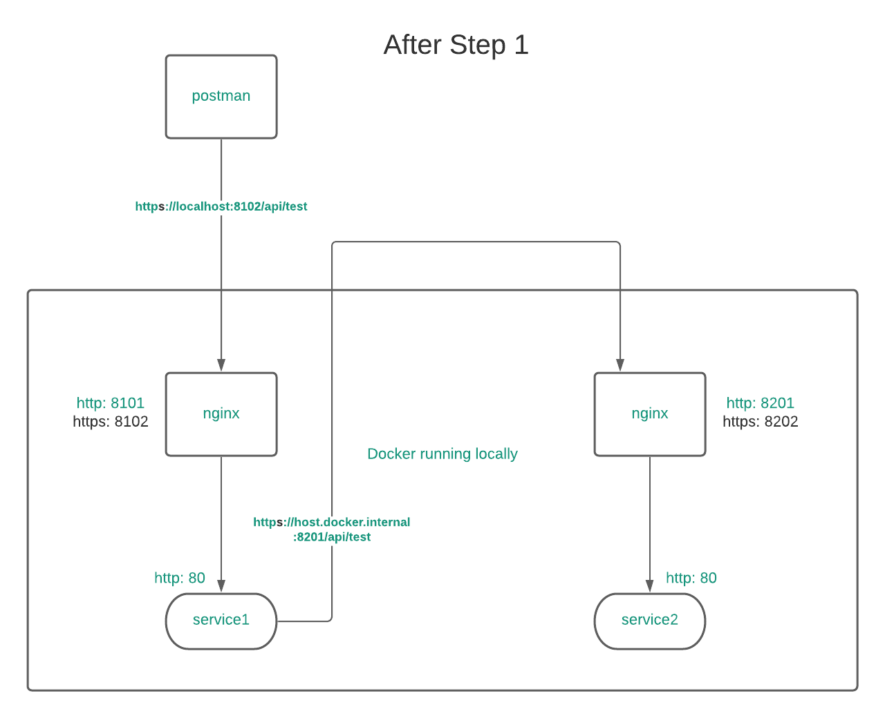

The Solution
Step 1 POC Recap
Postman should communicate with Service 1 over HTTP.
Service 1 should communicate with Service 2 over HTTP.

Slide 10
The Solution
Step 2 Demo
Notes:
Ensure that 2/nginx-shared/self-signed/cert.crt is imported in postman -> settings -> certificates -> CA Certificates as the PEM file.
Remember to run docker-compose build between demos
Checkout request headers in logs
Files to note:
Nginx.conf
Docker-compose.yml
Docker-compose.override.yml
Dockerfile
Certificate related files in nginx-shared/self-signed/

Slide 11
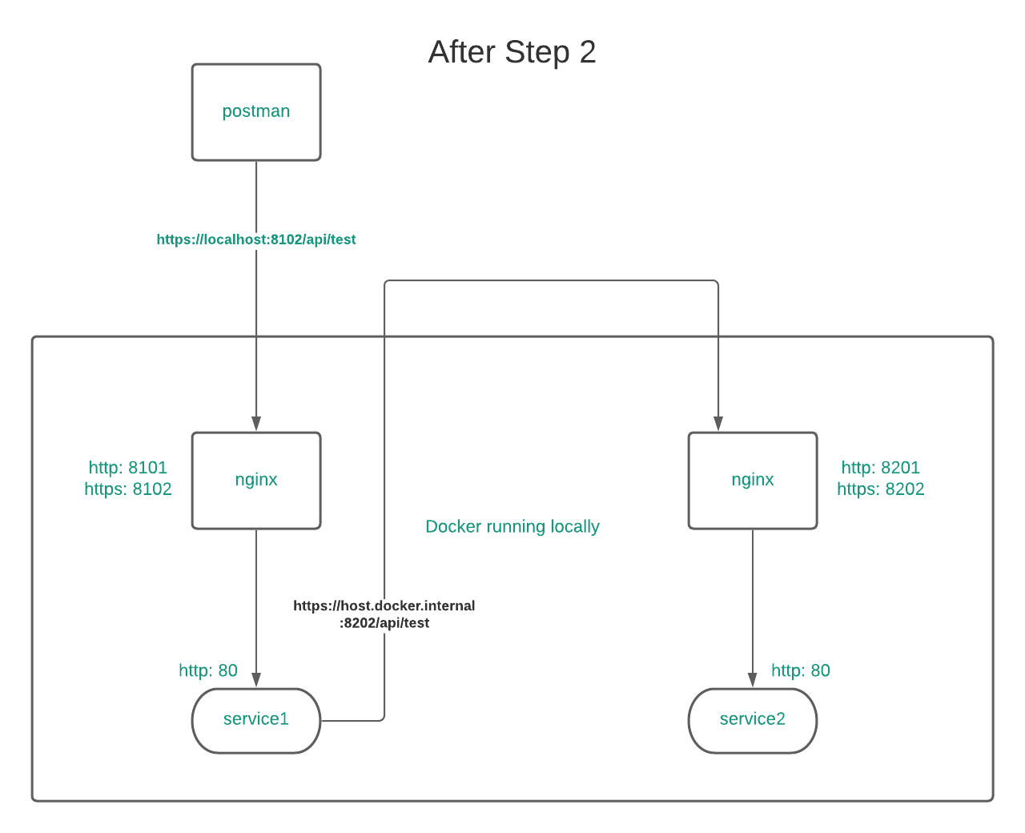

The Solution
Step 2 POC Recap
Postman should communicate with Service 1 over HTTPS.
Service 1 should communicate with Service 2 over HTTPS.

Slide 12
The Solution
Step 3 Demo
Notes:
Ensure that 3/ca/intermediate/certs/ca-chain.crt is imported in postman -> settings -> certificates -> CA Certificates as the PEM file.
Remember to run docker-compose build between demos
Checkout request headers in logs
Files to note:
Nginx.conf
Docker-compose.yml
Docker-compose.override.yml
Dockerfile
Certificate related files in nginx-shared/self-signed/

Slide 13
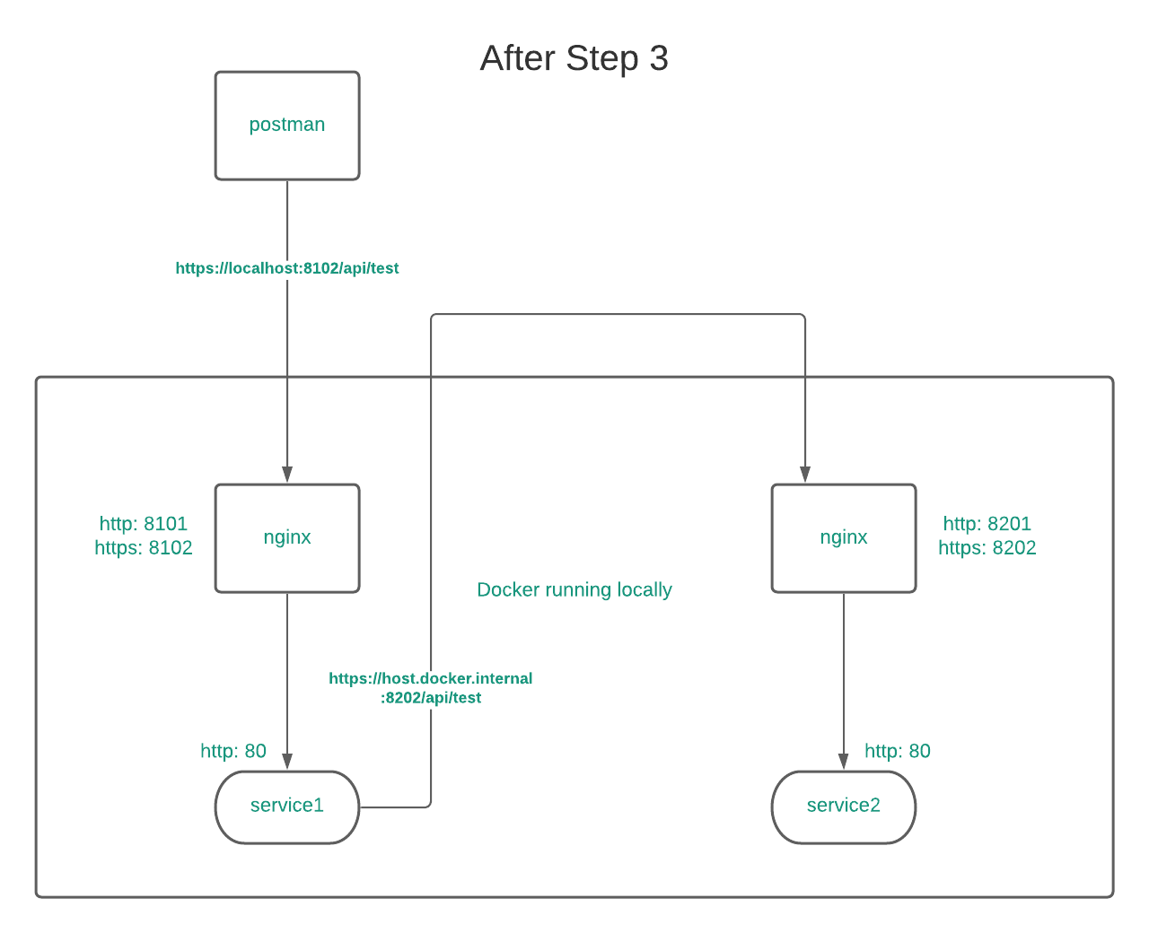
The Solution
Step 3 POC Recap
Postman should communicate with Service 1 over HTTPS.
Service 1 should communicate with Service 2 over HTTPS.

Slide 14
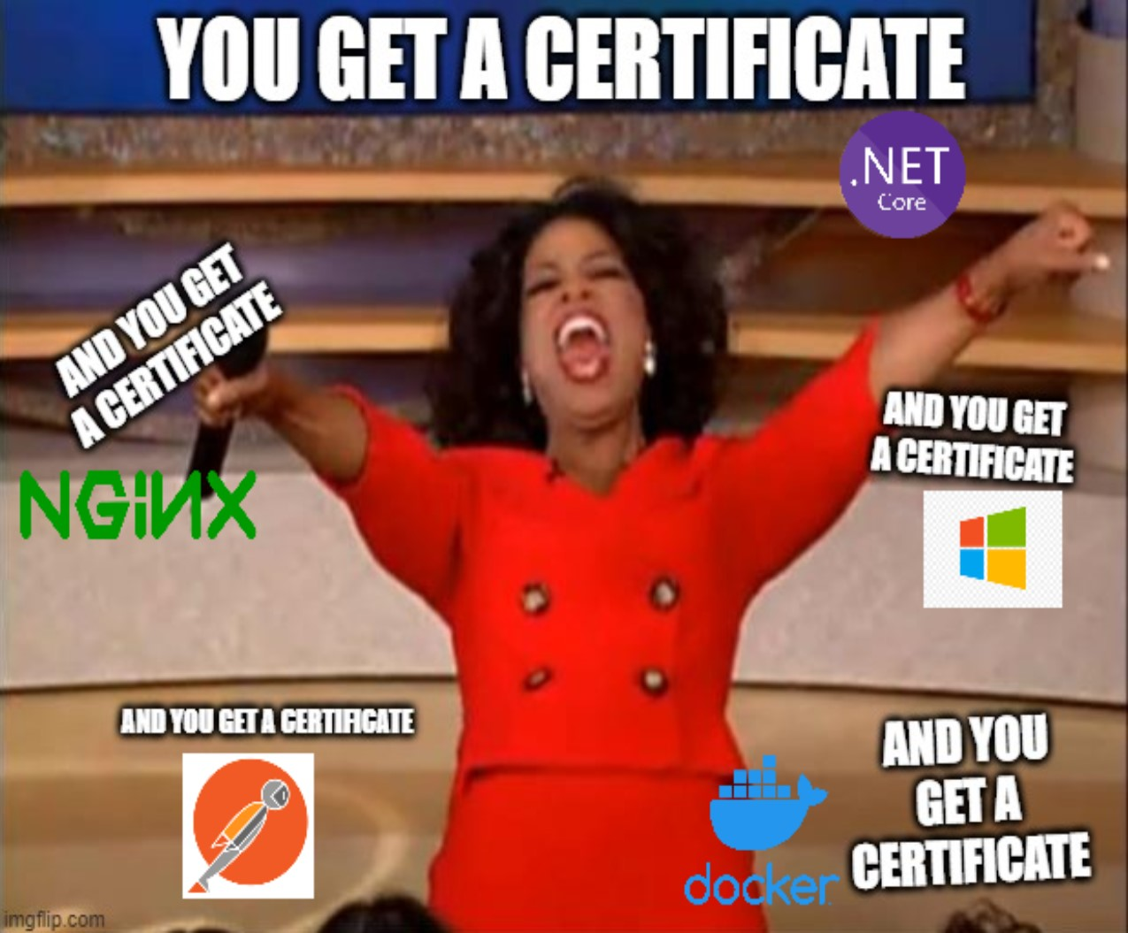
The Recap
Step 3 POC Recap
What I learned:

Slide 15
The Solution
Step 4 of proof of concept
Postman should communicate with Service 1 over HTTPS.
Service 1 should communicate with Service 2 over HTTPS.
HSTS should now work.

Slide 16
The Solution
Step 4 Demo
Notes:
Look at docker compose logs after making a request to show the headers and “Request is https: true/false”
Files to note:
PreForwardedHeadersLogHeadersMiddleware.cs
PostForwardedHeadersLogHeadersMiddleware.cs
LogResponseHeadersMiddleware.cs

Slide 17
The Solution
Step 4 of proof of concept
Postman should communicate with Service 1 over HTTPS.
Service 1 should communicate with Service 2 over HTTPS.
HSTS should now work.

Slide 18
The Recap
Recap
Docker Compose: Awesome, great for getting a project up and going quickly
NGINX: Simple and easy to get started and use
Certificates: Frustrating, but necessary.
OpenSSL: Need to know more, lots of commands & configuration to learn
Proof of Concept: Necessary. Docker build times for Identity API are 10x longer than working with a bare bones project. Iteration time is much quicker

Slide 19
Questions?
Questions?

