Slide 1
Service HTTPS communication in Docker
Devops Guild

Slide 2
Presentation Objectives
Bring to light a developer problem and demonstrate the learning process taken to achieve a desired solution.
Agenda:
Address the problem
Propose solution
Develop proof of concept
Recap of lessons learned

Slide 3
The Problem
Ensure Identity API is enforcing HSTS headers
Roadblocks:
Local development usually has this setting turned off because https is not enforced
Production environment differs from Development environment
Examples: docker, load balancer, multi-instance
Https development not set up (except for auth)

Slide 4
The Solution
Setup docker-compose to mimic “Production” environment
Will allow me to see similar behavior to a production environment
Roadblocks:
Learn docker-compose
Learn how to load balance services in docker-compose
Learn OpenSSL
Learn how certificates work
Learn how to create/modify certificates
Learn how OUR certificates work
Learn how docker containers interact with certificates
Learn that different distributions of linux handle certificates differently
Learn how to use Docker networks to communicate between containers
Learn how to get docker containers to communicate over https
Learn how the proper way to enable HSTS in dotnet core
Figure out why nothing is working
Cry

Slide 5
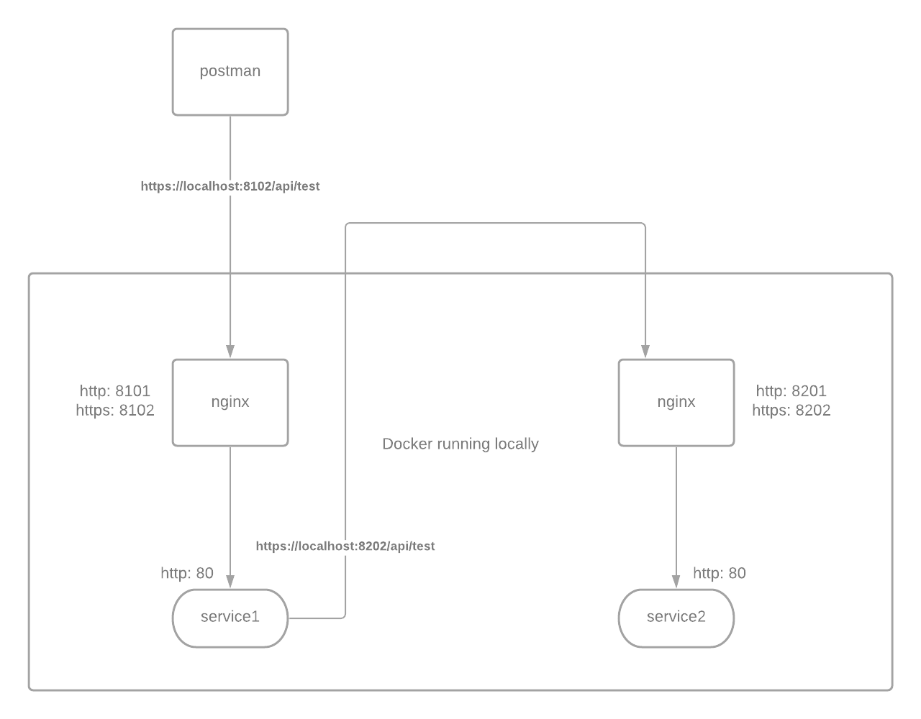
The Solution
Setup docker-compose to mimic “Production” environment

