Slide 1
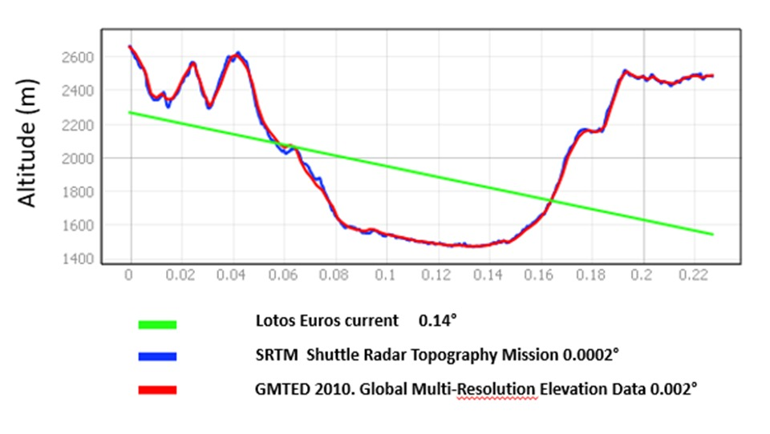

Slide 2
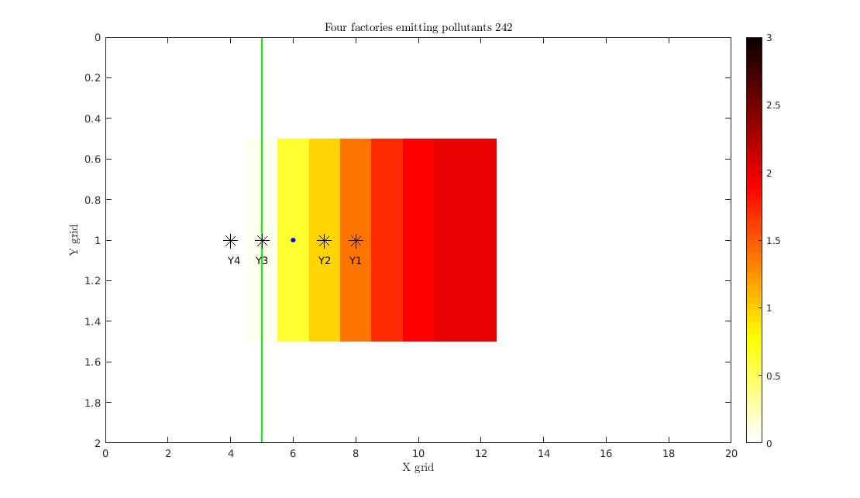
Reality
Mountain

Slide 3
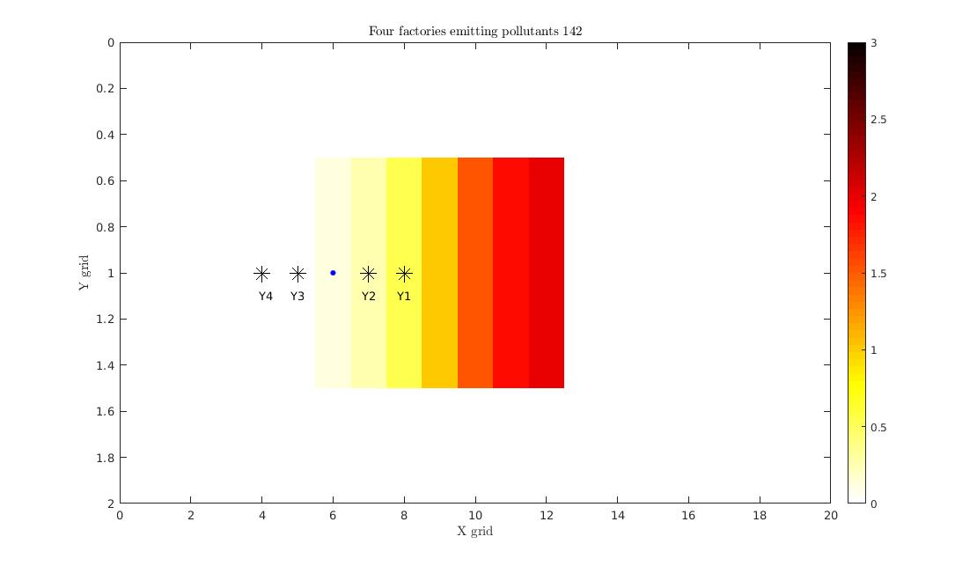
Model

Slide 4
Localization
Distance based localization

Slide 5
