Slide 1


Internship: Final Presentation
September 20, 2016

Slide 2

Internship Supervisor Mr. Thomas Krotkine
Anjan BHATTRAI
bhattr_a
UI and Frontend
Internship Duration
6 Months (25th Sept 15 – 24th Mar 16)
Engineering School:
Internship Company:
International Masters
[Software Engineering]
2

Slide 3
Career Path
Internship mission
About Inspheris
Internship Tasks
Breakdown
Skills Utilized
What did I learn
Internship Impact
Conclusion
Agenda
2

Slide 4
Career Path
Internship mission
About Inspheris
Internship Tasks
Breakdown
Skills Utilized
What did I learn
Internship Impact
Conclusion
Agenda
2

Slide 5



UI/UX and Frontend, Freelancer Kathmandu
UI and Frontend [Inspheris] Freelancer
UI/UX and Software Project Manager
15 feb - sep
sep -
mar
2011-14
2014
16 - now
Masters in Software Engineering, Epita
Internship [UI and Front end]
Inspheris
Introduction: Career Path
5

Slide 6

Internship Mission
My Mission : from technical UI Manager to Software project Manager
Beginning : Work as an UI/UX and Frontend Developer.
Involved working closely with Senior Managers, Project managers, UI/UX Teams, Support Teams in France and overseas.
Last Achievement : Bring all of my technical and management skills to drive projects to successful completion.
6

Slide 7
Career Path
Internship mission
About Inspheris
Internship Tasks
Breakdown
Skills Utilized
What did I learn
Internship Impact
Conclusion
Agenda
7

Slide 8
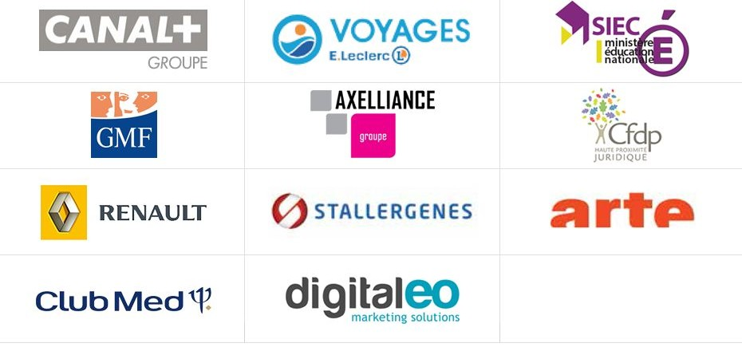
Inspheris is a French IT company with specialization in social networking and community platform since 2006.
Reference:
Inspheris develop intranet 2.0, Social software & professional communities application for all size businesses.
7

Slide 9
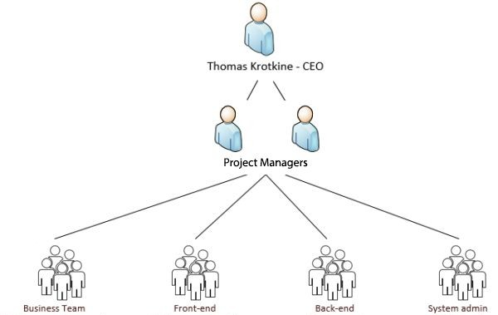

Inspheris Team
10

Slide 10
Career Path
Internship mission
About Inspheris
Internship Tasks
Agenda
Breakdown
Skills Utilized
What did I learn
Internship Impact
Conclusion
10

Slide 11
Internship Tasks
research, discuss and develop different aspect of the software, UI/UX feasibility and enhancement.
collecting/organizing technical information, creating a plan and breakdown of the actions to be taken.
help communication and sales with marketing materials.
review the usability and user friendliness within company’s software.
defining different new features that can be implemented
11

Slide 12
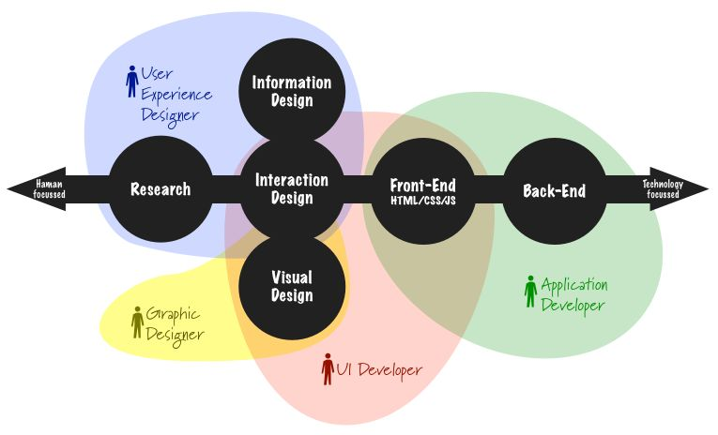
UI/UX and FrontEnd
11

Slide 13
Career Path
Internship mission
About Inspheris
Internship Tasks
Breakdown
Agenda
Skills Utilized
What did I learn
Internship Impact
Conclusion

Slide 14
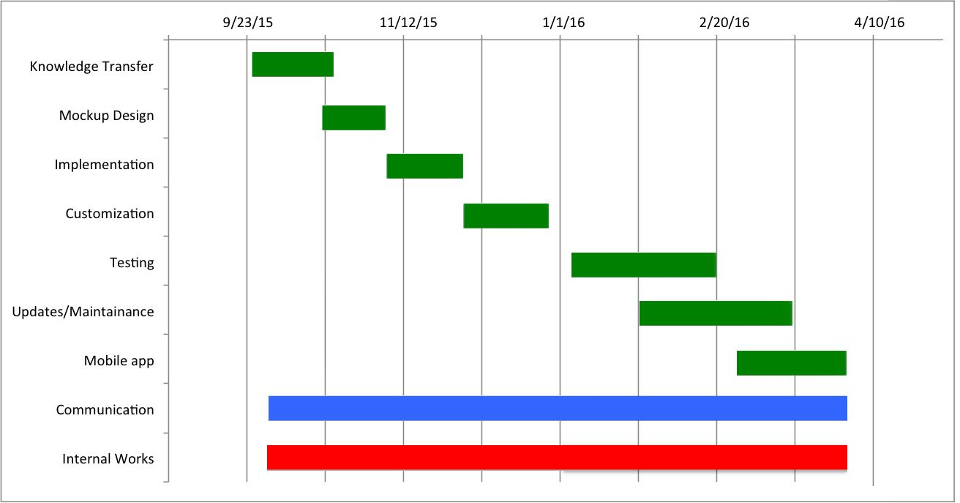
Breakdown
Gantt Chart

Slide 15
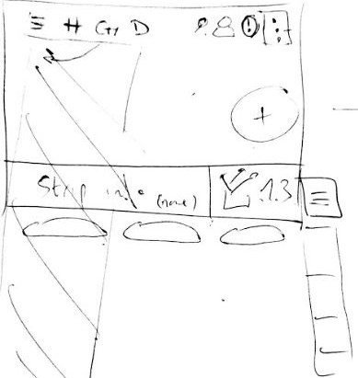
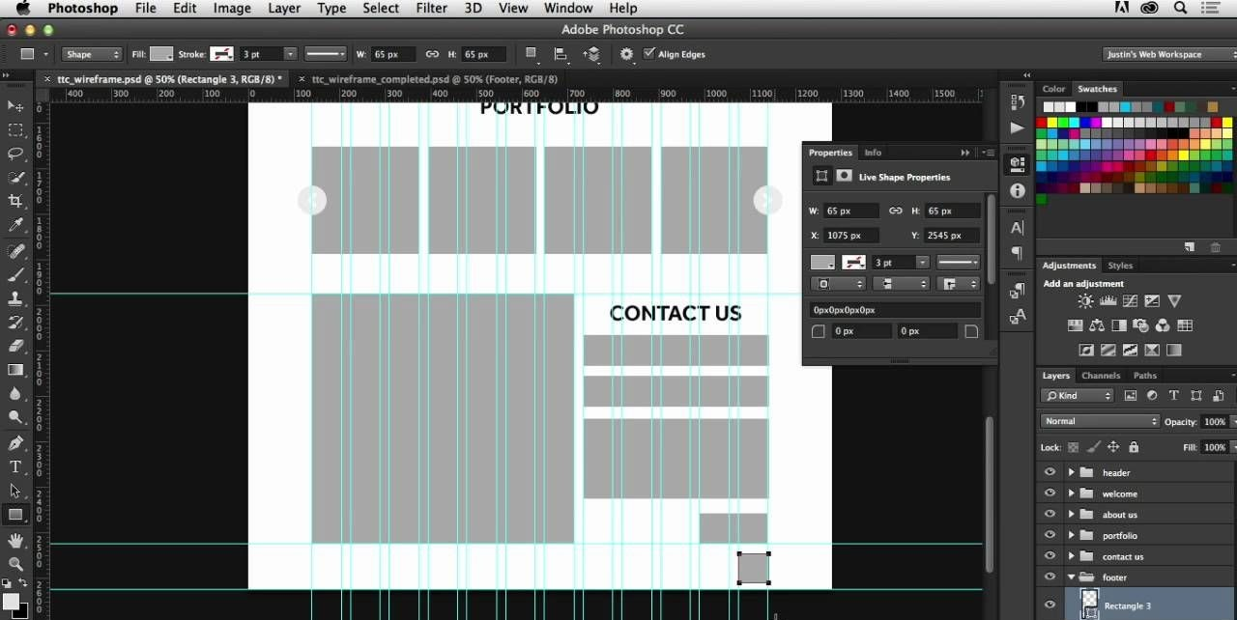
Mockup Design
Handsketch
PSD Mockup
15

Slide 16
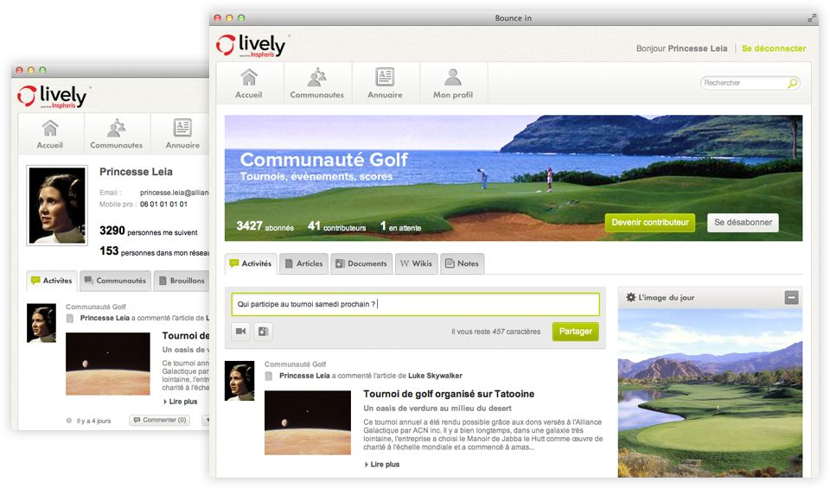
Implementation
Software implementation
16

Slide 17
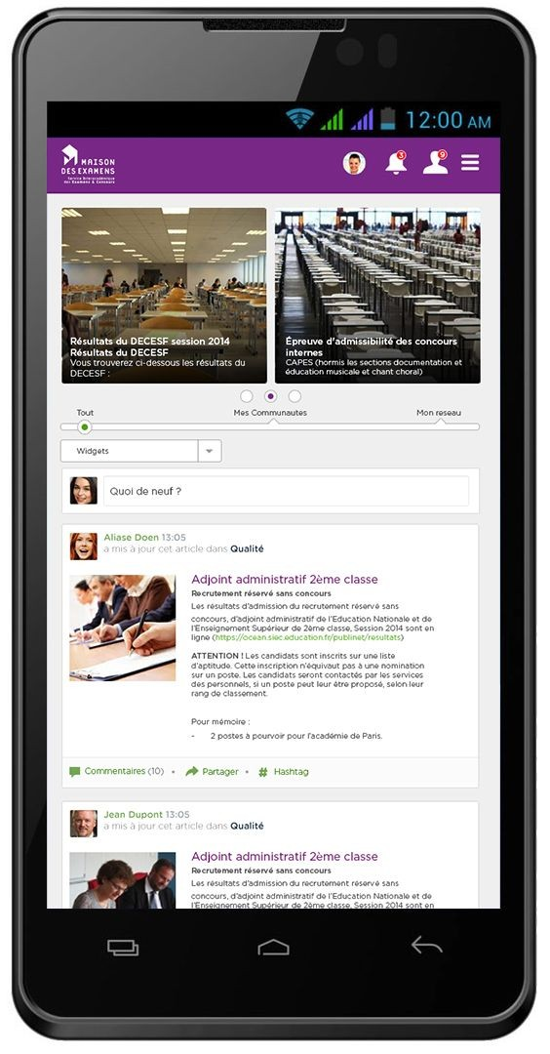
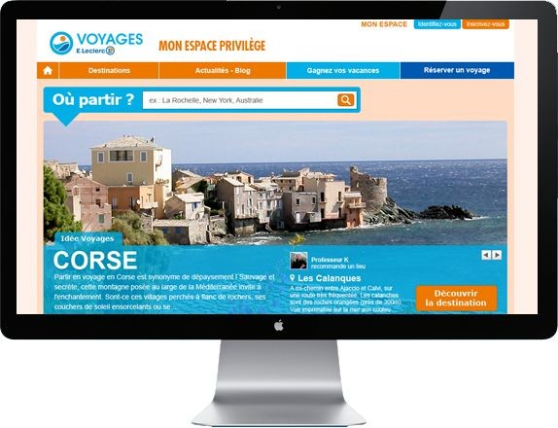
Responsive Implementation
Responsive Design and implementation
16

Slide 18
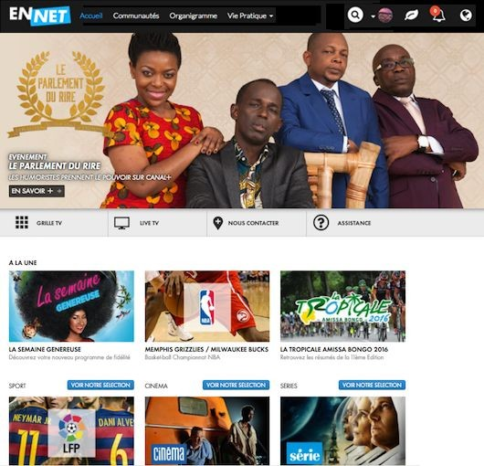
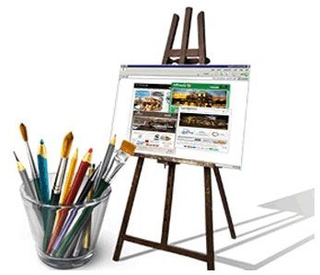
Customization
Customization of software according to client
18

Slide 19
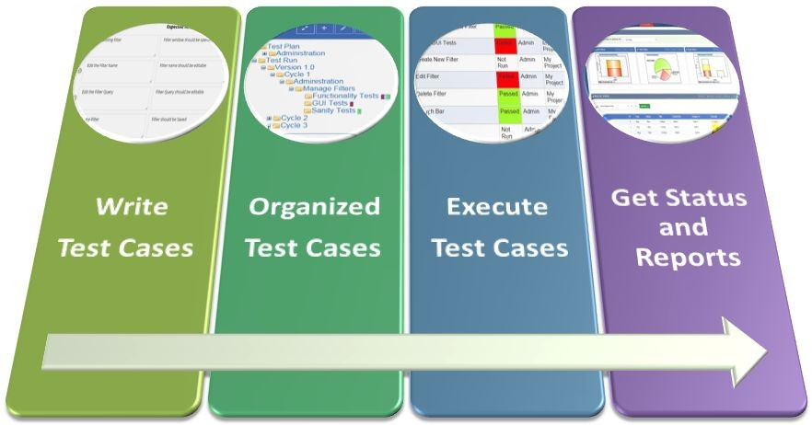
Testing
19

Slide 20
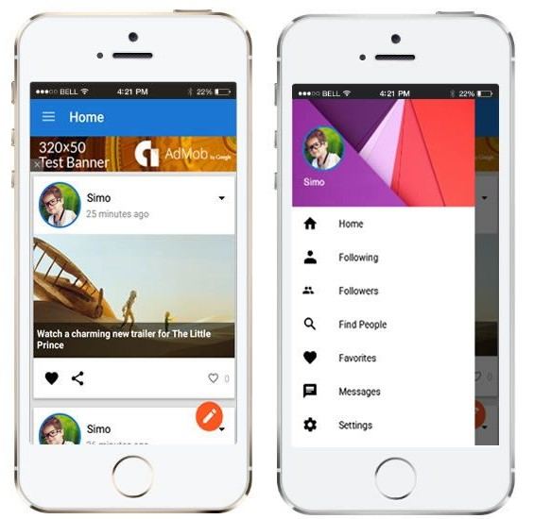


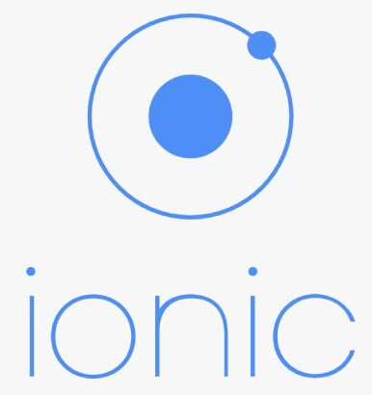
Mobile App
Mobile App Example
20

Slide 21
Career Path
Internship mission
About Inspheris
Internship Tasks
Breakdown
Agenda
Skills Utilized
What did I learn
Internship Impact
Conclusion

Slide 22

Skills Utilized
Software Engineering Skills
Development Operation skills
Administrative and collaboration tools

Slide 23
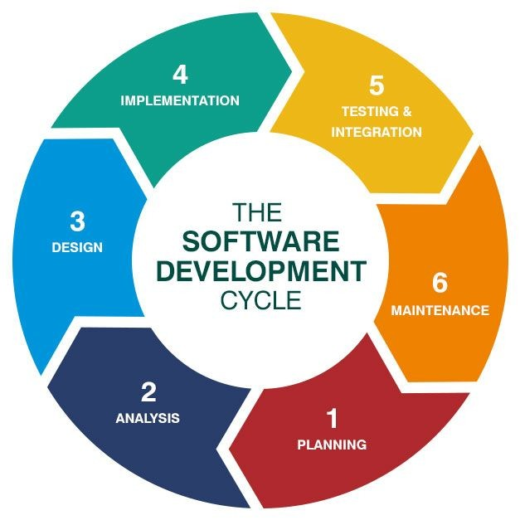
Skills Utilized
Software Engineering Skills:
Research modern trend in UI and Frontend,
Convert ideas to action,
design and develop mobile responsive, PSD-HTML-JS-Angular implementation,
software testing,
mobile App development

Slide 24



Skills Utilized
Development Operation skills:
Revision control with GIT technology.
Jenkins and automated systems.
Troubleshoot and updates

Slide 25

Skills Utilized
Administrative and collaboration tools:
Using Trello to create ticket and track bugs and development
Using different tools like Google office services, invision, lucidchart, teamwork, zendesk to communicate with the leads.
Working with marketing and sales

Slide 26
Career Path
Internship mission
About Inspheris
Internship Tasks
Breakdown
Skills Utilized
Agenda
What did I learn
Internship Impact
Conclusion

Slide 27
What I learned?
Technical skills:
Soft skills:
Management skills:
UI/UX tools and technologies,
Latest trends and updates,
angular Framework,
ionic framework,
Responsive web
Teamwork in an international working environment
Communication skills
French Working culture
project management,
time management
and more

Slide 28
Career Path
Internship mission
About Inspheris
Internship Tasks
Breakdown
Skills Utilized
What did I learn
Agenda
Internship Impact
Conclusion

Slide 29

Internship Impact
Current Situation: Software Project Manager
Long Term advantages:
International Master’s Degree
easy to integrate with international teams
Growth : Critical Thinking and analysis
Lead the team and projects
position, money, Job title and career growth

Slide 30

Conclusion
This internship has been an excellent
and rewarding experience.
It was a great opportunity to improve personal and professional skills.
These valuable skills have boosted my professional skills to a higher level and prepare me for future career.

Slide 31
Thank You
Anjan BHATTRAI
31

