Slide 1
Google Protocol Buffers and the ProtoDebugger
Authors: Joseph Santini and Alian Rodriguez
Advisor: Susanne Sherba
Date: 11/16/2012

Slide 2
Topics
Google Protocol Buffers
What are Protocol Buffers?
How to use Protocol Buffers
Capstone Introduction
Problem Diagnosis
Proposed Solution
ProtoDebugger
ProtoDebugger Design
ProtoDebugger GUI
Demonstration
References
Questions

Slide 3
What are Protocol Buffers?
Protocol Buffers
Created within Google Developers
A flexible, efficient, automatic mechanism for serializing structured data.
An alternative to XML
Smaller, simpler, faster, and generates easy to use data classes.
Features of Protocol Buffer
Language Neutral
Compiled with Java, C++ or Python
New fields can be introduce without breaking code
Servers could parse data and pass it through without knowing all the new fields
Automatic generation of serialization and de-serialization code

Slide 4
How to use Protocol Buffers
Below is an example of a protobuf defintion in a .proto file:
message Person
{ required string name = 1;
required int32 id = 2;
optional string email = 3;
enum PhoneType
{ MOBILE = 0;
HOME = 1;
WORK = 2; }
message PhoneNumber
{ required string number = 1;
optional PhoneType type = 2 [default = HOME]; }
repeated PhoneNumber phone = 4; }
Once the message definition is complete, you could use the Java or C++ protocol buffer compiler to create data access classes based on the .proto message. Using the above example, the C++ compile generates a class called Person, which then can be used in the follow manner:
Person person; person.set_name("John Doe"); person.set_id(1234); person.set_email("jdoe@example.com"); fstream output("myfile", ios::out | ios::binary); person.SerializeToOstream(&output);
You can also extend your protocol without breaking the code and keeping backwards-compatibility: You could add new fields to the message formats since the old binaries will ignore the new fields.

Slide 5
Problem Diagnosis
Google Protocol Buffer is a lightweight mechanism for the transportation of data that is supported by Java and C++. However:
No way to edit messages “on the fly”
Necessary for debugging and integration testing
No user-friendly format to view Protocol Buffers
Need to add print statements in code to view proto messages
This can impact software development performance
Analysts don’t have access to tools that change proto messages to fit their needs
Tester require software development aid to create proper proto messages for integration.

Slide 6
Proposed Solution
Create a tool, known as the ProtoDebugger, that reads in compiled Protocol Buffers and display a UI format based on it
ProtoDebugger Features:
User can input data into the ProtoDebugger as long as it meets protocol buffer criteria.
Ability to print the protocol buffer onto a file or display on the screen
Java based GUI system

Slide 7
ProtoDebugger Design
UML Diagrams go here

Slide 8
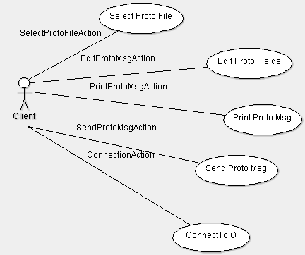
ProtoDebugger Design
Client-Side Use case diagram for the ProtoDebugger

Slide 9
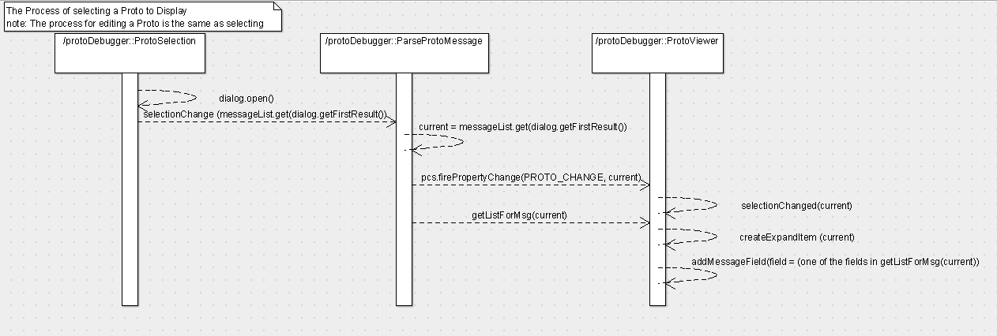
ProtoDebugger Design

Slide 10
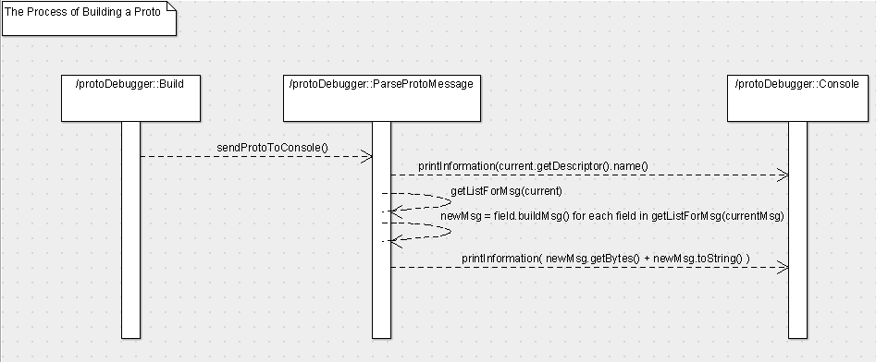
ProtoDebugger Design

Slide 11
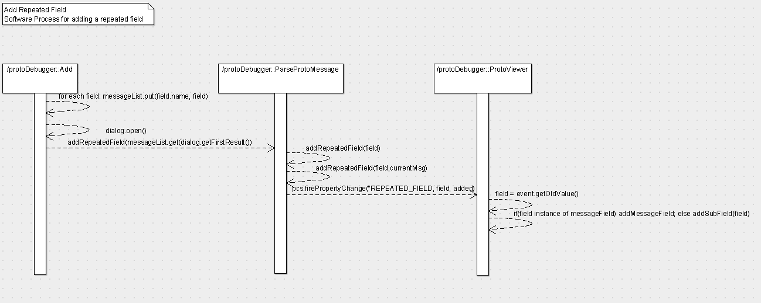
ProtoDebugger Design

Slide 12
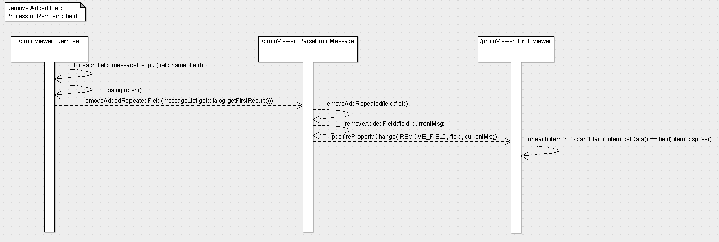
ProtoDebugger Design

Slide 13
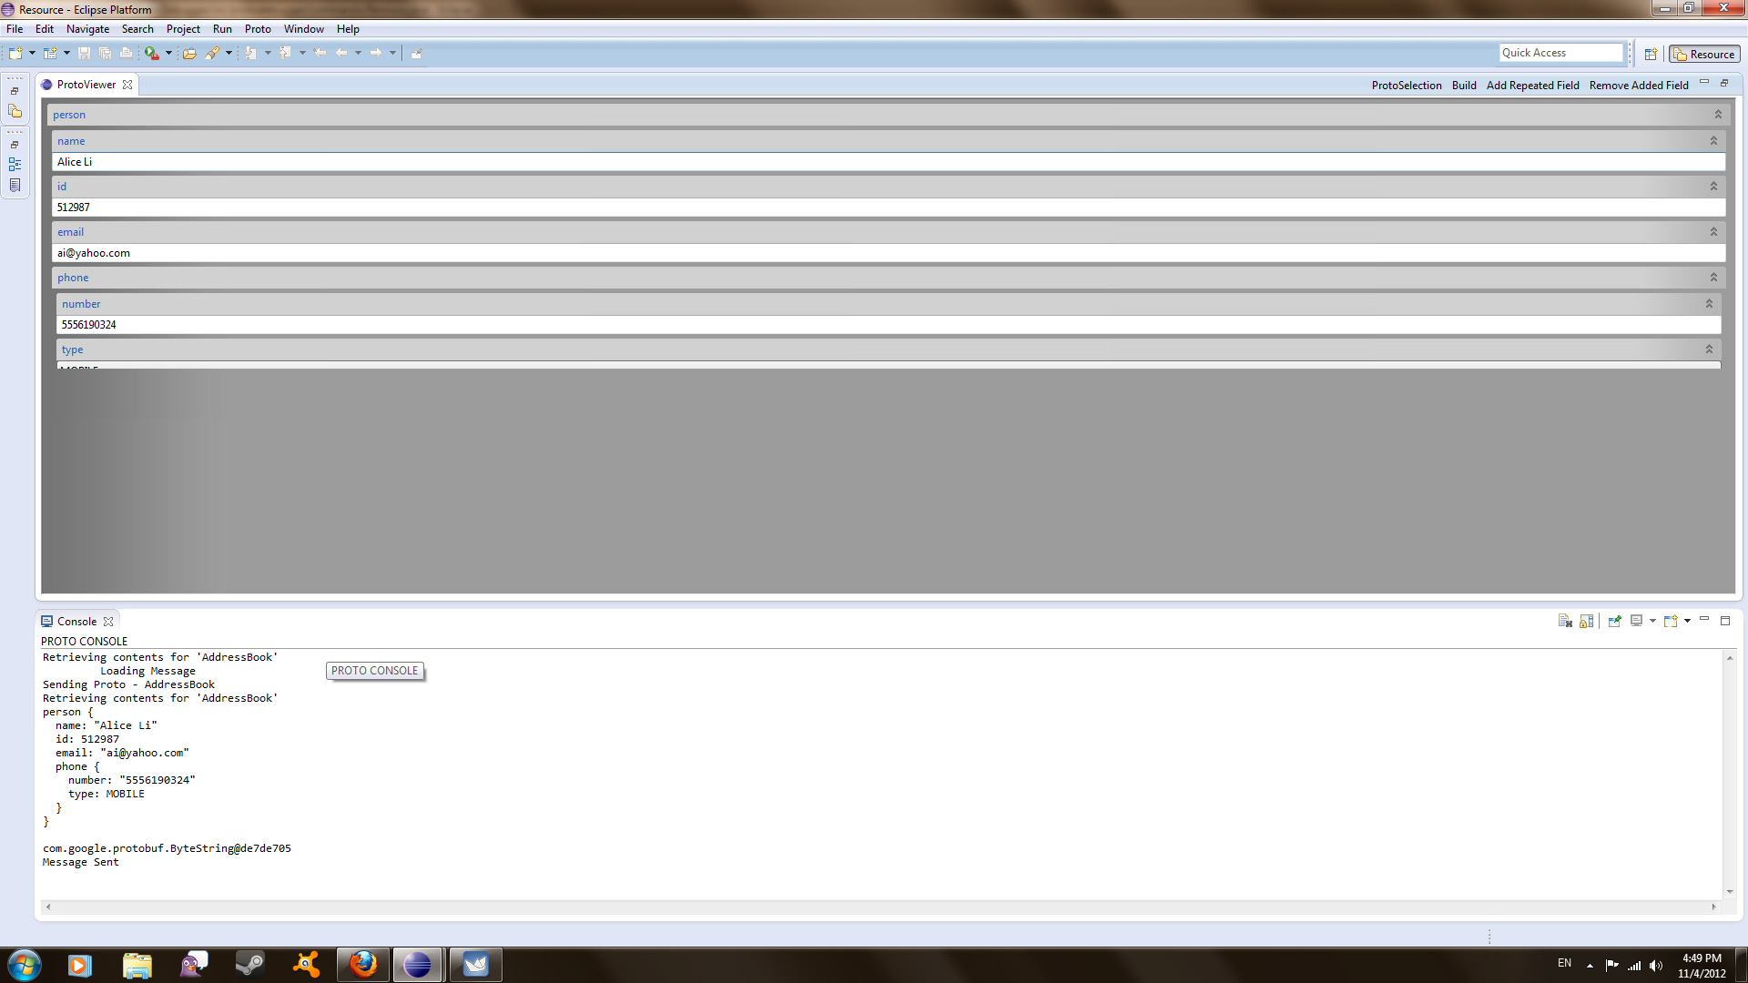
ProtoDebugger GUI: ScreenShots

Slide 14
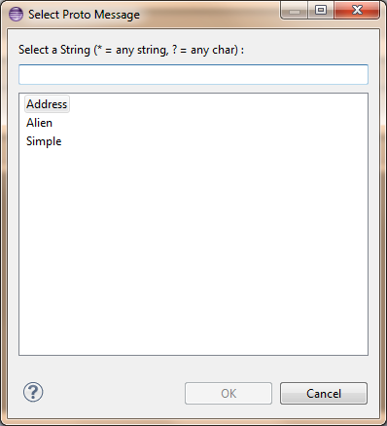
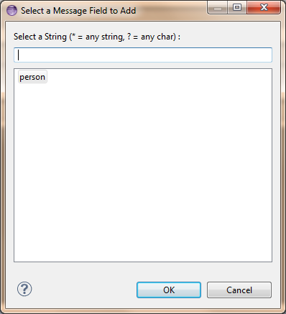
ProtoDebugger GUI: ScreenShots

Slide 15
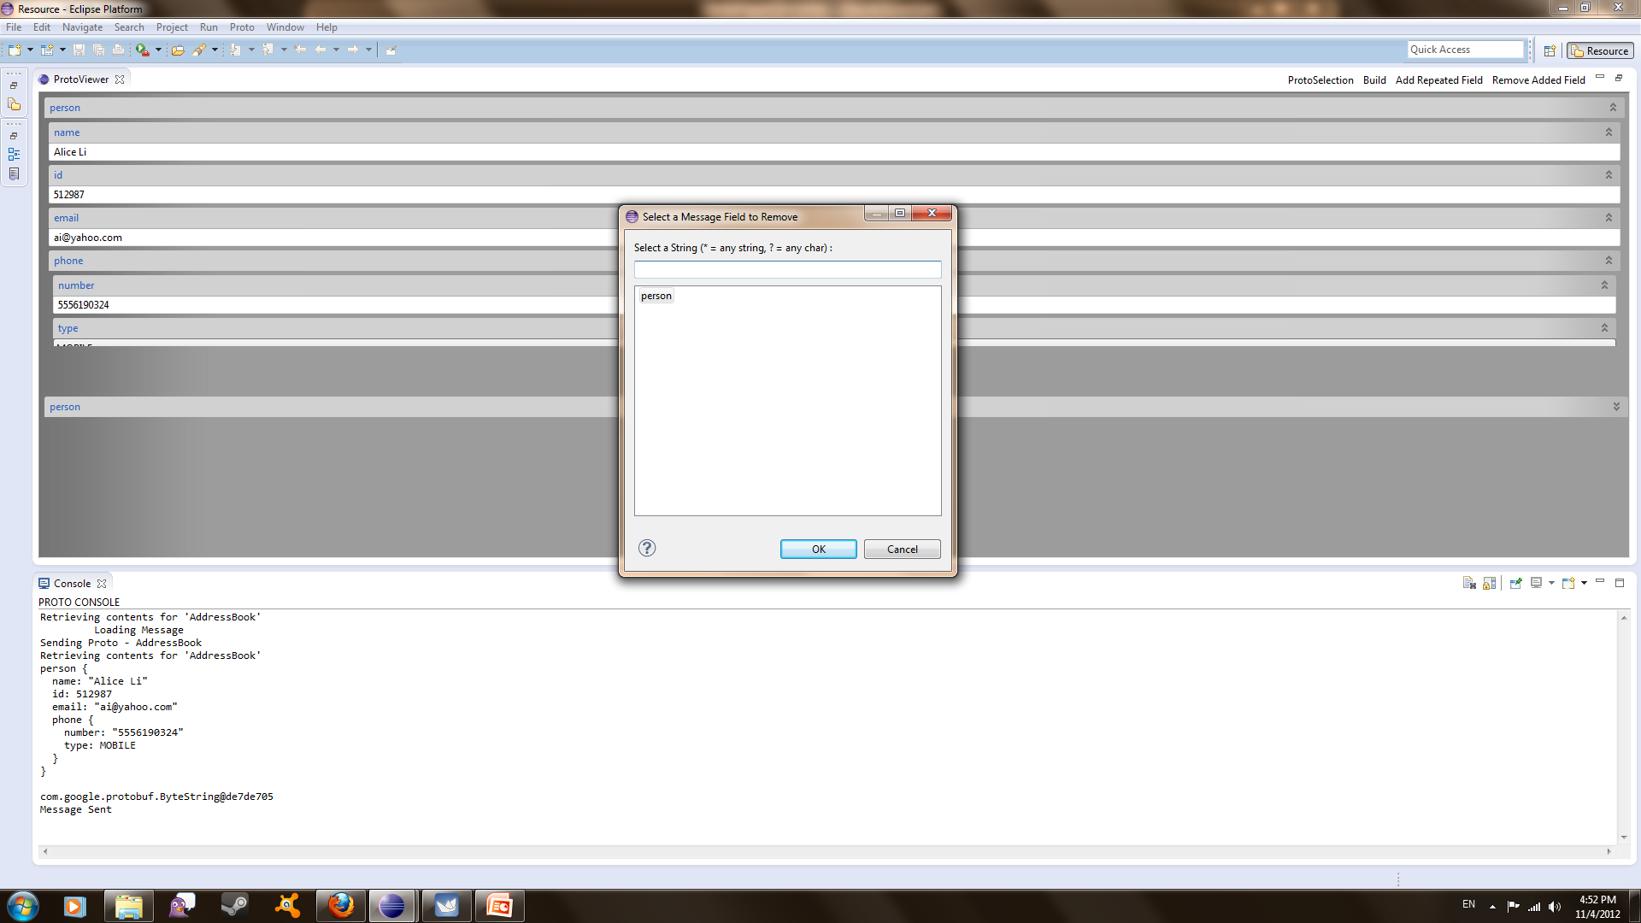
ProtoDebugger GUI: ScreenShots

Slide 16
Demonstration

Slide 17
Lessons Learned

Slide 18
References
"Protocol Buffers." Google Developers. Google, n.d. Web. 23 Oct. 2012. <https://developers.google.com/protocol-buffers/>.

Slide 19

Questions

