Slide 1
Green Corridor
Ammonia Bunkering Optimization
MILP Model Analysis & Results

Slide 2
Executive Summary
Metric | Value
Operational Scenarios | 3 cases
Feasible Solutions | 270 total
Case 1 Optimal NPC | $153.5M
Best Case (Ulsan) | $94.9M (-38%)
Optimal Shuttle Size | 2,500-5,000 m³

Slide 3
Case 1: Busan Port Storage
Storage-based bunkering at Busan Port (intra-port transfer)
Optimal Configuration:
• Shuttle Size: 2,500 m³
• Pump Capacity: 2,000 m³/h
• NPC (20 years): $153.5M
Characteristics:
• Large storage tank (35,000 tons)
• 2.0 hour intra-port travel time
• Higher storage cost burden

Slide 4
Case 2-1: Yeosu Route
Long-distance shuttle route: Yeosu → Busan (86 nm)
Optimal Configuration:
• Shuttle Size: 5,000 m³
• Pump Capacity: 2,000 m³/h
• NPC (20 years): $158.2M
Performance vs Case 1:
• +3.1% more expensive
• Travel Time: 5.73 hours
• No storage cost (26% savings)
• Higher fuel consumption

Slide 5
Case 2-2: Ulsan Route
OPTIMAL
Short-distance shuttle route: Ulsan → Busan (25 nm)
Optimal Configuration:
• Shuttle Size: 5,000 m³
• Pump Capacity: 2,000 m³/h
• NPC (20 years): $94.9M
Performance vs Case 1:
✓ -38.2% cost reduction (BEST OPTION)
• Travel Time: 1.67 hours (shortest)
• 33% lower fuel consumption vs Yeosu
• Lowest total NPC

Slide 6
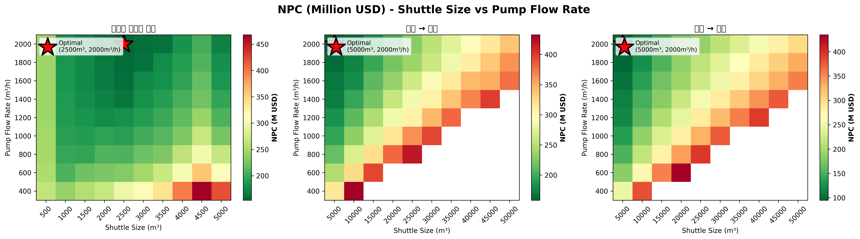
NPC Heatmaps: Shuttle Size vs Pump Flow Rate

Slide 7
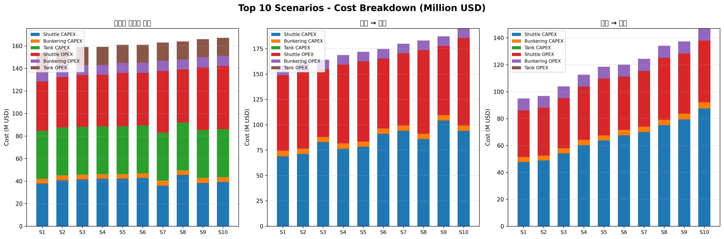
Top 10 Cost Breakdown by Component

Slide 8
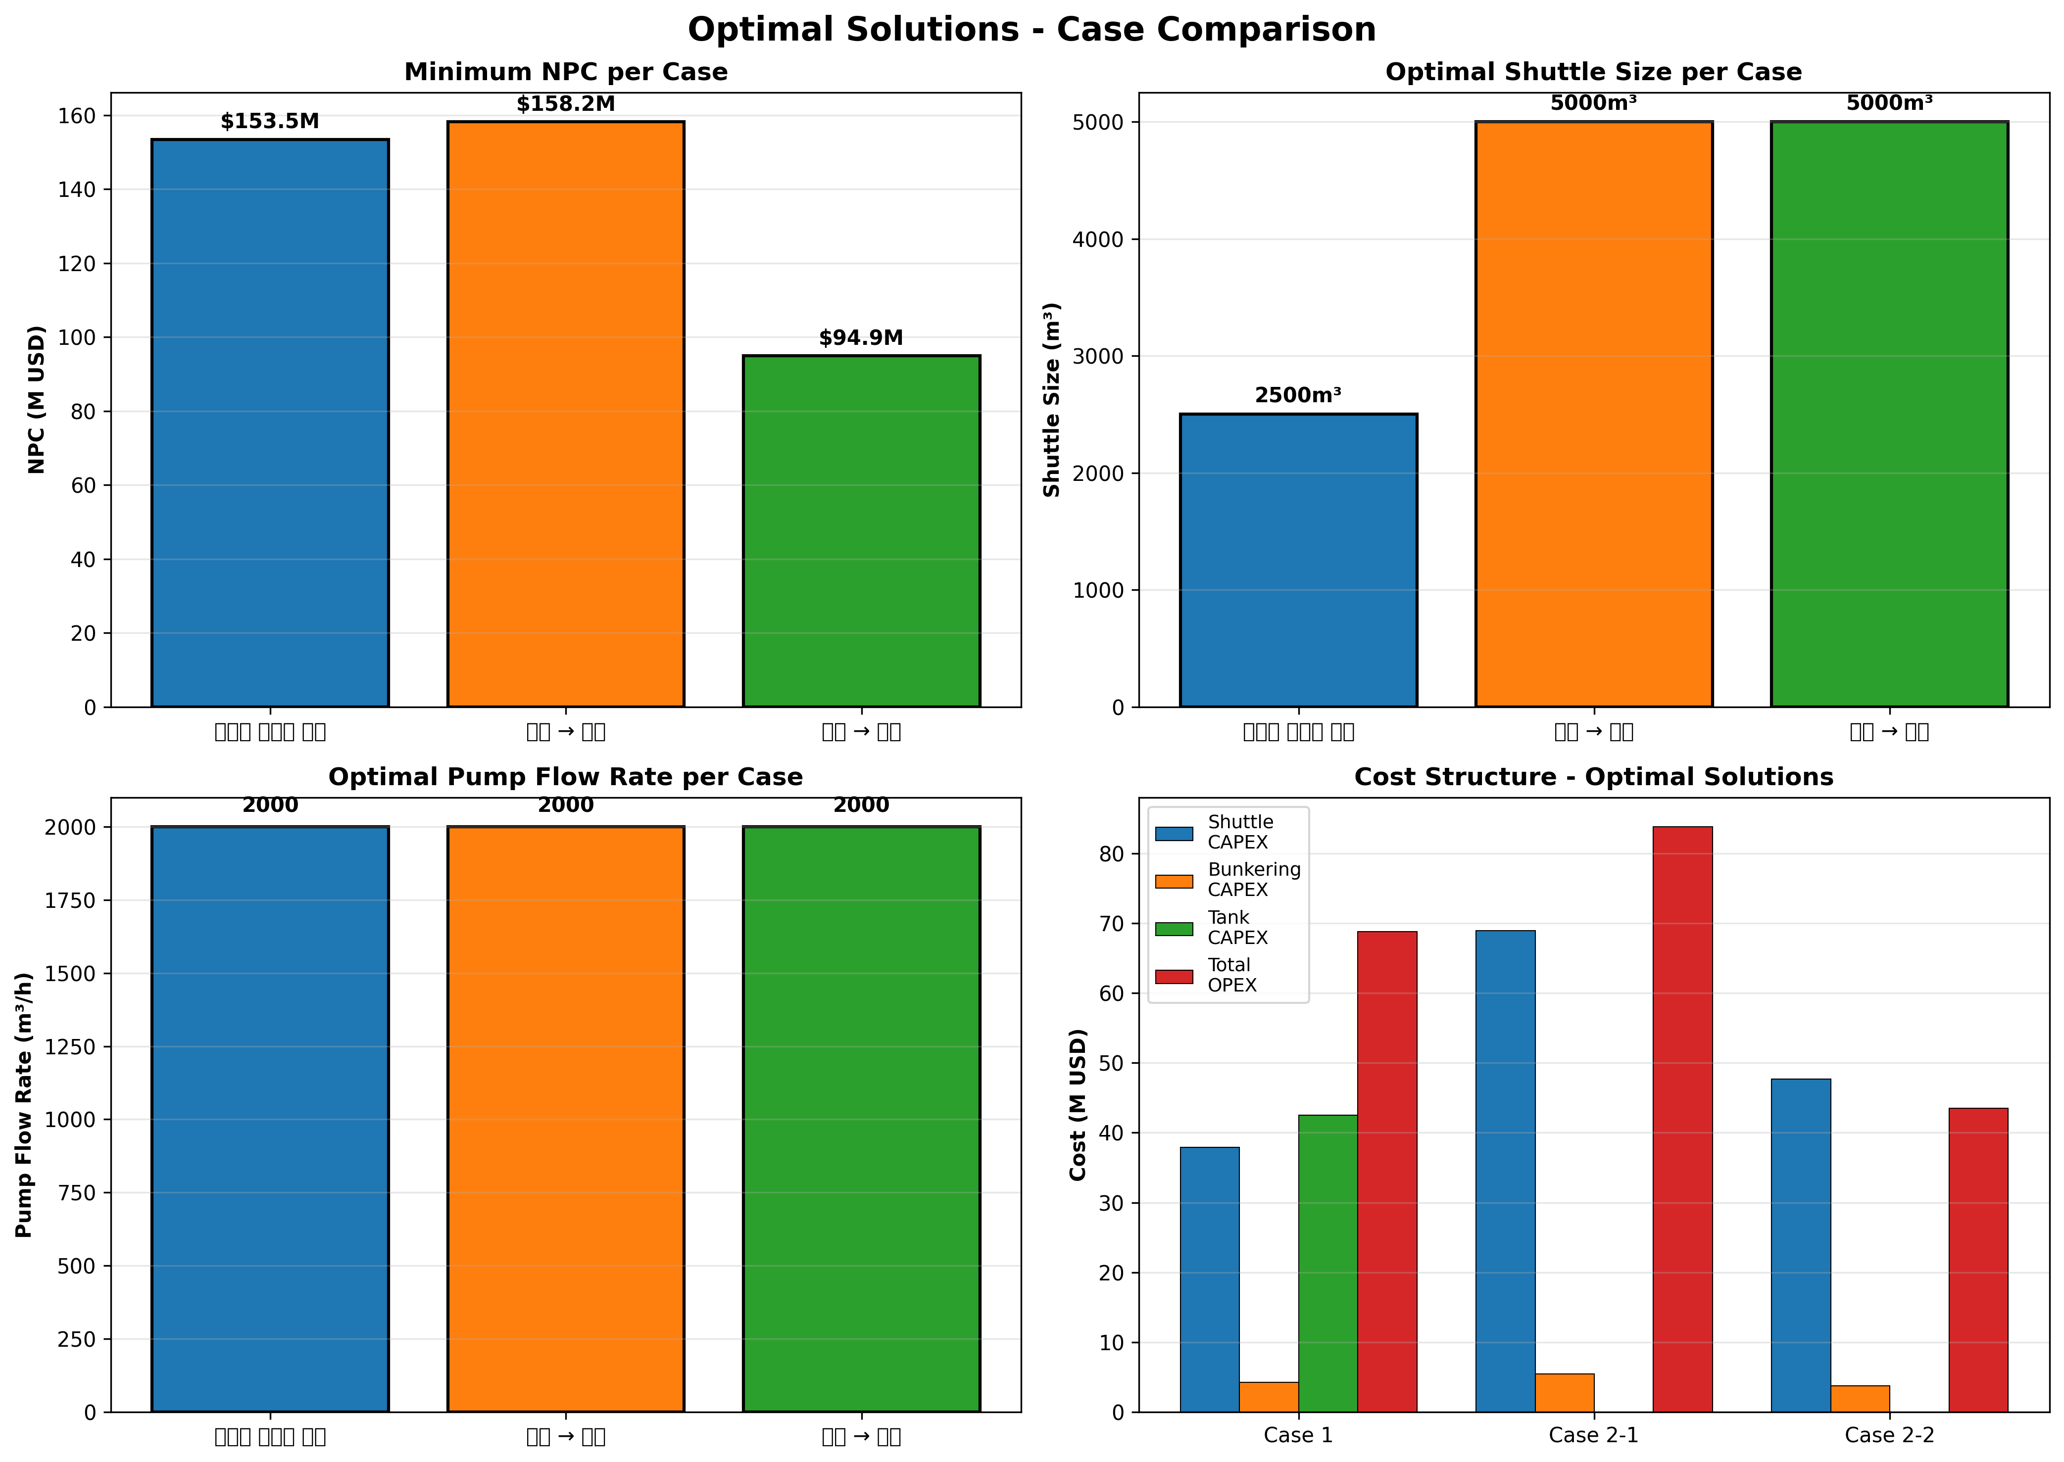
Case Comparison: NPC, Equipment, Cost

Slide 9
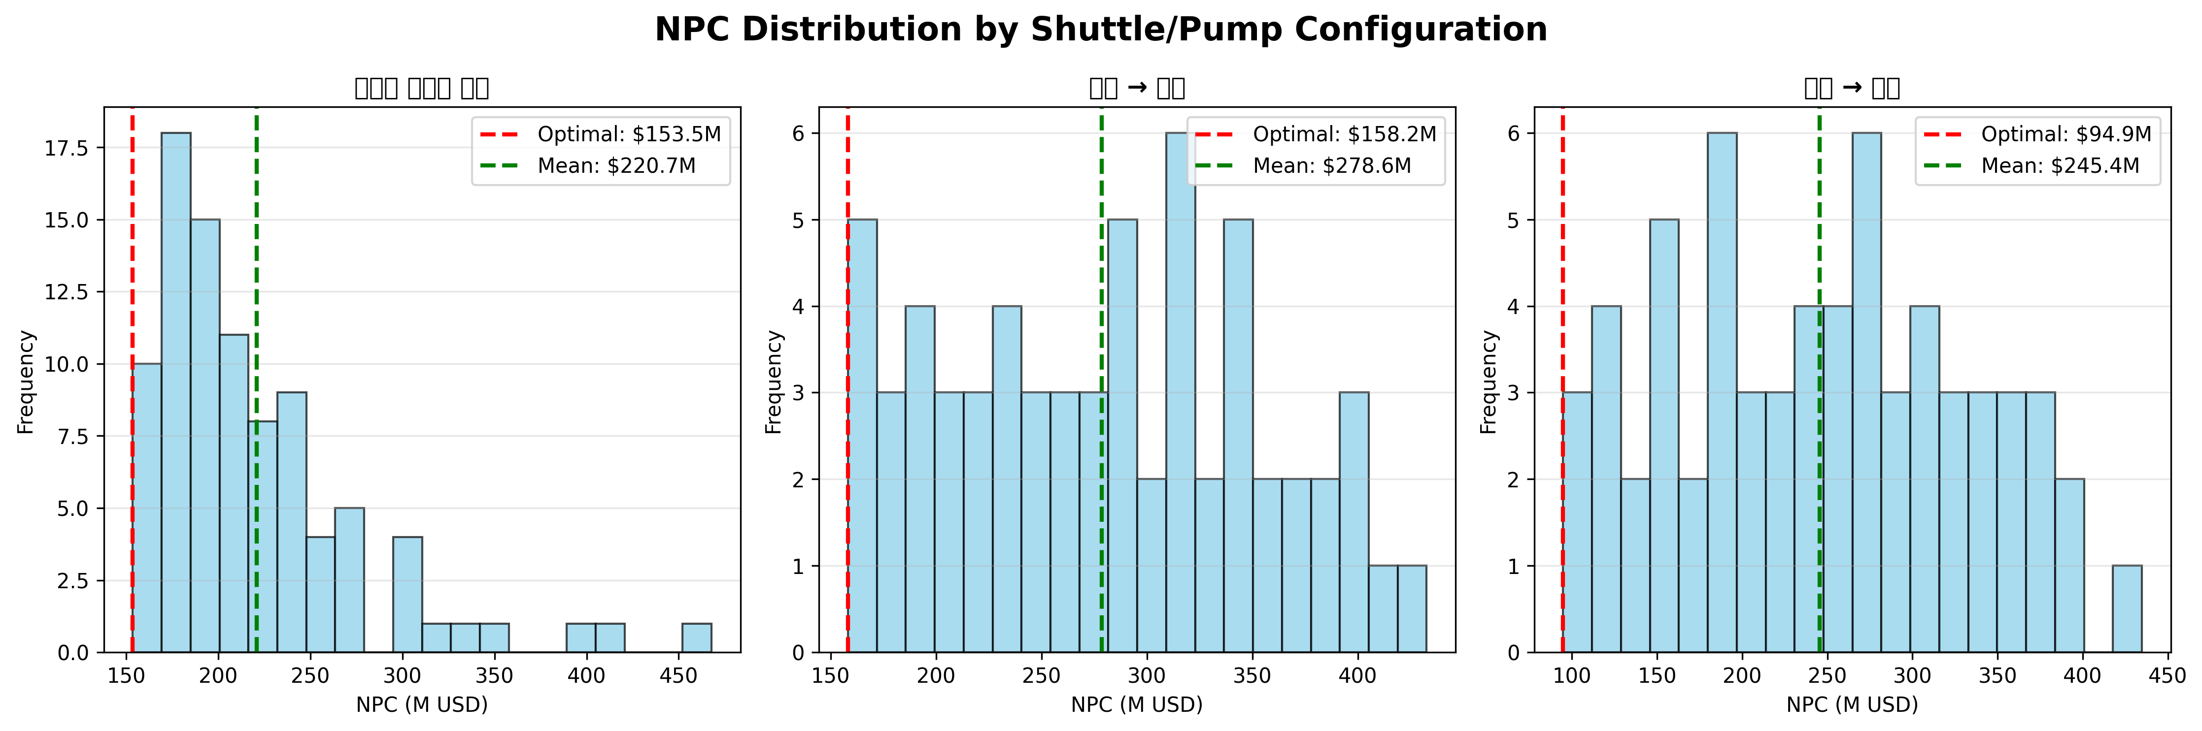
NPC Distribution Analysis

Slide 10
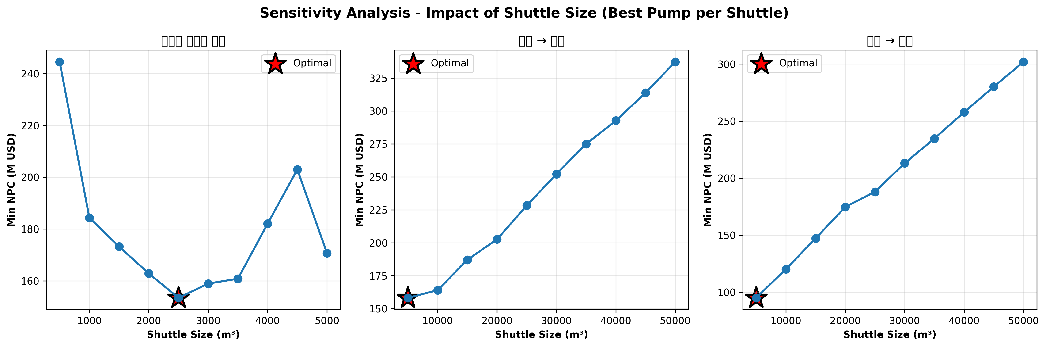
Sensitivity Analysis: Shuttle Size Impact

Slide 11
Key Findings
Ulsan Route Optimal
38.2% cost reduction vs Busan ($94.9M vs $153.5M)
Storage Tank Burden
Tank CAPEX ($28.9M) limits Case 1 competitiveness
Equipment Sizing
5,000 m³ shuttles optimal for long-distance routes
Distance Critical
25 nm route reduces fuel by 33% vs 86 nm route

Slide 12
NPC Breakdown by Component (20-Year Horizon)
Cost Component | Case 1 | Case 2-1 | Case 2-2
Total NPC | $153.5M | $158.2M | $94.9M
Shuttle CAPEX | $24.8M | $24.1M | $24.1M
Bunkering CAPEX | $9.8M | $9.8M | $9.8M
Tank CAPEX | $28.9M | $0 | $0
Total OPEX | $90.0M | $124.3M | $61.0M

Slide 13
Economic Analysis & Equipment Requirements
Case 1 Initial Shuttles
6
Case 2-1 Initial Shuttles
8
Case 2-2 Initial Shuttles
8
Cost per Tonne (Case 1)
~$45
Cost per Tonne (Case 2-2)
~$28
Ulsan route fuel consumption 33% lower due to shorter distance (25 nm vs 86 nm)

Slide 14
Strategic Recommendations
1. Prioritize Ulsan Route: Deploy infrastructure toward Case 2-2 for 38% cost savings
2. Optimize Fleet: Use 5,000 m³ shuttles for long-distance, 2,500 m³ for storage-based
3. Reassess Storage: High tank CAPEX ($28.9M) limits Case 1 competitiveness
4. Phased Deployment: Start with 6-8 shuttles in 2030, grow 10% annually

Slide 15
Implementation Roadmap
2030
Foundation: 6-8 shuttles, 35 vessels
2035
Growth: 10-12 shuttles, 100+ vessels
2040
Scaling: Optimize efficiency, 200+ vessels
2050
Maturity: 500 vessels, integrated supply chain

Slide 16
Methodology Overview
Optimization Model:
MILP (Mixed-Integer Linear Programming)
Objective:
Minimize total Net Present Cost across 2030-2050
Decision Variables:
Fleet size, shuttle/pump specifications, bunkering cycles
Cost Components:
CAPEX (vessels, equipment, storage), OPEX (fuel, maintenance, cooling)
Discount Rate:
7% annual for NPV calculations
Solver:
CBC (Coin-or Branch and Cut) via PuLP with <0.1% optimality gap

Slide 17
Conclusion
Ulsan Route (Case 2-2) is the Economically Optimal Solution
Achieves $94.9M NPC over 20 years—38.2% cost reduction vs Busan storage scenario
Strategic Implications
Development should focus on Ulsan infrastructure with 5,000 m³ shuttles and 2,000 m³/h pumps
to serve Green Corridor vessels economically through 2050
Next Steps
Proceed with detailed feasibility analysis for Ulsan infrastructure, port coordination, and phased fleet deployment

Slide 18
Questions?
Green Corridor Ammonia Bunkering Optimization
Infrastructure Planning 2030-2050

