Slide 1
Facial Expression Recognition Using Deep Learning
Alex Rowson, Alex Slotter

Slide 2
Introduction
OBJECTIVE: HIGH ACCURACY IN FER DATASET USING DEEP LEARNING.
IMPORTANCE: PSYCHOLOGY, HEALTHCARE, EDUCATION, HCI.
STRATEGY: ITERATIVE CNN DESIGNS FROM BASELINE TO ATTENTION MODELS.
Notes:
Emotion detection is important bc it lets systems respond to human feelings
Customer experience, mental health, telemedicine and tele-schooling
Trying to find which model type/features work the best for this specific dataset and application

Slide 3
Preprocessing and Augmentation
Dataset came split for test and train, in 48x48
Augmentations: horizontal flip, ±10° rotation, random crop
Normalization: mean=0.5, std=0.5
Purpose: Better generalization, less overfitting

Slide 4
Models

Slide 5
Baseline CNN (EmotionCNN)
3 Conv Layers (32→64→128) with MaxPooling for downsampling + Dropout for overfitting
Fully connected layer for classification
Captures hierarchical facial features
Struggled with complex features of emotions
Accuracy: 58.26%

Slide 6
CNN with Fixed Custom Kernels
Handcrafted filters: Sobel, Centre, Sharpen and Diagonal – enables focus on facial features
Same CNN structure as baseline
Enhanced edge-based features
Proved kernels could be useful for dataset
Accuracy: 59.72%

Slide 7
SimpleResNetFER
Custom Kernel + BatchNorm
3 Residual Blocks (64→128→256)
Global Avg Pooling + Fully connected Layer
Gradient stability, deeper features
Performed below expected
Accuracy: 53.13%
Notes:
ResNet doesn't just learn the transformation of the input through convolutions, but instead learns how much to modify the input by adding the learned residual (the change). This helps combat the vanishing gradient problem, particularly in deep networks, and allows the network to "skip" layers if needed—hence, the term "residual."

Slide 8
CustomFERCNN with CBAM (Best Model)
3 Conv Blocks (64→128→256) + CBAM (attention)
Focus on eyes, mouth, brows via attention
Combined with focus of kernels
ReLU for prevention of vanishing gradients
Dropout + FC (512→7)
Accuracy: 62.18%
Notes:
Using 3 convolutional blocks with increasing filter sizes allows the model to extract hierarchical features—starting with edges and progressing to complex emotional cues. This structured expansion in representational power is key to achieving higher accuracy in emotion recognition.

Slide 9
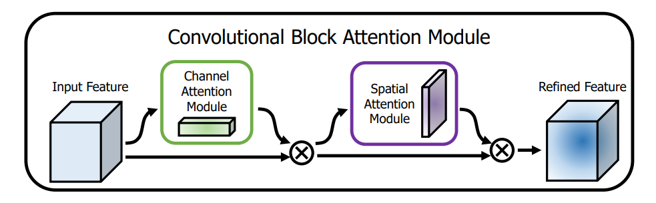
Convolutional Block Attention Module
Module that can be added to convolutional networks
Channel attention selects most important feature sets
Spatial attention chooses most important regions spatially
  Uses AvgPool and MaxPool to highlight active regions
  Sigmoid activation scales between 0-1
Notes:
Feature sets in this case aren't useful (could be in RGB images with 3 channels)

Slide 10

Evaluation Strategy
3-Fold Cross Validation
Optimizer: Adam (adaptive learning rate, good with noisy data)
Loss: Cross-Entropy
Epochs: 15–20
Metrics: Validation & Test Accuracy

Slide 11
K-Fold
Average Accuracy: 48.98 %
Showed that our actual accuracy may not be as high
The current train/test split benefits the model, but wouldn’t help it with real world data with a random split
Something that could be addressed through future work
Notes:
More proof of overfitting issues – discuss later in slides

Slide 12
Results Summary
EmotionCNN: 58.26%
Custom Kernels CNN: 59.72%
SimpleResNetFER: 53.13%
CustomFERCNN + CBAM: 62.18%
Notes:
CustomFERCNN+CBAM had ~60% but was further improved by the kernels (!!) big talking point how our kernels improved the models

Slide 13
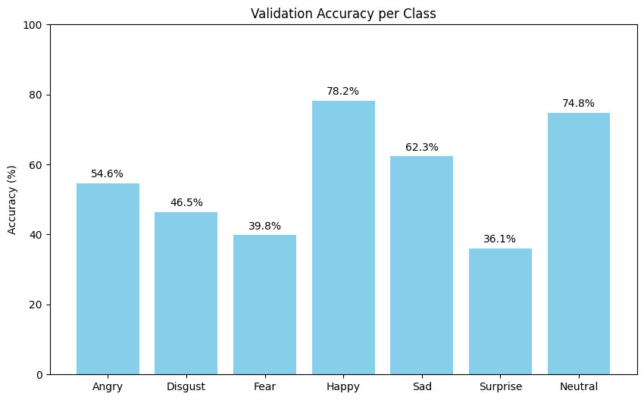
Class-wise Performance

Slide 14
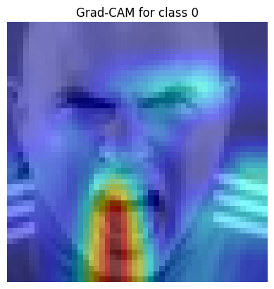
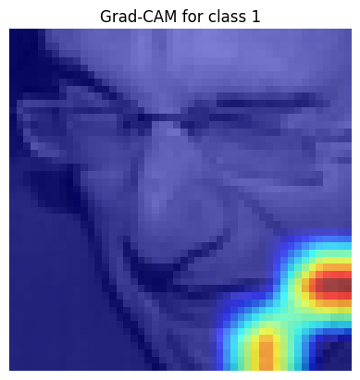
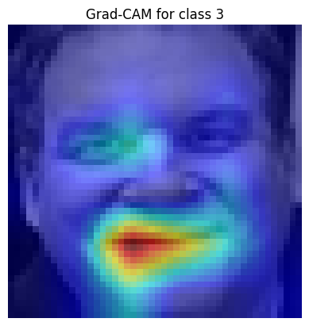
Model Focus
Notes:
Angry, disgusted, happy
Generally focuses on mouth
Some activation on singular eye interestingly

Slide 15
Impact of L2 Regularization
Without L2: Loss ~1.8 at epoch 20
With L2: Loss ~1.4
L2 reduces overfitting
  Adds penalty based on sum of weights, reduces extreme patterns and values
Notes:
"L2 regularization (also called ridge regularization) adds a penalty to the loss function equal to the sum of the squared model weights (times a constant)."
It discourages large weights, which helps prevent overfitting and improves generalization.
Implemented through the built-in function in the Adam optimizer 'weight_decay" parameter

Slide 16
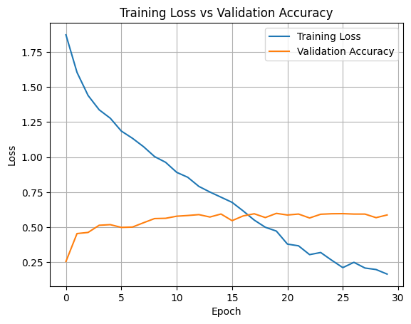
Training Trends
Notes:
Trained models to 20 epochs – for best model we tested expanding to 30 but no change - showed our parameter was good
LEAD INTO OVERFITTING – training loss keeps going down but validation accuracy does not change –textbook overfitting

Slide 17
Key Challenges
Class imbalance: few fear/disgust samples
Emotion localization varies by expression
Overlapping features complicate classification
Overfitting
Notes:
Overfitting likely due to class imbalances, complexity of the individual key points for each emotion

Slide 18
Reflection and Future Work
Video emotion – computer vision
Transformers for image classification
Multi-task learning – increased predictors like age or gender
Use more dropout layers with the existing model to reduce overfitting
Notes:
Vision Transformers is the other model commonly used nowadays besides CNNs

Slide 19
Q&A

