Slide 1

HL7 EU
Common cancer model ontology and LLM evolution and perspective
Stefano Lotti, FHL7
HL7 Italy Chair
HL7 International OSA WG Co-Chair
01.12.2025
HL7 Europe Working Group Meeting 2025 Cologne

Slide 2
Objectives
Objectives
formalize and consolidate the Common Cancer Model,
integrate the Common Cancer Model within the HL7 tooling ecosystem,
develop mappings between ontological concepts and FHIR resources.
Moreover, Ontologies are increasingly recognized as a key tool for Large Language Models (LLM), facilitating more structured and semantically robust GenAI agents. This integration holds significant potential for advancing data analysis through Retrieval-Augmented Generation (RAG) methodologies.
An underlying goal is to understand the bidirectional relationship between AI technologies and healthcare standards — investigating how AI can aid in standards development and how established formal standards can enhance AI’s accuracy and reliability.
Current Status: This work is currently a discussion draft for the HL7 EU community. Documentation and source code are available on Confluence.

Slide 3
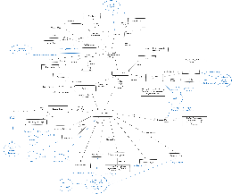








Development Approach and Tools
The initial OWL 2 model was generated from the European Cancer Common Conceptual Model v2, developed with Claude 3.7 Sonnet Large Language Model (LLM).
The Cameo Concept Modeler plugin was then used to import the OWL model into MagicDraw UML 2024x and correct/extend the ontology.
A Python utility (owl2plantuml_v17.py) has been developed to transform OWL 2 ontologies into PlantUML diagrams, useful for the HL7 Tools chain.
Subsequent discussions following the Madrid Working Group Meeting led to the current release (version 2.1).
Ontology is available in multiple serializations: RDF/XML, JSON-LD, OWL Functional syntax, and Turtle format
The new version has also been exported in Eclipse UML for manipulation with open-source tool as Papyrus UML (after the WGM we'll release the imported Papyrus UML Model).
The current updated model is aligned with the new version EU Cancer Common Conceptual Model, and has been verified and revised with the assistance of Claude 4.5 Opus LLM.
Original EU-CCM
MCP servers for Ontology curation and RAG

Slide 4
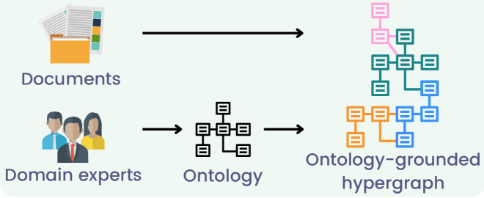




Proposed Next Steps
Resolve some minor doubts about the formal model (e.g., multiplicity of relationships)
continuous alignment with model developments (also against the logical model)
Test the use of the model with LLMs.
Possible examples (TBD):
OG RAG
OWL MCP
OG-RAG addresses traditional Retrieval-Augmented Generation (RAG) limitations by using hypergraphs to incorporate ontology-grounded knowledge. It retrieves minimal, highly relevant contexts, significantly boosting response accuracy and factual grounding.
In our context can be used with FHIR Resource specification or with clinical research data
OWL-MCP is a Model-Context-Protocol (MCP) server for working with Web Ontology Language (OWL) ontologies.
The MCP server provides function calls for finding, adding, or removing OWL axioms, using OWL functional syntax. Each function call is accompanied by the file path of the OWL file on your disk. Any format supported by py-horned-owl is accepted (we following OBO guidelines and recommend functional syntax for source).
Relevant Context
Query
Factual deduction
Response

