Slide 1

IS THE SAMPLE NORMALLY DISTRIBUTED?
By Sakina Lougue

Slide 2
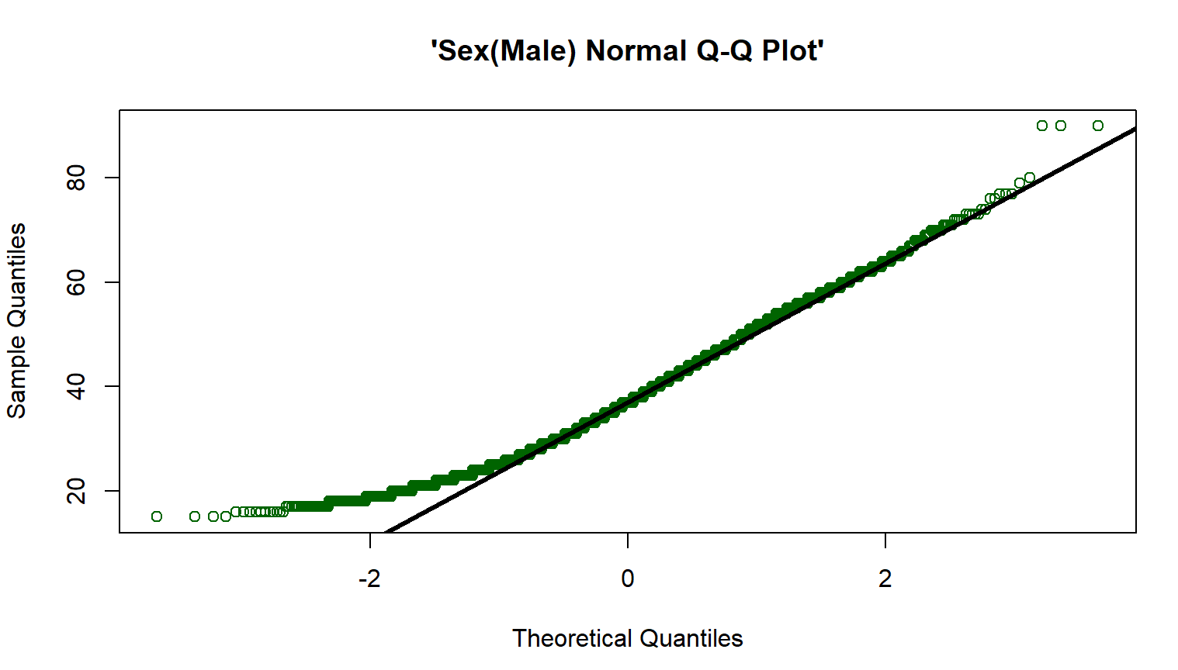
MEN
METHOD 1 : qqnorm

Slide 3
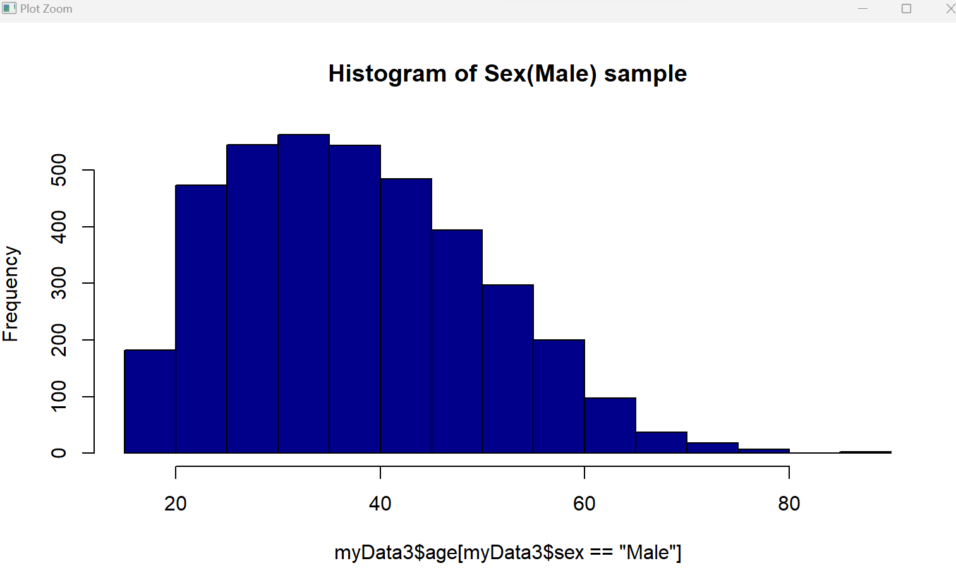
Method 2: Histogram

Slide 4
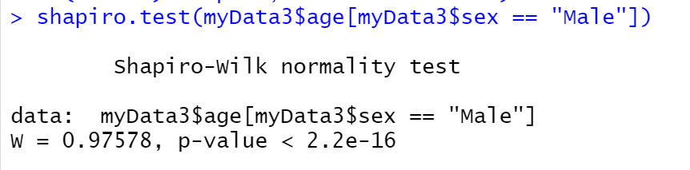
Method 3: Shapiro Test

Slide 5
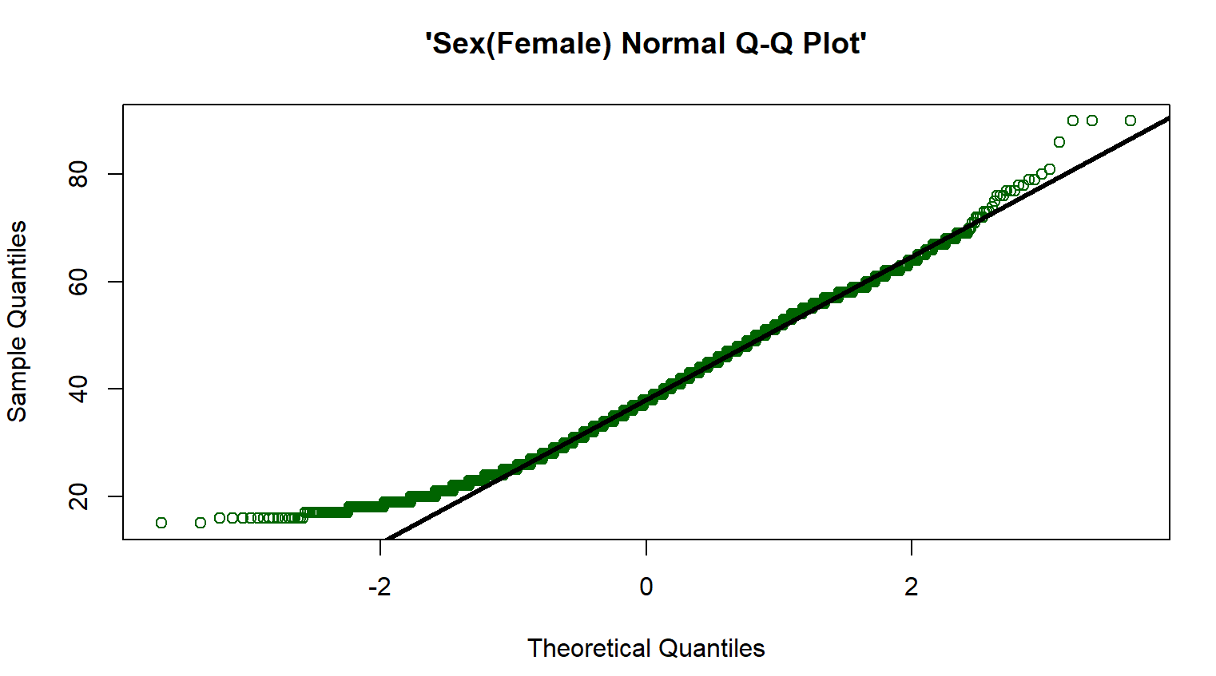
WOMEN
Method 1: qqnom

Slide 6
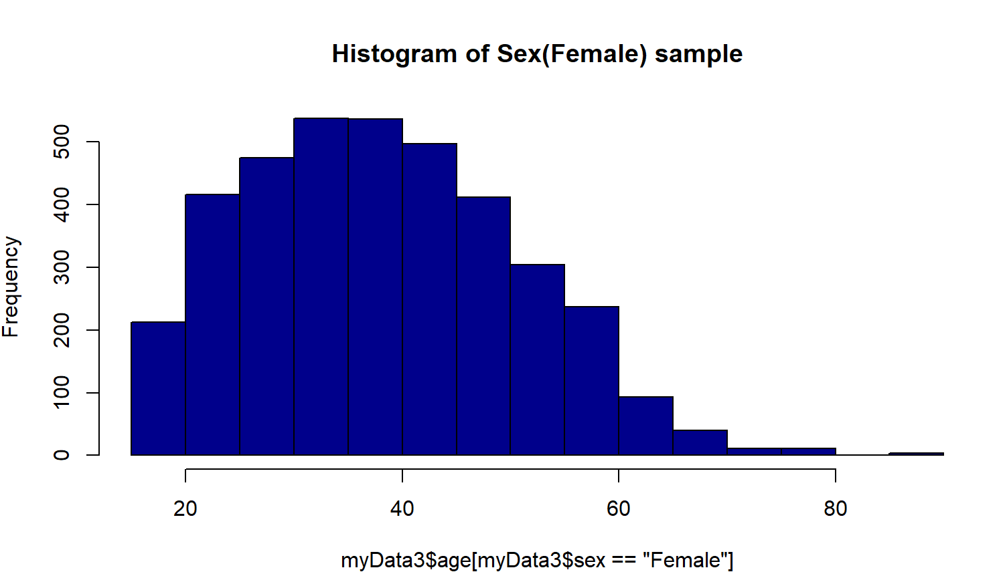
Method 2: Histogram

Slide 7
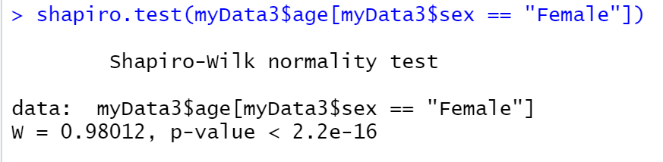
Method 3: Shapiro Test

